Slide 1

Distance and
Accumulated Change

Slide 2
Rate of Change
We use derivatives to find the rate of change of a quantity from an original function

Slide 3
Rate of Change
If we know the rate of change, can we find the original function?
  Working backwards

Slide 4
Rate of Change
Example:
  We can find distance traveled (position) from its rate of change (velocity)
  We can find the population/amount (total) from the % rate that it is changing

Slide 5
Distance Traveled
How do we measure distance traveled?
Change in distance with respect to time = velocity
Want to find
Given

Slide 6
Distance Traveled
Example:
  Velocity = 50 miles per hour for a 4 hour trip?
  What was the distance traveled?

Slide 7
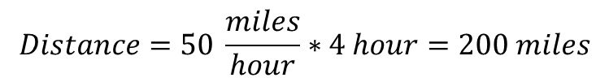
Distance Traveled
Example:
  Velocity = 50 miles per hour for a 4 hour trip?
  What was the distance traveled?
Distance = Velocity * Time
$$Distance=50 \frac{miles}{hour}∗4 hour=200 miles$$

Slide 8
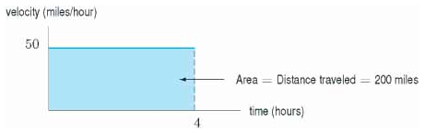
Distance Traveled – Graph
Distance = Velocity * Time
$$Distance=50 \frac{miles}{hour}∗4 hour=200 miles$$

Slide 9
Distance Traveled
Now what if you traveled 30 mph for 2 hours, then 40 mph for half an hour, then 20 mph for 4 hours.
Find the total distance traveled.

Slide 10
Distance Traveled
Now what if you traveled 30 mph for 2 hours, then 40 mph for half an hour, then 20 mph for 4 hours.
Find the total distance traveled.
$$\left(30\frac{miles}{hour}\right)\left(2 hours\right)+\left(40\frac{miles}{hour}\right)\left(\frac{1}{2} hour\right)+\left(20\frac{miles}{hour}\right)\left(4 hours\right)=160 miles$$

Slide 11
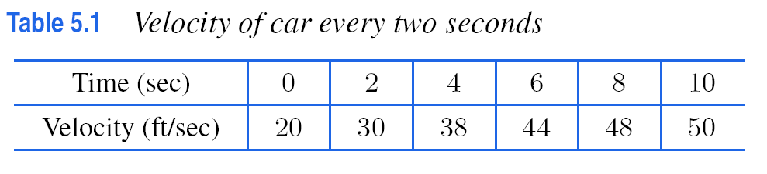
Suppose a car is moving with increasing velocity and suppose we measure the car's velocity every two seconds, obtaining the data in table below
How far has the car traveled?
Time for you to write!

Slide 12
Suppose a car is moving with increasing velocity and suppose we measure the car's velocity every two seconds, obtaining the data in table below
How far has the car traveled?
Lower Estimate: 20*2 seconds + 30 * 2 + 38 *2 + 44 * 2 + 48 * 2 = 360 feet

Slide 13
Suppose a car is moving with increasing velocity and suppose we measure the car's velocity every two seconds, obtaining the data in table below
How far has the car traveled?
Lower Estimate: 20*2 seconds + 30 * 2 + 38 *2 + 44 * 2 + 48 * 2 = 360 feet
Upper Estimate: 30 * 2 + 38 *2 + 44 * 2 + 48 * 2 + 50 * 2 = 420 feet

Slide 14
Suppose a car is moving with increasing velocity and suppose we measure the car's velocity every two seconds, obtaining the data in table below
How far has the car traveled?
underestimate
Lower Estimate: 20*2 seconds + 30 * 2 + 38 *2 + 44 * 2 + 48 * 2 = 360 feet
Upper Estimate: 30 * 2 + 38 *2 + 44 * 2 + 48 * 2 + 50 * 2 = 420 feet
overestimate
So we know the distance traveled is between 360 and 420 feet

Slide 15
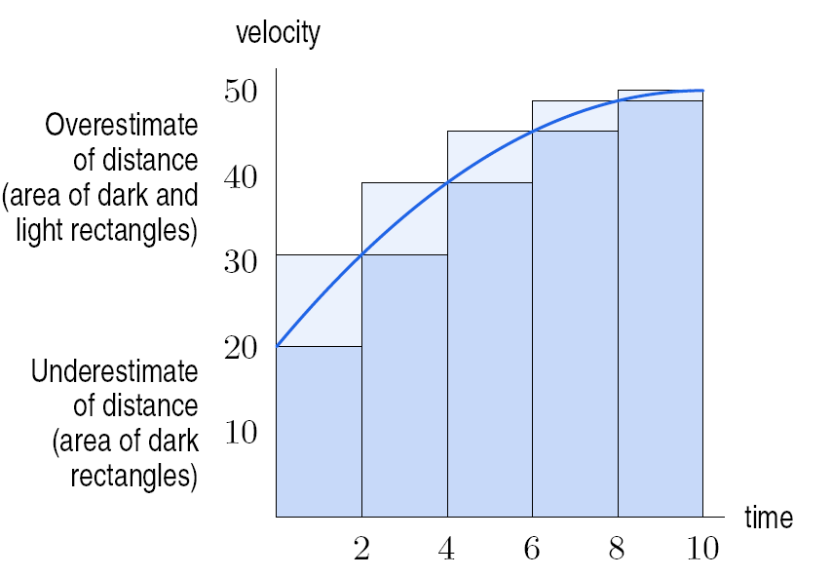
Shaded area estimates distance traveled. Velocity measured every 2 seconds

Slide 16
How do we improve our estimate?

Slide 17
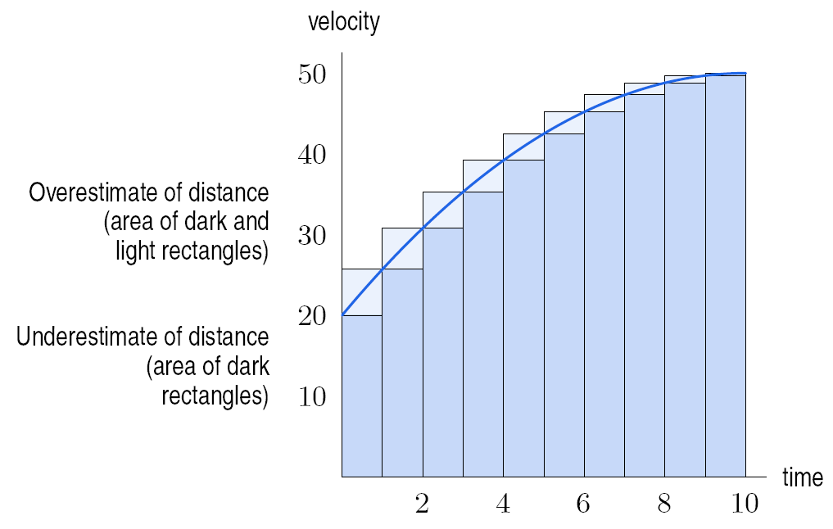
Shaded area estimates distance traveled. Velocity measured every one second

Slide 18
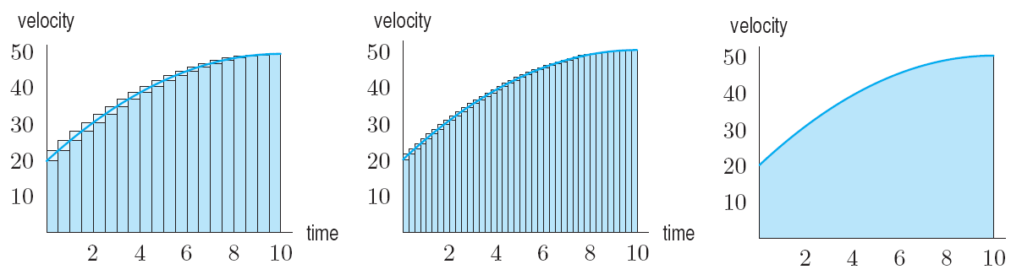
If the velocity is positive, the total distance traveled is the area under the velocity curve.
Velocity
measured every
½ second
Velocity measured every
¼ second
Distance traveled is area
under curve
As the number of subdivisions increase,
distance is area between velocity curve and horizontal axis.

Slide 19
Example 2 – Area Under Curve
With time t in seconds, the velocity of a bicycle, in feet per second, is given by v(t) = 5t.
How far does the bicycle travel in 3 seconds?
Time for you to write!

Slide 20

Example 3: Graph Velocity – Estimate Distance
Your velocity is given by $v\left(t\right)=t^{2}+4$ in m/sec, with t in seconds. Estimate the distance, s, traveled between t = 0 and t = 5. Use an overestimate with data every one second.
Time for you to write!

Slide 21
Your velocity is given by $v\left(t\right)=t^{2}+4$ in m/sec, with t in seconds. Estimate the distance, s, traveled between t = 0 and t = 5. Use an overestimate with data every one second.
t (seconds) | 0 | 1 | 2 | 3 | 4 | 5
m/sec

Slide 22
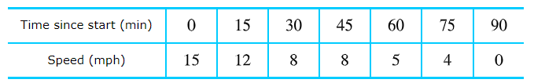
Application Problem
James runs a marathon. His friend Bob rides behind him on a bicycle and clocks his speed every 15 minutes. James starts out strong, but after an hour and a half he is so exhausted that he has to stop. Bob’s data follow:
Give upper and lower estimates for the distance James ran in total during the entire duration.
Time for you to solve!

Slide 23
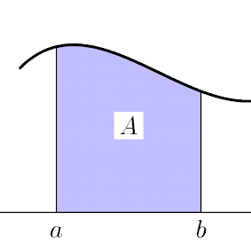
The Definite Integral

Slide 24
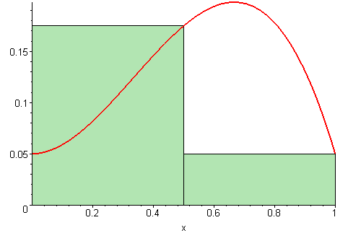
Definite Integrals and Area
Last we approximated total change given the rate of change
Next, we want more accuracy by decreasing Δt (size of the intervals, “change in time”) and increasing n (number of subintervals of length Δt)

Slide 25
Definite Integrals and Area
We can always use the rate of change of a quantity to estimate the total change of the quantity
  The area under the rate of change graph gives total change of the original function
We can also find area under any curves
  Exact area under any curve is total change in its antiderivative. (coming up soon)

Slide 26
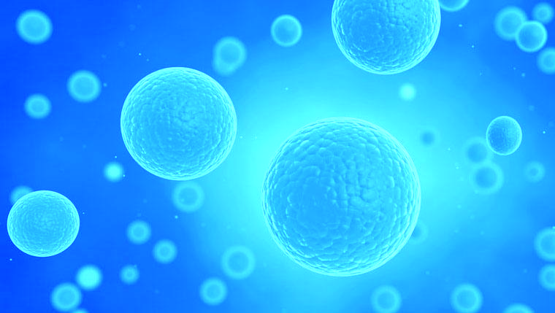

Bacteria Example
If t is in hours since the start of a 20-hour period, a bacteria population increases at a rate given by the following function:
Where f(t) is in millions of bacteria per hour
$$f\left(t\right)=3+0.1t^{2}$$

Slide 27
Bacteria Example
Make an underestimate of the total change in the number of bacteria over this period using Δt = 4 hours

Slide 28

Bacteria Example
Make an underestimate of the total change in the number of bacteria over this period using Δt = 4 hours
For Δt = 4 hours, we measure the rate every 4 hours and the number of subintervals, n = 20-hour period / 4 = 5.
Create a table and a graph

Slide 29
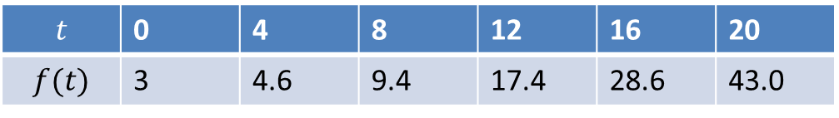

Δt = 4 hours
$$f\left(t\right)=3+0.1t^{2}$$
$$t$$ | 0 | 4 | 8 | 12 | 16 | 20
$$f(t)$$ | 3 | 4.6 | 9.4 | 17.4 | 28.6 | 43.0
  Underestimate Total change
  $= 3.0∙4 + 4.6∙4 + 9.4∙4+17.4∙4+28.6∙4 = 252.0$million bacteria

Slide 30
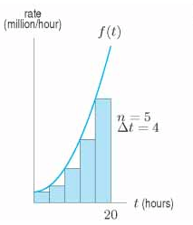

Bacteria Example
$$f\left(t\right)=3+0.1t^{2}$$
Can you see why this
is an underestimate?

Slide 31



Bacteria Example
For Δt = 2 hours, we measure the rate every 4 hours and the number of subintervals, n = 20-hour period / 2 = 10.
  Total change
  $= 3.0∙2 + 3.4∙2 + 4.6∙2 + 6.6∙2 + 9.4∙2 + 13.0∙2 +…+35.4∙2 = 288.0$million bacteria
$$f\left(t\right)=3+0.1t^{2}$$

Slide 32
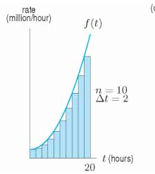
Bacteria Example
Better Estimate

Slide 33
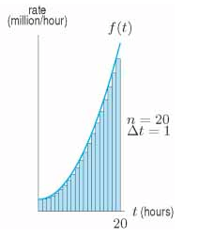
Bacteria Example Δt = 1
Even Better Estimate

Slide 34
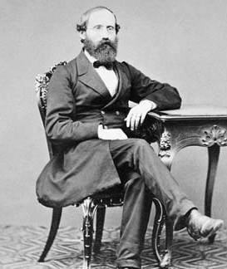

Finite Sums
Riemann Sums
  Where f(t) is continuous for $a≤t≤$ b
Divide interval [a,b] into n equal subdivisions each of width Δt
Where Δt $= \frac{b−a}{n}\left(\frac{length of interval}{number of subintervals}\right)$
Let $t_{0},t_{1},…,t_{n}$be endpoints of subdivisions

Slide 35
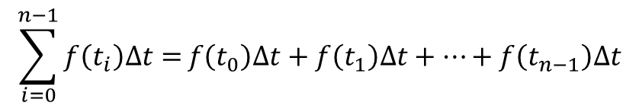
Riemann Sums
$$\sum_{i=0}^{n−1}{f\left(t_{i}\right)∆t=}f\left(t_{0}\right)∆t+f\left(t_{1}\right)∆t+⋯+f\left(t_{n−1}\right)∆t$$
Summation sign
Height * width

Slide 36
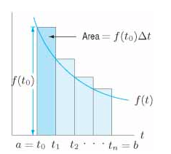
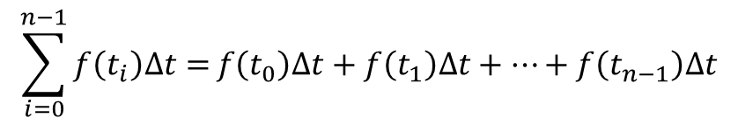
Types of Sums
Left-Hand Sum
  Choose left endpoint of each subinterval
$$\sum_{i=0}^{n−1}{f\left(t_{i}\right)∆t=}f\left(t_{0}\right)∆t+f\left(t_{1}\right)∆t+⋯+f\left(t_{n−1}\right)∆t$$
Summation sign
Left of rectangle touches function

Slide 37
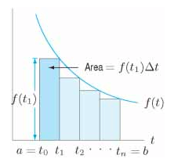
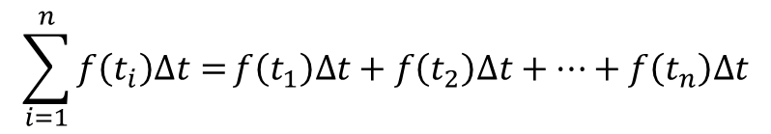
Types of Sums
Right-Hand Sum
  Choose right endpoint of each subinterval
$$\sum_{i=1}^{n}{f\left(t_{i}\right)∆t=}f\left(t_{1}\right)∆t+f\left(t_{2}\right)∆t+⋯+f\left(t_{n}\right)∆t$$
Summation sign
Right of rectangle touches function

Slide 38
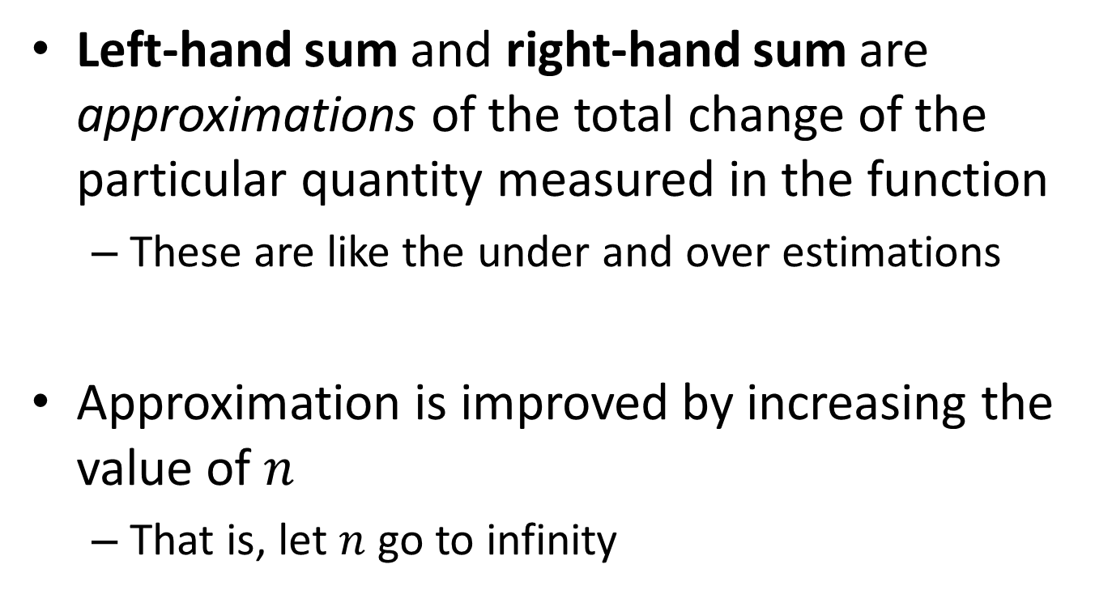
Definition of the Definite Integral
Left-hand sum and right-hand sum are approximations of the total change of the particular quantity measured in the function
  These are like the under and over estimations
Approximation is improved by increasing the value of $n$
  That is, let $n$ go to infinity

