Slide 1
The Definite Integral As Area

Slide 2
Definition of the Definite Integral
Left-hand sum and right-hand sum are approximations of the total change of the particular quantity measured in the function
  These are like the under and over estimations
Approximation is improved by increasing the value of $n$
  That is, let $n$ go to infinity

Slide 3
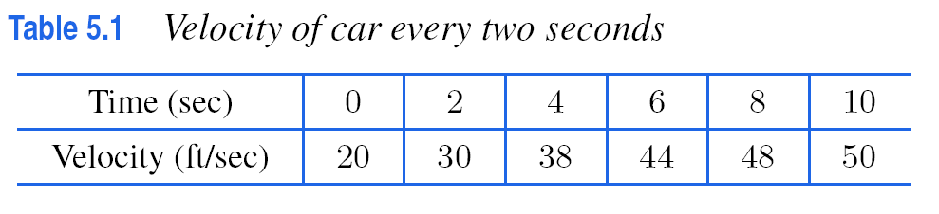
Definition of the Definite Integral
Limiting value of left-hand sum as number of rectangles becomes infinitely larger (subintervals infinitely small)
$$\lim_{n→∞}\sum_{i=0}^{n−1}{f\left(t_{i}\right)∆t=}\int_{a}^{b}{f\left(t\right)dt}$$
Integral symbol

Slide 4
Definition of the Definite Integral
Limiting value of right-hand sum as number of rectangles becomes infinitely larger (subintervals infinitely small)
$$\lim_{n→∞}\sum_{i=i}^{n}{f\left(t_{i}\right)∆t=}\int_{a}^{b}{f\left(t\right)dt}$$
Integral symbol

Slide 5
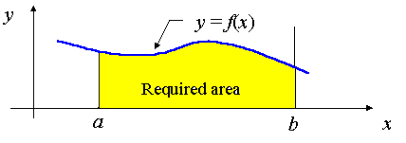
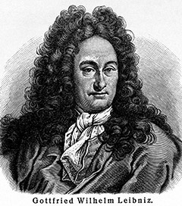
Definite Integrals
When f(t) is positive $\int_{a}^{b}{f\left(t\right) dt}$ represents the EXACT AREA under the graph of f(t) between
t = a and t = b.
  Integral adds up infinitely many values
  Can find areas of any shape curve

Slide 6
FTC
Fundamental Theorem of Calculus
  Coming up later….
The definite integral of the derivative of a function gives the total change of the function.
$\int_{a}^{b}{f′\left(t\right)dt}$
represents the total change of f(t) between t = a and t = b
$\int_{a}^{b}{f^{′}\left(t\right)dt}$= f(b) – f(a)

Slide 7
FTC (another way to state)
Fundamental Theorem of Calculus
  Coming up
The definite integral of the derivative of a function gives the total change of the function.
$\int_{a}^{b}{f(t)dt}$= F(b) – F(a)
where F is the antiderviative of f: F’(t) = f(t)

Slide 8
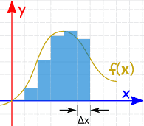
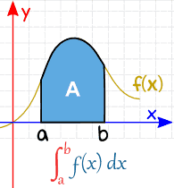
Definite Integrals
We can always use the rate of change to estimate its total change.
  If we also know initial value:
  initial value + change in value = current value
So we can always estimate the original function from its rate of change, or derivative (going backwards)
  This is called integration, or first step finding the antiderivative, then using the Fundamental Theorem of Calculus to Find Area.
Integrating is also the process of finding area under curves.

Slide 9
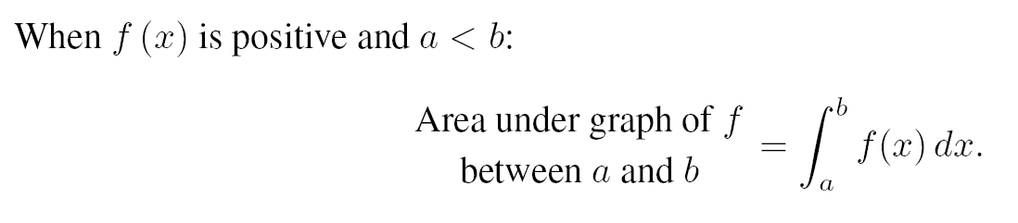
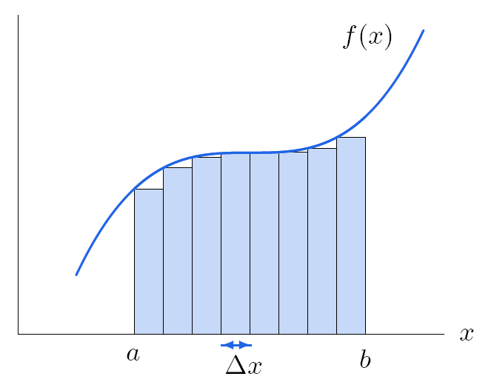

Area of rectangles approximating the area under the curve
Shaded area is the definite integral

Slide 10
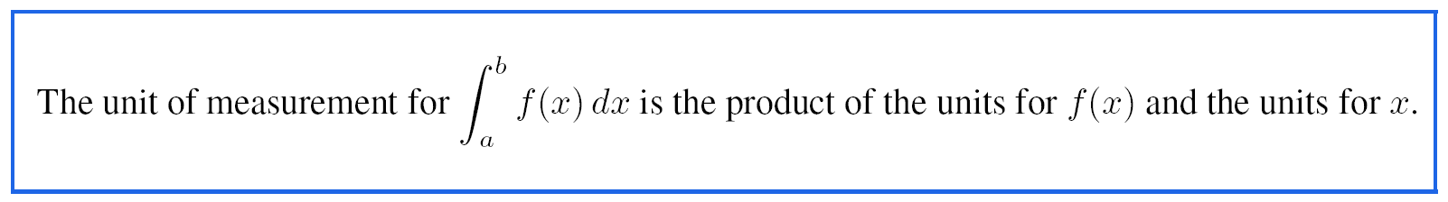
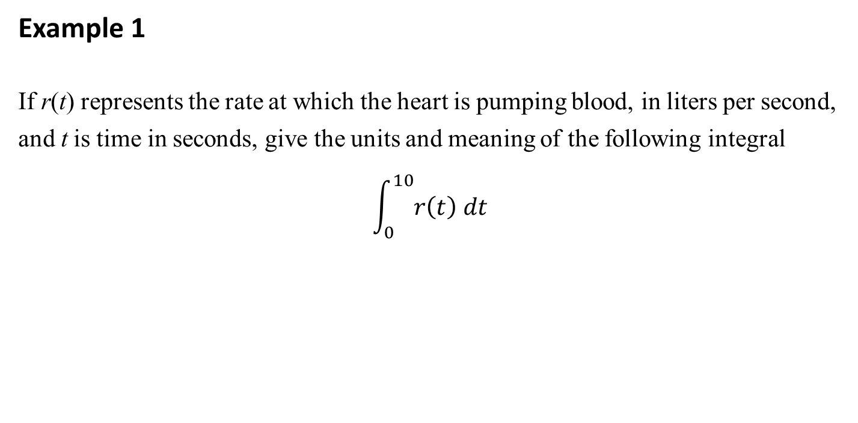
Example 1
If r(t) represents the rate at which the heart is pumping blood, in liters per second, and t is time in seconds, give the units and meaning of the following integral
$$\int_{0}^{10}{r\left(t\right) dt}$$
Remember this is the derivative and thus a rate

Slide 11
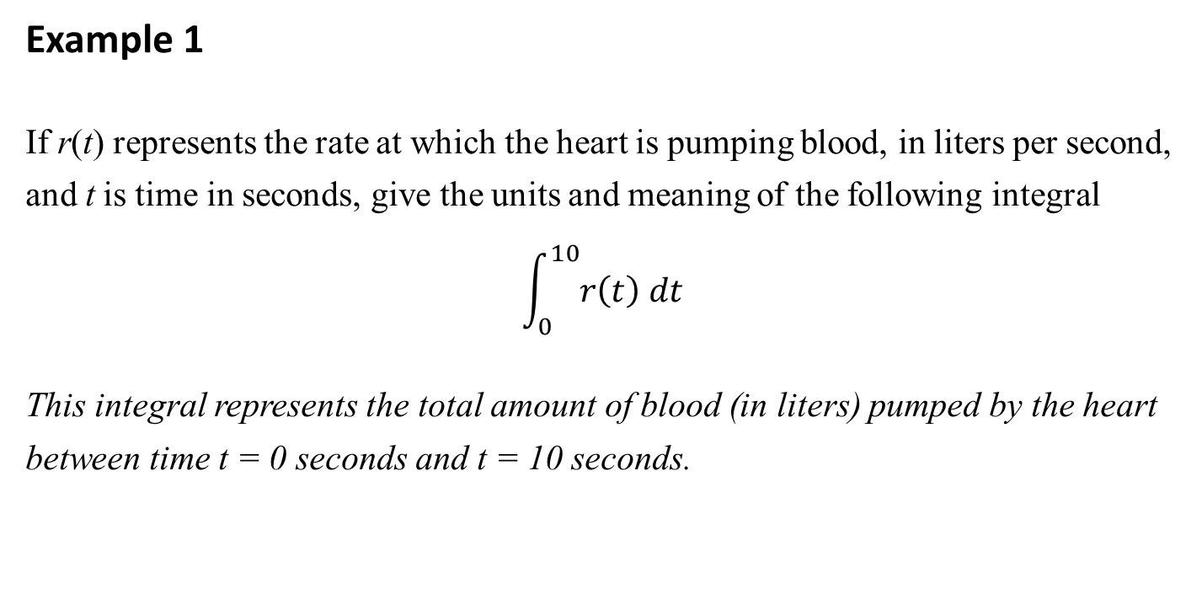
Example 1
If r(t) represents the rate at which the heart is pumping blood, in liters per second, and t is time in seconds, give the units and meaning of the following integral
$$\int_{0}^{10}{r\left(t\right) dt}$$
This integral represents the total amount of blood (in liters) pumped by the heart between time t = 0 seconds and t = 10 seconds.

Slide 12
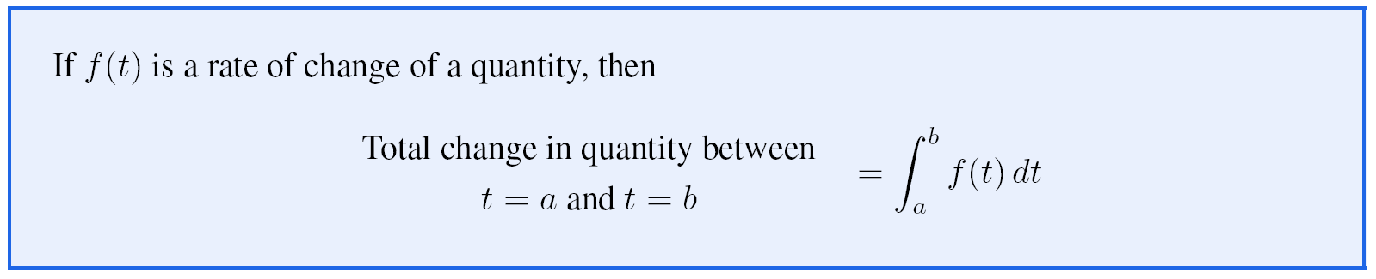

Slide 13
Example
  Change in position f(t) is the integral of velocity v(t) = f(t), that is the rate of change of position

Slide 14
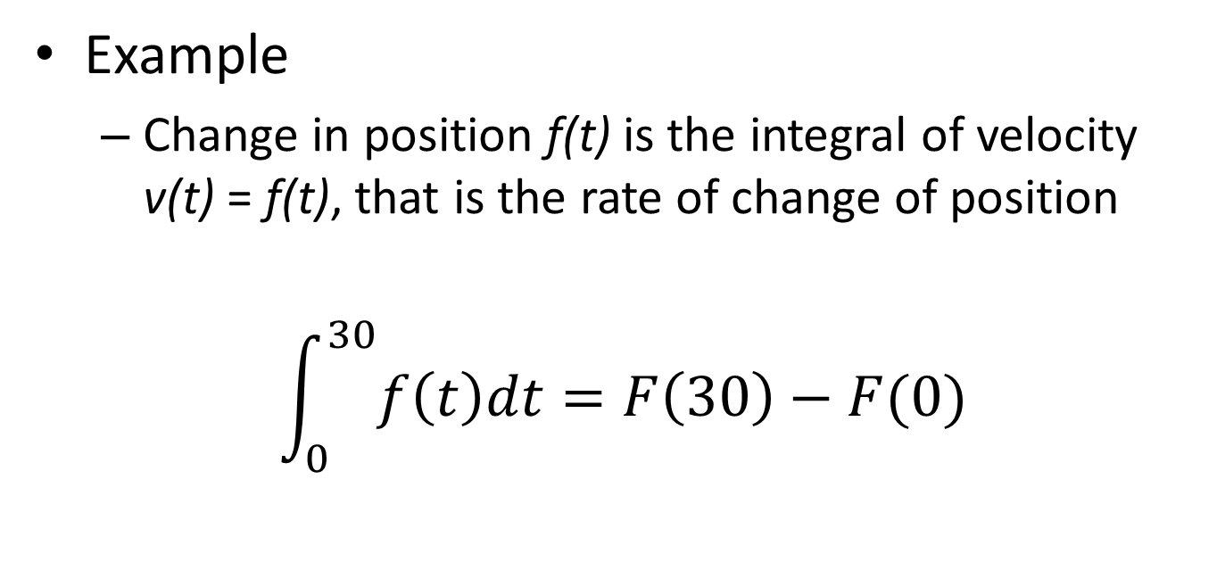
Example
  Change in position f(t) is the integral of velocity v(t) = f(t), that is the rate of change of position
$$\int_{0}^{30}{f\left(t\right)dt=F\left(30\right)−F(0)}$$
Evaluate end points with original function
This is what we call the antiderivative

Slide 15
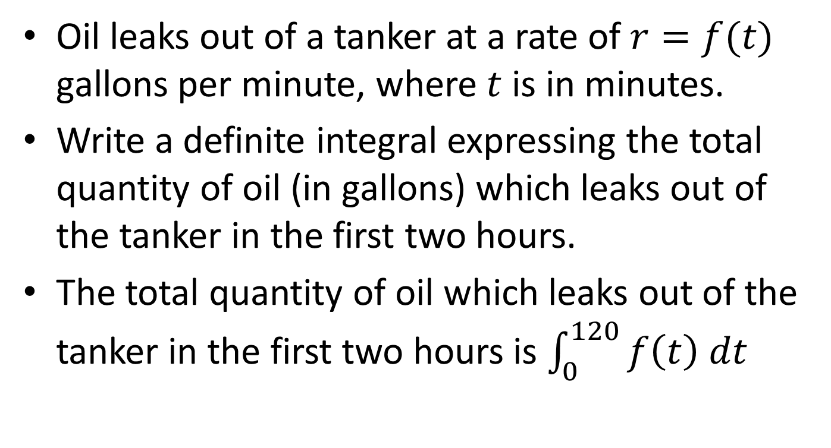
Example 2
Oil leaks out of a tanker at a rate of $r=f(t)$ gallons per minute, where $t$ is in minutes.
Write a definite integral expressing the total quantity of oil (in gallons) which leaks out of the tanker in the first two hours.
The total quantity of oil which leaks out of the tanker in the first two hours is $\int_{0}^{120}{f\left(t\right) dt}$

Slide 16

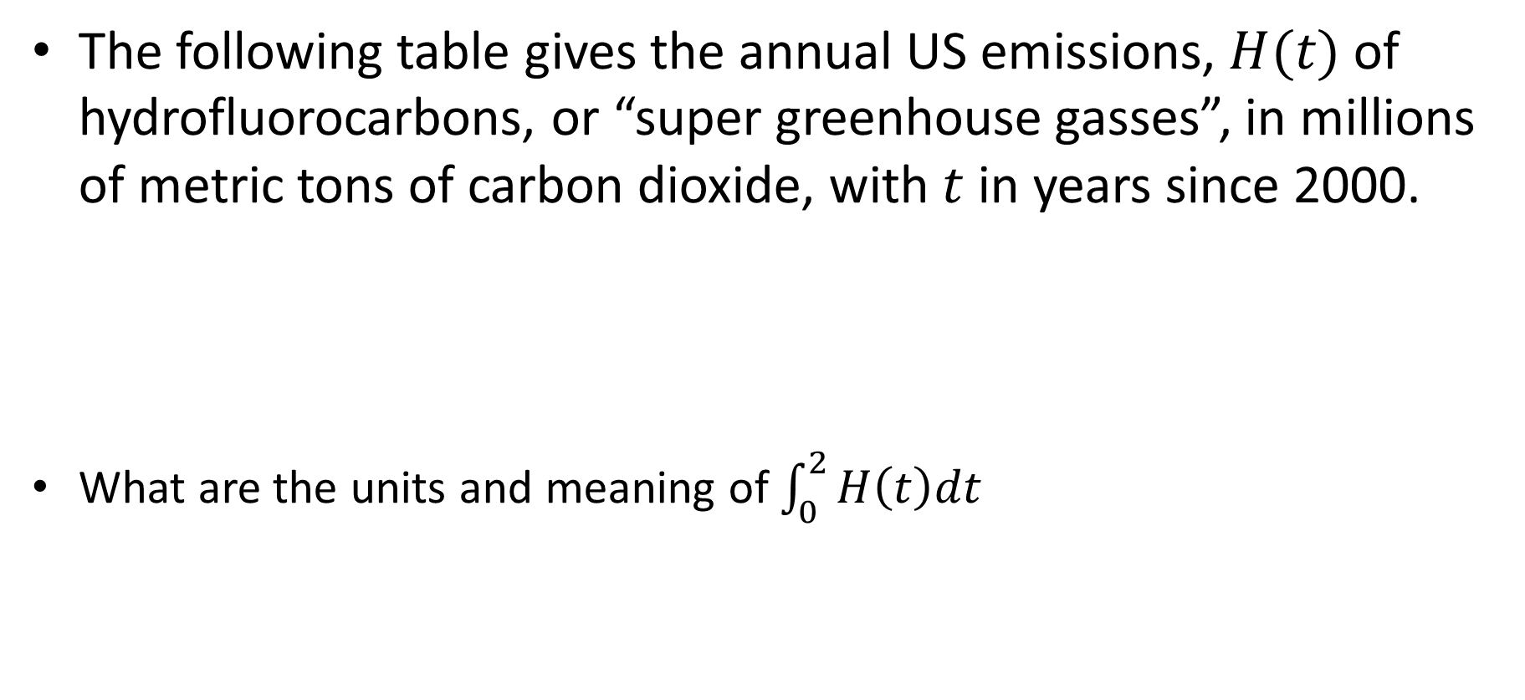
Example 3
The following table gives the annual US emissions, $H(t)$ of hydrofluorocarbons, or “super greenhouse gasses”, in millions of metric tons of carbon dioxide, with $t$ in years since 2000.
What are the units and meaning of $\int_{0}^{2}{H\left(t\right)dt}$

Slide 17
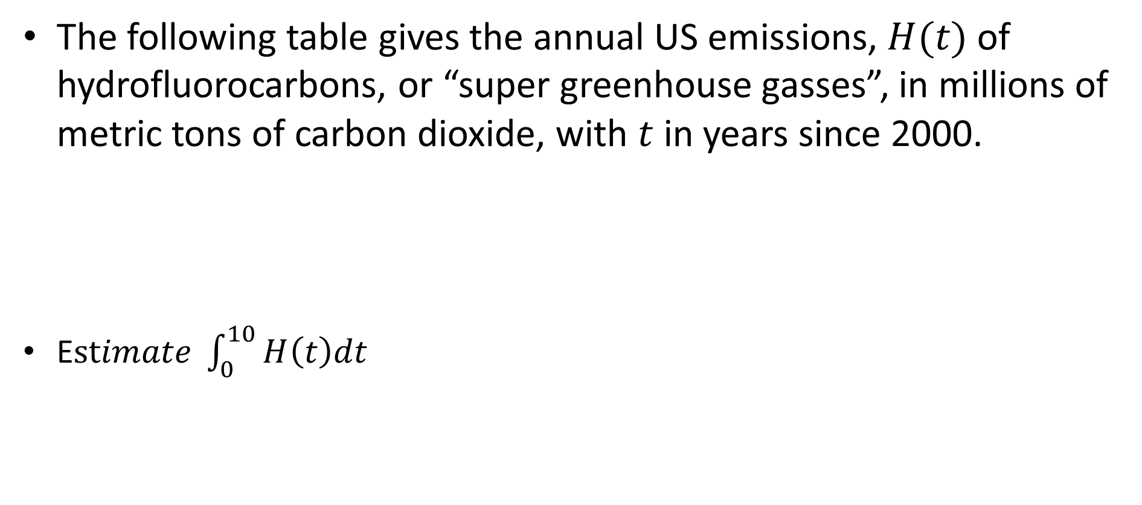
Example 3
The following table gives the annual US emissions, $H(t)$ of hydrofluorocarbons, or “super greenhouse gasses”, in millions of metric tons of carbon dioxide, with $t$ in years since 2000.
E$stimate \int_{0}^{10}{H\left(t\right)dt}$

Slide 18
Analyzing & Constructing Antiderivatives

Slide 19



What is an Antiderivative?
$$F(x)$$
Derivative
$$f(x)$$
$$F^{′}\left(x\right)=f(x)$$

Slide 20
What is an Antiderivative?
$$F(x)$$
Derivative
$$f(x)$$
$$F^{′}\left(x\right)=f(x)$$

Slide 21
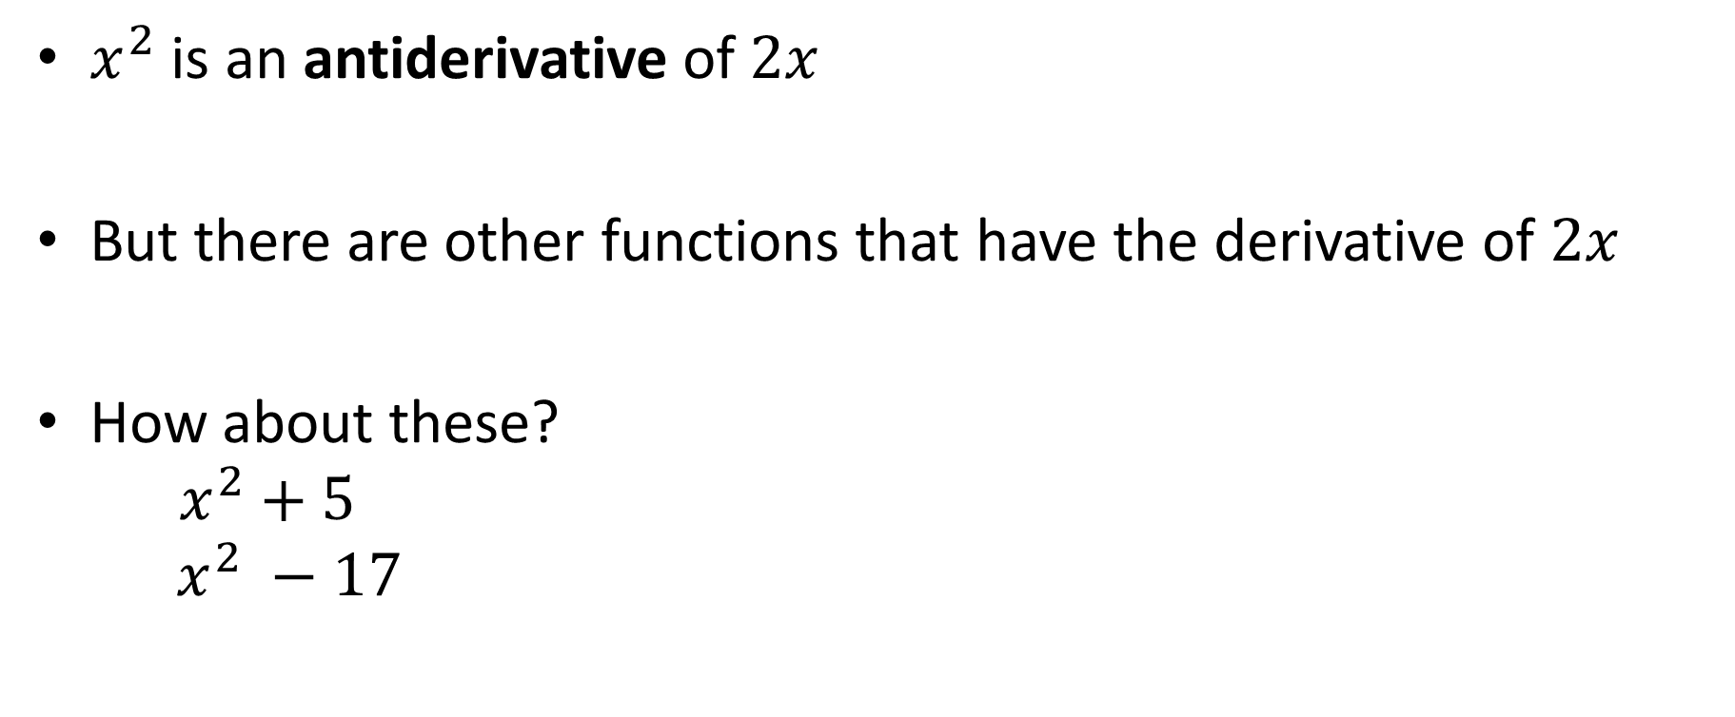
Example
$x^{2}$ is an antiderivative of $2x$
But there are other functions that have the derivative of $2x$
How about these?
$x^{2}+5$
$x^{2} −17$

Slide 22

Constant
Because the derivative of a constant is 0, then we can say that $x^{2}+C$ is an antiderivative of $2x$
  Family of antiderivatives for any constant C

Slide 23
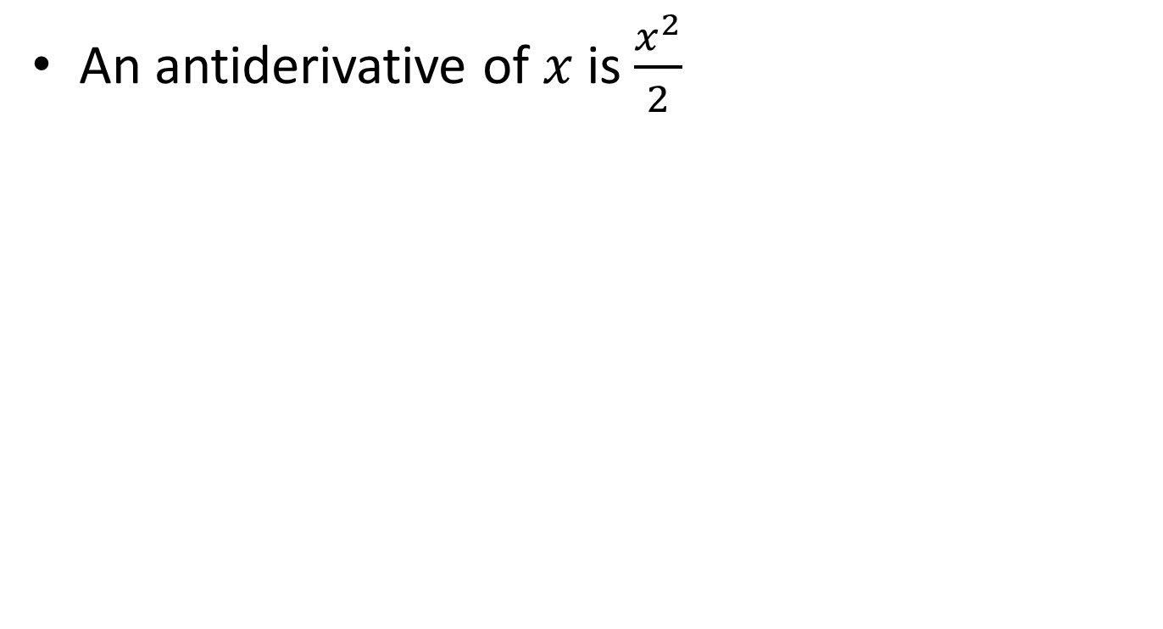
Patterns
An antiderivative of $x$ is $\frac{x^{2}}{2}$

Slide 24
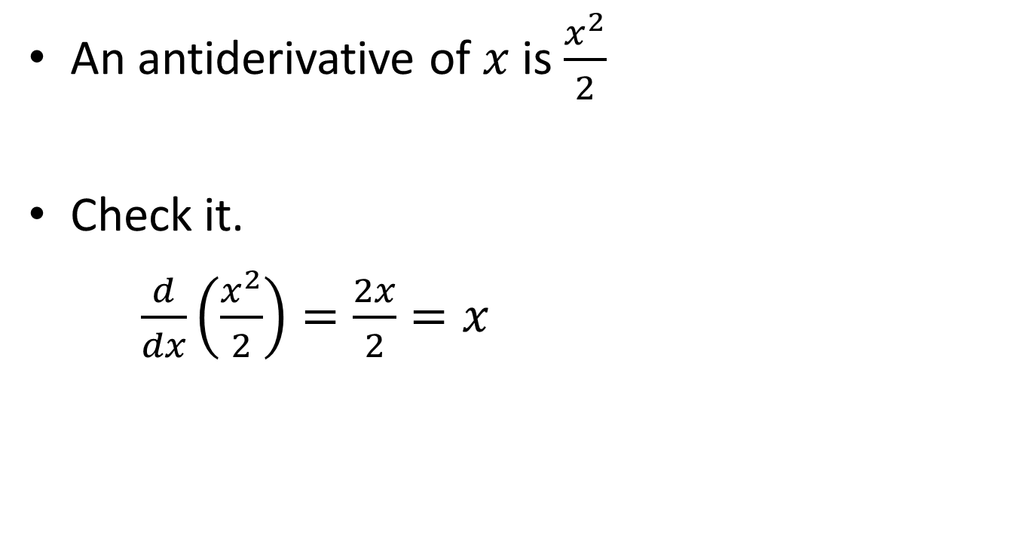
Patterns
An antiderivative of $x$ is $\frac{x^{2}}{2}$
Check it.
$\frac{d}{dx}\left(\frac{x^{2}}{2}\right)=\frac{2x}{2}=x$

Slide 25
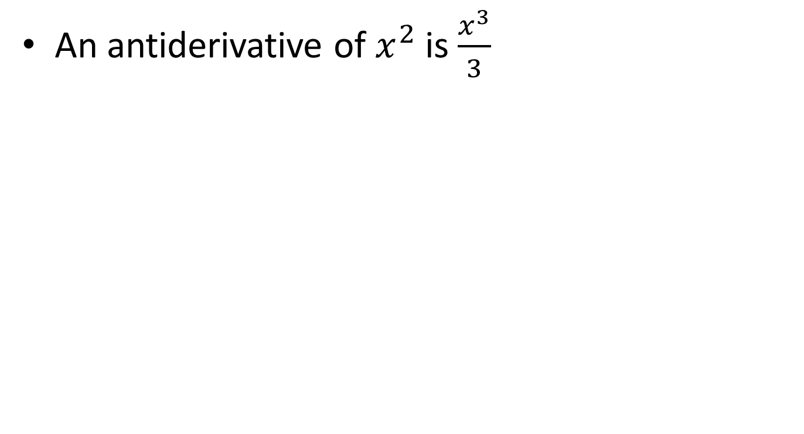
Patterns
An antiderivative of $x^{2}$ is $\frac{x^{3}}{3}$

Slide 26
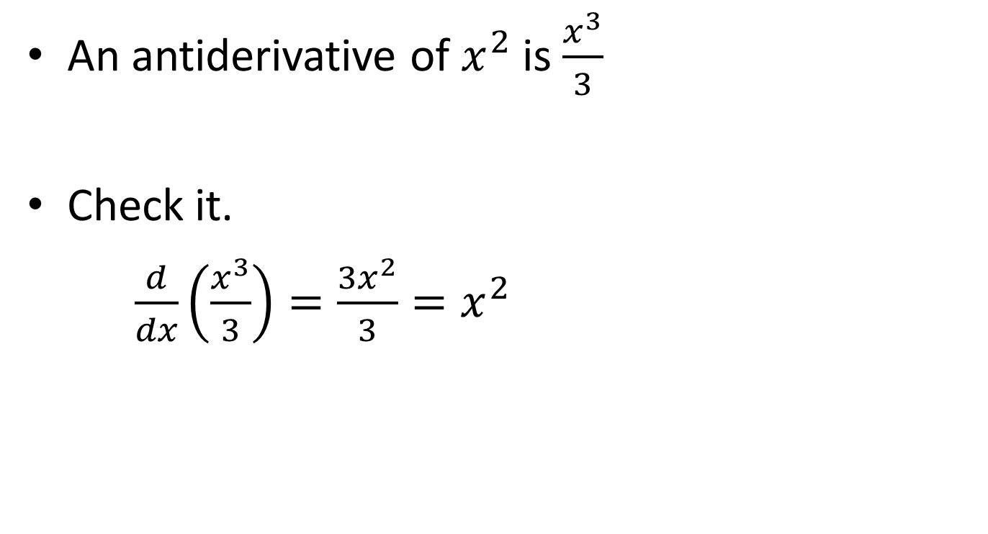
Patterns
An antiderivative of $x^{2}$ is $\frac{x^{3}}{3}$
Check it.
$\frac{d}{dx}\left(\frac{x^{3}}{3}\right)=\frac{3x^{2}}{3}=x^{2}$

Slide 27
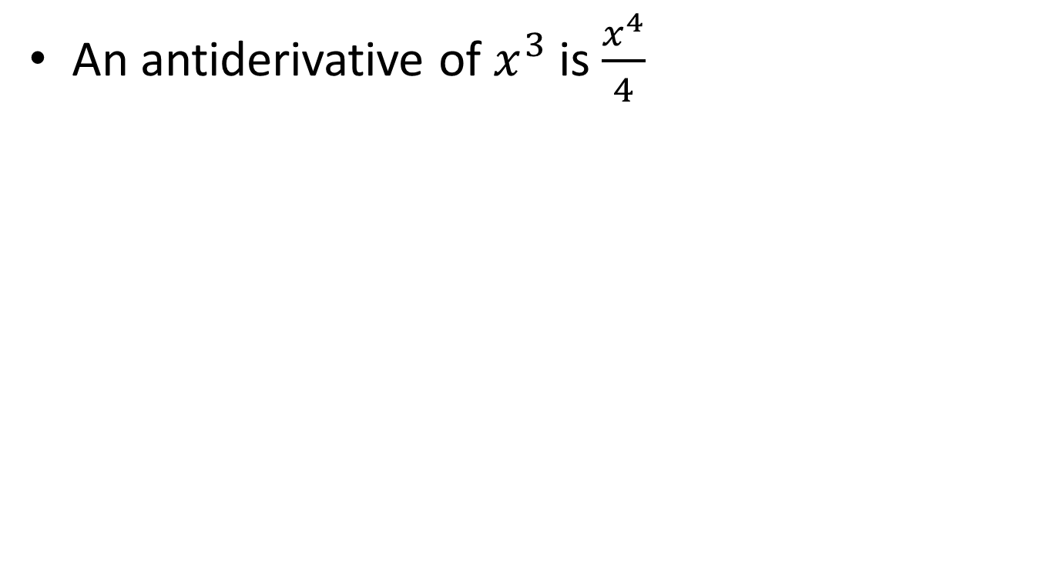
Patterns
An antiderivative of $x^{3}$ is $\frac{x^{4}}{4}$

Slide 28
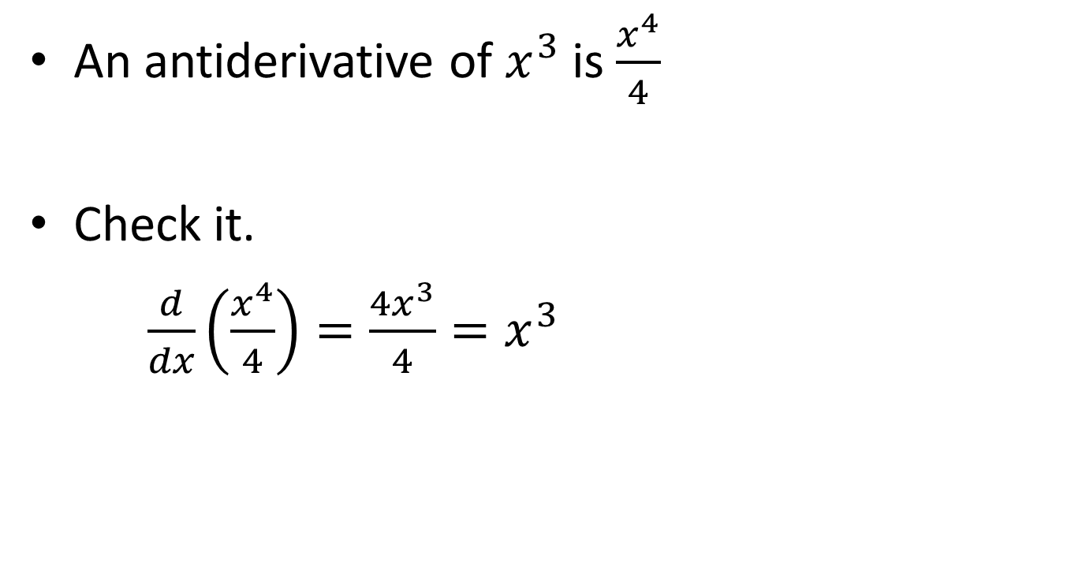
Patterns
An antiderivative of $x^{3}$ is $\frac{x^{4}}{4}$
Check it.
$\frac{d}{dx}\left(\frac{x^{4}}{4}\right)=\frac{4x^{3}}{4}=x^{3}$

Slide 29
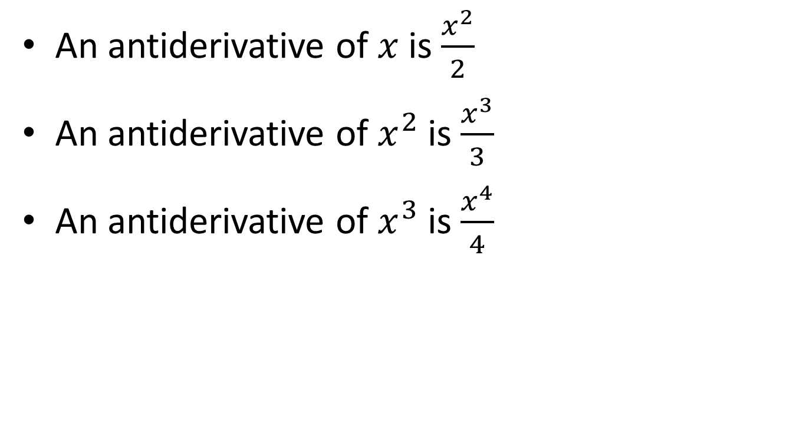
Do You See The Pattern?
An antiderivative of $x$ is $\frac{x^{2}}{2}$
An antiderivative of $x^{2}$ is $\frac{x^{3}}{3}$
An antiderivative of $x^{3}$ is $\frac{x^{4}}{4}$

Slide 30

Do You See The Pattern?
An antiderivative of $x$ is $\frac{x^{2}}{2}$
An antiderivative of $x^{2}$ is $\frac{x^{3}}{3}$
An antiderivative of $x^{3}$ is $\frac{x^{4}}{4}$
$$\int{x^{n}dx}=\frac{x^{n+1}}{n+1}+C$$

Slide 31
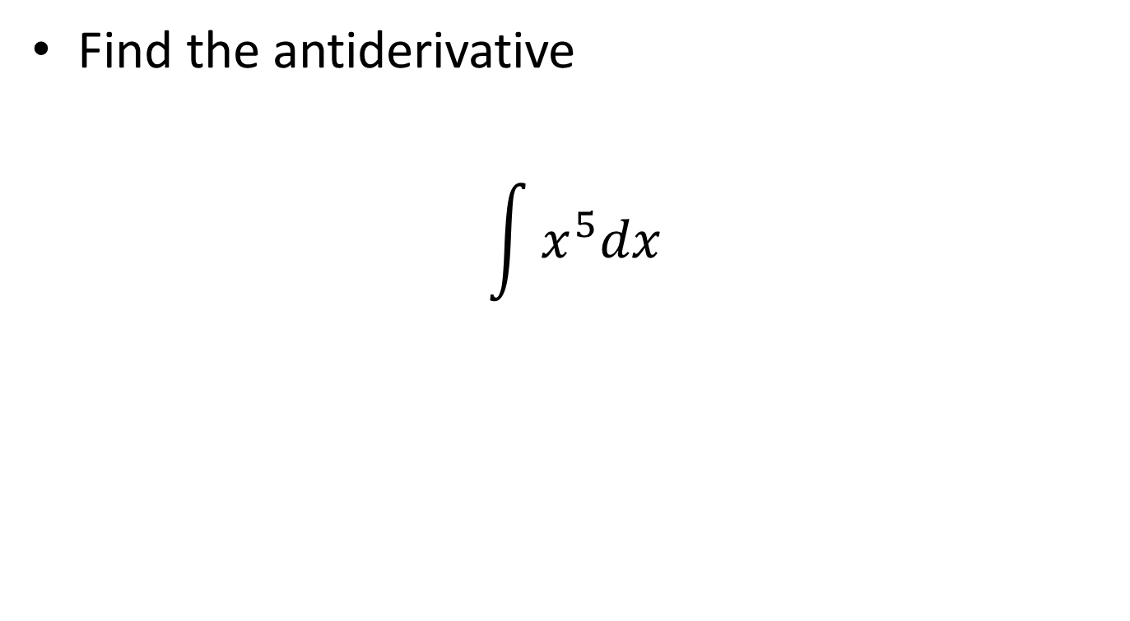
Examples
Find the antiderivative
$$\int{x^{5}dx}$$

Slide 32

Examples
Find the antiderivative
$$\int{x^{5}dx}=\frac{x^{5+1}}{5+1}+C=\frac{x^{6}}{6}+C$$

Slide 33
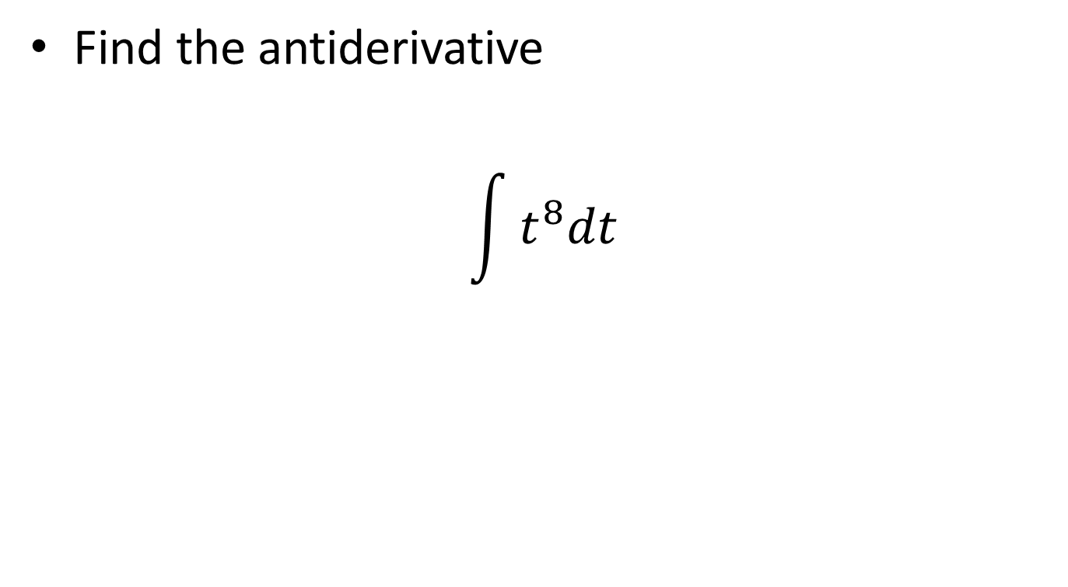
Examples
Find the antiderivative
$$\int{t^{8}dt}$$

Slide 34
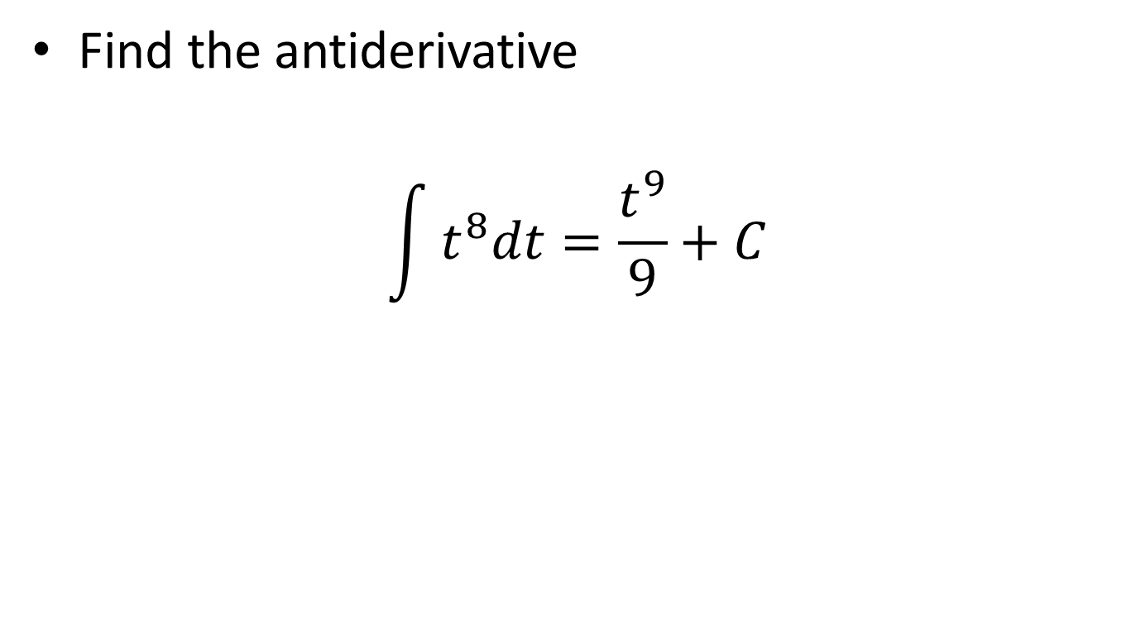
Examples
Find the antiderivative
$$\int{t^{8}dt}=\frac{t^{9}}{9}+C$$

Slide 35
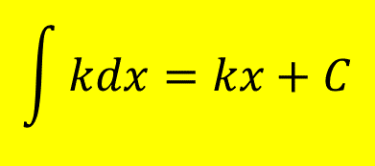
Dealing with Constants
$$\int{kdx}=kx+C$$

Slide 36
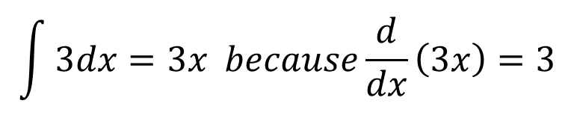
Dealing with Constants
$$\int{kdx}=kx+C$$
$$\int{3dx=3x because\frac{d}{dx}\left(3x\right)=3}$$

Slide 37
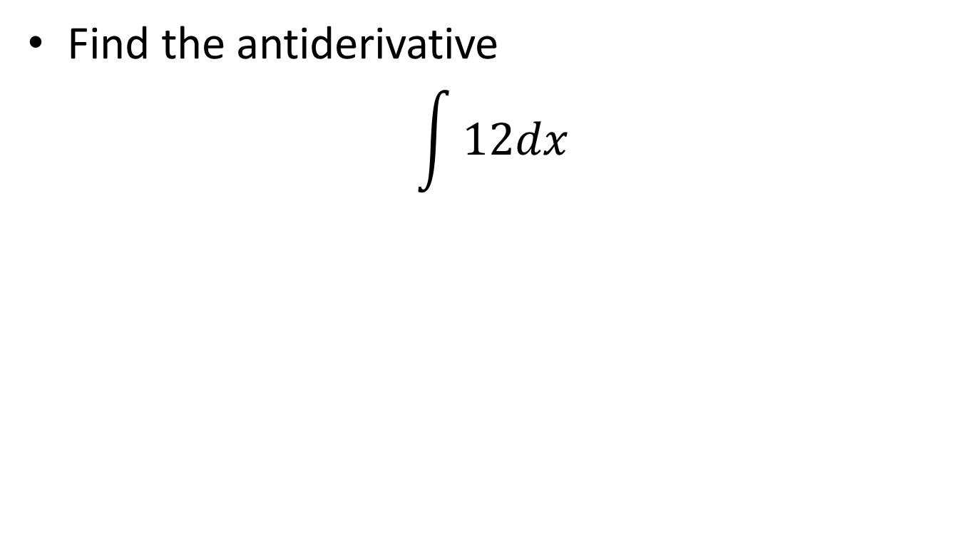
Examples
Find the antiderivative
$$\int{12dx }$$

Slide 38
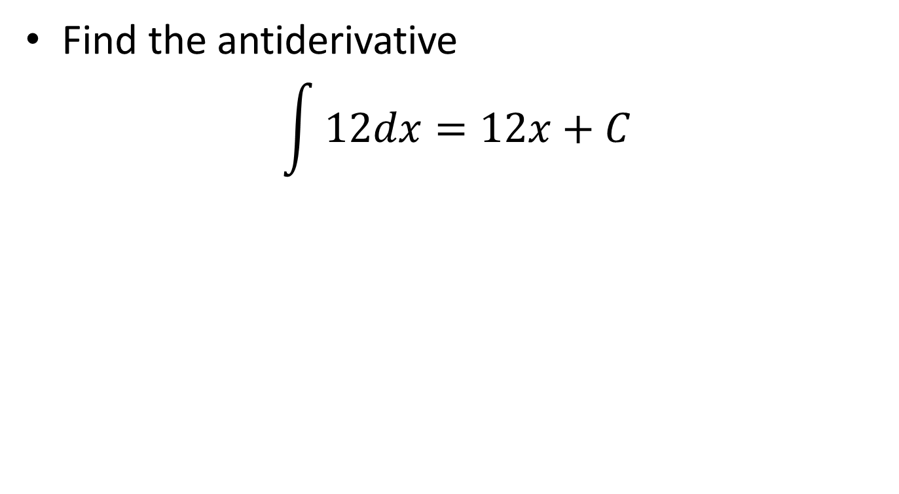
Examples
Find the antiderivative
$$\int{12dx=12x+C}$$

Slide 39
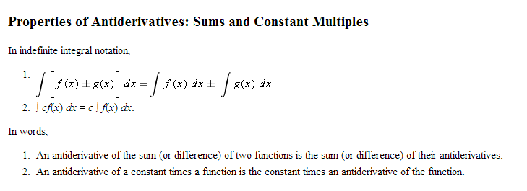
Properties

Slide 40
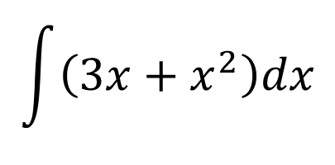
Examples
$$\int{\left(3x+x^{2}\right)dx}$$

Slide 41
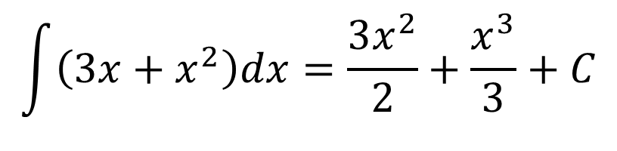
Examples
$$\int{\left(3x+x^{2}\right)dx}=\frac{3x^{2}}{2}+\frac{x^{3}}{3}+C$$

Slide 42
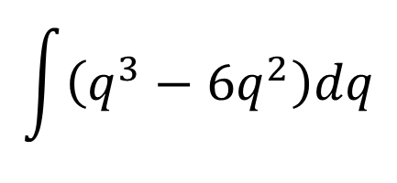
Examples
$$\int{\left(q^{3}−6q^{2}\right)dq}$$

Slide 43
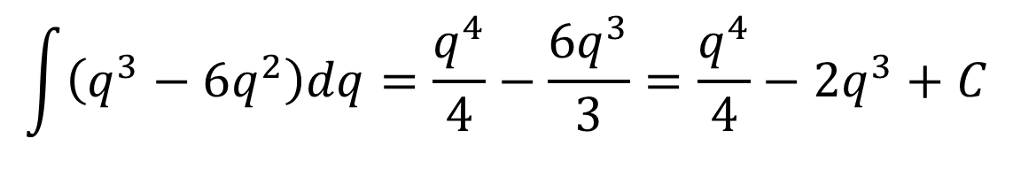
Examples
$$\int{\left(q^{3}−6q^{2}\right)dq}=\frac{q^{4}}{4}−\frac{6q^{3}}{3}=\frac{q^{4}}{4}−2q^{3}+C$$

Slide 44
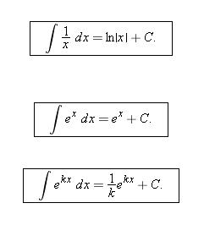
Antiderivatives for ln and e

Slide 45

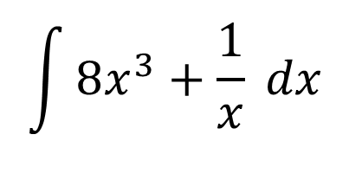
Examples
$$\int{8x^{3}+\frac{1}{x} dx}$$

Slide 46
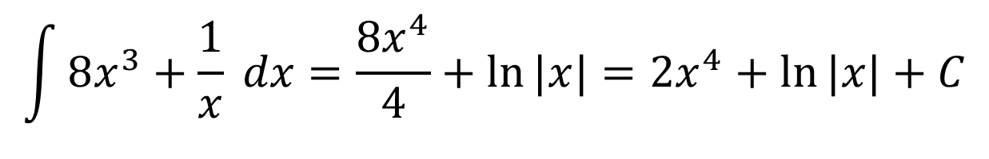
Examples
$$\int{8x^{3}+\frac{1}{x} dx}=\frac{8x^{4}}{4}+\ln{|x|}=2x^{4}+\ln{|x|}+C$$

Slide 47

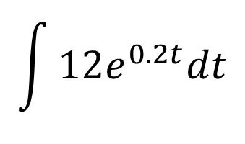
Examples
$$\int{12e^{0.2t}dt}$$

Slide 48
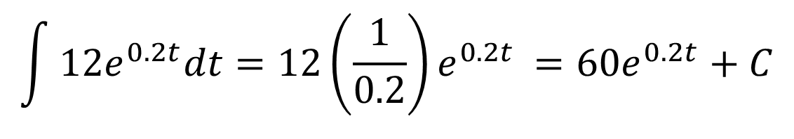
Examples
$$\int{12e^{0.2t}dt}=12\left(\frac{1}{0.2}\right)e^{0.2t }=60e^{0.2t}+C$$

Slide 49


Antiderivatives for sin and cos

Slide 50
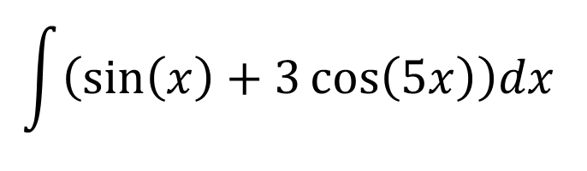
Example
$$\int{\left(\sin\left(x\right)+3\cos\left(5x\right)\right)dx }$$

Slide 51
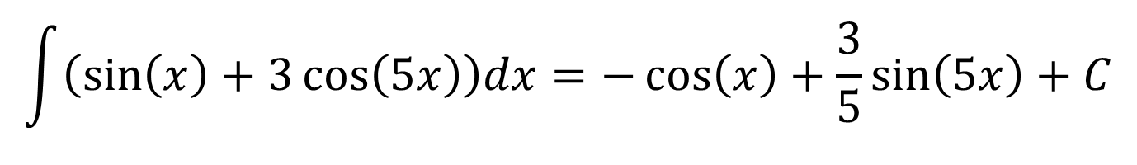
Example
$$\int{\left(\sin\left(x\right)+3\cos\left(5x\right)\right)dx=−\cos\left(x\right)+\frac{3}{5}\sin\left(5x\right)+C}$$

Slide 52
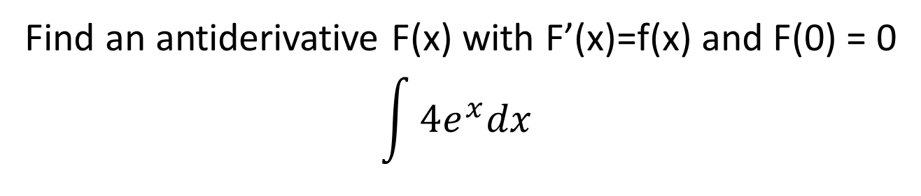
Example Finding C
Find an antiderivative F(x) with F’(x)=f(x) and F(0) = 0
$$\int{4e^{x}dx }$$

