Slide 1
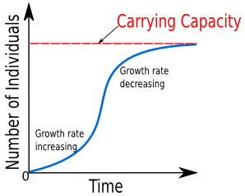
Logistic Growth a.k.a. Verhulst Model

Slide 2
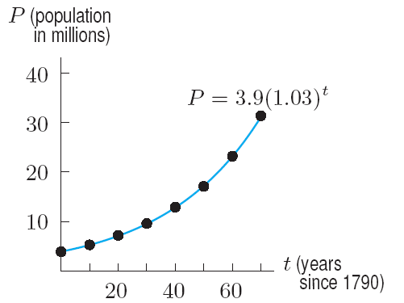
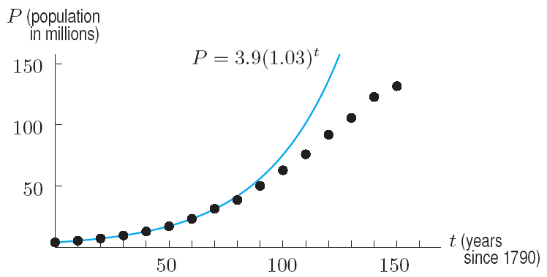
Visual Perspectives of US Population Growth
An exponential model
for the US Population, 1790 – 1860
The exponential model and the US Population, 1790 – 1940. Not a good fit beyond 1860
Rate of growth begins to decrease

Slide 3
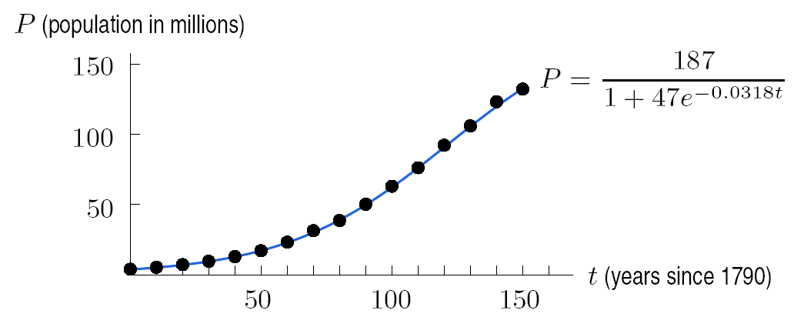
A logistic function (model) for the US population, 1791 – 1940

Slide 4
Example 1
If t is in years since 1990, one model for the population of the world, P in billions, is
$$P(t)=\frac{40}{1+11e^{−0.08t}}$$
What does the model predict for the maximum sustainable population of the world?

Slide 5
Increasing everywhere
Concave up at first and then becomes concave down
Levels off at a horizontal asymptote

Slide 6
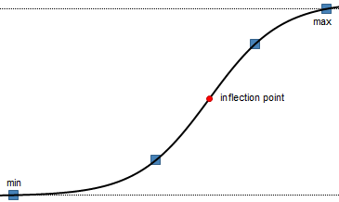
L is the carrying capacity
Largest population an environment can support
Inflection point
Known as the point of diminishing returns, where P is growing the fastest and occurs when P = L/2
Carrying capacity
Point of diminishing returns

Slide 7
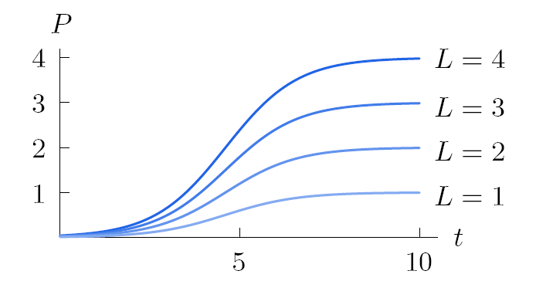
Approximately exponential
Graph of for various values of L

Slide 8
Concave up
Graph of for various values of L

Slide 9
Concavity changes L/2
Graph of for various values of L

Slide 10
Concave down
Graph of for various values of L

Slide 11
Carrying capacity
Graph of for various values of L

Slide 12
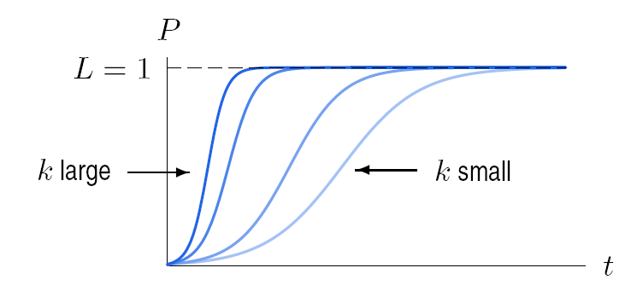
Graph of for various values of k
The logistic function is approximately exponential
for small values of t, with growth rate k.

Slide 13
Example 1
If t is in years since 1990, one model for the population of the world, P in billions, is
$$P(t)=\frac{40}{1+11e^{−0.08t}}$$
What does the model predict for the maximum sustainable population of the world?

Slide 14
Example 1
If t is in years since 1990, one model for the population of the world, P in billions, is
$$P=\frac{40}{1+11e^{−0.08t}}$$
What does the model predict for the maximum sustainable population of the world? 40

Slide 15
Example 1
If t is in years since 1990, one model for the population of the world, P in billions, is
$$P=\frac{40}{1+11e^{−0.08t}}$$
According to the model, when will the earth’s population reach 39.9 billion? Round to the nearest year

Slide 17
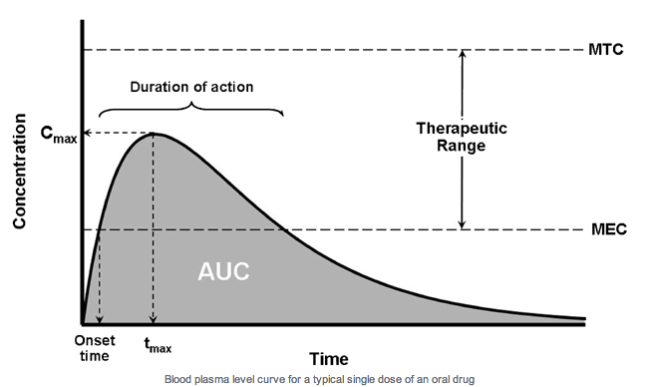
Surge Function
aka Drug Concentration Curve

Slide 18
Example 2
The drug concentration for a drug after t hours is given by $C=11.5te^{−0.3t} ng/ml$
Where ng/ml is nanograms per milliliter

Slide 19
Example 2
The drug concentration for a drug after t hours is given by $C=11.5te^{−0.3t} ng/ml$
The minimum effective concentration is 10 ng/ml.

Slide 20
Example 2
The drug concentration for a drug after t hours is given by $C=11.5te^{−0.3t} ng/ml$
The minimum effective concentration is 10 ng/ml.
Is the drug effective at t = 2 hours?

Slide 21
Example 2
The drug concentration for a drug after t hours is given by $C=11.5\left(2\right)e^{−0.3\left(2\right)}=12.6 ng/ml$
The minimum effective concentration is 10 ng/ml

Slide 22
Example 3
If time, t is in hours and concentration, C, is in ng/ml, the drug concentration curve for a drug is given by $C(t)=12.4te^{−0.2t}$.
How many hours does it take for the drug to reach its peak concentration?

Slide 23
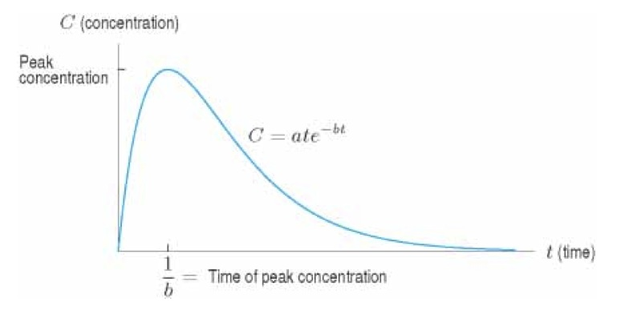
Surge Function
Linear growth
Exponential decay

Slide 24
Surge Function
Linear growth
Increases rapidly and then decreases towards zero with a maximum at t = 1/b
Exponential decay

Slide 25
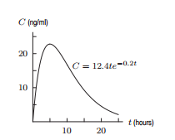
Example 3
If time, t is in hours and concentration, C, is in ng/ml, the drug concentration curve for a drug is given by $C(t)=12.4te^{−0.2t}$.
How many hours does it take for the drug to reach its peak concentration?
The surge function $y=ate^{bt}$ changes from increasing to decreasing at t = 1/b = 1/0.2 = 5 hours

Slide 26
Example 3
If time, t is in hours and concentration, C, is in ng/ml, the drug concentration curve for a drug is given by $C(t)=12.4te^{−0.2t}$.
How many hours does it take for the drug to reach its peak concentration?
What is the concentration at that time?

Slide 27
Example 3
If time, t is in hours and concentration, C, is in ng/ml, the drug concentration curve for a drug is given by $C(t)=12.4te^{−0.2t}$.
How many hours does it take for the drug to reach its peak concentration?
What is the concentration at that time?
$$C(5)=12.4\left(5\right)e^{−0.2\left(5\right)}=22.8 ng/ml$$

