Slide 1
Derivatives of
Exponential and Logarithmic Functions

Slide 2
Exponential Growth
What are some things you can think of that grow exponentially?

Slide 3
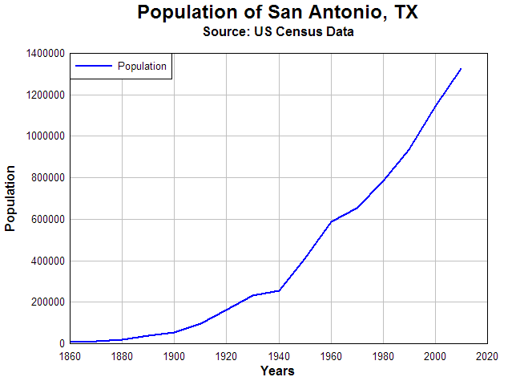
Examples of Exponential Growth and Decay
Human Population growth (up to a point…)

Slide 4
Examples of Exponential Growth and Decay
Growth of Bacteria in a Petri Dish (again, up to a point)
Decay of radioactive atoms (Carbon-14)
Removal of drugs from body
  Example: 50% of caffeine is removed from your body approximately every 4 hours

Slide 5
Derivatives of Exponential and Logarithmic Functions
Formulas for derivatives of:

Slide 6






Derivative of $f\left(x\right)=e^{x}$
The number e is a famous irrational number, and is one of the most important numbers in mathematics. The first few digits are:
2.718281828459045235
(and more ...)
It is often called Euler's number after Leonhard Euler.
e is the base of the Natural Logarithms (invented by John Napier).
Find f’(1) for various values of h
$${f^{′}\left(1\right)=lim}_{h→0}\left(\frac{e^{1+0.1}−e^{1}}{0.1}\right)=2.859$$
$${f^{′}\left(1\right)=lim}_{h→0}\left(\frac{e^{1+0.01}−e^{1}}{0.01}\right)=2.732$$
$${f^{′}\left(1\right)=lim}_{h→0}\left(\frac{e^{1+0.001}−e^{1}}{0.001}\right)=2.720$$
${f^{′}\left(1\right)=lim}_{h→0}\left(\frac{e^{1+0.0001}−e^{1}}{0.0001}\right)=2.7$18
${f^{′}\left(1\right)=lim}_{h→0}\left(\frac{e^{1+0.00001}−e^{1}}{0.00001}\right)=2.7$18
Getting close to “e”

Slide 7

Derivative Function of $f\left(x\right)=e^{x}$
Start with the limit definition of the derivative:

Slide 8
h | -0.01 | -0.001 | 0 | 0.001 | 0.01
 | 0.995 | 0.9995 | 1 | 1.0005 | 1.005
Limiting Value

Slide 9
h | -0.01 | -0.001 | 0 | 0.001 | 0.01
 | 0.995 | 0.9995 | 1 | 1.0005 | 1.005

Slide 10
So
h | -0.01 | -0.001 | 0 | 0.001 | 0.01
 | 0.995 | 0.9995 | ? | 1.0005 | 1.005

Slide 11
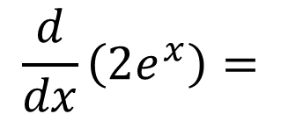
Examples
$$\frac{d}{dx}\left(2e^{x}\right)=$$

Slide 12
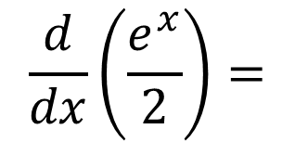
Examples
$$\frac{d}{dx}\left(2e^{x}\right)=$$
$$\frac{d}{dx}\left(\frac{e^{x}}{2}\right)=$$

Slide 13
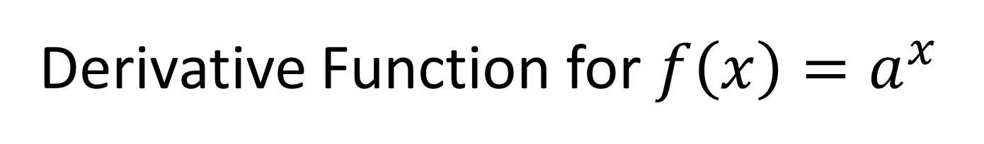
Derivative Function for $f\left(x\right)=a^{x}$

Slide 14
Derivative Function for $f\left(x\right)=a^{x}$
Need the “chain rule” (coming up) to understand and prove (later)

Slide 15

Derivative Function for $f\left(x\right)=a^{x}$
Examples:
$$\frac{d}{dx}\left(3^{x}\right)=$$

Slide 16

Derivative Function for $f\left(x\right)=a^{x}$
Examples:
$$\frac{d}{dx}4∙\left(5^{x}\right)=$$

Slide 17
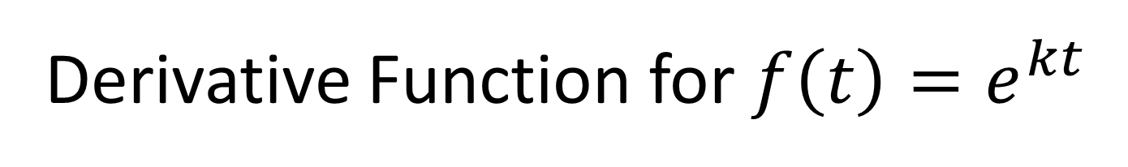
Derivative Function for $f\left(t\right)=e^{kt}$

Slide 18
Derivative Function for $f\left(t\right)=e^{kt}$
Need the “chain rule” (coming up) to understand and prove (later)

Slide 19
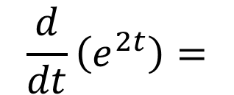
Derivative Function for $f\left(t\right)=e^{kt}$
Example:
$$\frac{d}{dt}\left(e^{2t}\right)=$$

Slide 20
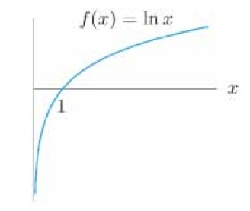

Derivative Function for $f\left(x\right)=ln⁡(x)$

Slide 21
Derivative Function for $f\left(x\right)=ln⁡(x)$
Notes:
Will also prove after chain rule

Slide 22
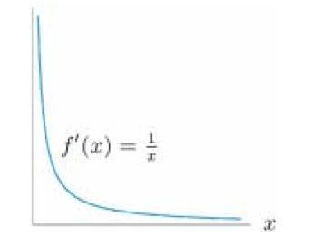
Derivative Function for $f\left(x\right)=ln⁡(x)$

Slide 23
Derivative Function for $f\left(x\right)=ln⁡(x)$
Notes:
Will also prove after chain rule

Slide 24
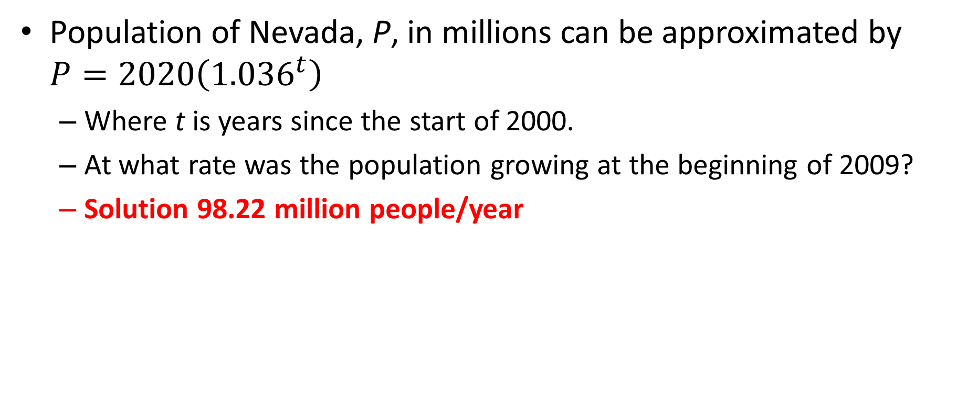
Applications Example 1
Population of Nevada, P, in millions can be approximated by $P=2020\left({1.036}^{t}\right)$
  Where t is years since the start of 2000.
  At what rate was the population growing at the beginning of 2009?
  Solution 98.22 million people/year
$$\frac{dP}{dt}=\frac{d}{dt}\left(2020\left({1.036}^{t}\right)\right)=2020\frac{d}{dt}\left({1.036}^{t}\right)=2020\left[\ln\left(1.036\right){1.036}^{9}\right]=98.22$$

Slide 25

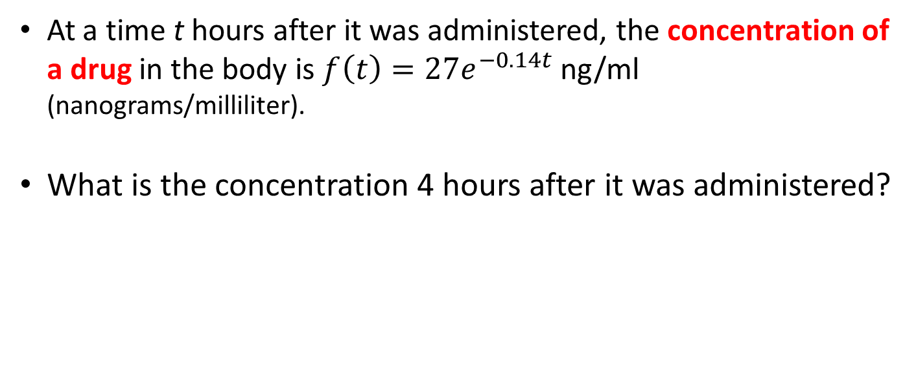
Applications Example 2
At a time t hours after it was administered, the concentration of a drug in the body is $f\left(t\right)=27e^{−0.14t}$ng/ml (nanograms/milliliter).
What is the concentration 4 hours after it was administered?
$$f\left(4\right)=27e^{−0.14(4)}=15.42 ng/ml$$

Slide 26
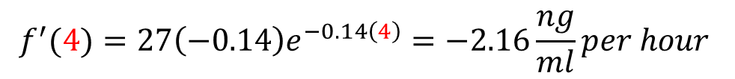
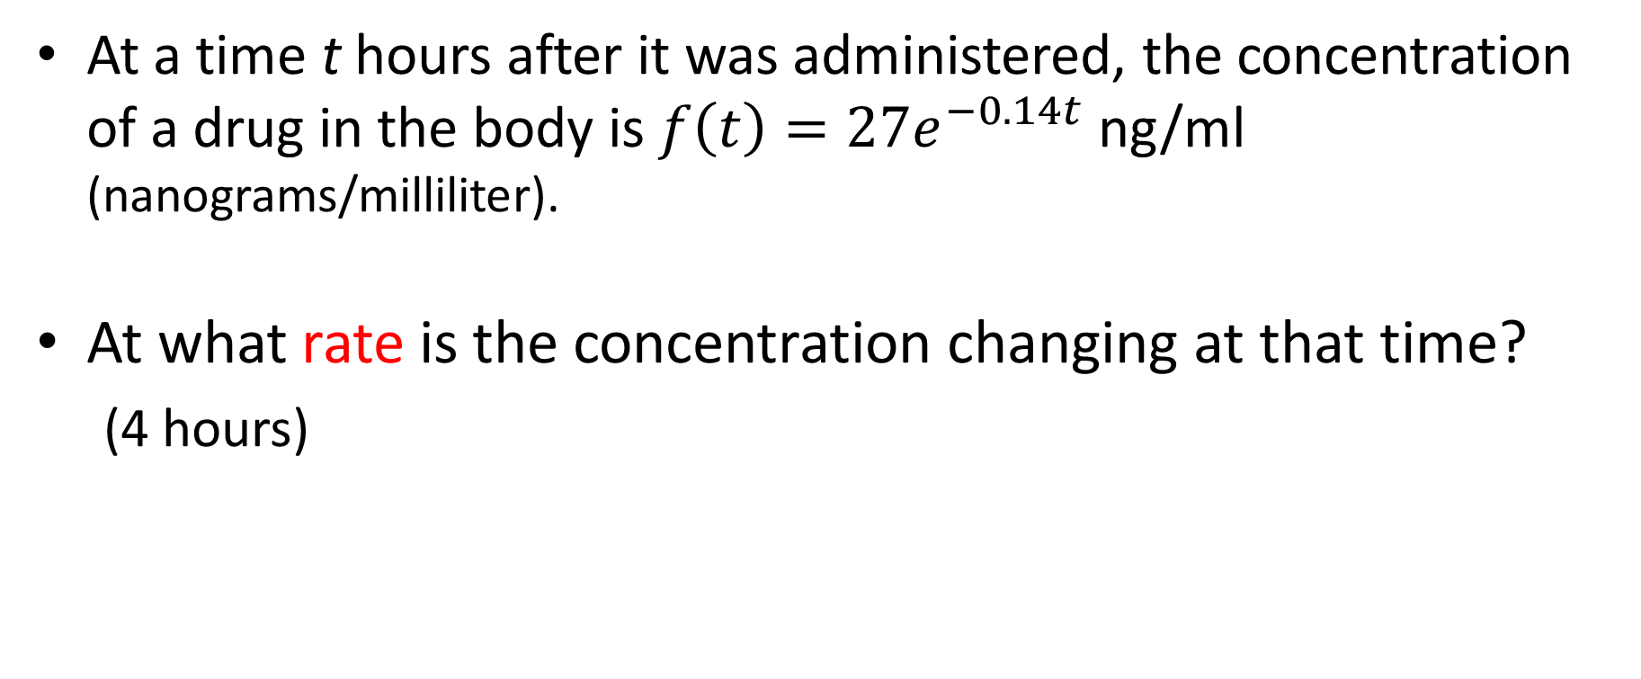
Applications Example 2
At a time t hours after it was administered, the concentration of a drug in the body is $f\left(t\right)=27e^{−0.14t}$ng/ml (nanograms/milliliter).
At what rate is the concentration changing at that time?
  (4 hours)
$$f^{′}(4)=27{\left(−0.14\right)e}^{−0.14\left(4\right)}=−2.16\frac{ng}{ml}per hour$$

