Slide 1
Chain Rule

Slide 2
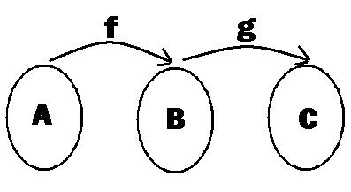
Composite Reminder
Algebra class

Slide 3
Composite Reminder
Algebra class
$$f\left(x\right)→g\left(x\right)→\left(fog\right)\left(x\right)=f(g\left(x\right))$$

Slide 4
Composite Reminder
Algebra class
$$f\left(x\right)=2x+3 and g\left(x\right)=x^{2}$$
Find $f(g\left(x\right))$

Slide 5
Composite Reminder
Algebra class
$$f\left(x\right)=2x+3 and g\left(x\right)=x^{2}$$
Find $f(g\left(x\right))$
$$f\left(g\left(x\right)\right)=f\left(x^{2}\right)$$

Slide 6
Composite Reminder
Algebra class
$$f\left(x\right)=2x+3 and g\left(x\right)=x^{2}$$
Find $f(g\left(x\right))$
$$f\left(g\left(x\right)\right)=f\left(x^{2}\right)=2x^{2}+3$$

Slide 7
The Chain Rule
Calories burned, C, depend upon number of miles traveled, m:
C(m)
Number of miles traveled, m, depends upon time, t.
m(t)
Therefore, Calories burned, depends upon time t
C(m(t))

Slide 8
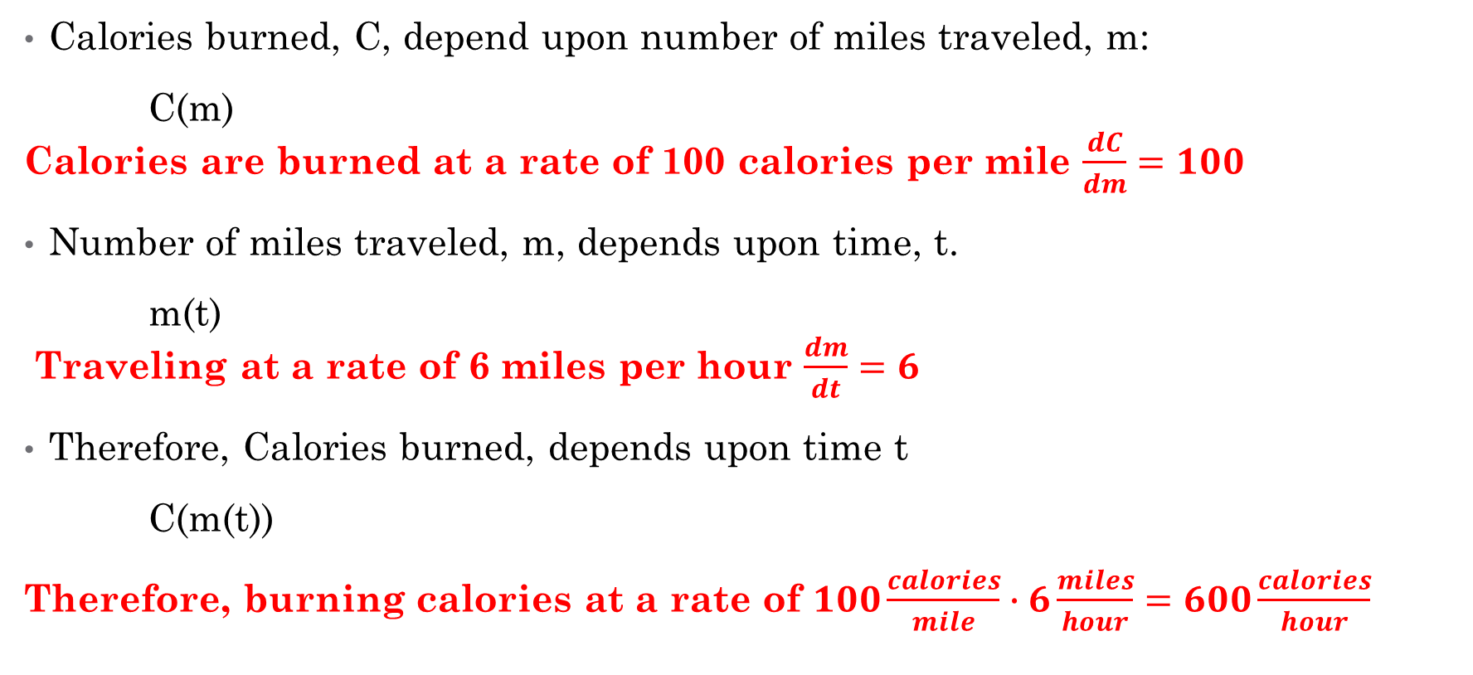
The Chain Rule
Calories burned, C, depend upon number of miles traveled, m:
C(m) Calories are burned at a rate of 100 calories per mile $\frac{dC}{dm}=100$
Number of miles traveled, m, depends upon time, t.
m(t) Traveling at a rate of 6 miles per hour $\frac{dm}{dt}=6$
Therefore, Calories burned, depends upon time t
C(m(t))
Therefore, burning calories at a rate of $100\frac{calories}{mile}∙6\frac{miles}{hour}=600\frac{calories}{hour}$

Slide 9
Chain Rule
Derivative of outer function
Derivative of inner function

Slide 10

The Chain Rule in General
If $y=f\left(u\right)$ and $u=g(x)$ (that is, y is a function of x meaning $f(g\left(x\right))$
Then ${y^{′}= f}^{′}\left(g\left(x\right)\right)∙g′(x)$
or $\frac{dy}{dx}=\frac{dy}{du}∙\frac{du}{dx}$
Derivative of outer function
Derivative of inner function
Derivative of outer function
Derivative of inner function

Slide 11
Example 1: $y={\left(2x^{2}+1\right)}^{2}$
Write it as the outside function
$$y=u^{2}$$
Find the inside function
$$u=2x^{2}+1$$

Slide 12
Example 1: $y={\left(2x^{2}+1\right)}^{2}$
Write it as the outside function
$$y=u^{2}$$
$$\frac{dy}{du}=2u$$
Find the inside function
$$u=2x^{2}+1$$
$$\frac{du}{dx}=4x$$
Take derivatives of both

Slide 13
Example 1: $y={\left(2x^{2}+1\right)}^{2}$
Write it as the outside function
$$y=u^{2}$$
$$\frac{dy}{du}=2u$$
Find the inside function
$$u=2x^{2}+1$$
$$\frac{du}{dx}=4x$$
Multiply the derivatives
$$2u ∙4x=8ux$$

Slide 14
Example 1: $y={\left(2x^{2}+1\right)}^{2}$
Write it as the outside function
$$y=u^{2}$$
$$\frac{dy}{du}=2u$$
Find the inside function
$$u=2x^{2}+1$$
$$\frac{du}{dx}=4x$$
Substitute u back
$$2u ∙4x=8xu$$
$$8x\left(2x^{2}+1\right)$$

Slide 15
Example 1: $y={\left(2x^{2}+1\right)}^{2}$
Write it as the outside function
$$y=u^{2}$$
$$\frac{dy}{du}=2u$$
Find the inside function
$$u=2x^{2}+1$$
$$\frac{du}{dx}=4x$$
Multiply
$$8x\left(2x^{2}+1\right)=16x^{3}+8x$$

Slide 16
Example 1: $y={\left(2x^{2}+1\right)}^{2}$
Repeated: If easy enough, find the outside derivative times the inside derivative
Outside Derivative: $2{\left(2x^{2}+1\right)}^{1}$
Inside Derivative: $4x$
Multiply: $8x(2x^{2}+1)$
Distribute: $16x^{3}+8x$

Slide 17
Example 1: $y={\left(2x^{2}+1\right)}^{2}$
Why not just FOIL and then take the derivative? Much easier! NO CHAIN RULE!

Slide 18
So why do we even need the chain rule?
Do you want to multiply this out 100 times?
What if you had $y={\left(2x^{2}+1\right)}^{100}$?

Slide 19
Chain Rule in Four Steps
First, recognize you have a composite function
Find inner $u=g\left(x\right)$ and outer functions $y=f(u)$
Find the derivative of each function $\frac{dy}{du}$ and $\frac{du}{dx}$
Multiply the derivatives together $\frac{dy}{dx}=\frac{dy}{du}∙\frac{du}{dx}$
Substitute for $u$

Slide 20

Example 2: $y=ln⁡(x^{3}+5)$ Find $\frac{dy}{dx}$
$y=ln⁡(u)$ and $u=x^{3}+5$
$\frac{dy}{du}=\frac{1}{u}$ and $\frac{du}{dx}=3x^{2}$
$\frac{1}{u}∙3x^{2}$
$\frac{dy}{dx}=\frac{3x^{2}}{x^{3}+5}$

Slide 21
Example 3: $y=\frac{1}{ln⁡(x^{3}+5)}$ Find $\frac{dy}{dx}$

Slide 22

Example 3: $y=\frac{1}{ln⁡(x^{3}+5)}={\left[\ln\left(x^{3}+5\right)\right]}^{−1}$
$y=u^{−1}$ and $u=ln⁡(x^{3}+5)$
$\frac{dy}{du}=−u^{−2}$ and $\frac{du}{dx}=\frac{3x^{2}}{x^{3}+5}$
$−u^{−2}∙\frac{3x^{2}}{x^{3}+5}$
$\frac{dy}{dx}=−{\left(\ln\left(x^{3}+5\right)\right)}^{−2}\frac{3x^{2}}{x^{3}+5}$
From last example, chain rule within a chain rule

Slide 23

Chain Rule for $ln⁡(x)$
Shortcut $y=\ln\left(x\right)$
Derivative $y^{′}=\frac{1}{x}$
Chain Rule $y=\ln\left(x\right)$
Derivative $y^{′}=\frac{1}{x} ∙\frac{d}{dx}\left(x\right)=\frac{1}{x}∙1=\frac{1}{x}$
Chain Rule $y=ln⁡(x^{3}+5)$
Derivative $y^{′}=\frac{1}{x^{3}+5}∙\frac{d}{dx}\left(x^{3}+5\right)=\frac{1}{x^{3}+5}∙3x^{2}=\frac{3x^{2}}{x^{3}+5}$

Slide 24
Chain Rule for $e^{kt}$
Shortcut $y=e^{x}$
Derivative $y^{′}=e^{x}$
Chain Rule $y=e^{x}$
Derivative $y^{′}=e^{x}∙\frac{d}{dx} \left(x\right)=e^{x}∙1=e^{x}$
Chain Rule $y=e^{3x}$
Derivative $y^{′}=e^{3x}∙\frac{d}{dx}\left(3x\right)=e^{3x}∙3=3e^{3x}$

Slide 25
Use Chain Rule to Prove
Rewrite:
So
Use Chain Rule on

