Slide 1
Derivatives of Periodic Functions

Slide 2
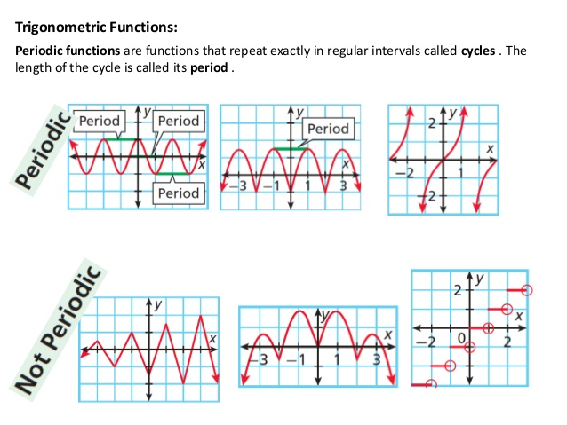
Periodic Functions
Examples of periodic behavior
Heartbeat
Breathing
Sleep wake cycle
Menstrual Cycle
Flu outbreaks
Measles outbreaks
Before vaccination
Firing of Neurons

Slide 3
Trigonometric Functions are Used to Model Periodic Behavior
sin(x) | sec(x)
cos(x) | csc(x)
tan(x) | cot(x)

Slide 4
Derivative of
Remember the definition of finding a derivative is taking limits as h → 0

Slide 5
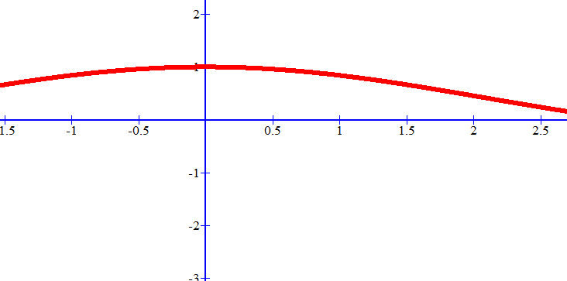
h | [cos(h)-1]/h
0.1 | -0.049958347
0.01 | -0.004999958
0.001 | -0.0005
0.0001 | -5.000E-05
h | sin(h)/h
0.1 | 0.998334166
0.01 | 0.999983333
0.001 | 0.999999833
0.0001 | 0.999999998

Slide 6
Derivative of

Slide 7
$$y=sin⁡(x)$$
Find where the slope = 0
$$\frac{dy}{dx}sin\left(x\right)=cos⁡(x)$$

Slide 8
$$y=sin⁡(x)$$
Where are the slopes increasing, that is positive?
$$\frac{dy}{dx}sin\left(x\right)=cos⁡(x)$$

Slide 9
$$y=sin⁡(x)$$
Where are the slopes decreasing, that is negative?
$$\frac{dy}{dx}sin\left(x\right)=cos⁡(x)$$

Slide 10
Derivative of
Derivative of cos(x) is found similarly and is equal to – sin(x)

Slide 11
$$y=cos⁡(x)$$
$$\frac{dy}{dx}cos\left(x\right)=−sin⁡(x)$$

Slide 12
Derivative of
Rewrite:
Quotient Rule:

Slide 13
$$\frac{dy}{dx}tan(x)=sec^{2}(x)$$
$$y=tan⁡(x)$$

Slide 15
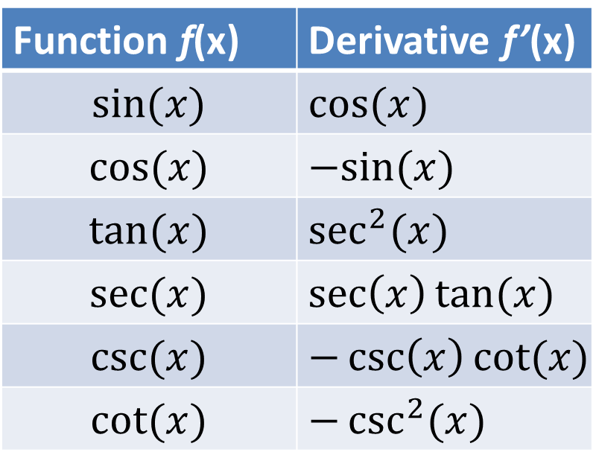
Derivatives of Trig Functions
Function f(x) | Derivative f’(x)
$$sin⁡(x)$$ | $$cos⁡(x)$$
$$cos⁡(x)$$ | $$−sin⁡(x)$$
$$tan⁡(x)$$ | $$\sec^{2}{(x)}$$
$$sec⁡(x)$$ | $$\sec\left(x\right)tan⁡(x)$$
$$csc⁡(x)$$ | $$−\csc\left(x\right)cot⁡(x)$$
$$cot⁡(x)$$ | $$−\csc^{2}{(x)}$$
Notes:
Don’t need to memorize

Slide 16
Example 1: Differentiate
$$y^{′}=0−2cos\left(x\right)+4x^{3}$$
$$y^{′}=4x^{3}−2cos\left(x\right)$$

Slide 17
Example 2: Calculate the derivative of
$$y=cos⁡(u)$$
$$u=x^{2}+1$$
$$y^{′}=−sin⁡(u)$$
$$u′=2x$$
$$y^{′}=−2x sin⁡(u)$$
$$y^{′}=−2x sin⁡(x^{2}+1)$$

Slide 18
Example 3: Calculate the derivative of
$$w=sec⁡(u)$$
$$u=\sqrt{v}$$
$$v=x^{2}+1$$
Double Chain Rule!

Slide 19

Example 3: Calculate the derivative of
$$w=sec⁡(u)$$
$$u=\sqrt{v}$$
$$v=x^{2}+1$$
$$u′=\frac{1}{2\sqrt{v}}$$
$$v′=2x$$
$$w^{′}=\sec\left(u\right)tan⁡(u)$$
$$y^{′}=\sec\left(u\right)\tan\left(u\right)∙\frac{1}{2\sqrt{v}}∙2x$$
$$y^{′}=\frac{x sec\sqrt{x^{2}+1} tan\sqrt{x^{2}+1}}{\sqrt{x^{2}+1}}$$

Slide 20
Application
The depth of the water, $y$, in meters, in the Bay of Fundy, Canada, is given as a function of time, $t$, in hours after midnight, by the function
$$y=10+7.5cos⁡(0.507t)$$
How quickly is the tide rising or falling at 3am?

Slide 21
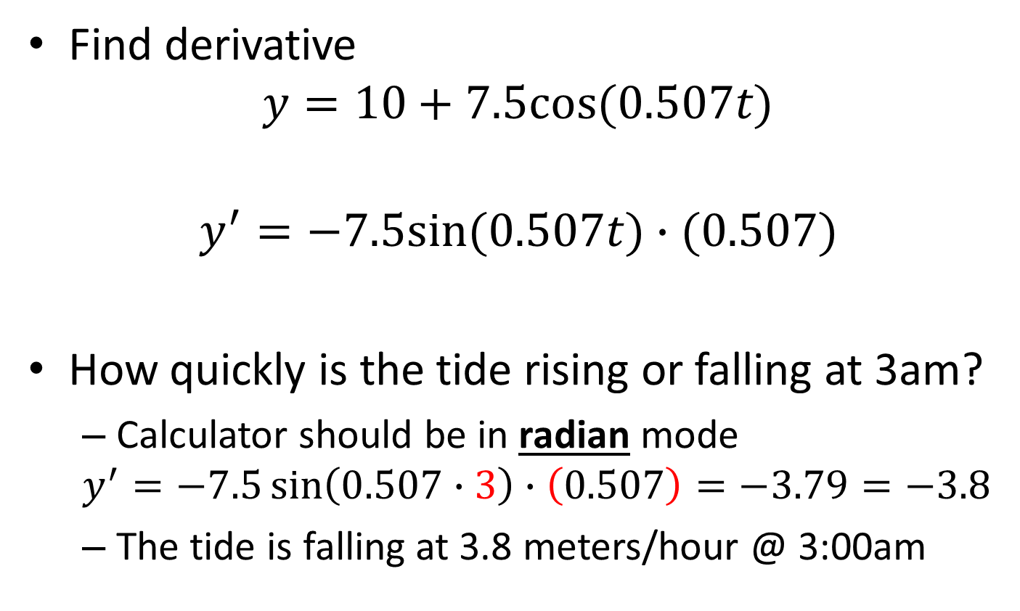
Application
Find derivative
$$y=10+7.5cos⁡(0.507t)$$
$$y^{′}=−7.5sin⁡(0.507t)∙(0.507)$$
How quickly is the tide rising or falling at 3am?
Calculator should be in radian mode
$$y^{′}=−7.5\sin\left(0.507∙3\right)∙\left(0.507\right)=−3.79=−3.8$$
The tide is falling at 3.8 meters/hour @ 3:00am

