Slide 1
Local Maxima and Minima

Slide 2
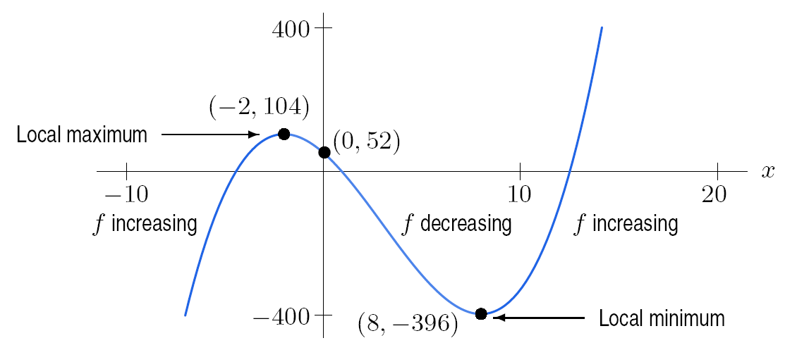
y
Graph of f (x) = x³ – 9 x² – 48 x +52

Slide 3
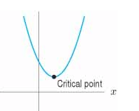
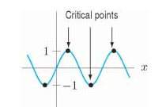
Critical points
For any function f, a point p in the domain of f where the derivative equals 0, that is, f’(p) = 0 is called a critical point.
If a function, continuous on an interval (its domain), has a local maximum or minimum at p, the p is a critical point or an end point on the interval.

Slide 4
Find all critical points and where the function is increasing and decreasing for
$f\left(x\right)=x^{3}−9x^{2}−48x+52$

Slide 5
Find all critical points and where the function is increasing and decreasing for
$f\left(x\right)=x^{3}−9x^{2}−48x+52$
$$f^{′}\left(x\right)=3x^{2}−18x −48$$
Step 1: Find derivative

Slide 6
Find all critical points and where the function is increasing and decreasing for
$f\left(x\right)=x^{3}−9x^{2}−48x+52$
$$f^{′}\left(x\right)=3x^{2}−18x −48$$
Step 2: Set derivative = 0 and solve for x

Slide 7
Find all critical points and where the function is increasing and decreasing for
$f\left(x\right)=x^{3}−9x^{2}−48x+52$
$$f^{′}\left(x\right)=3x^{2}−18x −48$$
$$3x^{2}−18x −48=0$$
Step 2: Set derivative = 0 and solve for x

Slide 8
Find all critical points and where the function is increasing and decreasing for
$f\left(x\right)=x^{3}−9x^{2}−48x+52$
$$f^{′}\left(x\right)=3x^{2}−18x −48$$
$$3x^{2}−18x −48=0$$
$$3\left(x^{2}−6x−16\right)=0$$
Factor out a 3

Slide 9
Find all critical points and where the function is increasing and decreasing for
$f\left(x\right)=x^{3}−9x^{2}−48x+52$
$$f^{′}\left(x\right)=3x^{2}−18x −48$$
$$3x^{2}−18x −48=0$$
$$3\left(x^{2}−6x−16\right)=0$$
$$3\left(x−8\right)\left(x+2\right)=0$$
Factor trinomial

Slide 10
Find all critical points and where the function is increasing and decreasing for
$f\left(x\right)=x^{3}−9x^{2}−48x+52$
$$f^{′}\left(x\right)=3x^{2}−18x −48$$
$$3x^{2}−18x −48=0$$
$$3\left(x^{2}−6x−16\right)=0$$
$$3\left(x−8\right)\left(x+2\right)=0$$
$$x=8 and x=−2$$
Set both factors = 0 and solve

Slide 11
See where increasing/decreasing
Pick values between c.p. and plug into f’(x)
-2
8

Slide 12
See where increasing/decreasing
Pick values between c.p. and plug into f’(x)
$$f^{′}\left(−3\right)=3{(−3)}^{2}−18\left(−3\right)−48=33$$
-2
8

Slide 13
See where increasing/decreasing
Pick values between c.p. and plug into f’(x)
$$f^{′}\left(0\right)=3{(0)}^{2}−18\left(0\right)−48=−48$$
-2
8

Slide 14
See where increasing/decreasing
Pick values between c.p. and plug into f’(x)
$$f^{′}\left(9\right)=3{(9)}^{2}−18\left(9\right)−48=33$$
-2
8

Slide 15
See where increasing/decreasing
Pick values between c.p. and plug into f’(x)
Local max
increasing
decreasing
increasing
Local min
-2
8

Slide 16
$f\left(−2\right)={(−2)}^{3}−9{\left(−2\right)}^{2}−48(−2)+52$
$f\left(8\right)={(8)}^{3}−9{\left(8\right)}^{2}−48(8)+52$

Slide 17
Changes in direction at a critical point, p: Local maxima or minima

Slide 18
Changes in direction at a critical point, p: Local maxima or minima

Slide 19
$f\left(x\right)=x^{3}−9x^{2}−48x+52$
$$f^{′}\left(x\right)=3x^{2}−18x −48$$
Find second derivative
$$f^{′′}\left(x\right)=6x−18$$

Slide 20
$f\left(x\right)=x^{3}−9x^{2}−48x+52$
$$f^{′}\left(x\right)=3x^{2}−18x −48$$
$$f^{′′}\left(x\right)=6x−18$$
Plug in c.p.
$$f^{′′}\left(−2\right)=6\left(−2\right)−18=−30$$
Plug in c.p.
$$f^{′′}\left(8\right)=6\left(8\right)−18=30$$

Slide 21
$f\left(x\right)=x^{3}−9x^{2}−48x+52$
$$f^{′}\left(x\right)=3x^{2}−18x −48$$
$$f^{′′}\left(x\right)=6x−18$$
$$f^{′′}\left(−2\right)=6\left(−2\right)−18=−30$$
Max
$$f^{′′}\left(8\right)=6\left(8\right)−18=30$$
Min
2nd Derivative | Original Function
Positive | Concave Up
Negative | Concave Down
Zero | Straight – no concavity

Slide 22
Not every critical point of a function is a local maximum or minimum

Slide 23
Max/Min Application
Suppose Sean and Razja are applying for the same job.

Slide 24
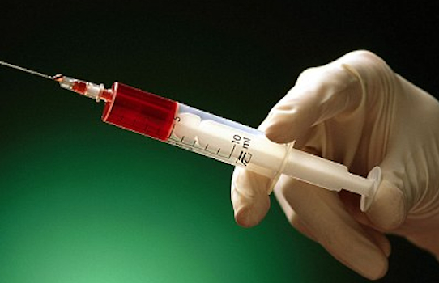
Max/Min Application
Sean wants the job so badly, he stabs Razja with a needle and administers a particular drug in Razja’s blood stream so he will fail the drug test for the job.

Slide 25
Max/Min Application
Dr. Misutka performs an experiment to find the percent of concentration of the drug in the blood stream so Razja will know when the percent is beginning to decrease and he can be ready for the drug test.

Slide 26
Max/Min Application
Dr. Misutka finds that t hours later the percent of concentration of the drug in the blood stream can be modeled by the following function
$$k\left(t\right)= \frac{5t}{t^{2}+1}$$

Slide 27
Max/Min Application
DJ tells Razja, “Don’t worry dude, after one hour the concentration of the drug in your blood stream will start to decrease.
Just take a nap for a few hours, like you do in class ☺, and you will be fine!”

Slide 28
Max/Min Application
Is DJ correct that the concentration of the drug in the blood stream will basically top out at 1 hour and then start to decrease?

Slide 29
Find the critical point
$$k\left(t\right)= \frac{5t}{t^{2}+1}$$
$$k′\left(t\right)= \frac{5\left(t^{2}+1\right)−5t(2t)}{{\left(t^{2}+1\right)}^{2}}$$
$$k^{′}(t)= \frac{5t^{2}+5−10t^{2}}{{\left(t^{2}+1\right)}^{2}}=\frac{−5t^{2}+5}{{\left(t^{2}+1\right)}^{2}}$$
Set derivative = 0 and solve for t
$$0=\frac{−5t^{2}+5}{{\left(t^{2}+1\right)}^{2}}$$

Slide 30
Find the critical point
Set derivative = 0 and solve for t
$$0=\frac{−5t^{2}+5}{{\left(t^{2}+1\right)}^{2}}$$
$$0=−5t^{2}+5$$
$$5t^{2}=5$$
$$\frac{5t^{2}}{5}=\frac{5}{5}$$
$$t^{2}=1$$
$$\sqrt{t^{2}}=\sqrt{1}$$
$$t=1$$

Slide 31
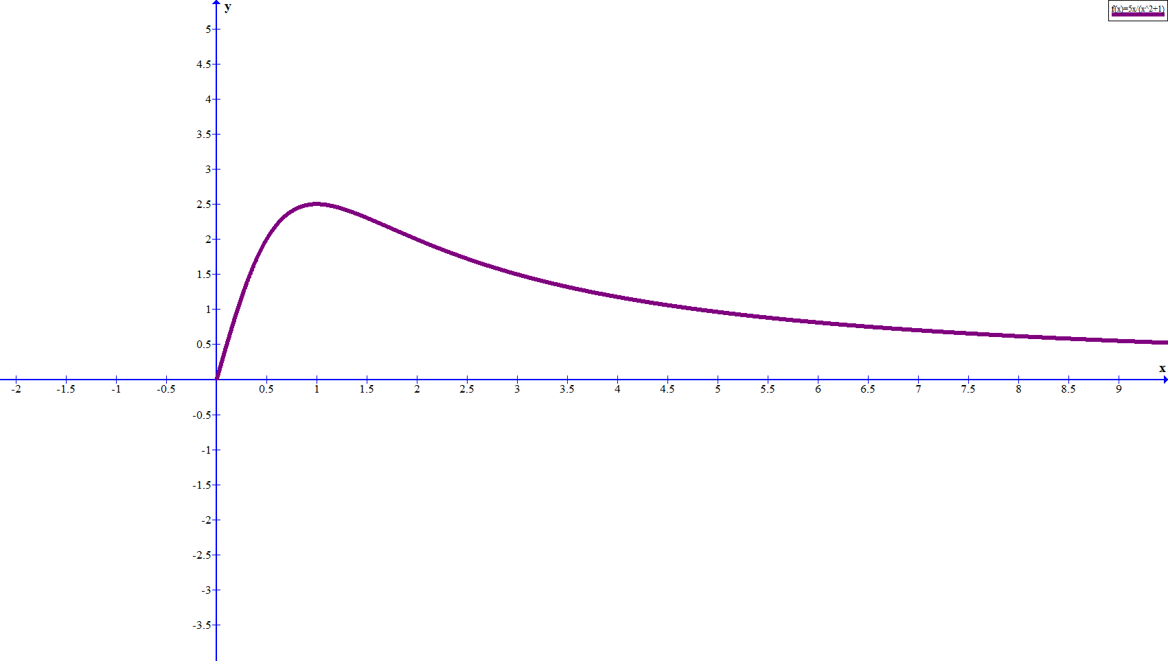
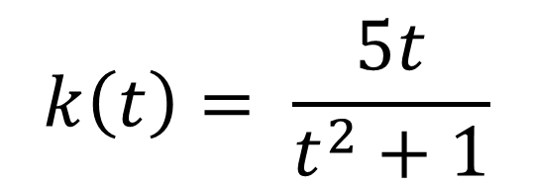
$$k\left(t\right)= \frac{5t}{t^{2}+1}$$

