Slide 1
Inflection Points

Slide 2
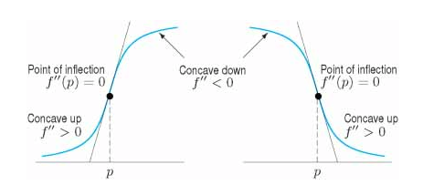
Inflection Points
Inflection points are points where a graph changes concavity
2nd derivative must change sign

Slide 3
Inflection Points
Inflection points are points where a graph changes concavity
2nd derivative must change sign
To find inflection points:
Find where 2nd derivative equals 0
Check if 2nd derivative changes sign to the left and right of the inflection point

Slide 4
Example: Finding Inflection Points
Find the “possible” inflection points for the following function
$$f\left(x\right)=x^{3}−9x^{2}−48x+52$$
$$f^{′}\left(x\right)=3x^{2}−18x−48$$
$$f^{′′}\left(x\right)=6x−18$$

Slide 5
Example: Finding Inflection Points
Find the “possible” inflection points for the following function
$$f^{′′}\left(x\right)=6x−18$$
$$6x−18=0$$
$$6x=18$$
$$x=3$$
Possible inflection point

Slide 6
Example: Finding Inflection Points
Find the “possible” inflection points for the following function
$$f^{′′}\left(x\right)=6x−18$$
$$f^{′′}\left(2\right)=6\left(2\right)−18=12−18=−6$$
$$f^{′′}\left(4\right)=6\left(4\right)−18=24−18=6$$
Plug in value to the left and value to the right of inflection point, x = 3 and see if sign changes
Sign changed

Slide 7
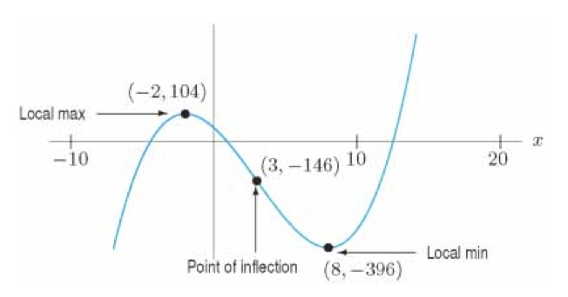
$$f^{′′}\left(2\right)=6\left(2\right)−18=−6$$
$$f^{′′}\left(4\right)=6\left(4\right)−18=6$$
Because sign changed from positive to negative, x = 3 is an inflection point
Find y value
$$f\left(3\right)=3^{3}−9{\left(3\right)}^{2}−48\left(3\right)+52=−146$$

