Slide 1
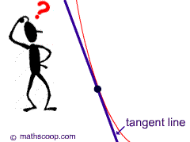
Derivative Function

Slide 2
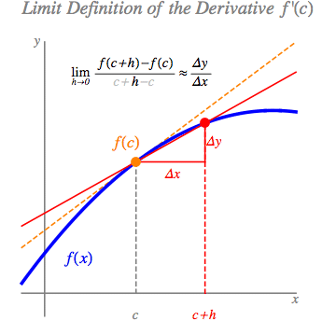
From Secant (ARC) to Tangent (IRC)

Slide 3
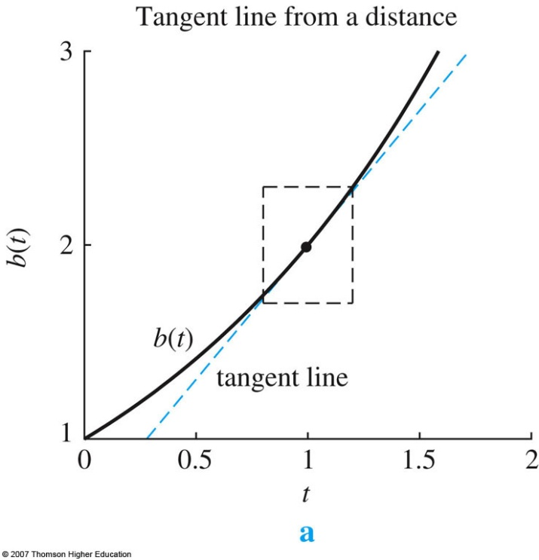
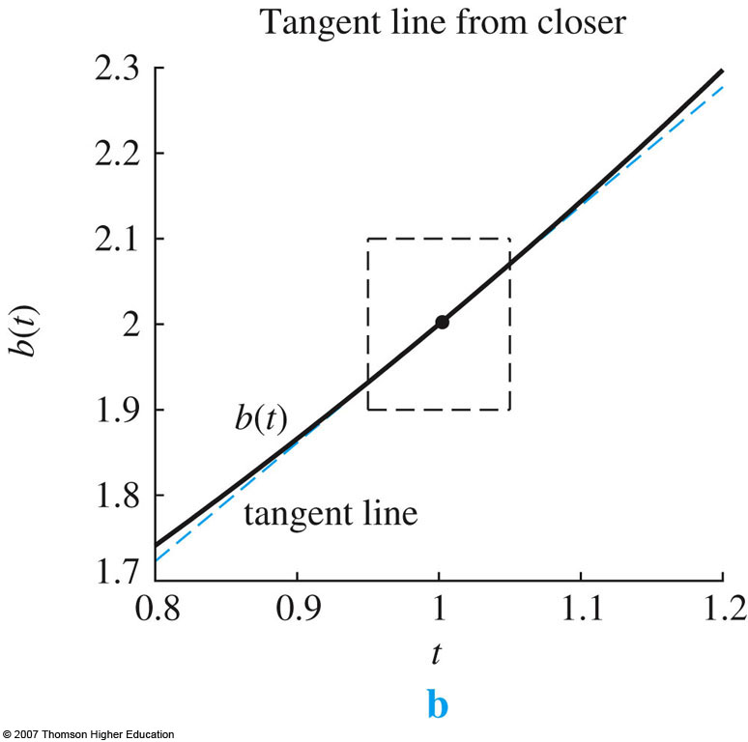
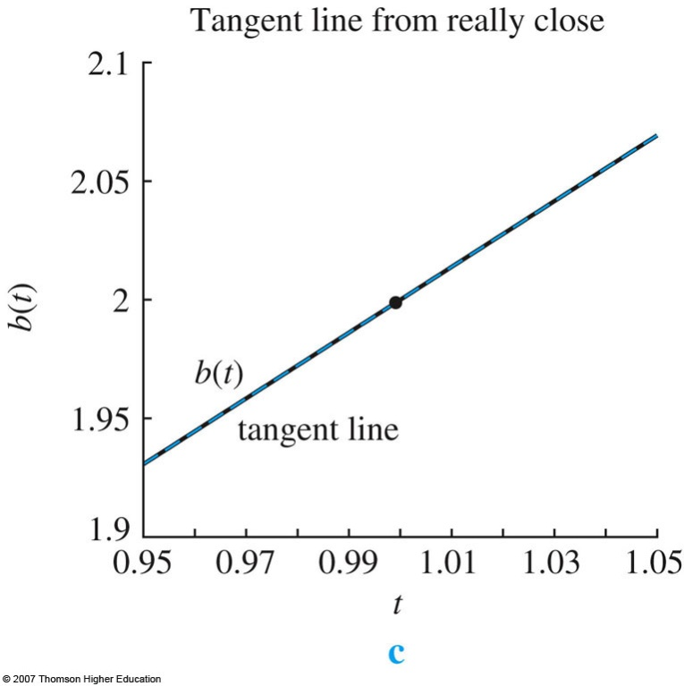
Zoom in close becomes more similar to the curve

Slide 4
Derivative at a point

Slide 5
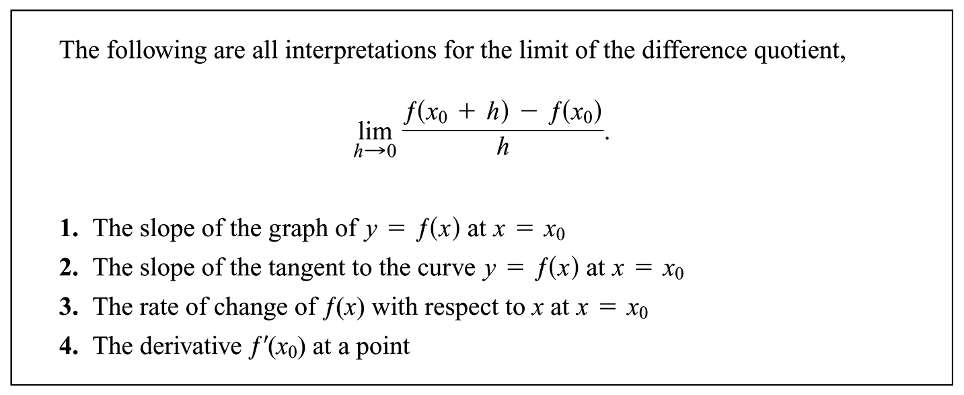

Slide 6
Derivative vs. Derivative Function
Previously, we found the derivative at a particular point $x_{0}$
What if we wanted “any” point $x$
Come up with a function for the derivative
Derivative takes on different values at different points
A function of the particular point chosen

Slide 7
Derivative Function
Defined:
f ’(x) = instantaneous rate of change of f AT x

Slide 9
Derivative @ ANY POINT
$$f\left(t\right)=16t^{2}$$
$$Find f′(t)$$

Slide 10
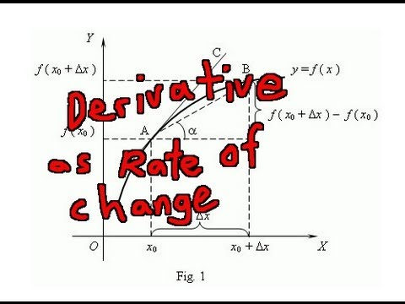
Interpretations of the Derivative

Slide 11
Function vs. Derivative
In the free fall example
Function $f\left(t\right)=16t^{2}$
This gives the VALUE in this example of the height of a particular object
For example, $f\left(2\right)=16{\left(2\right)}^{2}=16\left(4\right)=64$ feet
Derivative $f^{′}\left(t\right)=32t$
This gives the RATE in this example in feet per second the object is falling
For example, $f^{′}\left(2\right)=32\left(2\right)=64$ feet/second
Do you notice the difference?

Slide 12
Interpretations of the Derivative
Leibniz Notation
Determining the units of the derivative
Interpreting derivative using units
Using derivative to predict future values: Tangent Line Approximation

Slide 13
More Notation
$$\frac{Difference in y values}{Difference in x values}$$
Helps determine units y “per” x

Slide 14
Leibniz notation examples
The cost, C, of a steak in dollars, is a function of the weight, W, of the steak, in pounds
Written as: $\frac{dC}{dW} with units dollars per pound$
The number, N, of gallons of gas left in a gas tank is a function of the distance, D, in miles the car has been driven.
Written as $\frac{dN}{dD}with units gallons per mile$

Slide 15
Evaluating the Derivative at a Point
Function $f\left(t\right)=16t^{2}$
Derivative, $f^{′}\left(t\right)=32t$
Leibniz notation $\frac{dy}{dt}|_{2}=32\left(2\right)=64$feet/second vs $f^{′}\left(2\right)=32\left(2\right)=64$ feet / second
Evaluation point

Slide 16
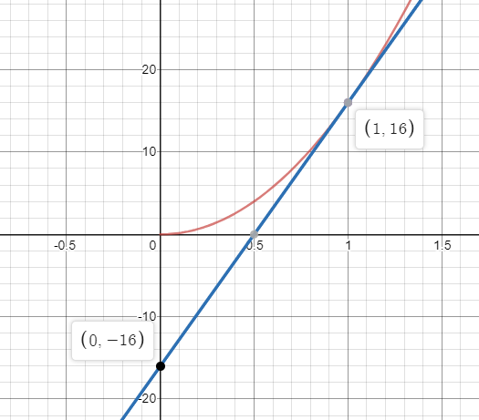
“Approximating” with Derivatives
Tangent line approximation
Do you remember how we came up with the equation?
$y−y_{1}=m\left(x−x_{1}\right)$
$f\left(t\right)−f\left(a\right)=f^{′}\left(a\right)\left(t−a\right)$
$f(t)≈f\left(a\right)+f^{′}\left(a\right)\left(t−a\right)$
WANT $≈$ KNOW + RATE KNOWN * ERROR
$y$= 32x – 16
$f(t)$ = 32t – 16

Slide 17
“Approximating” with Derivatives
Tangent line approximation
$$f\left(t\right)≈f\left(a\right)+f^{′}\left(a\right)\left(t−a\right)$$
Use tangent line approximation to predict the height of a ball at time 0.5 seconds given the height and its rate of change at time 0.4 seconds

Slide 18
Time (seconds) | Height (feet) | Derivative (feet/second)
0 | 7 | 20
0.1 | 8.84 | 16.8
0.2 | 10.36 | 13.6
0.3 | 11.56 | 10.4
0.4 | 12.44 | 7.2
0.5 | 13 | 4
0.6 | 13.24 | 0.8
0.7 | 13.16 | -2.4
0.8 | 12.76 | -5.6
0.9 | 12.04 | -8.8
1 | 11 | -12

Slide 19
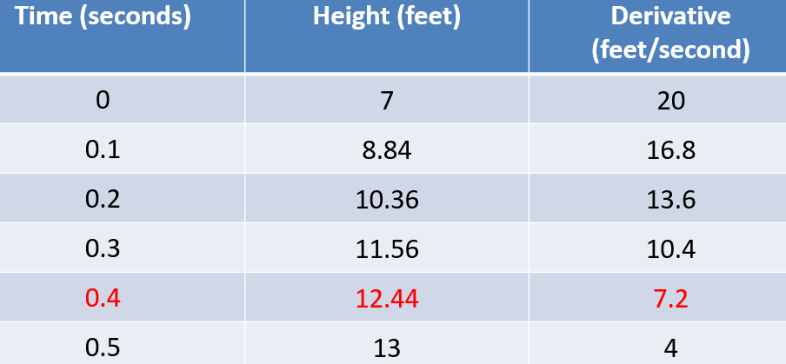
“Approximating” with Derivatives
Tangent line approximation
$$f\left(0.5\right)≈f\left(0.4\right)+f^{′}\left(0.4\right)\left(0.5−0.4\right)$$
$$f\left(0.5\right)≈12.44+7.2\left(0.1\right)≈13.16 ft$$
I told you this was just an “approximation”

Slide 20
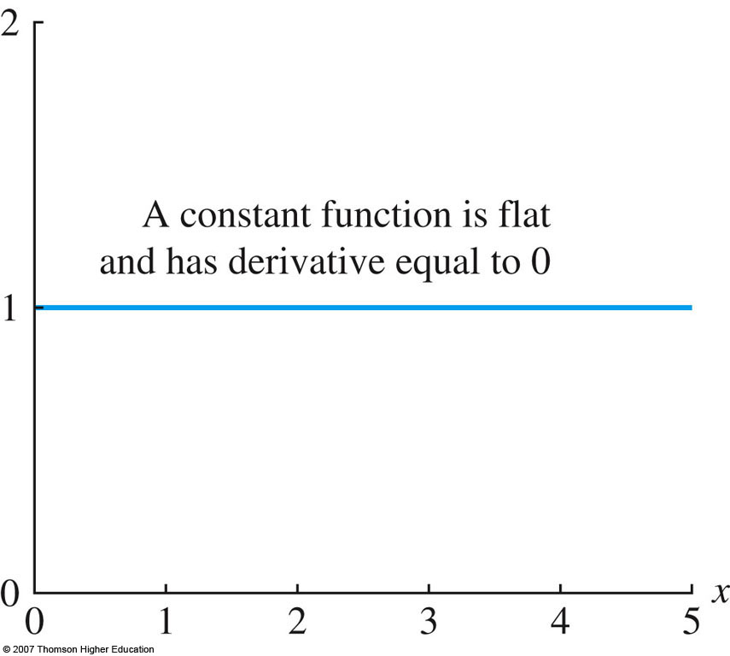

Slide 21
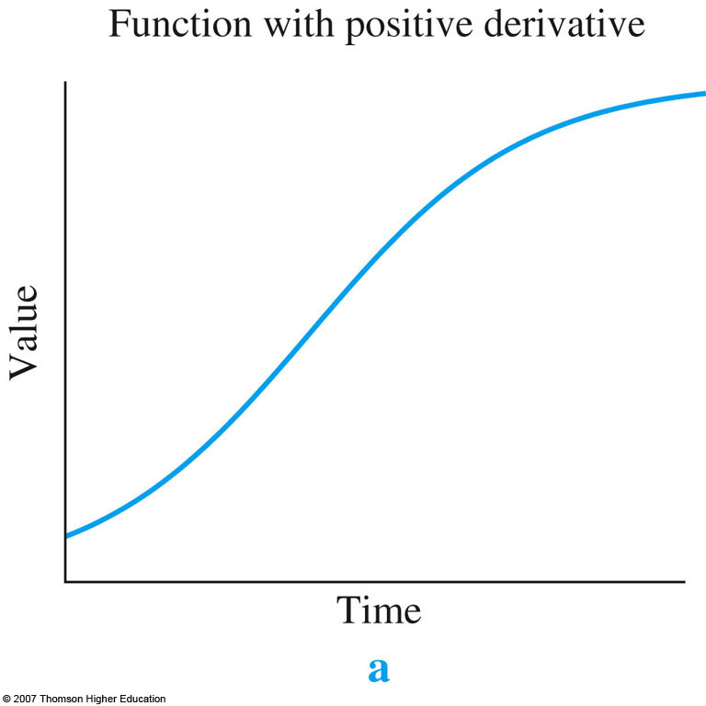

Slide 22
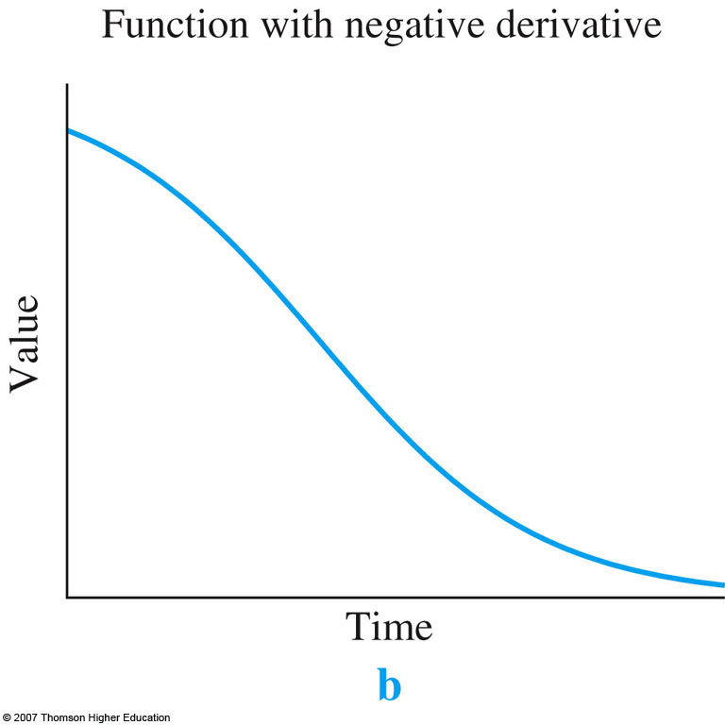

Slide 23
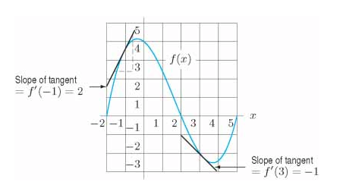
Graphs of Derivatives
x | -2 | -1 | 0 | 1 | 2 | 3 | 4 | 5
f ’(x) | 6 | 2 | -1 | -2 | -2 | -1 | 1 | 4

Slide 24
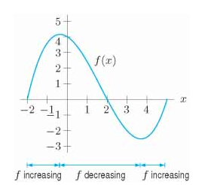
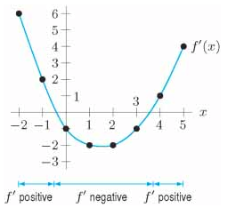
Graphs of Derivatives
Where slope is 0
x | -2 | -1 | 0 | 1 | 2 | 3 | 4 | 5
f ’(x) | 6 | 2 | -1 | -2 | -2 | -1 | 1 | 4

Slide 25
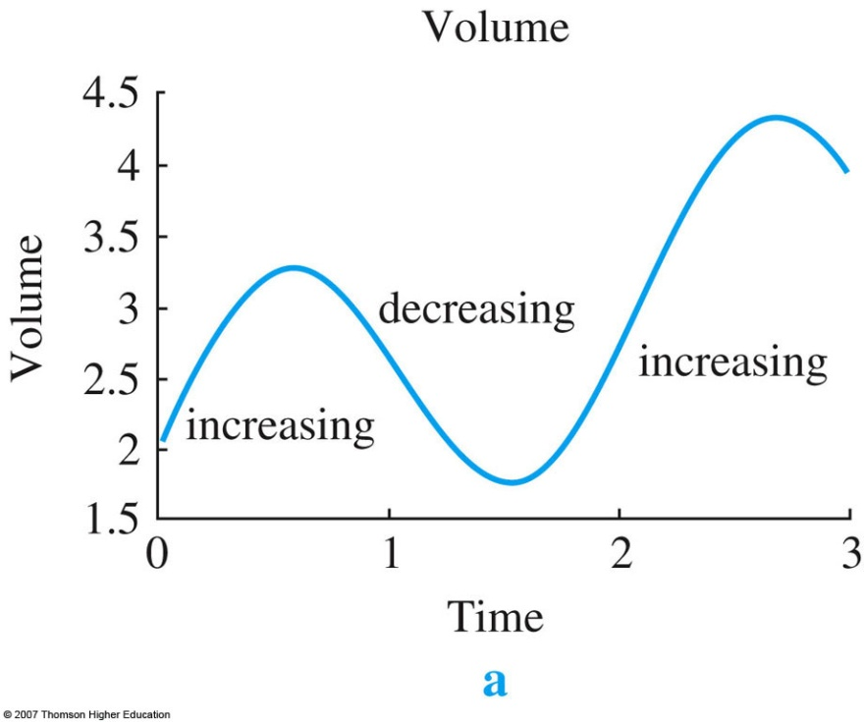
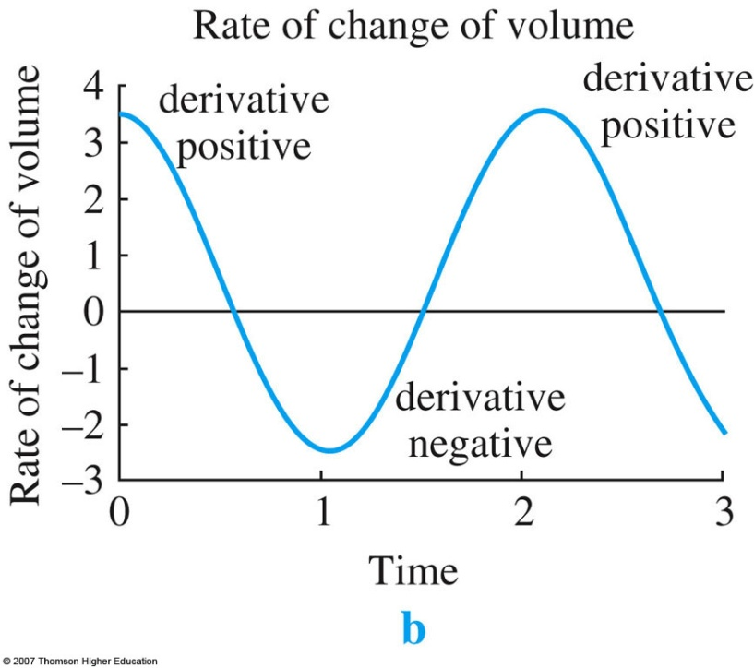
Graphs of Derivatives

Slide 26
Finding Formula for Derivative
Guess a formula for the derivative of
$$f\left(x\right)= x^{2}$$

Slide 27
Finding Formula for Derivative
Use ARC to estimate values of f ’(1), f ’(2) and f ’(3)
$$f\left(x\right)= x^{2}$$

Slide 28
$$f\left(x\right)= x^{2}$$
$$f^{′}\left(1\right)≈\frac{f\left(1+0.001\right)−f\left(1\right)}{0.001}=\frac{{1.001}^{2}−1^{2}}{0.001}=2$$
$$f^{′}\left(2\right)≈\frac{f\left(2+0.001\right)−f\left(2\right)}{0.001}=\frac{{2.001}^{2}−2^{2}}{0.001}=4$$
Suggests f ’(x) = 2x
$$f^{′}\left(3\right)≈\frac{f\left(3+0.001\right)−f\left(3\right)}{0.001}=\frac{{3.001}^{2}−3^{2}}{0.001}=6$$

