Slide 1
Mathematical Modeling
Setting Up Differential Equations

Slide 2
Setting up a Differential Equation
Suppose a population biologist wants to develop an equation that will forecast the population of an endangered animal.
By studying data on the population in the past, she can try to find a relationship between a population and its rate of change

Slide 3
Setting up a Differential Equation
A function that gives the rate of change of the population would be the derivative of the function describing the population itself.
A differential equation is an equation that involves an unknown function $y=f(x)$ and a finite number of its derivatives

Slide 4
Setting up a Differential Equation
Solving the differential equation for $y$would give the unknown function to be used for forecasting the population.

Slide 5
Example 1: Marine Harvesting
Fish population increases at a rate of 20% per year
Fish are caught by fishermen at a rate of 10 million fish per year

Slide 6
How does the fish population change over time?
$$Rate of Change=Rate of Increase −Rate of Decrease$$
Total Fish population
Reproduction
Fishing

Slide 7
How does the fish population change over time?
$$Rate of Change=Rate of Increase −Rate of Decrease$$
Let P = the number of fish (million)
t = time in years
Rate fish removed by harvesting = 10 million fish/year
$$\frac{change in the population}{change in time}=\frac{dP}{dt}=0.2P−10$$
Rate of increase due to breeding = 20% $∙$ current population = 0.20P million fish/year

Slide 8
This is a differential equation that models how the fish population changes.
The unknown quantity in the equation is the function that gives Population in terms of time

Slide 9
Example 2: Quantity of a Drug in the Body
Patient undergoing major surgery is given antibiotic intravenously at a rate of 85 mg per hour
Rate the drug is excreted from body is proportional to amount present with proportionality constant equal to 0.1 if time is in hours
That is, 10% of the drug is excreted per hour

Slide 10
Write differential equation describing how quantity of drug in patient’s body changes over time
Rate of change of amount of drug = Rate in – Rate out
Quantity is decreasing at a rate of 0.1 times the quantity
Quantity of the drug is increasing at a constant rate of 85 mg/hour

Slide 11
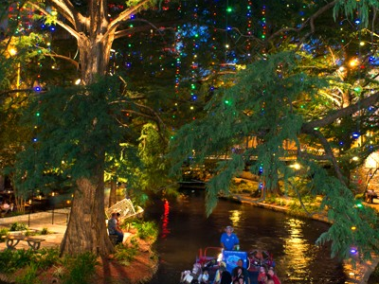
Example 3: Exponential Population Growth
Population of San Antonio is currently growing at a rate of about 2% per year

Slide 12
Example 3: Exponential Population Growth
$P$ = number of people in San Antonio
$t$ = time in years
$$\frac{dP}{dt}=0.02P$$
What will happen as time goes on?

Slide 13
Investigate Rate of Change of the Population for a Wide Range of Population Values
Population | Rate of Change
0 | 0
50,000 | 1000
100,000 | 2000
500,000 | 10,000
1,000,000 | 20,000
1,500,000 | 30,000
2,000,000 | 40,000
2,100,000 | 42,000
No growth
Growth increasing
Growth slowing down

Slide 14
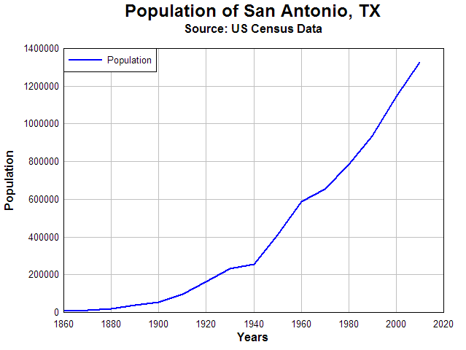

Slide 15
Example 4: Logistic Population Growth
Population growth rate slows down when population gets large enough
Environment can only support a certain number of individuals, this number of individuals is called the carrying capacity

Slide 16
Logistic Growth Model
Growth rate $r$changes as population size changes
Growth rate is $r\left(1 −\frac{P}{K}\right)$
If Population is small, $P≈0$, growth rate is $≈r$
If Population is large , $P≈K$, growth rate is $≈$0

Slide 17
Logistic Growth Model
What will happen as time goes on?

Slide 18
Investigate Rate of Change of the Population for a Wide Range of Population Values
Population | Rate of Change
0 | 0
50,000 | 975
100,000 | 1,900
500,000 | 7,500
1,000,000 | 10,000
1,500,000 | 7,500
2,000,000 | 0
2,100,000 | -2,100

Slide 19
Euler’s Method
Predicting future values using differential equations
Know current value
Calculate rate of change at current value
Predict a little bit into the future
It’s the tangent line approximation again!

Slide 20
Euler’s Method
Start with an initial value,
say 1,327,606 people in San Antonio in 2010
Rate of Growth in 2010 is $1,327,606 ∙0.02=26,552.12\frac{people}{year}$
Predict the number of people in 2011
$$1,327,606+26,552.12\frac{people}{year}∙1 year=1,354,158.12 people$$

Slide 21
Tangent Line Approximation

Slide 22
Euler’s Method in General

Slide 23
Euler’s Method with a step-size $h=1$
$$\frac{dP}{dt}=P^{′}\left(t\right)=0.02P\frac{ppl}{year} and P\left(2010\right)=1,327,606 ppl$$
$$1,327,606 people+26,552.12\frac{ppl}{year} ∙1 year=1,354,158.12 ppl$$
$$P\left(2010\right)+P^{′}\left(2010\right)∙\left(2011−2010\right)=P(2011)$$
$$P\left(2011\right)=1,354,158.12$$
Use prediction for 2011 to predict 2012:
$$P\left(2012\right)=P\left(2011\right)+P^{′}\left(2011\right)∙\left(2012 −2011\right)$$
$$P\left(2012\right)=1,354,158.12+ (1,354,158.12)(0.02)∙ \left(1\right)=1,381,241.28$$
Notes:
EULER’S METHOD

Slide 24
Notes:
EULERS METHOD

Slide 25
Euler’s Method with a step-size h=2
Versus
Which is more accurate?
Notes:
EULER’S METHOD

