Slide 1
Slope Fields
One way to find solution to
differential equations

Slide 2
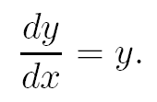
The slope of the graph is equal to its y coordinate
Differential Equation
If the solution goes through the point (0,1), the slope there is 1; if it goes through a point y = 4, it’s slope there is 4.

Slide 3
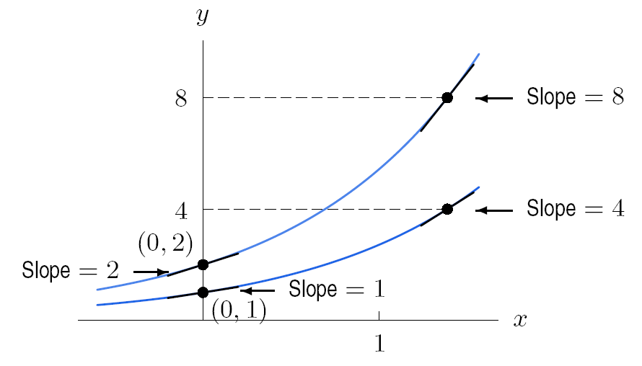
The slope of the graph is equal to its y coordinate
Solution to

Slide 4
The slope at the point (0,2) would be 2 because y = 2
Solution to

Slide 5
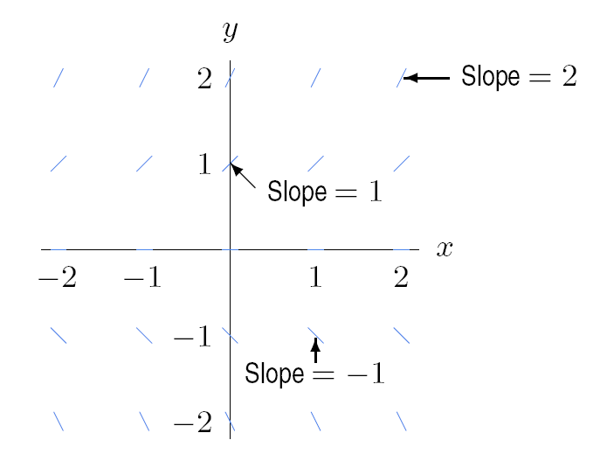
A small line segment is drawn to represent the slope of the curve at that point.
Visualizing the slope of y, if

Slide 6
If we draw MANY of these lines we have what is called a SLOPE FIELD
Visualizing the slope of y, if

Slide 7
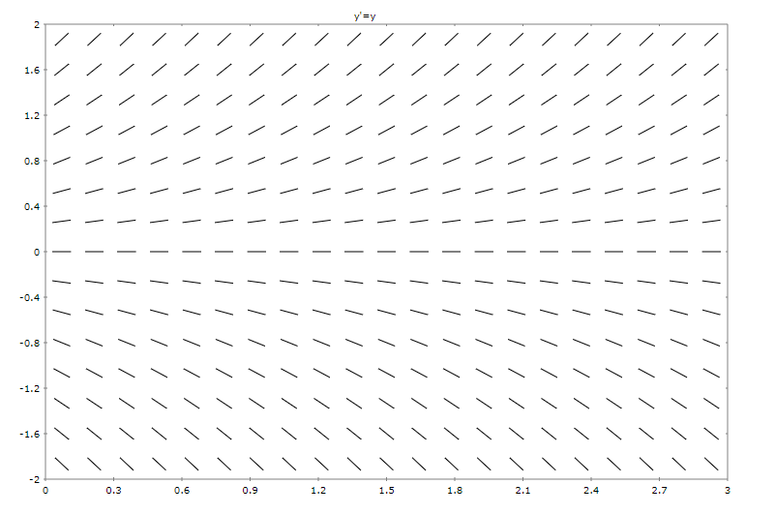
Positive slopes because y is positive
Negative slopes because y is negative
Slope field for

Slide 8
Slopes increase as y increases
Slope field for

Slide 9
Constant slope
Slope field for

Slide 10
Slopes decreases as y decreases
Slope field for

Slide 11
Ghost of a solution curve
Slope field for

Slide 12
Start anywhere and trace the slope lines that are tangent to your path
Slope field for

Slide 13
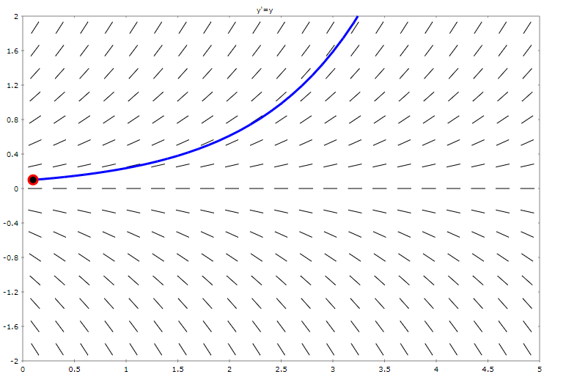
Exponential shape where $y=e^{x}$ is a solution to this differential equation
Slope field for

Slide 14
Family of solutions curves
For any constant C
Exponential shape where $y=Ce^{x}$ is a solution to this differential equation
Slope field for

Slide 15
Check it!
$$\frac{dy}{dx}=y$$
$$\frac{dy}{dx}=Ce^{x}$$
$$y=Ce^{x}$$
Look the same to me!

Slide 16
Example $\frac{dy}{dx}=2x$

Slide 17
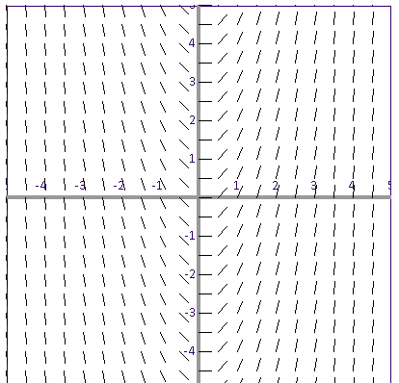
Example $\frac{dy}{dx}=2x$

Slide 18
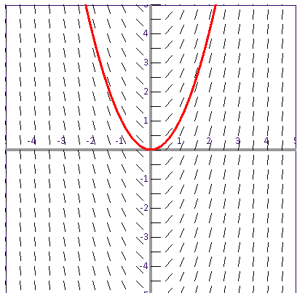
Example $\frac{dy}{dx}=2x$
Which we knew by taking antiderivative of 2x
Solution curve of parabolas $y=x^{2}+c$

Slide 19
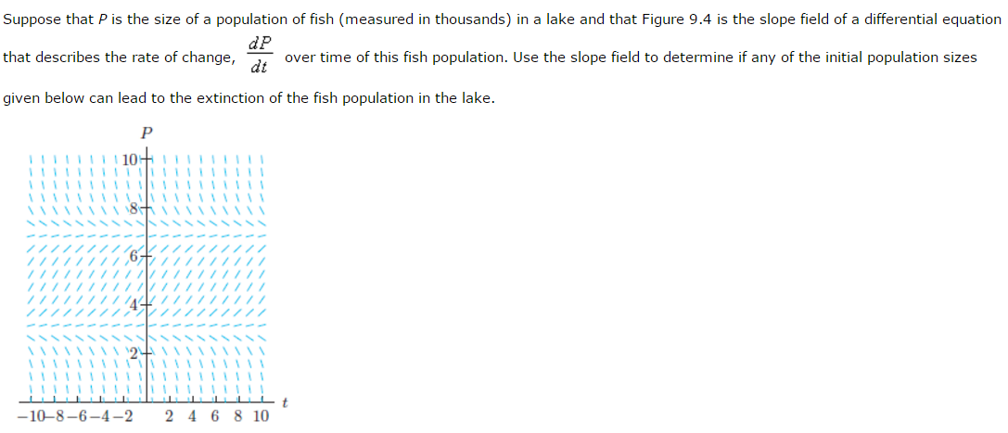
1000 fish
5000 fish
7000 fish
8000 fish
Start of the population means P(0) = population

