Slide 1
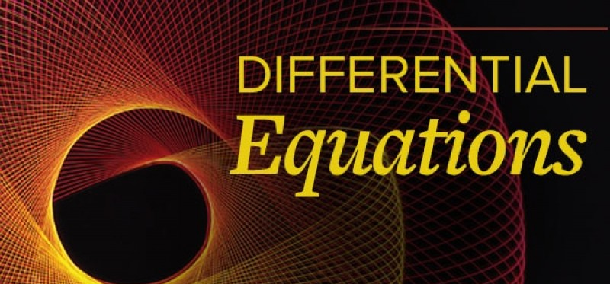
Solutions of Differential Equations

Slide 2
Differential Equations
A differential equation is an equation involving the derivative of an unknown function.
A solution to a differential equation is any function that satisfies the differential equation
Solutions can be estimated numerically using Euler’s method (Tangent Line Approximation)
Sometimes exact formulas for solutions can be found
Separation of Variables (lecture after Slope Fields)

Slide 3
Fish Population Example
Population increases at a continuous rate of 20% per year
The fish are being harvested at a constant rate of 10 million fish per year
P = fish population, in millions, in year t
Rate In – Rate Out

Slide 4
Fish Population Example
Find a function, giving P in terms of t
Suppose at t = 0 the fish population is 60 million
Substitute P into the differential equation to compute the derivative
At time t = 0 then P(0) = 60

Slide 5
Fish Population Example
Find a function, giving P in terms of t
Suppose at t = 0 the fish population is 60 million
Substitute P into the differential equation to compute the derivative
At time t = 0
What does this value mean?

Slide 6
Fish Population Example
Find a function, giving P in terms of t
Suppose at t = 0 the fish population is 60 million
Substitute P into the differential equation to compute the derivative
At time t = 0
At t = 0, the fish population is changing at the rate of 2 million fish a year.
At the end of the first year, the fish population = 62, that is at t = 1, P = 62

Slide 7
Fish Population Example
Use this new value to estimate the rate during the second year
At t = 1, the fish population is changing at the rate of 2.4 million fish a year.
At the end of the second year, the fish population = 62+2.4=64.4, that is at t = 2, P = 64.4

Slide 8
Fish Population Example

Slide 9
Formulas for the Solution to a Differential Equation

Slide 10
Formula
A function P = f(t) which satisfies the differential equation
is called the solution of the differential equation

Slide 11
Formula
Not always easy to find
Table showed approximate numerical values
Sometimes possible to find a formula for the solution

Slide 12
Formula
Given formula: $P=50+Ce^{0.20t}$ where C is any constant

Slide 13
Formula
Check the formula: $P=50+Ce^{0.20t}$
Substitute left and right sides of the differential equation separately

Slide 14
Formula
$$\frac{dP}{dt}=0.20P−10$$
$P=50+Ce^{0.20t}$
Left side which is $\frac{dP}{dt}$
Which says find the derivative of the function $P=50+Ce^{0.20t}$
$\frac{dP}{dt}=0.20Ce^{0.20t}$

Slide 15
Formula
$$\frac{dP}{dt}=0.20P−10$$
$P=50+Ce^{0.20t}$
Right side = $0.20P −10$

Slide 16
Formula
$P=50+Ce^{0.20t}$
Right side = $0.20P −10$
$=0.20\left(50+Ce^{0.20t}\right)−10$

Slide 17
Formula
$P=50+Ce^{0.20t}$
Right side = $0.20P −10$
$=0.20\left(50+Ce^{0.20t}\right)−10$ $=10+0.20Ce^{0.20t}−10$
$$=0.20Ce^{0.20t}$$

Slide 18
Formula
$P=50+Ce^{0.20t}$
Right side = $0.20P −10$
$=0.20\left(50+Ce^{0.20t}\right)−10$ $=10+0.20Ce^{0.20t}−10$
$$=0.20Ce^{0.20t}$$
Left side = $\frac{dP}{dt}=0.20Ce^{0.20t}$

Slide 19
Formula
Because we got the same expression on both sides, we say that $P=50+Ce^{0.20t}$ is a solution of this differential equation
Where any choice of C works

Slide 20
Finding Value for Constant, C
Select a single solution
Need initial population
Given P = 60 when t = 0

Slide 21
Finding Value for Constant, C
Select a single solution
Need initial population
Given P = 60 when t = 0
Substitute $60=50+Ce^{0.20(0)}$

Slide 22
Finding Value for Constant, C
Select a single solution
Need initial population
Given P = 60 when t = 0
Substitute $60=50+Ce^{0.20(0)}$
Solve for C gives C = 10
Thus $P=50+10e^{0.20t}$ would be a solution when P = 60 and t = 0

Slide 23
Euler’s Method
Fill in the missing values in the table given that $\frac{dy}{dt}=0.5y$.
Assume the rate of growth, given by $\frac{dy}{dt},$is approximately constant over each unit time interval.
t | 0 | 1 | 2 | 3 | 4
y | 12

Slide 24
Euler’s Method
$$\frac{dy}{dt}=0.5y$$
t | 0 | 1 | 2 | 3 | 4
y | 12
We know that at time t = 0, y = 12

Slide 25
Euler’s Method
$$\frac{dy}{dt}=0.5y$$
t | 0 | 1 | 2 | 3 | 4
y | 12 | 18
$\frac{dy}{dt}=0.5$(12) = 6 which says the increase is 6 from 12 to 18

Slide 26
Euler’s Method
$$\frac{dy}{dt}=0.5y$$
t | 0 | 1 | 2 | 3 | 4
y | 12 | 18 | 27
$\frac{dy}{dt}=0.5$(18) = 9 which says the increase is 9 from 18 to 27

Slide 27
Euler’s Method
$$\frac{dy}{dt}=0.5y$$
t | 0 | 1 | 2 | 3 | 4
y | 12 | 18 | 27 | 40.5
$\frac{dy}{dt}=0.5$(27) = 13.5 which says the increase is 13.5 from 27 to 40.5

Slide 28
Euler’s Method
$$\frac{dy}{dt}=0.5y$$
t | 0 | 1 | 2 | 3 | 4
y | 12 | 18 | 27 | 40.5 | 60.75
$\frac{dy}{dt}=0.5$(40.5) = 20.25 which says the increase is 20.25 from 40.5 to 60.75

