Slide 1
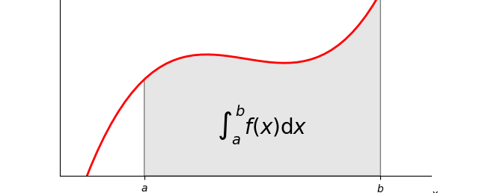
More of FTC (Applications)

Slide 2
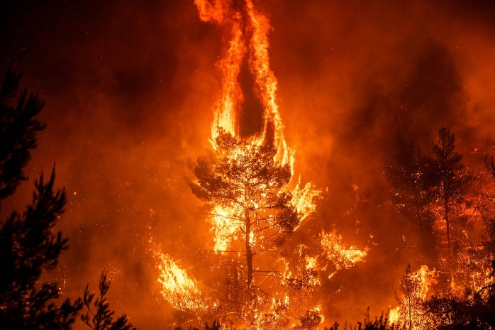
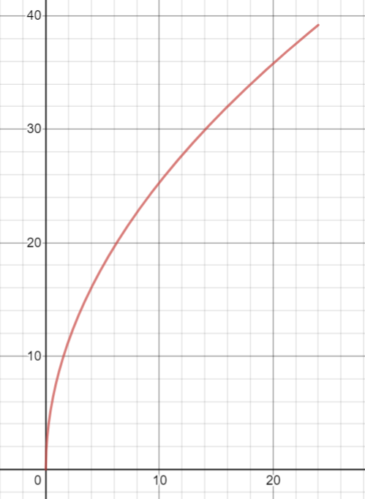
A forest fire covers 2015 acres at time t = 0.
The fire is growing at a rate of $8\sqrt{t}$ acres per hours, where t is in hours.
How many acres are covered 24 hours later? (Round to the nearest integer)
FTC Application Example 1

Slide 3
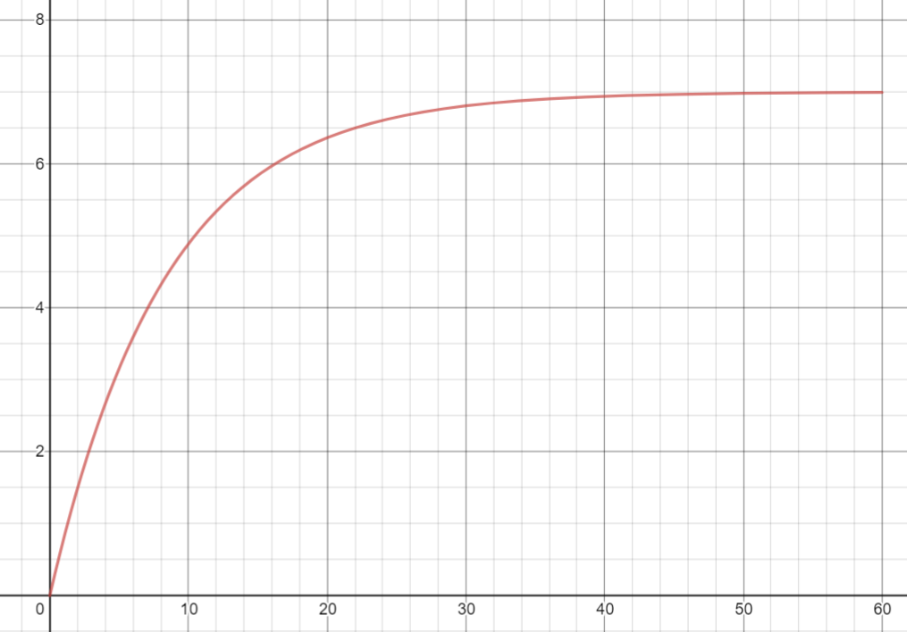
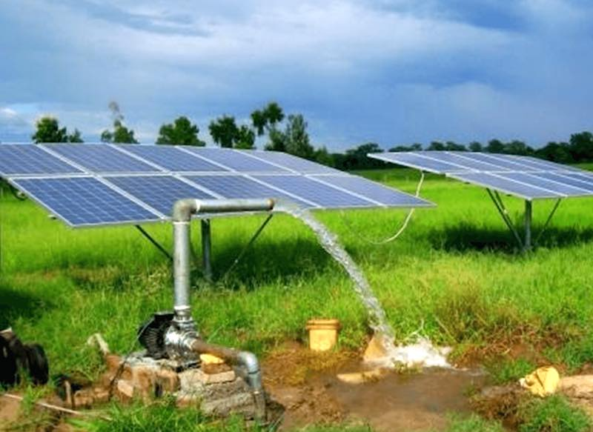
Water is pumped out of a holding tank at a rate of $7−7e^{−0.12t}$ liters/minute where t is in minutes since the pump started.
If the holding tank contains 1000 liters of water when the pump is started, how much water does it hold one hour later?
FTC Application Example 2

Slide 4
Average Value
Average value of $f$ on the interval from $a$ to $b$
$$\frac{1}{b−a}\int_{a}^{b}{f\left(x\right) dx}$$

Slide 5
Example: Average Value
Find the average value of $f\left(x\right)=\sin\left(x\right)$ on $\left[0,π\right]$
$$\frac{1}{b−a}\int_{a}^{b}{f\left(x\right) dx}$$
$$\frac{1}{π−0}\int_{0}^{π}{sin\left(x\right) dx}$$

Slide 6
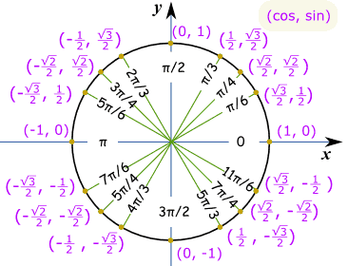
Example: Average Value
$$\frac{1}{π−0}\int_{0}^{π}{sin\left(x\right) dx}$$
$$\frac{1}{π}\left[−\cos\left(x\right)\right]$$
$$\frac{1}{π}\left[−\cos\left(π\right)−\left(−\cos\left(0\right)\right)\right]=\frac{1}{π}\left[−\left(−1\right)+1\right]=\frac{1}{π}\left(2\right)=\frac{2}{π}≈0.6366$$
$$π$$
0
Reasonable as $sin⁡(x)$ varies between 0 to 1 on the interval 0 and $π$

Slide 7
Values of Constants
Reminder: Indefinite Integral (Family of functions with constant C)
$$\int{f\left(x\right)dx}=F\left(x\right)+C$$

Slide 8
Example: Bacteria Population
Suppose that a population of bacteria grows at a rate that slows down with time, so that the growth rate after $t$ days is given by
$$p\left(t\right)=\frac{5000}{\sqrt{t}} for t≥1$$
Suppose that when $t=1$, the population is $25,000$.
Find the function $P(t)$ giving the population at time $t$.

Slide 9
Example: Bacteria Population
Given rate: $p\left(t\right)=\frac{5000}{\sqrt{t}}$
Find: $P(t)$ ← original function
$$P\left(t\right)=\int{\frac{5000}{\sqrt{t}} dt}$$
$$=5000\int{t^{−1/2} dt}$$
$$=5000\frac{t^{−\frac{1}{2}+\frac{2}{2}}}{−\frac{1}{2}+\frac{2}{2}}$$

Slide 10
Example: Bacteria Population
$$=5000\frac{t^{−\frac{1}{2}+\frac{2}{2}}}{−\frac{1}{2}+\frac{2}{2}}=5000\frac{t^{1/2}}{\frac{1}{2}}=5000\left(\frac{2}{1}\right)t^{1/2}=10,000t^{1/2}+C$$

Slide 11
Example: Bacteria Population
Given rate: $p\left(t\right)=\frac{5000}{\sqrt{t}}$
Find: $P(t)$ ← original function
$$P\left(t\right)=\int{\frac{5000}{\sqrt{t}} dt}=10,000t^{1/2}+C$$
How to find C?
GIVEN information: Suppose that when $t=1$, the population is $25,000$

Slide 12
Example: Bacteria Population
Suppose that when $t=1$, the population is $25,000$.
$$P\left(t\right)=10,000t^{1/2}+C$$
$$25,000=10,000 {\left(1\right)}^{1/2}+C$$
$$15,000=C$$
$$∴P\left(t\right)=10,000t^{1/2}+15,000$$

Slide 13
Example: Bacteria Population
How many days will it take for the population to reach 115,000?
$$P\left(t\right)=10,000t^{1/2}+15,000$$
$$115,000=10,000 t^{1/2}+15,000$$
$$100,000=10,000 t^{1/2}$$
$$10=t^{1/2}$$
$$100=t$$
The population will reach 115,000 after 100 days

Slide 14
Example: Yeast Culture
A yeast culture weighing 2 grams is removed from a refrigerator unit and is expected to grow at the rate of $w\left(t\right)=0.4 e^{0.2t}$ grams per hour at a higher controlled temperature.
How much will the weight of the culture increase during the first 7 hours of growth?
How much will the weight of the culture increase from the end of the 7th hour to the end of the 14th hour of growth?

Slide 15
Example: Yeast Culture
A yeast culture weighing 2 grams is removed from a refrigerator unit and is expected to grow at the rate of $w\left(t\right)=0.4 e^{0.2t}$ grams per hour at a higher controlled temperature.
How much will the weight of the culture increase during the first 7 hours of growth?
$$\int{04.e^{0.2t} dt}$$
What goes here?

Slide 16
Example: Yeast Culture
A yeast culture weighing 2 grams is removed from a refrigerator unit and is expected to grow at the rate of $w\left(t\right)=0.4 e^{0.2t}$ grams per hour at a higher controlled temperature.
How much will the weight of the culture increase during the first 7 hours of growth?
$$\int_{0}^{7}{0.4e^{0.2t} dt}$$
$$0.4\left(\frac{1}{0.2}\right)e^{0.2t}$$
7
0

Slide 17
Example: Yeast Culture
A yeast culture weighing 2 grams is removed from a refrigerator unit and is expected to grow at the rate of $w\left(t\right)=0.4 e^{0.2t}$ grams per hour at a higher controlled temperature.
How much will the weight of the culture increase during the first 7 hours of growth?
$$0.4\left(\frac{1}{0.2}\right)e^{0.2t}$$
$$2e^{0.2(7)}−2e^{0.2\left(0\right)}≈6.11$$
7
0
What are the units?

Slide 18
Example: Yeast Culture
A yeast culture weighing 2 grams is removed from a refrigerator unit and is expected to grow at the rate of $w\left(t\right)=0.4 e^{0.2t}$ grams per hour at a higher controlled temperature.
How much will the weight of the culture increase during the first 7 hours of growth?
$$0.4\left(\frac{1}{0.2}\right)e^{0.2t}$$
$$2e^{0.2(7)}−2e^{0.2\left(0\right)}≈6.11$$
7
0
The weight increase is about 6.11 grams

Slide 19
Example: Yeast Culture
A yeast culture weighing 2 grams is removed from a refrigerator unit and is expected to grow at the rate of $w\left(t\right)=0.4 e^{0.2t}$ grams per hour at a higher controlled temperature.
How much will the weight of the culture increase from the end of the 7th hour to the end of the 14th hour of growth?

Slide 20
Example: Yeast Culture
A yeast culture weighing 2 grams is removed from a refrigerator unit and is expected to grow at the rate of $w\left(t\right)=0.4 e^{0.2t}$ grams per hour at a higher controlled temperature.
How much will the weight of the culture increase from the end of the 7th hour to the end of the 14th hour of growth?
$$\int_{7}^{14}{04.e^{0.2t} dt}$$
$$2e^{0.2t}$$
14
7

Slide 21
Example: Yeast Culture
A yeast culture weighing 2 grams is removed from a refrigerator unit and is expected to grow at the rate of $w\left(t\right)=0.4 e^{0.2t}$ grams per hour at a higher controlled temperature.
How much will the weight of the culture increase from the end of the 7th hour to the end of the 14th hour of growth?
$$2e^{0.2t}$$
$$2e^{0.2(14)}−2e^{0.2\left(7\right)}=24.78$$
14
7
The weight increase from the 7th to the 14th hour is about 24.78 grams

Slide 22
Example: Oil Company
Suppose that the rate of consumption of a natural resource is $c′(t)$, where $c^{′}\left(t\right)=ke^{rt}$.
Here $t$ is time in years, $r$ is a constant and $k$ is the consumption in the year when $t=0$.
In 2010, an oil company sold 2.1 billion barrels of oil. Assume that $r=0.10$.
Write $c′(t)$ for the oil company, letting $t=0$ represent 2010.
$$c^{′}\left(t\right)=2.1e^{0.10t}$$

Slide 23
Example: Oil Company
Set up a definite integral for the amount of oil that the company will sell in the next 10 years.
$$c^{′}\left(t\right)=2.1e^{0.10t}$$
$$\int_{0}^{10}{2.1e^{0.10t} dt}$$

Slide 24
Example: Oil Company
Evaluate the integral
$$\int_{0}^{10}{2.1e^{0.10t} dt}$$
$$2.1\left(\frac{1}{0.10}\right)e^{0.10t}$$
10
0

Slide 25
Example: Oil Company
Evaluate the integral
$$\int_{0}^{10}{2.1e^{0.10t} dt}$$
$$2.1\left(\frac{1}{0.10}\right)e^{0.10t}=21e^{0.10(10)}−21e^{0.10\left(0\right)}=36.08$$
10
0
36.08 billions of barrels of oil

Slide 26
Example: Oil Company
The company has about 20 billion barrels of oil in reserve. Find the number of years this amount will last.
$$20= \int_{0}^{T}{2.1e^{0.10t} dt}$$
Want to solve for t

Slide 27
$$20= \int_{0}^{T}{2.1e^{0.10t} dt}$$
$$20=21e^{0.10T}−21e^{0.10(0)}$$
$$20=21e^{0.10T}−21$$
$$41=21e^{0.10T}$$
$$\frac{41}{21}=e^{0.10T}$$
$$\ln\left(\frac{41}{21}\right)=\ln\left(e^{0.10T}\right)$$
$$\ln\left(\frac{41}{21}\right)=0.10T$$
$$\frac{\ln\left(\frac{41}{21}\right)}{0.10}=T$$
$$T=6.7 years$$

