Slide 1
Average Rate of Change vs. Instantaneous Rate of Change
Bio Calculus

Slide 2
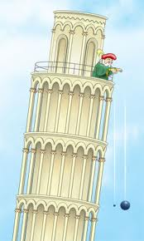
Galileo’s Free Fall Law
FREE FALL
Dropped a solid object from rest with the fall distance proportional to the square of the time it has been falling

Slide 3
Galileo’s Free Fall Law
FREE FALL
Dropped a solid object from rest with the fall distance proportional to the square of the time it has been falling
Let y = distance fallen in feet after t seconds

Slide 4
Galileo’s Free Fall Law
Constant of proportionality

Slide 5
Galileo’s Free Fall Law
Distance fallen
measured in feet
Distance fallen
measured in meters

Slide 6
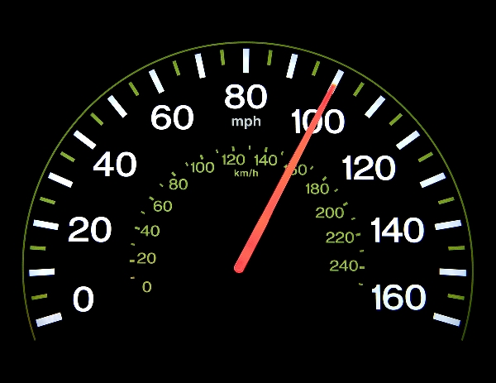
How do you find AVERAGE speed?

Slide 7
How do you find AVERAGE speed?
Distance covered
Think about $\frac{miles}{hour}$
Time elapsed
$$\frac{change in distance}{length of time interval}$$

Slide 8
Example: Average Rate of Change
You committed a murder!
The cops have you surrounded at the top of the Towers of America (750 feet up)
You drop the murder weapon over the side.

Slide 9
Example: Average Rate of Change
You committed a murder!
The cops have you surrounded at the top of the Towers of America (750 feet up)
You drop the murder weapon over the side.
What is the average speed the murder weapon is traveling the first two seconds of the fall?

Slide 10
How do you find AVERAGE speed?
Distance covered
Think about $\frac{feet}{seconds}$
Time elapsed
$$\frac{change in distance}{length of time interval}$$

Slide 11
Average Speed
So an object’s average speed (toaster) during an interval of time is found by dividing the distance covered by the time elapsed
$$\frac{change in distance}{length of time interval}$$

Slide 12
Example: Average Rate of Change
You drop the murder weapon from the top of the tower
What is the average speed the toaster is traveling the first two seconds of the fall?
In other words from time = 0 to time = 2 (in seconds)

Slide 13
Average Rate of Change Formula

Slide 14
Galileo’s Free Fall Law

Slide 15
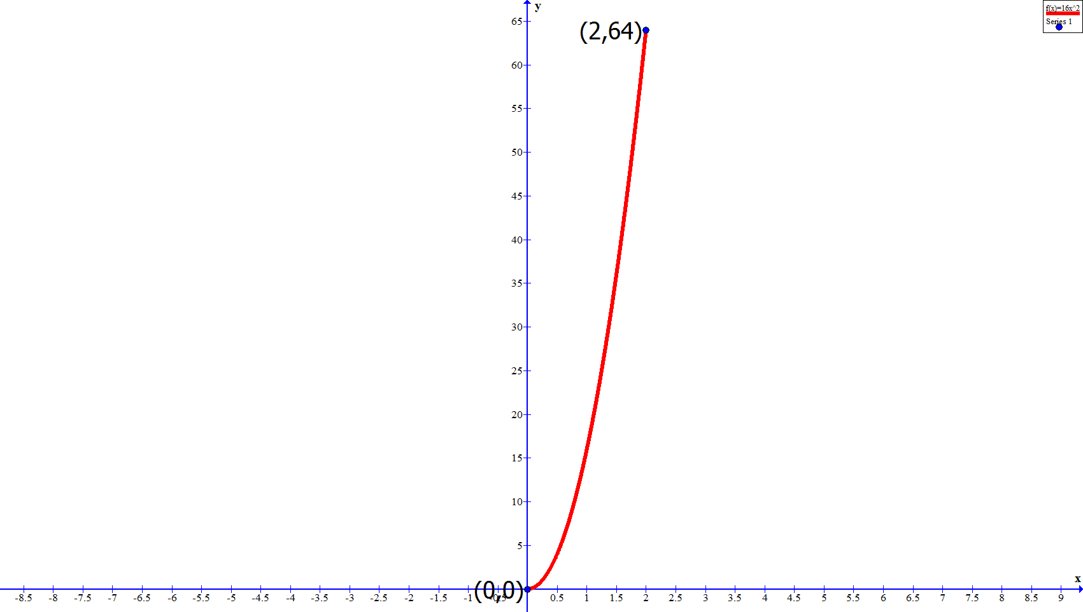
Graph it!

Slide 16
Graph it!
(64-0)/(2-0) = 32

Slide 17
Example: Average Rate of Change
What is the average speed during the 1-second interval between second 1 and second 2?

Slide 18
“Instantaneous” Rate of Change
We want to determine speed of the murder weapon at “any second” of time $t_{0}$ instead of intervals of time

Slide 19
“Instantaneous” Rate of Change
We want to determine speed at “any second” of time $t_{0}$ instead of intervals of time
Let the time intervals get smaller and smaller
t₀
time

Slide 20
“Instantaneous” Rate of Change
$$\frac{change in distance}{length of time interval}$$
We want to determine speed at “any second” of time $t_{0}$ instead of intervals of time
Let the time intervals get smaller and smaller
t₀
t₁
time
Average Rate of Change$=\frac{f\left(t_{1}\right)−f(t_{0})}{t_{1}−t_{0}}$

Slide 21
“Instantaneous” Rate of Change
$$\frac{change in distance}{length of time interval}$$
We want to determine speed at “any second” of time $t_{0}$ instead of intervals of time
Let the time intervals get smaller and smaller
Let’s call this distance h
t₀
time
t₀ + h
Average Rate of Change$=\frac{f\left(t_{1}\right)−f(t_{0})}{t_{1}−t_{0}}$

Slide 22
“Instantaneous” Rate of Change
$$\frac{change in distance}{length of time interval}$$
We want to determine speed at “any second” of time $t_{0}$ instead of intervals of time
Let the time intervals get smaller and smaller
t₀
time
t₀ + h
h
Distance = $∆t=\left(t_{0}+h\right)−t_{0}=h$
Instantaneous Rate of Change$=\frac{f\left(t_{0}+h\right)−f(t_{0})}{h}$

Slide 23
“Instantaneous” Rate of Change
$$\frac{change in distance}{length of time interval}$$
We want to determine speed at “any second” of time $t_{0}$ instead of intervals of time
Let the time intervals get smaller and smaller
t₀
time
t₀ + h
h
Instantaneous Rate of Change$=\frac{f\left(t_{0}+h\right)−f(t_{0})}{h}$

Slide 24
“Instantaneous” Rate of Change
$$\frac{change in distance}{length of time interval}$$
We want to determine speed at “any second” of time $t_{0}$ instead of intervals of time
Let the time intervals get smaller and smaller
t₀
time
t₀ + h
h
Instantaneous Rate of Change$=\frac{f\left(t_{0}+h\right)−f(t_{0})}{h}$

Slide 25
“Instantaneous” Rate of Change
$$\frac{change in distance}{length of time interval}$$
We want to determine speed at “any second” of time $t_{0}$ instead of intervals of time
Let the time intervals get smaller and smaller
t₀
t₀ + h
time
h
Instantaneous Rate of Change$=\frac{f\left(t_{0}+h\right)−f(t_{0})}{h}$

Slide 26
“Instantaneous” Rate of Change
$$\frac{change in distance}{length of time interval}$$
We want to determine speed at “any second” of time $t_{0}$ instead of intervals of time
How small to make the distance?
t₀
t₀ + h
time
h
Instantaneous Rate of Change$=\frac{f\left(t_{0}+h\right)−f(t_{0})}{h}$

Slide 27
“Instantaneous” Rate of Change
$$\frac{change in distance}{length of time interval}$$
We want to determine speed at “any second” of time $t_{0}$ instead of intervals of time
How small to make the distance?
What are you measuring? PRECISION MATTERS
t₀
t₀ + h
time
h
Instantaneous Rate of Change$=\frac{f\left(t_{0}+h\right)−f(t_{0})}{h}$

Slide 28
“Instantaneous” Rate of Change
Notice that we can let h (our distance of the time interval) get smaller and smaller but it can never equal zero
$$\frac{∆y}{∆t}=\frac{f(t_{0}+h)−f\left(t_{0}\right)}{h}$$
NOTE: This is still the SLOPE formula

Slide 29
Back to Murder Example
Time interval of 0.1 seconds
Between 1.1 and 1 second
For exactly 1 second
$$\frac{∆y}{∆t}=\frac{16{(1+0.1)}^{2}−16{(1)}^{2}}{0.1}=33.6 ft/sec$$

Slide 30
Example
Time interval of 0.01 seconds
Between 1.01 and 1 second
$$\frac{∆y}{∆t}=\frac{16{(1+0.01)}^{2}−16{(1)}^{2}}{0.01}=32.16 ft/sec$$

Slide 31
Example
Time interval of 0.001 seconds
Between 1.001 and 1 second
$$\frac{∆y}{∆t}=\frac{16{(1+0.001)}^{2}−16{(1)}^{2}}{0.001}=32.016 ft/sec$$

Slide 32
Example
As h gets smaller and smaller
t | h | speed
1 | 0.1 | 33.6
1 | 0.01 | 32.16
1 | 0.001 | 32.016
1 | 0.0001 | 32.0016
1 | 0.00001 | 32.00016
limit

Slide 33
LIMITS
Approaches a limiting values of 32 ft/sec as the time interval decreases
This suggest that the toaster is falling at a speed of 32 ft/sec at exactly t₀ = 1 second

Slide 34
CHECK IT!
Check Algebraically
$$\frac{∆y}{∆t}=\frac{16{(t_{0}+h)}^{2}−16({t_{0})}^{2}}{h}$$

Slide 35
CHECK IT!
Check Algebraically
$$\frac{∆y}{∆t}=\frac{16{(t_{0}+h)}^{2}−16({t_{0})}^{2}}{h}=\frac{16{(1+h)}^{2}−16{(1)}^{2}}{h}=\frac{16\left(1+2h+h^{2}\right)−16}{h}$$
$$=\frac{16+32h+16h^{2}−16}{h}=\frac{32h+16h^{2}}{h}=\frac{h(32+16h)}{h}=32+16h=32$$
Remember h is the time interval, so as h approaches 0, the LIMIT is 32 ft/sec
That is, 32 + 16(0) = 32

Slide 36
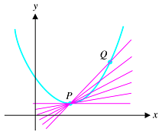
What are we doing?
Visualize

Slide 37
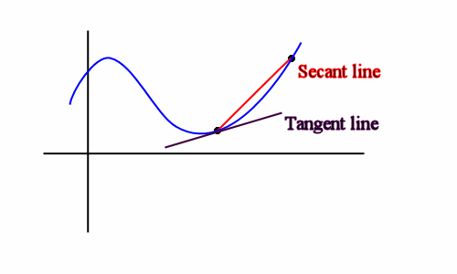
Secant Line vs. Tangent Line

Slide 38
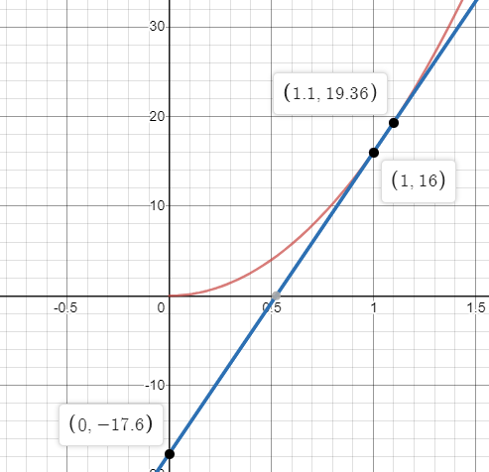
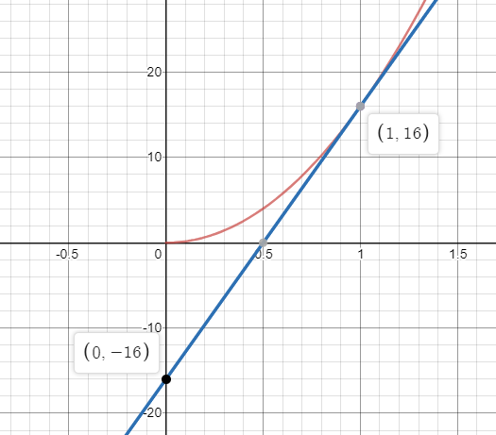
Secant Line
Tangent Line
y = 32x – 16
y = 33.6x – 17.6

Slide 39
Instantaneous Rate of Change
Math language
The instantaneous rate of change of a function f(x) at a point x = a is the limiting value of the average rate of change as the point x = a + h approaches x = a.
$$\lim_{h→0}{\frac{f(a+h)−f(a)}{h}}$$

Slide 40
ARC | IRC
Example: average speed | Example: instantaneous speed
Slope of secant line | Slope of tangent line
Small gap/error
0 gap/error

Slide 41
Instantaneous Rate of Change
Also called
Derivative
Slope of graph of function
Slope of tangent line to graph of function
NOTATION

