Slide 1

Calculus for the Bio Sciences
Lecture 1: Introduction to the Course and Review Material
Instructor: Cindy Roberts

Slide 2
What is Calculus?

Slide 3
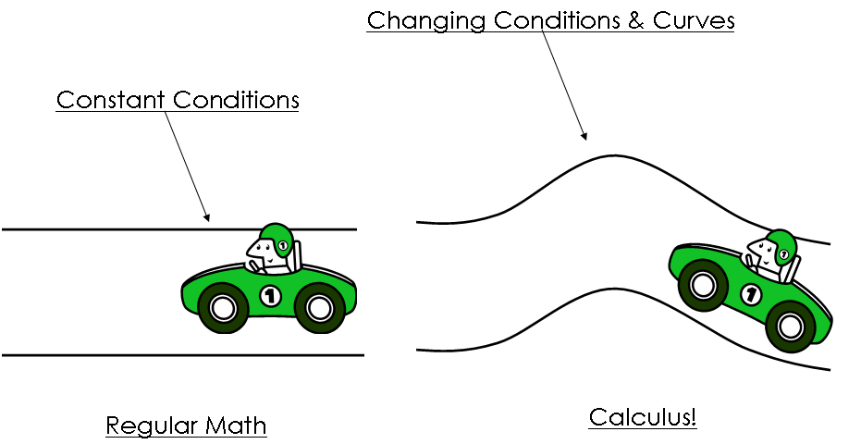
Mathematics of change

Slide 4
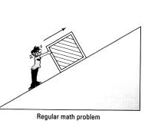
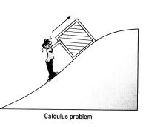
Mathematics of change
Unchanging
  Force
  Speed
Changing
  Steepness of incline
  Amount of energy

Slide 5
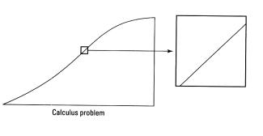
Make it linear

Slide 6
Who uses calculus?
“Mathematical modeling”

Slide 7
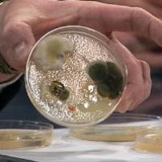
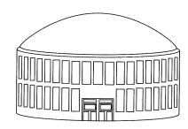
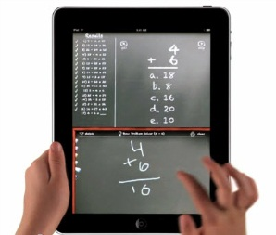
Who uses this stuff?
Science
  Bacterial Growth, Blood pressure, Cancer rates, Energy,
  Population growth, rate drug leaves/enters the body, examine
  surgery by mathematical models
Construction
  Football stadium
    Calculate area of a complicated, non spherical shape and
    cost of material, maximum force to withstand
Business (uncertainty)
  The sensitivity of demand to changes in price varies with product.
    Light bulbs (need) vs. iPad (want), Stock market prediction

Slide 8
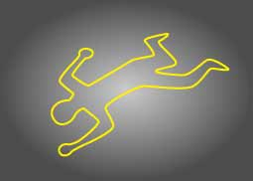
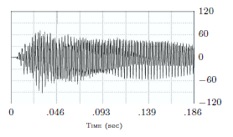
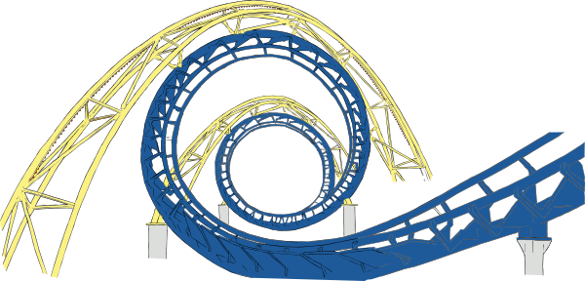
Who uses this stuff?
Forensic Scientists
  Estimated time of death using “Newton’s Law of Cooling”
Musicians
  Approximate wave functions (detect tones on guitar, pianos, etc.)
Engineers
  Mechanical analysis of systems to study position,
  speed and acceleration
  Designing shapes on items by computer to save
  money with a mathematical model first

Slide 9
Review material
Things You Should Already Know But May Have Forgotten!

Slide 10

Different forms of lines
Slope intercept $y=mx+b$
Point-Slope $y−y_{1}=m(x−x_{1})$
General $Ax+By=C$

Slide 11
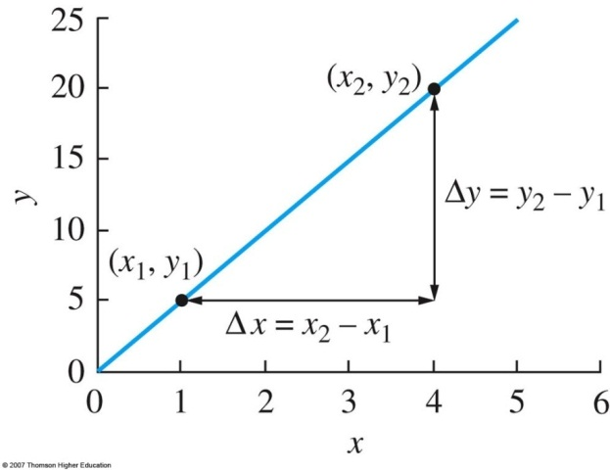
Slope-intercept form
Equation of a line y = mx + b
Slope of a line = m
Y-Intercept = b
Greek “delta” symbol

Slide 12
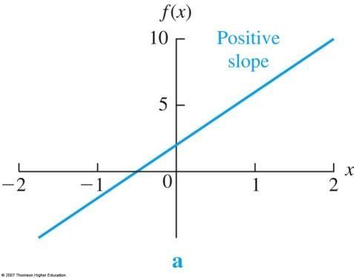
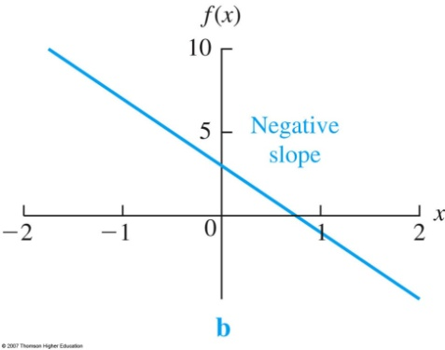
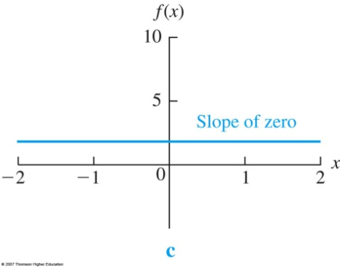
Slope properties
Positive Slope
  Graph: Lines Goes Up
  Function: Increasing
Negative Slope
  Graph: Line Goes Down
  Function: Decreasing
Zero Slope
  Graph: Flat
  Function: Constant

Slide 13

example
Given two points, find the equation of a line
  Point (0,2) and Point (2,3)
  Find the slope $\frac{3−2}{2−0}=\frac{1}{2}$
  Use point-slope form of a line and pick either point
  Point-Slope $y−2=\frac{1}{2}(x−0)$
  Solve for y
  $y=\frac{1}{2}x+2$

Slide 14
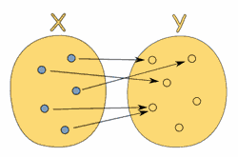
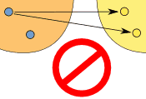
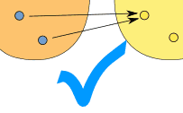
functions
Math Models
  Equation, graph, table, verbal representation
Relation
  Input/Outputs

Slide 15
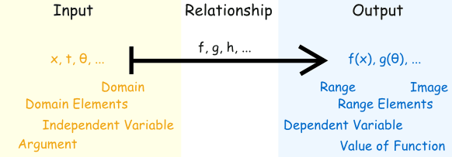

functions

Slide 16
Graphs of common functions

Slide 17


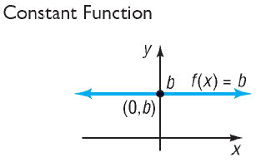
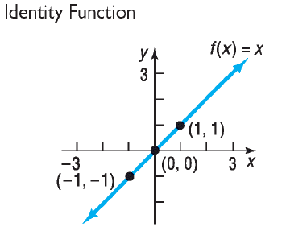


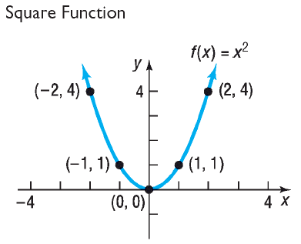
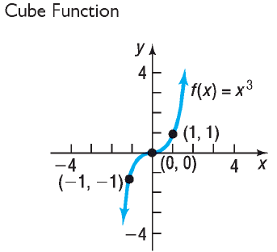
Quadratic Function
Cubic Function

Slide 18


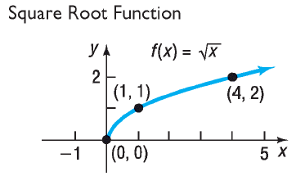
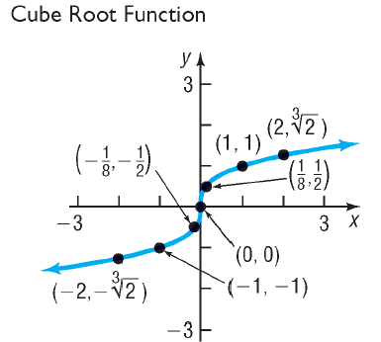
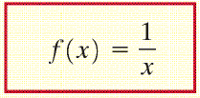

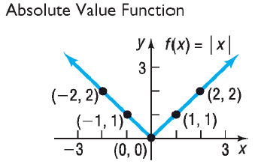
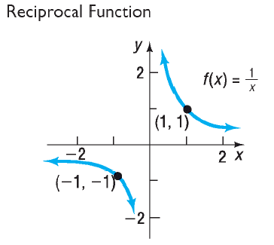

Slide 19
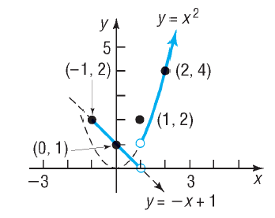
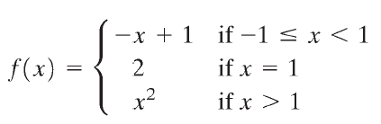
Piecewise function

Slide 20


example
A city’s population was 30,800 in the year 2000 and is growing by 850 people per year
Give a formula for the city’s population, $P$, as a function of the number of years,$t$, since 2000
$$P= 850t+30,800$$

Slide 21

example
A city’s population was 30,800 in the year 2000 and is growing by 850 people per year
Give a formula for the city’s population, $P$, as a function of the number of years,$t$, since 2000
Predict the population for 2010
$$P= 850\left(10\right)+30,800=39,300$$

Slide 22


example
A city’s population was 30,800 in the year 2000 and is growing by 850 people per year
Give a formula for the city’s population, $P$, as a function of the number of years,$t$, since 2000
When is the population expected to reach 45,000?
$$P= 850t+30,800$$
$$45,000= 850t+30,800$$

Slide 23





$$45,000= 850t+30,800$$
$$45,000−30,800= 850t$$
$$14,200= 850t$$
$$\frac{14,200}{850}=t$$
$$16.71 years=t$$
Don’t forget units!

Slide 24
Increasing/decreasing functions

Slide 25
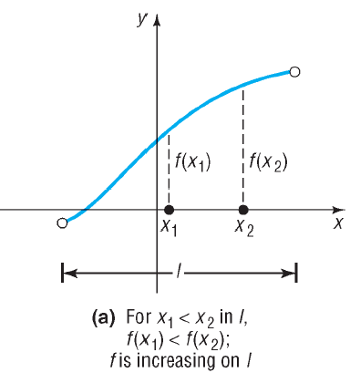

Slide 26
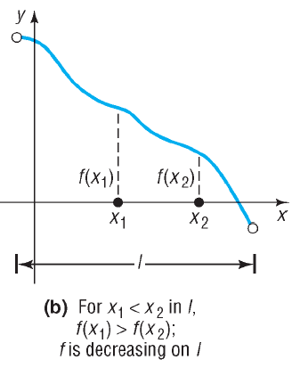

Slide 27
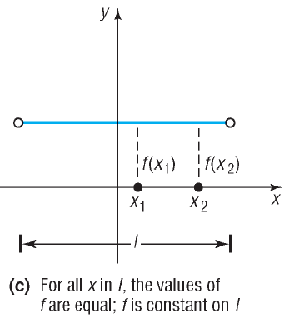

Slide 28
Minimum/maximum functions

Slide 29
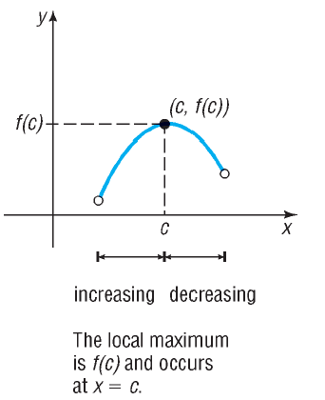

Slide 30
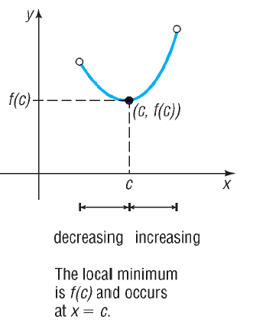

Slide 31
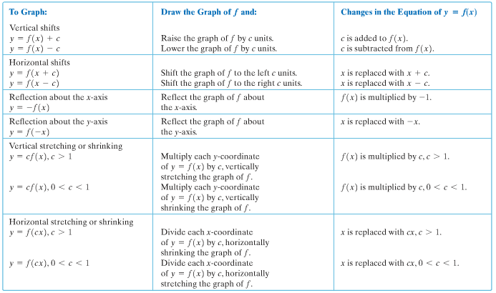
transformations

Slide 32
Composite functions

Slide 33
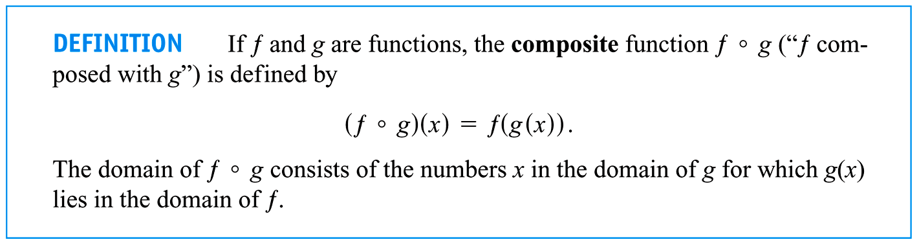
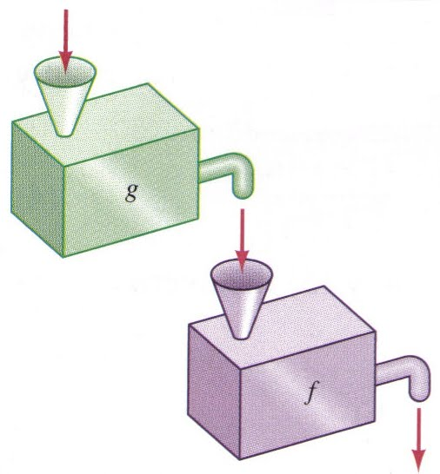

Slide 34



Oil is spilling from a well at a rate of 2,500 gallons per day. At this rate the radius of the circular pool of oil will change at a constant rate of 4 miles per day.
Write an expression that represents the radius of the oil slick at time t, r days after the leak has started.
Recognize the relationship of the change in area is dependent upon the radius as a function of time
$$r\left(t\right)=4t$$
Write an expression to represent the area of the oil spill in terms of the radius.
$$Area= πr^{2}=π{\left[r\left(t\right)\right]}^{2}$$
$$A\left(r\left(t\right)\right)=π{\left(4t\right)}^{2}=16{πt}^{2}$$
Find the area of the circular spill in 4 days.
Units?
$$A\left(r\left(t\right)\right)=A\left(4t\right)=16π{\left(4\right)}^{2}=804.25$$

Slide 35
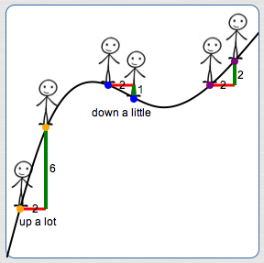
Average rate of change

Slide 36
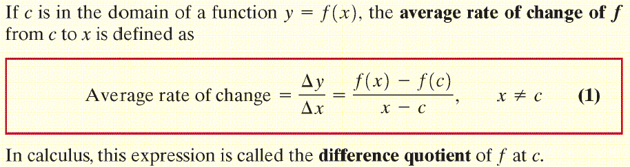

Slide 37

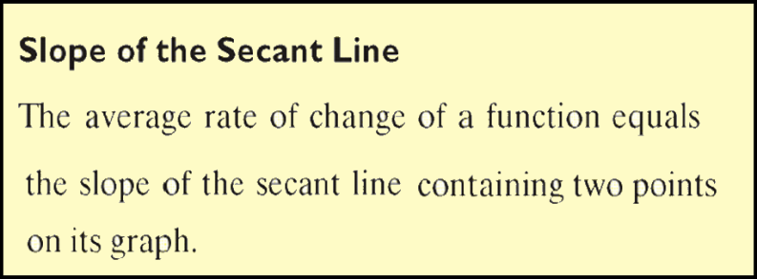
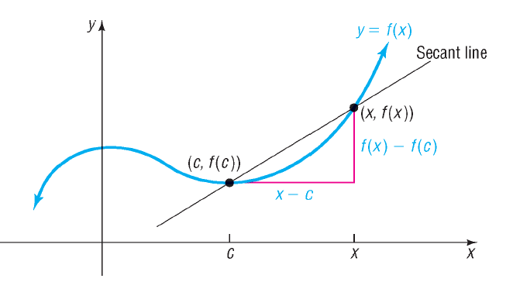

Slide 38

Average rate of change
Suppose that you are at a red light, and then the light turns green.
You put your foot on the accelerator and the car increases its speed from 0 mph to 50 mph in 5 seconds.
What is your average rate of change of your speed?
Units?
$$\frac{change speed}{change time}=\frac{50−0}{5−0}=\frac{50}{5}=10$$

Slide 39
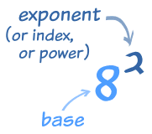
Logarithms & exponential functions

Slide 40
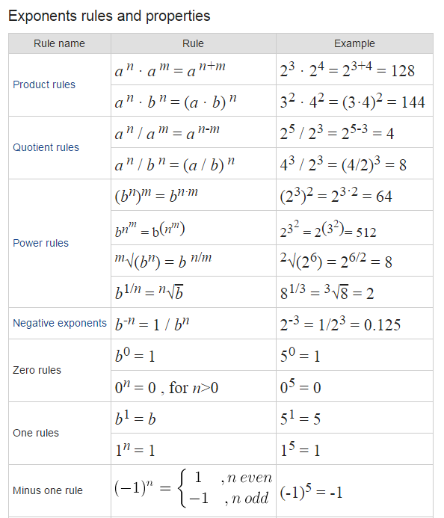

$$x^{2} ∙x^{4}=$$
$${\left(x^{2}\right)}^{4}=$$
$$\frac{x^{5}}{x^{2}}=$$
$${\left(x^{4}\right)}^{\frac{1}{2}}=$$

Slide 41

$$x^{2} ∙x^{4}=x^{2+4}=x^{6}$$
$${\left(x^{2}\right)}^{4}=x^{2∗4 }=x^{8}$$
$$\frac{x^{5}}{x^{2}}=x^{5−2}=x^{3}$$
$${\left(x^{4}\right)}^{\frac{1}{2}}=x^{\frac{4}{2}}=x^{2}$$

Slide 42
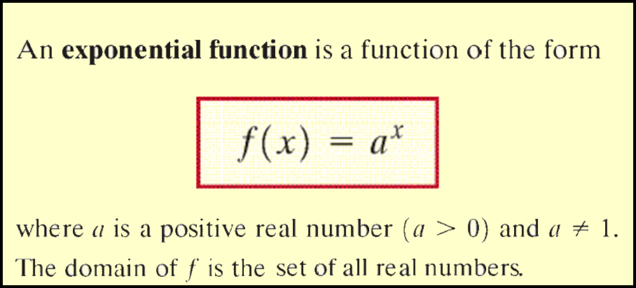

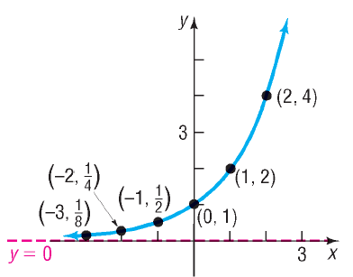
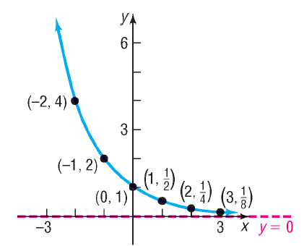

Slide 43
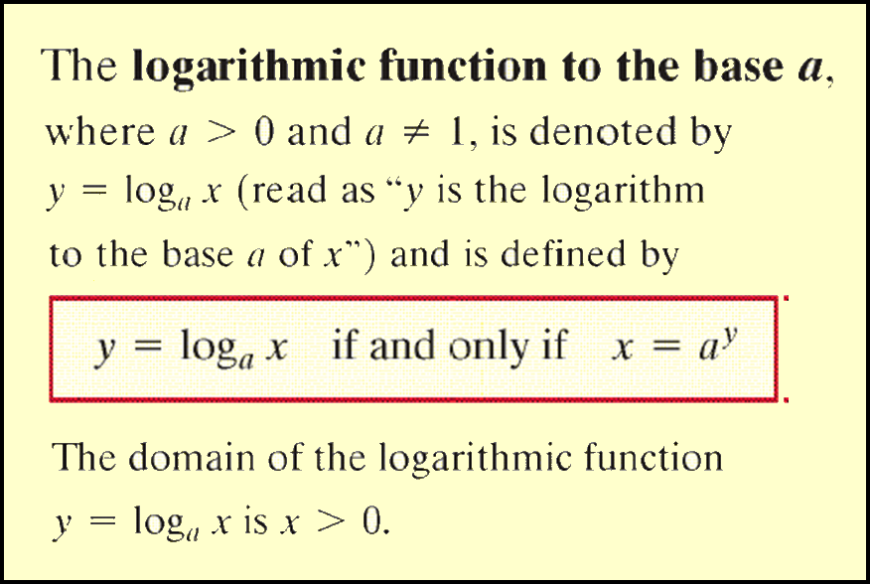

Slide 44
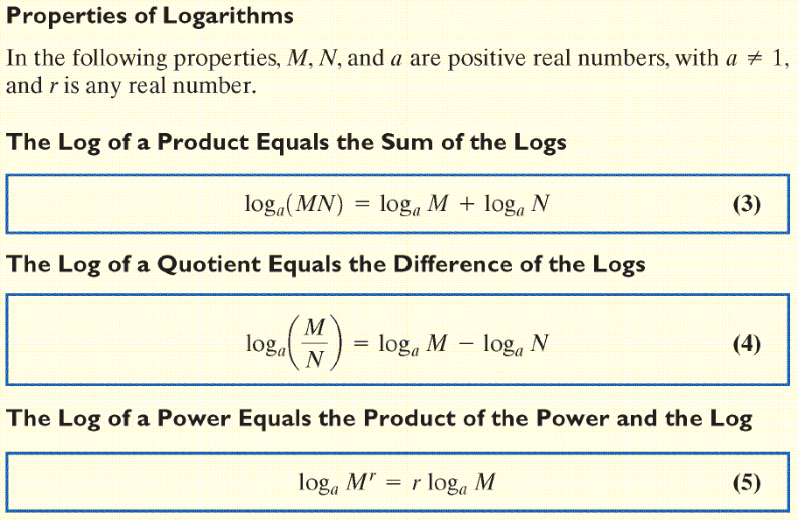

Slide 45
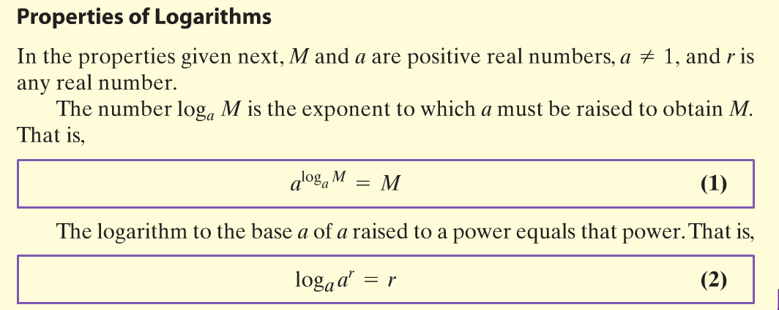

Slide 46
Circles

Slide 47



Slide 48



Slide 49
Angles & trigonometry

Slide 50

Trig rules
Unit Circle
  You don’t have to memorize!
Angles
Identities
Formulas
  Sum/Difference
  Double-Angle
  Half-Angle
  Sum-to-Product
  Right-Triangles
  Law of Sines/Cosines

Slide 51

Sine & cosine graphs

