Slide 1
Integration by Substitution

Slide 2
Integration by Substitution
Find antiderivative when integrand is the result of a chain-rule derivative
Reverses the chain rule
Product of two factors
Derivative of the outside
Derivative of the inside

Slide 3
Substitution of an Integral
To make a substitution in an integral
Let $u$ be the “inside function”
And $du =\left(\frac{du}{dx}\right) dx$ to match the “outside function”
Then express the integrand in terms of $u$
NOTE:
The “inside function” is typically
Inside parentheses
Under radical
Exponent
Denominator

Slide 4
Problem-Solving Strategy Integration by Substitution
Look carefully at the integrand and select an expression $g(x)$ within the integrand to set equal to $u$
This is what I call the inside function
Substitute $u=g\left(x\right)$ and $du=g^{′}\left(x\right)dx$ into the integral
Outside function times the derivative of the inside function
Evaluate the integral with respect to $u$
If the integral cannot be evaluated we need to go back and select a different expression to use as $u$
Write the final result in terms of $x$ and the expression $g(x)$

Slide 5
Examples
Make a substitution to find the antiderivative
$$\int{e^{x^{2}}∙2x dx}$$

Slide 6
Examples
Make a substitution to find the antiderivative
$$\int{{\left(x^{2}−3\right)}^{3} 2x dx}$$

Slide 7
Examples
Make a substitution to find the integral
$$\int{\frac{1}{x^{2}+4} ∙2x dx}$$

Slide 8
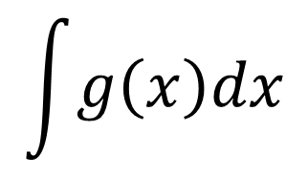
Leibniz Integral Notation
$$\int{g\left(x\right)dx}$$
If we substitute u = g(x)

Slide 9
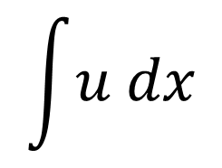
Leibniz Integral Notation
$$\int{u dx}$$
If we substitute u = g(x)

Slide 10
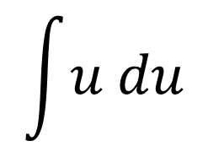
Leibniz Integral Notation
$$\int{u du}$$
Then our variable of integration has to match our variable of our function

Slide 11
What if the derivative factor is missing?
Meaning in each of the previous examples the factor 2x was present as the derivative of the “inside” function.

Slide 12

What if the derivative factor is missing?
Find $\int{te^{(t^{2}+1)}dt}$

Slide 13

What if the derivative factor is missing?
Find $\int{x^{3}\sqrt{x^{4}+5} dx}$

Slide 14
WARNING!
In the preceding examples, we can apply substitution only when a constant is missing from the inside function.
There will be times that you cannot use substitution such as $\int{x^{2}\sqrt{x^{4}+5} dx}$
Because $x^{2}dx$ is not a constant multiple of $dw=4x^{3}dx$
In order to use substitution, it helps if the integrand contains the derivative of the inside function, to within a constant factor.

Slide 15

Substitution with Periodic Functions
Find $\int{3x^{2}\cos\left(x^{3}\right)dx}$

Slide 16

Substitution with Periodic Functions
Find $\int{e^{cos⁡(θ)}\sin\left(θ\right)dθ}$

Slide 17

Substitution with Periodic Functions
Find $\int{\frac{sin⁡(t)}{\cos^{3}{(t)} } dt}$

Slide 18
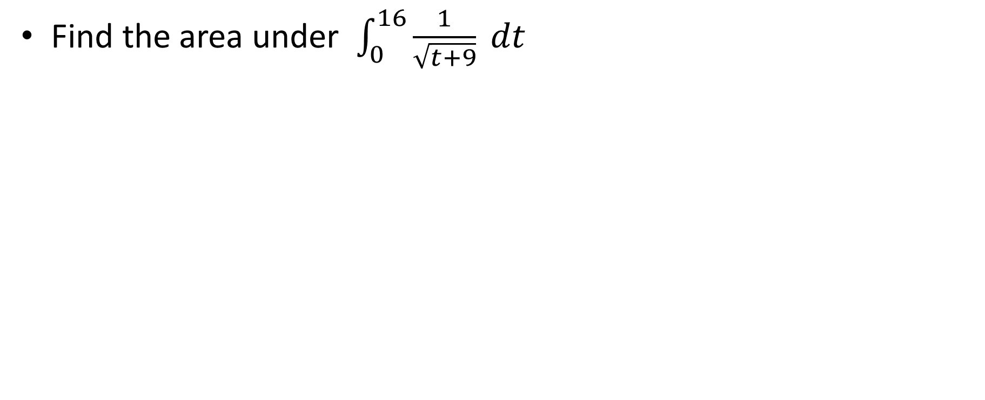
Definite Integrals by Substitution
Find the area under $\int_{0}^{16}{\frac{1}{\sqrt{t+9}} dt}$

Slide 19
Integration by Substitution
Applications

Slide 20
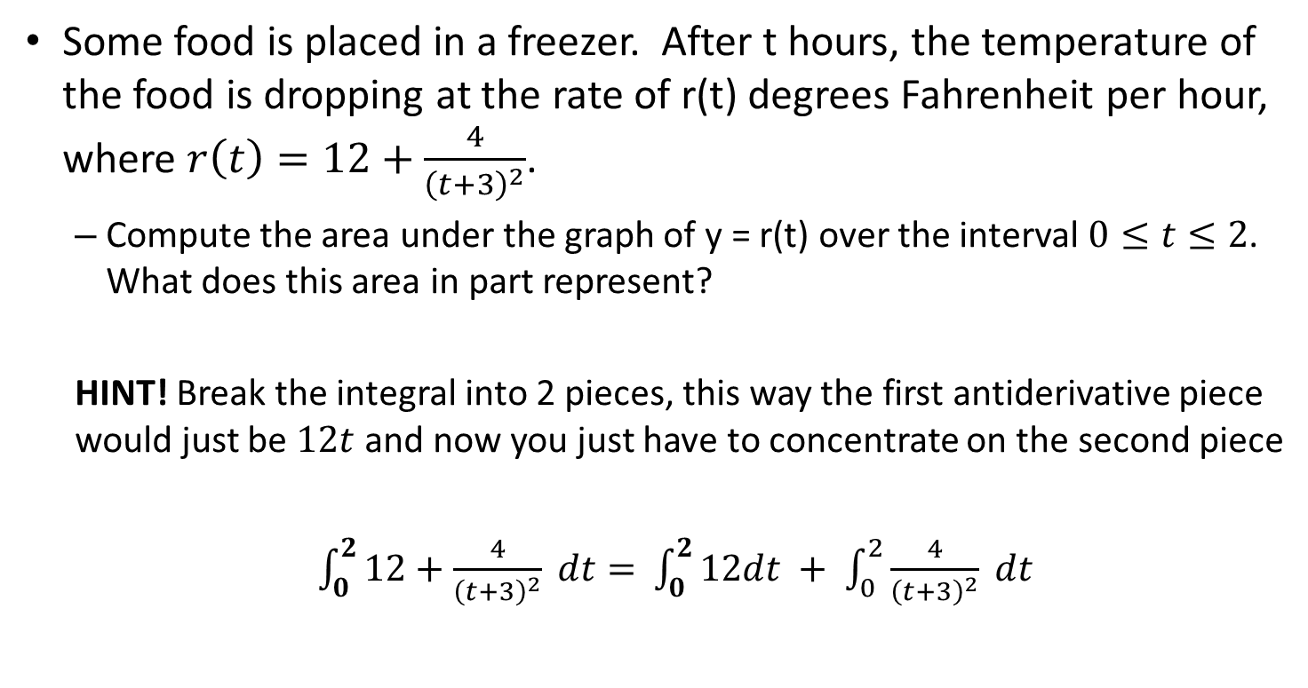
Example 1
Some food is placed in a freezer. After t hours, the temperature of the food is dropping at the rate of r(t) degrees Fahrenheit per hour, where $r\left(t\right)=12+\frac{4}{{\left(t+3\right)}^{2}}$.
Compute the area under the graph of y = r(t) over the interval $0≤t≤2$. What does this area in part represent?
HINT! Break the integral into 2 pieces, this way the first antiderivative piece would just be $12t$ and now you just have to concentrate on the second piece
$\int_{0}^{2}{12+\frac{4}{{\left(t+3\right)}^{2}} dt= }$ $\int_{0}^{2}{12dt + \int_{0}^{2}{\frac{4}{{\left(t+3\right)}^{2}} dt} }$

Slide 21
Example 2
After two hours, a drug is slowly leaving the body at a rate of $\frac{ln(x)}{x} mg/hr$. What is the amount of the drug in the body between 2 and 10 hours?
HINT: Why not separate the fraction so you can see the $u=ln⁡(x)$ then the leftover $du=\frac{1}{x}$
$\int_{2}^{10}{\frac{ln(x)}{x}dx}$ $= \int_{2}^{10}{ln\left(x\right)∙\frac{1}{x} dx}$

Slide 22
Example 3
A population is growing at a rate of $p\left(t\right)=1000e^{t/3}$. What is the population after 5 years?
HINT: Typically the $e^{t/3}$ the $t/3$ part would be the $u$ , however, if you think about this you could separate it as $\frac{1}{3} t$ and just use the $\int{e^{kt}dt}$ rule and not even use substitution

