Slide 1
The Fundamental Theorem of Calculus

Slide 2
FTC
How antiderivatives are used to calculate definite integrals exactly
Calculation is based on the Fundamental Theorem of Calculus
Connects derivatives and integration

Slide 3
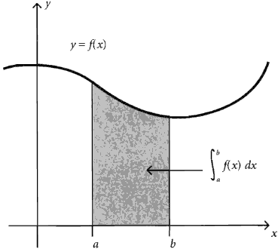
FTC Proof

Slide 4
FTC = AREA
If $f$, the derivative of F (original function), is continuous, then
$$\int_{a}^{b}{f\left(x\right)dx=F\left(b\right)−F(a)}$$

Slide 5

FTC = AREA
If $f$, the derivative of F (original function), is continuous, then
$$\int_{a}^{b}{f\left(x\right)dx=F\left(b\right)−F(a)}$$
Step 1: Find F (antiderivative)

Slide 6
FTC = AREA
If $f$, the derivative of F (original function), is continuous, then
$$\int_{a}^{b}{f\left(x\right)dx=F\left(b\right)−F(a)}$$
Step 2: Calculate F(b) – F(a)

Slide 7

Shorthand Notation
For F(b) – F(a) you will usually see
$${F(x)}_{a}^{b}=F\left(b\right)−F(a)$$
Evaluation line

Slide 8
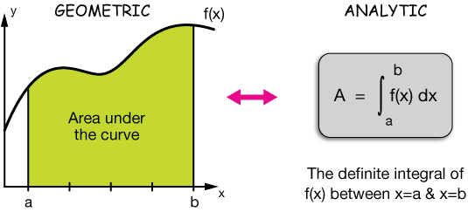
FTC
This gives an EXACT answer where previously with Riemann Sums you were approximating with left or right hand sums (i.e. finding area under curves by calculating the area of the rectangles)

Slide 9
FTC
WARNING: This method only works when you can find a formula for an antiderivative F(x)
Otherwise you have to go back to Riemann Sums and table data

Slide 10
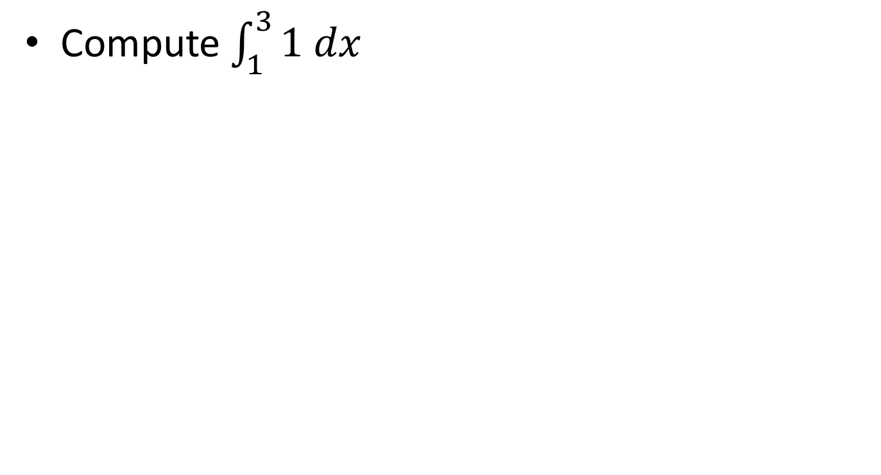
Show this works!
Compute $\int_{1}^{3}{1 dx}$

Slide 11
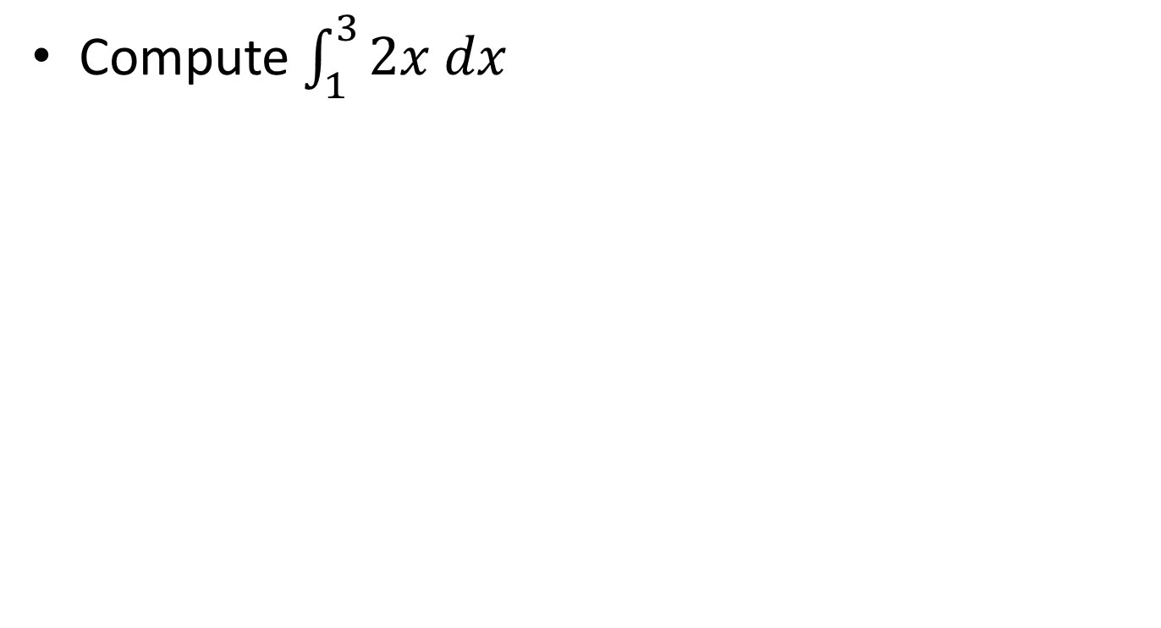
Show this works!
Compute $\int_{1}^{3}{2x dx}$

Slide 12
Examples
Use the FTC to compute the definite integrals
$$\int_{0}^{2}{6x^{2} dx}$$

Slide 13
Examples
Use the FTC to compute the definite integrals
$$\int_{0}^{2}{t^{3}dt}$$

Slide 14
Examples
Use the FTC to compute the definite integrals
$$\int_{1}^{2}{\left(8x+5\right)dx}$$

Slide 15
Examples
Use the FTC to compute the definite integrals
$$\int_{0}^{1}{8e^{2t}dt}$$

Slide 16
Remember this is AREA!
Write a definite integral to represent the area under the graph of $f\left(t\right)=e^{0.5t}$ between t = 0 and t = 4.
Use FTC to calculate the area

Slide 17
Area
Find exact area of region bounded by the x-axis and the graph of $y=x^{3}−x$

Slide 18
Application
Oil is leaking out of a ruptured tanker at the rate of $r\left(t\right)=70e^{−0.04t}$ thousand liters per minute.
At what rate is oil leaking out at $t=0$?

Slide 19
Application
Oil is leaking out of a ruptured tanker at the rate of $r\left(t\right)=70e^{−0.04t}$ thousand liters per minute.
How many liters leak out during the first hour?

