Slide 1
4.10
Antiderivatives

Slide 2
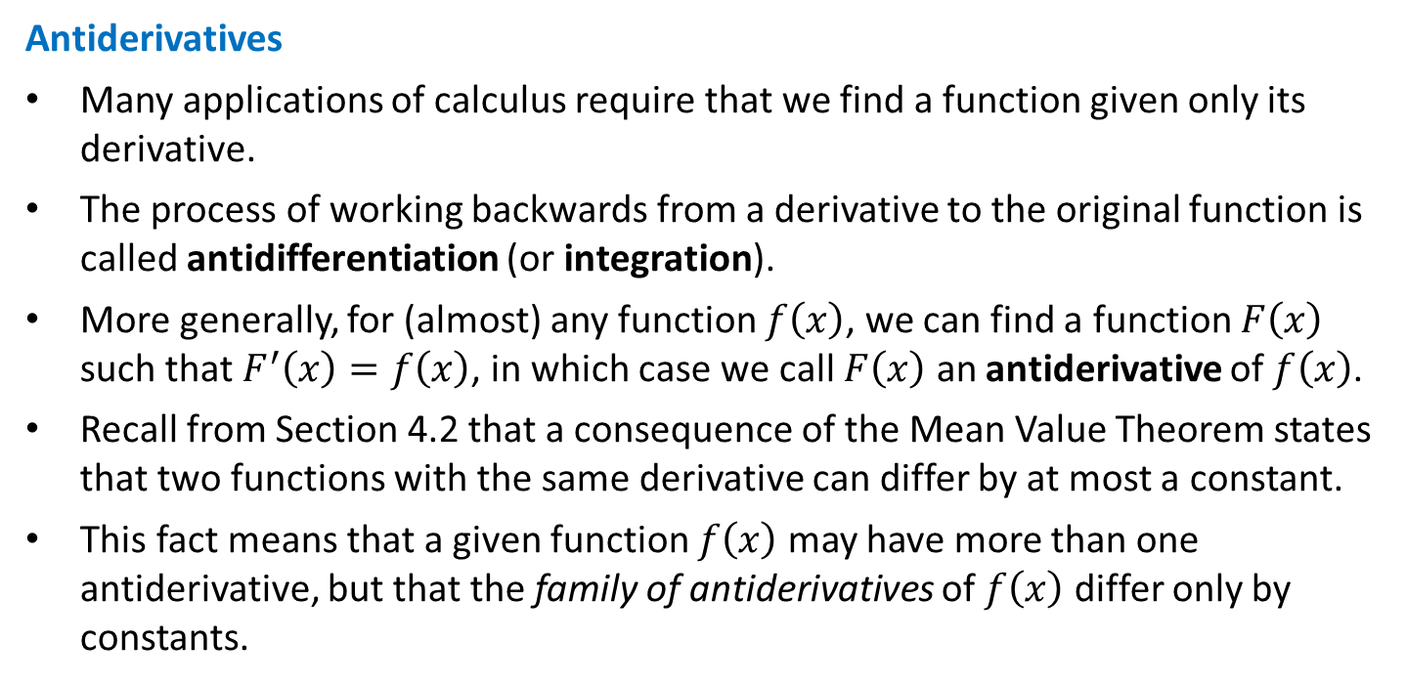
Antiderivatives
Many applications of calculus require that we find a function given only its derivative.
The process of working backwards from a derivative to the original function is called antidifferentiation (or integration).
More generally, for (almost) any function $f\left(x\right)$, we can find a function $F\left(x\right)$ such that $F^{′}\left(x\right)=f\left(x\right)$, in which case we call $F\left(x\right)$ an antiderivative of $f\left(x\right)$.
Recall from Section 4.2 that a consequence of the Mean Value Theorem states that two functions with the same derivative can differ by at most a constant.
This fact means that a given function $f\left(x\right)$ may have more than one antiderivative, but that the family of antiderivatives of $f\left(x\right)$ differ only by constants.

Slide 3
Indefinite Integrals
We introduce a new notation for the family of antiderivatives of a function, called the indefinite integral.
Just like the $\frac{d}{dx}$ in Leibniz notation was viewed (at first) as just that: notation with no meaning or interpretation, the integral sign $∫$and the $dx$ notation here should not (yet) be interpreted as having any meaning.
With this notation, if $F\left(x\right)$ is an antiderivative of $f\left(x\right)$, then we have
$$\int{f\left(x\right) dx}=F\left(x\right)+C$$

Slide 4
EXAMPLE Evaluate the following indefinite integrals, i.e., find the family of antiderivatives for each function.
$\int{2x dx}$
$\int{\cos{x} dx}$
$\int{e^{x} dx}$
$\int{2x dx}=\boxed{x^{2}+C}$
$\int{\cos{x} dx}=\boxed{\sin{x}+C}$
$\int{e^{x} dx}=\boxed{e^{x}+C}$

Slide 5
EXAMPLE Recall the Power Rule for derivatives: $\frac{d}{dx}\left[x^{n}\right]=nx^{n−1}$. Find a Power Rule for antiderivatives, i.e., evaluate the following indefinite integral.
$$\int{x^{n} dx}$$
Since differentiation subtracts 1 from the power, an antiderivative of $x^{n}$ must involve $x^{n+1}$.
But $\frac{d}{dx}\left[x^{n+1}\right]=\left(n+1\right)x^{n}$ not $x^{n}$, so we must have
$\frac{d}{dx}\left[\frac{1}{n+1}x^{n+1}\right]=x^{n}$
And the Power Rule for antiderivatives is
$$\int{x^{n} dx}=\frac{1}{n+1}x^{n+1}+C$$

Slide 6
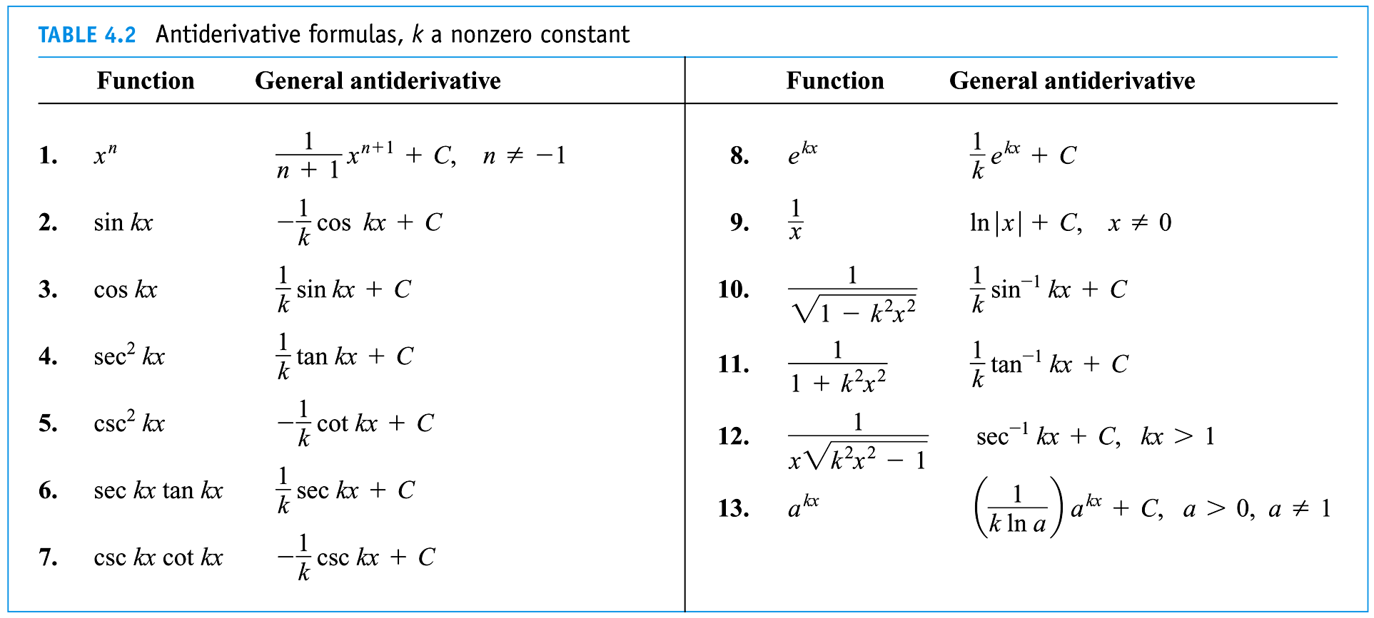
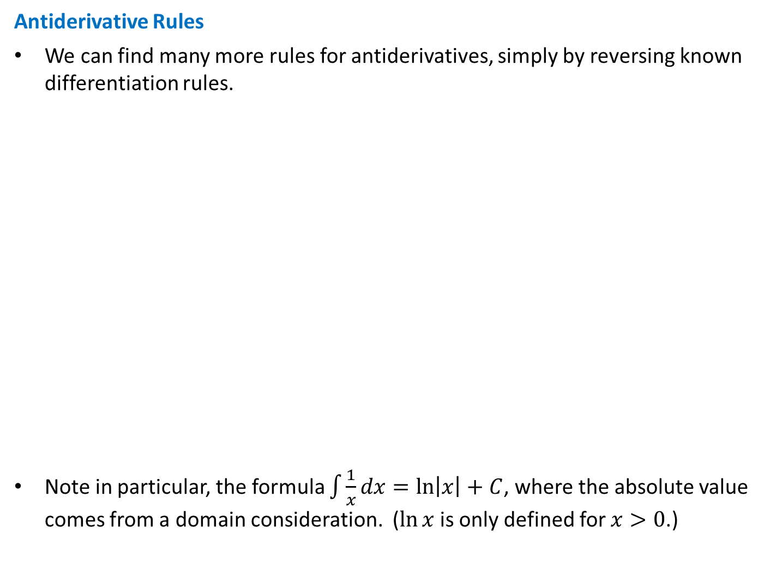
Antiderivative Rules
We can find many more rules for antiderivatives, simply by reversing known differentiation rules.
Note in particular, the formula $\int{\frac{1}{x}dx}=\ln\left|x\right|+C$, where the absolute value comes from a domain consideration. ($\ln{x}$ is only defined for $x>0$.)

Slide 7
EXAMPLE Evaluate the following indefinite integrals.
$\int{x^{5}dx}$
$\int{\frac{1}{\sqrt{x}}dx}$
$\int{\sin\left(2x\right)dx}$
$\int{e^{−3x}dx}$
$\int{x^{5}dx}=\boxed{\frac{1}{6}x^{6}+C}$
$\int{\frac{1}{\sqrt{x}}dx}=\int{x^{{−1}/2}dx}=\frac{1}{1/2}x^{1/2}+C=\boxed{2\sqrt{x}+C}$
$\int{\sin\left(2x\right)dx}=\boxed{−\frac{1}{2}\cos\left(2x\right)+C}$
$\int{e^{−3x}dx}=\boxed{−\frac{1}{3}e^{−3x}+C}$

Slide 8
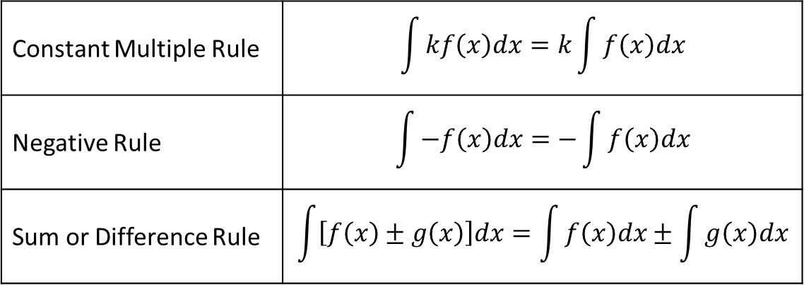
Properties of the Indefinite Integral
We frequently also consider antiderivatives of sums, differences, products, quotients, powers and compositions of functions.
It took all of Chapter 3 for us to develop differentiation rules for such combinations of functions, and the bulk of Calculus II is devoted to doing the same for antiderivatives.
However, we can determine a couple of simple but useful properties right now.
The proofs of these properties follow directly from the corresponding rules for differentiation.
Constant Multiple Rule | $$\int{kf\left(x\right)dx}=k\int{f\left(x\right)dx}$$
Negative Rule | $$\int{−f\left(x\right)dx}=−\int{f\left(x\right)dx}$$
Sum or Difference Rule | $$\int{\left[f\left(x\right)±g\left(x\right)\right]dx}=\int{f\left(x\right)dx}±\int{g\left(x\right)dx}$$

Slide 9
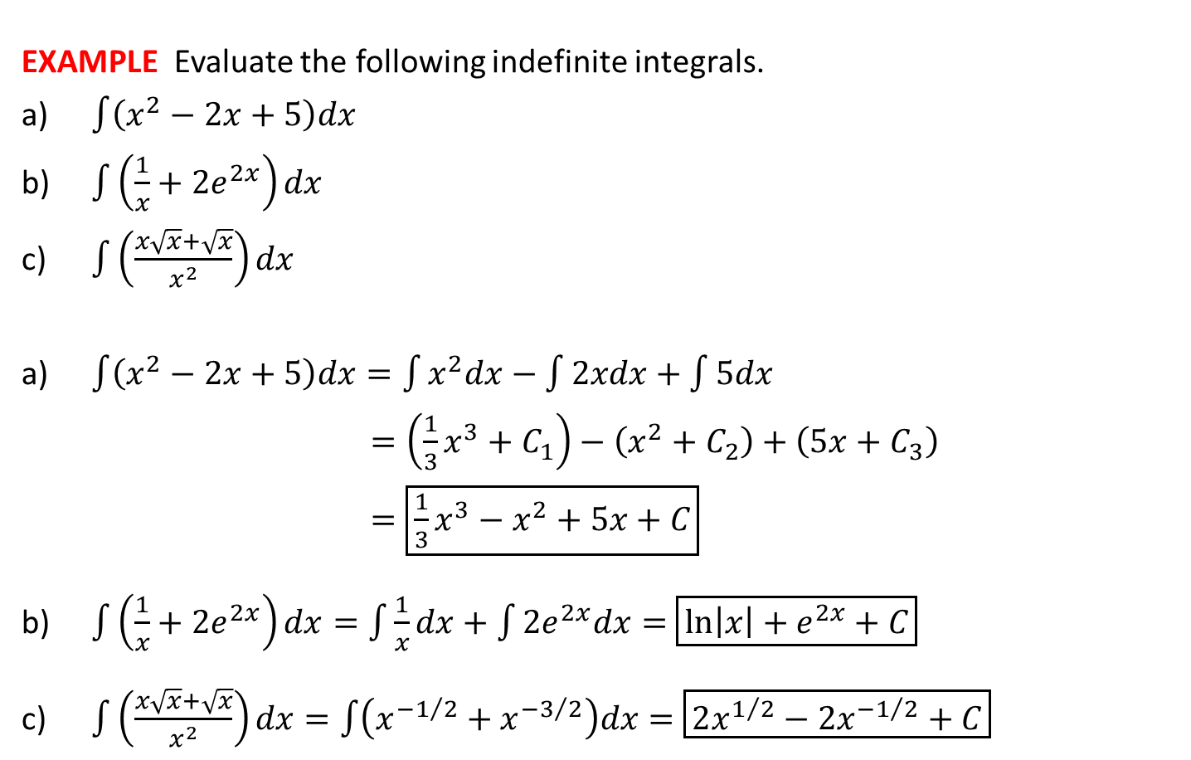
EXAMPLE Evaluate the following indefinite integrals.
$\int{\left(x^{2}−2x+5\right)dx}$
$\int{\left(\frac{1}{x}+2e^{2x}\right)dx}$
$\int{\left(\frac{x\sqrt{x}+\sqrt{x}}{x^{2}}\right)dx}$
$\int{\left(x^{2}−2x+5\right)dx}=\int{x^{2}dx}−\int{2xdx}+\int{5dx}$
$=\left(\frac{1}{3}x^{3}+C_{1}\right)−\left(x^{2}+C_{2}\right)+\left(5x+C_{3}\right)$
$=\boxed{\frac{1}{3}x^{3}−x^{2}+5x+C}$
$\int{\left(\frac{1}{x}+2e^{2x}\right)dx}=\int{\frac{1}{x}dx}+\int{2e^{2x}dx}=\boxed{\ln\left|x\right|+e^{2x}+C}$
$\int{\left(\frac{x\sqrt{x}+\sqrt{x}}{x^{2}}\right)dx}=\int{\left(x^{{−1}/2}+x^{{−3}/2}\right)dx}=\boxed{2x^{1/2}−2x^{{−1}/2}+C}$

