Slide 1
4.7
Applied Optimization Problems

Slide 2
Applied Optimization
Consider the question, “How large a box can you construct with a given amount of material?”
This is an optimization problem, and solving such problems typically involve finding a maximum (or minimum) of an appropriate function.
Your author has this to say: If you can, express the unknown as a function of a single variable. This may require considerable manipulation.
I’d like to give you a little more to go on than that, so I will share with you the way that I learned how to approach these problems.
Let’s work an example similar to the opening question above, to see how it works.

Slide 3
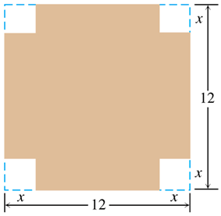
EXAMPLE An open-top box is to be made by cutting small congruent squares from the corners of a 12-in.-by-12-in. sheet of tin and bending up the sides. How large should the squares cut from the corners be to make the box hold as much as possible?
The constant in the problem is the 12 inch side of the sheet of tin.
The variable is the size of the square cut from each corner:
Let $x=$ the length of a side of each of these squares.
Note that we can place reasonable restrictions on the values of $x$ as $0≤x≤6$.
We then bend up the sides into an open-top box, and we are trying to maximize the volume of this box.
In other words, we have a volume function $V=lwh$, of which we need to find the extreme values.

Slide 4
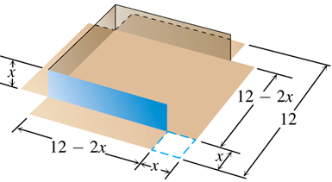
EXAMPLE An open-top box is to be made by cutting small congruent squares from the corners of a 12-in.-by-12-in. sheet of tin and bending up the sides. How large should the squares cut from the corners be to make the box hold as much as possible?
A closer examination of the box shows that
$h=x$, and
$l=w=12−2x$.
Thus, we can write the volume as a function of $x$:
$V\left(x\right)=\left(12−2x\right)\left(12−2x\right)x$
$=4x^{3}−48x^{2}+144x$ $\left(0≤x≤6\right)$
To find the maximum volume of the box, we determine the absolute extrema of this volume function.

Slide 5
EXAMPLE An open-top box is to be made by cutting small congruent squares from the corners of a 12-in.-by-12-in. sheet of tin and bending up the sides. How large should the squares cut from the corners be to make the box hold as much as possible?
$V\left(x\right)=4x^{3}−48x^{2}+144x$
$V^{′}\left(x\right)=12x^{2}−96x+144=12\left(x^{2}−8x+12\right)=12\left(x−2\right)\left(x−6\right)$
Critical Points: $x=2, 6$
To determine absolute extrema, we evaluate $V\left(x\right)$ at the critical points and the domain endpoints:
$V\left(0\right)=4{\left(0\right)}^{3}−48{\left(0\right)}^{2}+144\left(0\right)=0$
$V\left(2\right)=4{\left(2\right)}^{3}−48{\left(2\right)}^{2}+144\left(2\right)=128$
$V\left(6\right)=4{\left(6\right)}^{3}−48{\left(6\right)}^{2}+144\left(6\right)=0$
Thus, the maximum volume is $128 {in}^{3}$, when 2-inch squares are cut from each corner.

Slide 6
An Optimization Strategy
In general, we can approach optimization problems using the following steps:
In any word problem, it’s a good idea to start by drawing a picture (if applicable) and labeling all constants and variables involved.
Determine the objective function, i.e., the quantity to be optimized. In our first example, the objective function was the volume of the box.
Identify any constraints on the objective function. In our example, constraints included domain restrictions, along with the equations that related the length, width, and height to our variable.
Combine the objective function and the constraints into a differentiable function of a single variable, and find the extrema of this function.

Slide 7
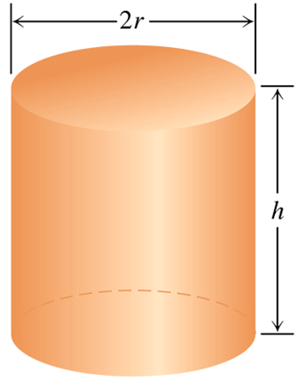
EXAMPLE You have been asked to design a one-liter can shaped like a right circular cylinder. What dimensions (in centimeters) will use the least material?
The only constant is the one-liter volume of the cylinder. Since $1 mL=1 {cm}^{3}$, this volume is $1000 {cm}^{3}$.
The variables include the cylinder’s height, $h$, and radius, $r$.
To determine the least amount of material to use, we must minimize the surface area of the cylinder. Thus, our objective function is
$Surface Area=Area of Side+2(Area of Base)$
$S=2πrh+2πr^{2}$
Constraints include
$V=πr^{2}h → 1000=πr^{2}h → h=\frac{1000}{πr^{2}}$
$r,h>0$
Thus, we wish to minimize the function
$S\left(r\right)=2πr\left(\frac{1000}{πr^{2}}\right)+2πr^{2}=\frac{2000}{r}+2πr^{2} \left(r>0\right)$

Slide 8
EXAMPLE You have been asked to design a one-liter can shaped like a right circular cylinder. What dimensions (in centimeters) will use the least material?
$S\left(r\right)=\frac{2000}{r}+2πr^{2} \left(r>0\right)$
$S^{′}\left(r\right)=−\frac{2000}{r^{2}}+4πr$
Critical Points: $S^{′}\left(r\right)=0 → −2000+4πr^{3}=0 → r=\sqrt[3]{\frac{500}{π}}≈5.42$
Since it doesn’t make sense to have a can of $0$ radius (or infinite radius), we need not concern ourselves with the domain endpoints.
However, we must still verify that the critical point yields a minimum. To do so, we may apply the Second Derivative Test for Local Extrema.
$S^{′′}\left(r\right)=\frac{4000}{r^{3}}+4π → S^{′′}\left(5.42\right)=\frac{4000}{{\left(5.42\right)}^{3}}+4π>0$
Thus, the one-liter can that uses the least material has radius $r≈5.42 cm$, and height $h≈\frac{1000}{π{\left(5.42\right)}^{2}}=10.84 cm$.

Slide 9
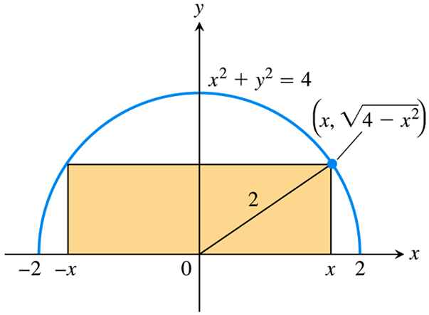
EXAMPLE A rectangle is to be inscribed in a semicircle of radius 2. What is the largest area the rectangle can have, and what are its dimensions?
As in the figure, any rectangle inscribed in such a semicircle will have its corner at a point $\left(x, \sqrt{4−x^{2}}\right)$ along the semicircle.
We are attempting to maximize the area $A=lh$ of the rectangle.
The constraints in this example include
$l=2x$,
$h=\sqrt{4−x^{2}}$, and
$0≤x≤2$
We thus have our objective function
$A\left(x\right)=2x\sqrt{4−x^{2}}$
defined on the interval $\left[0, 2\right]$.

Slide 10
EXAMPLE A rectangle is to be inscribed in a semicircle of radius 2. What is the largest area the rectangle can have, and what are its dimensions?
$A^{′}\left(x\right)=2x{\left[\sqrt{4−x^{2}}\right]}^{′}+{\left[2x\right]}^{′}\sqrt{4−x^{2}}$
$=2x\left(\frac{1}{2\sqrt{4−x^{2}}}\right)\left(−2x\right)+2\sqrt{4−x^{2}}$
$=−\frac{2x^{2}}{\sqrt{4−x^{2}}}+2\sqrt{4−x^{2}}$
$=−\frac{2x^{2}}{\sqrt{4−x^{2}}}+\frac{2\left(4−x^{2}\right)}{\sqrt{4−x^{2}}}$
$=\frac{8−4x^{2}}{\sqrt{4−x^{2}}}$
Critical Points:
$A^{′}$ is equal to 0 when $8−4x^{2}=0 → x=±\sqrt{2}$
$A^{′}$ is undefined when $4−x^{2}=0 → x=±2$
Based on the domain restriction $\left[0, 2\right]$, the only critical point is $x=\sqrt{2}$.

Slide 11
EXAMPLE A rectangle is to be inscribed in a semicircle of radius 2. What is the largest area the rectangle can have, and what are its dimensions?
We determine the absolute maximum using the critical point and domain endpoints:
$A\left(0\right)=2\left(0\right)\sqrt{4−0^{2}}=\left(0\right)\left(2\right)=0$
$A\left(\sqrt{2}\right)=2\sqrt{2}⋅\sqrt{4−{\left(\sqrt{2}\right)}^{2}}=\left(2\sqrt{2}\right)\left(\sqrt{2}\right)=4$
$A\left(2\right)=2\left(2\right)\sqrt{4−2^{2}}=\left(4\right)\left(0\right)=0$
Thus, the largest area the rectangle can have is 4 square units, when its dimensions are $l=2\sqrt{2}$ and $h=\sqrt{2}$.

Slide 12
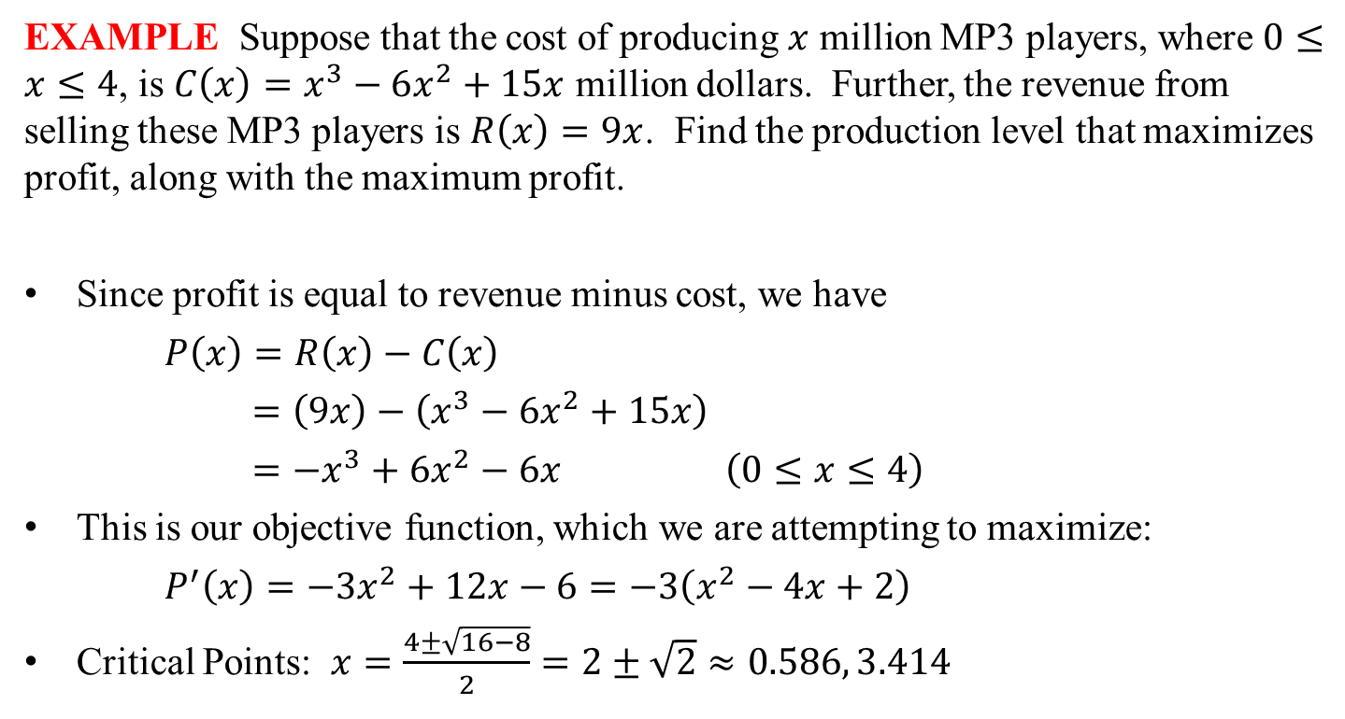
EXAMPLE Suppose that the cost of producing $x$ million MP3 players, where $0≤x≤4$, is $C\left(x\right)=x^{3}−6x^{2}+15x$ million dollars. Further, the revenue from selling these MP3 players is $R\left(x\right)=9x$. Find the production level that maximizes profit, along with the maximum profit.
Since profit is equal to revenue minus cost, we have
$P\left(x\right)=R\left(x\right)−C\left(x\right)$
$=\left(9x\right)−\left(x^{3}−6x^{2}+15x\right)$
$=−x^{3}+6x^{2}−6x$ $\left(0≤x≤4\right)$
This is our objective function, which we are attempting to maximize:
$P^{′}\left(x\right)=−3x^{2}+12x−6=−3\left(x^{2}−4x+2\right)$
Critical Points: $x=\frac{4±\sqrt{16−8}}{2}=2±\sqrt{2}≈0.586, 3.414$

Slide 13
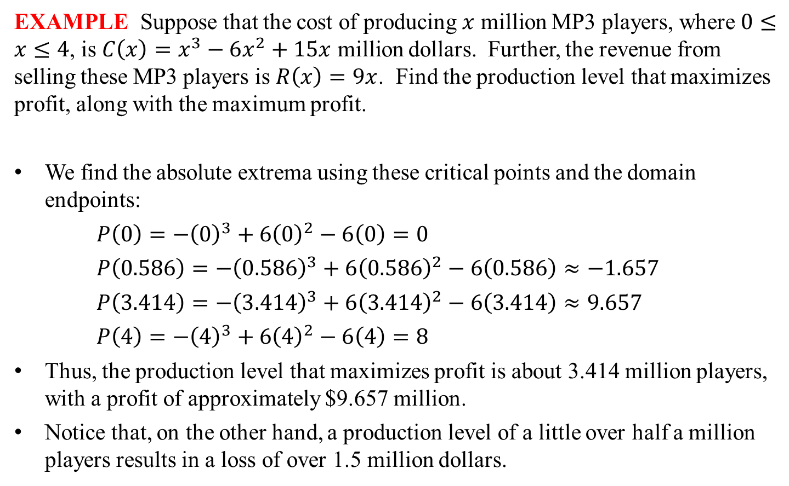
EXAMPLE Suppose that the cost of producing $x$ million MP3 players, where $0≤x≤4$, is $C\left(x\right)=x^{3}−6x^{2}+15x$ million dollars. Further, the revenue from selling these MP3 players is $R\left(x\right)=9x$. Find the production level that maximizes profit, along with the maximum profit.
We find the absolute extrema using these critical points and the domain endpoints:
$P\left(0\right)=−{\left(0\right)}^{3}+6{\left(0\right)}^{2}−6\left(0\right)=0$
$P\left(0.586\right)=−{\left(0.586\right)}^{3}+6{\left(0.586\right)}^{2}−6\left(0.586\right)≈−1.657$
$P\left(3.414\right)=−{\left(3.414\right)}^{3}+6{\left(3.414\right)}^{2}−6\left(3.414\right)≈9.657$
$P\left(4\right)=−{\left(4\right)}^{3}+6{\left(4\right)}^{2}−6\left(4\right)=8$
Thus, the production level that maximizes profit is about 3.414 million players, with a profit of approximately $9.657 million.
Notice that, on the other hand, a production level of a little over half a million players results in a loss of over 1.5 million dollars.

