Slide 1
5.1
Approximating Areas

Slide 2
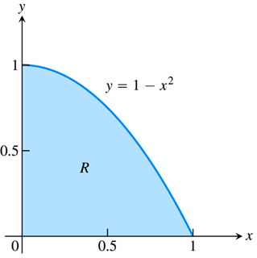
The Area Problem
We have geometry formulas for finding the area of a square, a rectangle, a circle, etc., but what about finding areas of more irregularly shaped regions?
As a first example, consider the area in the first quadrant under the parabola $y=1−x^{2}$.
There is no formula for determining this quantity, but maybe we could approach the problem by first approx- imating this area.
We decide to use a simpler shape, namely rectangles, to get a rough approximation of the actual area under this curve.

Slide 3
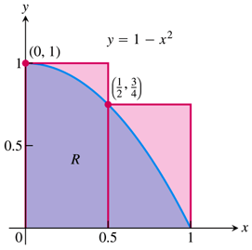
The Area Problem
By forming, say, two rectangles, each of width ½, and whose heights are given by the height of the function, we obtain an easily calculable approximation (the area in red) to the actual area under the curve (the area in blue).
True, this is not a very good approx- imation, so can you suggest a way to obtain a better one?

Slide 4
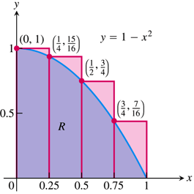
We Need More Rectangles
By using more rectangles, we are able to obtain what appears to be a closer approximation to the true area under the curve.
Presumably then, the more rectangles we use, the better the approximation will become, and that is the basic idea behind the area problem.
Notice as well that this approximation (in red) is an overestimate of the true value, due to the fact that we chose to use the highest points on the graph (the left endpoints of the intervals) as the heights of our rectangles.
This is typically called an upper sum, and we can find a corresponding lower sum by choosing the lowest points (the right endpoints) as the heights of our rectangles.

Slide 5
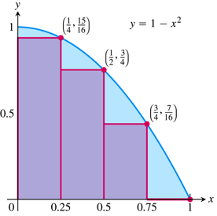
Lower Sums vs. Upper Sums
This lower sum (in red) is an underestimate of the true area under the curve, but we could still imagine that, the more rectangles we use, the closer our approx-imation should be to the true value.
In this example, we’ve seen that using left endpoints to calculate the heights of the rectangles gives an overestimate, and using right endpoints gives an underestimate.
Can you think of another choice for the height of each rectangle that might give a better approximation, even with the same number of rectangles?

Slide 6
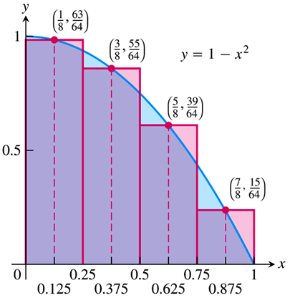
Midpoints: A Better Approximation?
Using the functional values at the midpoints of each subinterval as the heights of the rectangles appears to give a better approximation to the actual area, where the underestimates balance the overestimates, at least to some extent.
In the following example, we crunch the numbers to find the values of the different approximations that we have been considering.

Slide 7
EXAMPLE Approximate the area in the first quadrant under the curve $$y=1−x^{2}$$ with four rectangles, using a) left endpoints, b) right endpoints, and c) midpoints.
The following table gives all of the information we need about the function values:
Using left endpoints, we have
$A≈0.25⋅f\left(0\right)+0.25⋅f\left(0.25\right)+0.25⋅f\left(0.5\right)+0.25⋅f\left(0.75\right)$
$≈0.25\left(1\right)+0.25\left(0.9375\right)+0.25\left(0.75\right)+0.25\left(0.4375\right)≈\boxed{0.7813}$
$$x$$ | $$0$$ | $$0.125$$ | $$0.25$$ | $$0.375$$ | $$0.5$$ | $$0.625$$ | $$0.75$$ | $$0.875$$ | $$1$$
$$f\left(x\right)$$ | $$1$$ | $$0.9844$$ | $$0.9375$$ | $$0.8594$$ | $$0.75$$ | $$0.6094$$ | $$0.4375$$ | $$0.2344$$ | $$0$$

Slide 8
EXAMPLE Approximate the area in the first quadrant under the curve $$y=1−x^{2}$$ with four rectangles, using a) left endpoints, b) right endpoints, and c) midpoints.
The following table gives all of the information we need about the function values:
Using right endpoints, we have
$A≈0.25⋅f\left(0.25\right)+0.25⋅f\left(0.5\right)+0.25⋅f\left(0.75\right)+0.25⋅f\left(1\right)$
$≈0.25\left(0.9375\right)+0.25\left(0.75\right)+0.25\left(0.4375\right)+0.25\left(0\right)≈\boxed{0.5313}$
$$x$$ | $$0$$ | $$0.125$$ | $$0.25$$ | $$0.375$$ | $$0.5$$ | $$0.625$$ | $$0.75$$ | $$0.875$$ | $$1$$
$$f\left(x\right)$$ | $$1$$ | $$0.9844$$ | $$0.9375$$ | $$0.8594$$ | $$0.75$$ | $$0.6094$$ | $$0.4375$$ | $$0.2344$$ | $$0$$

Slide 9
EXAMPLE Approximate the area in the first quadrant under the curve $$y=1−x^{2}$$ with four rectangles, using a) left endpoints, b) right endpoints, and c) midpoints.
The following table gives all of the information we need about the function values:
Using midpoints, we have
$A≈0.25⋅f\left(0.125\right)+0.25⋅f\left(0.375\right)+0.25⋅f\left(0.625\right)+0.25⋅f\left(0.875\right)$
$≈0.25\left(0.9844\right)+0.25\left(0.8594\right)+0.25\left(0.6094\right)+0.25\left(0.2344\right)≈\boxed{0.6719}$
$$x$$ | $$0$$ | $$0.125$$ | $$0.25$$ | $$0.375$$ | $$0.5$$ | $$0.625$$ | $$0.75$$ | $$0.875$$ | $$1$$
$$f\left(x\right)$$ | $$1$$ | $$0.9844$$ | $$0.9375$$ | $$0.8594$$ | $$0.75$$ | $$0.6094$$ | $$0.4375$$ | $$0.2344$$ | $$0$$

Slide 10
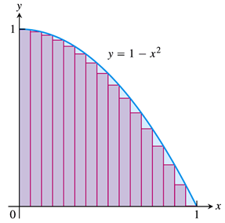
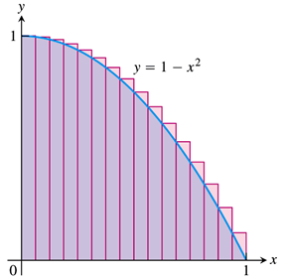
We Need More (and More) Rectangles
Whether we choose left-endpoints, right-endpoints, or midpoints to evaluate the height of the rectangles, the most important thing is the idea that the more rectangles we use, the closer our approximation should get to the true value.
Below are pictures of both a lower sum and an upper sum for the area of the region that we have been considering, this time using 16 rectangles.
It does indeed appear that our approximations are improving as we increase the number of rectangles.

Slide 11
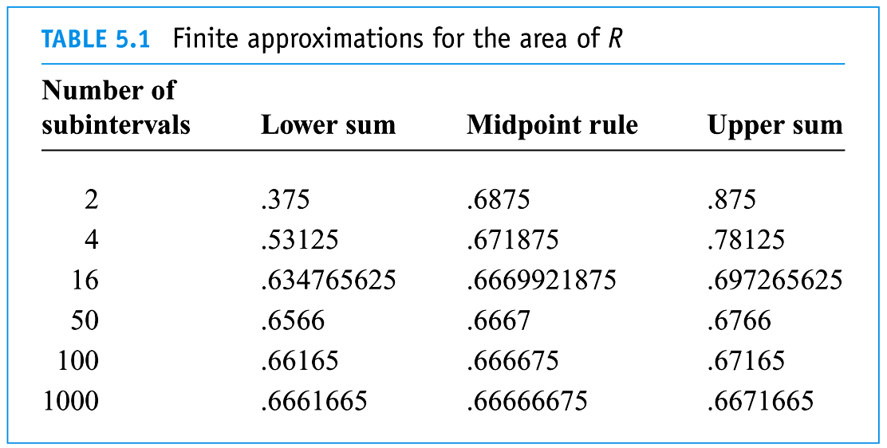
We Need MORE…Oh Never Mind, You Get the Idea
Using computers, we can generate approximations that involve as many rectangles as we would like.
Below is a table that lists approximations to the area of the region under consideration, using lower sums, midpoints, and upper sums, with various numbers of rectangles.

Slide 12
Convergence of Finite Approximations
Considering the values in the table on the preceding slide, it appears that all three approximations (lower sums, midpoints, and upper sums) are getting closer and closer (converging) to some fixed number.
Over the next couple of sections, we will investigate the algebra necessary to determine the limit of these approximations as more and more rectangles are used.
In effect, we will use the calculus notion of a limit to find the approximation when we use “infinitely many” rectangles.
We will see that, in the limit, it doesn’t matter if we use lower sums, upper sums, or midpoints, and we will define the area under the curve to be this limit of the finite approximations.

Slide 13
The General Procedure
Let’s step back and describe the process that we use to approximate the area under a curve:
Consider the $x$-interval over which we are taking the area. (In our example, this was the interval $\left[0,1\right]$.)
Divide this interval into subintervals, over which we form the approximating rectangles. (These subintervals are typically of equal width, but they don’t have to be.)
Choose a point in each subinterval at which to evaluate the function and determine the height of each approximating rectangle. (This is typically either left-endpoint, midpoint, or right-endpoint, but any point will do.)
Sum the areas of the approximating rectangles.

Slide 14
A Physical Interpretation
Recall that the slope of the tangent line had a corresponding physical interpretation, namely the velocity of an object in motion.
The area under a curve also has a physical interpretation, this time as the total distance traveled.
Now, if you drive for 2 hours at 60 mph, then you have traveled a total distance of $2×60=120$ miles, according to the formula $distance=rate×time$
But of course, you weren’t actually going 60 mph the entire 2 hours.
Say, on a different 2-hour drive, that you averaged
40 mph for the first 30 minutes,
60 mph for the next 30 minutes,
70 mph for the next 30 minutes, and
50 mph for the last 30 minutes.
Approximately how far did you travel?

Slide 15
A Physical Interpretation
Our 2-hour time interval has been split into ½-hour subintervals, and we know our average speed over each subinterval, so we can use the $distance=rate×time$ formula to determine our distance traveled in each ½-hour time period:
In the first 30 minutes, we traveled about $\frac{1}{2}\left(40\right)=20$ miles.
In the next 30 minutes, we traveled about $\frac{1}{2}\left(60\right)=30$ miles.
In the next 30 minutes, we traveled about $\frac{1}{2}\left(70\right)=35$ miles.
And in the last 30 minutes, we traveled about $\frac{1}{2}\left(50\right)=25$ miles.
Thus, our total distance traveled was approximately $20+30+35+25=110$ miles.
Notice how the process for approximating distance traveled is exactly analogous to that used to approximate the area under a curve.
In fact, distance traveled can be defined as the area under the velocity curve.

Slide 16
Example:
Oil is leaking out of a tanker damaged at sea. The damage to the tanker is worsening as evidenced by the increased leakage each hour, recorded in the following table.
Give an upper estimate, i.e., an estimate using right endpoints, of the total quantity of oil that has escaped after 5 hours.
Using subintervals of width one hour, and leakage rates at the end (right endpoint) of each hour, since these are the highest rates, giving an upper estimate, we have:
$$Oil Escaped≈1\left(70\right)+1\left(97\right)+1\left(136\right)+1\left(190\right)+1\left(265\right)=\boxed{758 gal}$$
Time (hr) | $$0$$ | $$1$$ | $$2$$ | $$3$$ | $$4$$ | $$5$$
Leakage (gal/hr) | $$50$$ | $$70$$ | $$97$$ | $$136$$ | $$190$$ | $$265$$

Slide 17
Finite Sums
We estimated the area under the curve $y=1−x^{2}$ using rectangles (see figure).
Our approach involved dividing the interval $\left[0,1\right]$ into subintervals of equal width, and then evaluating the function at the endpoint of each subinterval, giving a sum of the foll- owing form:
$Area≈\frac{1}{4}⋅f\left(\frac{1}{4}\right)+\frac{1}{4}⋅f\left(\frac{2}{4}\right)+\frac{1}{4}⋅f\left(\frac{3}{4}\right)+\frac{1}{4}⋅f\left(\frac{4}{4}\right)$
If we wanted to use more rectangles, this sum would involve more terms. With $n$ many rectangles, our sum would be
$Area≈\frac{1}{n}⋅f\left(\frac{1}{n}\right)+\frac{1}{n}⋅f\left(\frac{2}{n}\right)+⋯+\frac{1}{n}⋅f\left(\frac{n−1}{n}\right)+\frac{1}{n}⋅f\left(\frac{n}{n}\right)$
In this section, we introduce a notation that allows us to write such sums more compactly, as well as techniques for evaluating these sums without actually calculating each term in the sum.

Slide 18
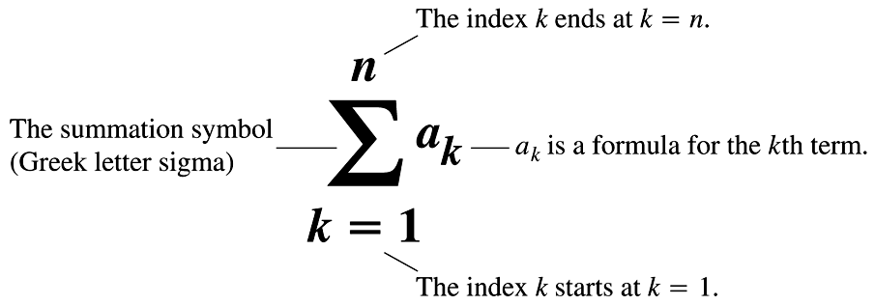
Sigma Notation
The notation we use for sums, called sigma notation, is as follows: Say we need to sum $n$ many terms, $a_{1}, a_{2}, a_{3},…, a_{n−1}, a_{n}$. We write
$$a_{1}+a_{2}+a_{3}+⋯+a_{n−1}+a_{n}=\sum_{k=1}^{n}{a_{k}}$$
and read $\sum_{k=1}^{n}{a_{k}}$ as “the sum of $a_{k}$ as $k$ goes from $1$ to $n$.”
The meanings of the various symbols used in this sigma notation are given in the following figure:

Slide 19
EXAMPLE Interpret, but do not attempt to evaluate, the following sums.
$\sum_{k=3}^{10}{k^{2}}$
$\sum_{k=1}^{100}{f\left(k\right)}$
$\sum_{k=3}^{10}{k^{2}}=3^{2}+4^{2}+5^{2}+6^{2}+7^{2}+8^{2}+9^{2}+{10}^{2}$
$\sum_{k=1}^{100}{f\left(k\right)}=f\left(1\right)+f\left(2\right)+f\left(3\right)+⋯+f\left(99\right)+f\left(100\right)$
Note: While the letter $k$ is typically used for the index variable, it need not be. In fact, any letter will do.

Slide 20
EXAMPLE Interpret and evaluate the following sums.
$$\sum_{k=1}^{5}{k}$$
$$=1+2+3+4+5$$
$$=\boxed{15}$$
$$\sum_{k=1}^{3}{{\left(−1\right)}^{k}k}$$
$$={\left(−1\right)}^{1}\left(1\right)+{\left(−1\right)}^{2}\left(2\right)+{\left(−1\right)}^{3}\left(3\right)$$
$$=−1+2−3=\boxed{−2}$$
$$\sum_{k=1}^{2}{\frac{k}{k+1}}$$
$$=\frac{1}{2}+\frac{2}{3}=\boxed{\frac{7}{6}}$$
$$=\frac{1}{1+1}+\frac{2}{2+1}$$
$$\sum_{k=4}^{5}{\frac{k^{2}}{k−1}}$$
$$=\frac{4^{2}}{4−1}+\frac{5^{2}}{5−1}$$
$$=\frac{16}{3}+\frac{25}{4}=\boxed{\frac{139}{12}}$$

Slide 21
Finite Sums
We now turn our attention to techniques for evaluating such sums, typically involving many more terms.
The sum/difference rules are nothing more than rearrangements of terms.
The constant multiple rule is a glorified GCF.
And the constant value rule is simply the definition of multiplication.

Slide 22
EXAMPLE Demonstrate the preceding algebra rules on the following sums.
$\sum_{k=1}^{3}{\left(k+4\right)}$
$\sum_{k=1}^{n}{\frac{1}{n}}$
$\sum_{k=1}^{3}{\left(k+4\right)}=\sum_{k=1}^{3}{k}+\sum_{k=1}^{3}{4}$
$=\left(1+2+3\right)+\left(3⋅4\right)=\boxed{18}$
$\sum_{k=1}^{n}{\frac{1}{n}}=n⋅\frac{1}{n}=\boxed{1}$

Slide 23
Finite Sums
We still face the problem of evaluating such sums when the number of terms is large. For example, what is $\sum_{k=1}^{100}{k}$ (the sum of the first 100 whole numbers)?
The following formulas allow us to perform these calculations very simply:
So that
$\sum_{k=1}^{100}{k}=\frac{100\left(101\right)}{2}=5050$.
Sum of the first $n$ whole numbers: | $$\sum_{k=1}^{n}{k}=\frac{n\left(n+1\right)}{2}$$
Sum of the first $n$ squares: | $$\sum_{k=1}^{n}{k^{2}}=\frac{n\left(n+1\right)\left(2n+1\right)}{6}$$
Sum of the first $n$ cubes: | $$\sum_{k=1}^{n}{k^{3}}={\left(\frac{n\left(n+1\right)}{2}\right)}^{2}$$

Slide 24
EXAMPLE Approximate the area in the first quadrant under the curve $y=1−x^{2}$ using $n$ rectangles of equal width whose heights are given by right-endpoint values (see figure).
For $n$ rectangles, the interval $\left[0, 1\right]$ must be divided into $n$ subintervals, as follows:
$\left[0,\frac{1}{n}\right], \left[\frac{1}{n},\frac{2}{n}\right], \left[\frac{2}{n},\frac{3}{n}\right], …, \left[\frac{n−1}{n},\frac{n}{n}\right]$.
Each subinterval will thus have width $\frac{1}{n}$, and the corresponding rectangles will have heights $f\left(\frac{1}{n}\right), f\left(\frac{2}{n}\right), f\left(\frac{3}{n}\right),⋯, f\left(\frac{n}{n}\right)$.
We can represent the sum of the areas of these approximating rectangles by
$\frac{1}{n}⋅f\left(\frac{1}{n}\right)+\frac{1}{n}⋅f\left(\frac{2}{n}\right)+⋯+\frac{1}{n}⋅f\left(\frac{n}{n}\right)=\sum_{k=1}^{n}{\left[\frac{1}{n}⋅f\left(\frac{k}{n}\right)\right]}$
Since $f\left(x\right)=1−x^{2}$, we further have
$\sum_{k=1}^{n}{\left[\frac{1}{n}⋅f\left(\frac{k}{n}\right)\right]}=\sum_{k=1}^{n}{\left[\frac{1}{n}⋅\left(1−{\left(\frac{k}{n}\right)}^{2}\right)\right]}=\sum_{k=1}^{n}{\left[\frac{1}{n}−\frac{k^{2}}{n^{3}}\right]}$

Slide 25
EXAMPLE Approximate the area in the first quadrant under the curve $y=1−x^{2}$ using $n$ rectangles of equal width whose heights are given by right-endpoint values (see figure).
We now use our algebra rules for sums to evaluate
$\sum_{k=1}^{n}{\left[\frac{1}{n}−\frac{k^{2}}{n^{3}}\right]}=\sum_{k=1}^{n}{\frac{1}{n}}−\sum_{k=1}^{n}{\frac{k^{2}}{n^{3}}}$
$=\sum_{k=1}^{n}{\frac{1}{n}}−\frac{1}{n^{3}}\sum_{k=1}^{n}{k^{2}}$
$=\left(n⋅\frac{1}{n}\right)−\frac{1}{n^{3}}\left[\frac{n\left(n+1\right)\left(2n+1\right)}{6}\right]$
$=1−\frac{1}{n^{3}}\left[\frac{2n^{3}+3n^{2}+n}{6}\right]$
$=1−\frac{1}{n^{3}}\left[\frac{n^{3}}{3}+\frac{n^{2}}{2}+\frac{n}{6}\right]$
$=1−\frac{1}{3}−\frac{1}{2n}−\frac{1}{6n^{2}}$
$=\boxed{\frac{2}{3}−\frac{1}{2n}−\frac{1}{6n^{2}}}$

Slide 26
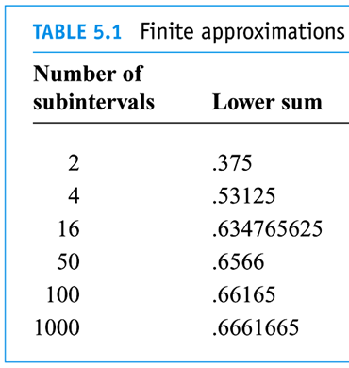
Limits of Finite Sums
We can use this result, $\sum_{k=1}^{n}{\left[\frac{1}{n}⋅f\left(\frac{k}{n}\right)\right]}=\frac{2}{3}−\frac{1}{2n}−\frac{1}{6n^{2}}$ to verify the lower sum approximations given in Table 5.1 in the last section.
With $n=4$ rectangles, we have
$Area≈\frac{2}{3}−\frac{1}{2\left(4\right)}−\frac{1}{6{\left(4\right)}^{2}}=\frac{2}{3}−\frac{1}{8}−\frac{1}{96}=0.53125$
With $n=50$ rectangles, we have
$Area≈\frac{2}{3}−\frac{1}{100}−\frac{1}{15,000}=0.6566$
With $n=1000$ rectangles, we have
$Area≈\frac{2}{3}−\frac{1}{2000}−\frac{1}{6,000,000}=0.6661665$
We previously guessed that these numbers look like they are approaching $\frac{2}{3}$, and we can now state that the limit of these finite approximations as the number of rectangles increases is
$\lim_{n→∞}{\sum_{k=1}^{n}{\left[\frac{1}{n}⋅f\left(\frac{k}{n}\right)\right]}}=\lim_{n→∞}\left[\frac{2}{3}−\frac{1}{2n}−\frac{1}{6n^{2}}\right]=\frac{2}{3}$.

Slide 27
Riemann Sums
Let’s attempt to generalize the process we just used to find the area under the curve $y=1−x^{2}$.
We first subdivide an $x$-interval $\left[a,b\right]$ into $n$ many subintervals, obtaining a “change in $x$” that will act as our rectangle widths. Let’s denote this change in the variable $x$ by $∆x$.
Such a subdivision is called a partition of the interval $\left[a,b\right]$, and since the subintervals need not be of equal width, we will call the width of the $k$th subinterval $∆x_{k}$.
We then choose any $x$-value within each subinterval, let’s call our choice $c_{k}$, and evaluate the function at that $x$-value to obtain the height of each rectangle, $f\left(c_{k}\right)$.

Slide 28
Riemann Sums
Summing the areas of the $n$ rectangles gives what is known as a Riemann sum:
$$\sum_{k=1}^{n}{f\left(c_{k}\right)∆x_{k}}$$
We then take the limit as the partition gets finer and finer, i.e., as the subintervals get smaller and smaller, and we call this the area under the curve.
To make the notation somewhat simpler, lets say we divide the interval $\left[a,b\right]$ into $n$ subintervals of equal width, so that we have only one $∆x$, given by $∆x=\frac{b−a}{n}$.
In this case, making the subintervals smaller and smaller simply means increasing $n$ (the number of rectangles), and we may write the area under the curve as
$$\lim_{n→∞}{\sum_{k=1}^{n}{f\left(c_{k}\right)∆x}}$$
This “limit of a Riemann sum” will define the integral (Section 5.3) much as the “limit of a difference quotient” defined the derivative (Section 3.2).

