Slide 1
2.4
Continuity

Slide 2
Goals
Definition of a Continuous Function
Continuity Test
Algebra of Continuous Functions
Compositions of Continuous Functions
Intermediate Value Theorem for Continuous Functions

Slide 3
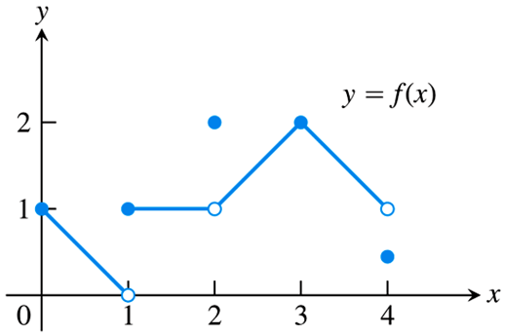
Continuity: A First Example
A continuous function is one whose graph can be drawn in one continuous motion, without lifting pencil from paper.
In this section we give a more precise definition of continuity, in terms of limits, as well as investigating some of the properties of continuous functions.
It helps first to consider when a function is discontinuous, as in the graph of one of our examples from Section 2.4:
This graph is discontinuous when you are forced to “pick up your pencil” as you draw it:
Points of discontinuity: $x=1, 2, 4$.
At all other points, the function is continuous:
Points of continuity: $\left[0,1\right)∪\left(1,2\right)∪\left(2,4\right)$.

Slide 4
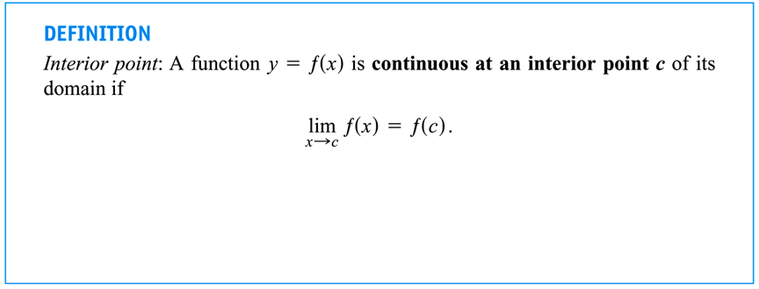
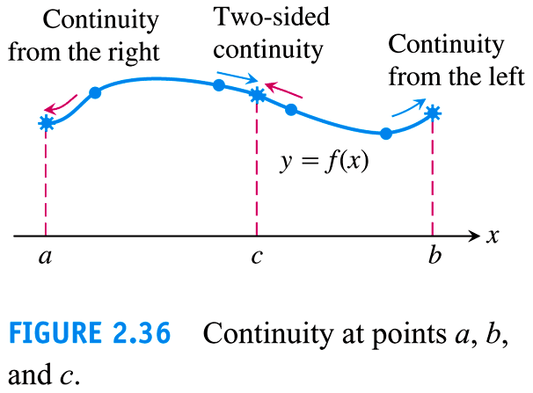
Continuity: A First Example
A careful study of the last example suggests that continuity can be defined in terms of limits, as follows:
Note that at a domain endpoint we only need “one-sided” continuity.

Slide 5
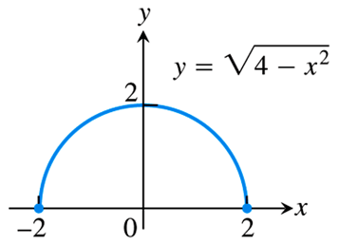
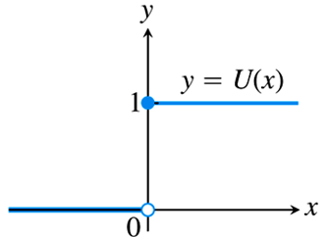
EXAMPLE Discuss the continuity of the following functions.
$f\left(x\right)=\sqrt{4−x^{2}}$
$U\left(x\right)=\left\{\begin{matrix}0 & \text{if} x<0 \\ 1 & \text{if} x≥0\end{matrix}\right.$
The function $\sqrt{4−x^{2}}$ is continuous at every point of its domain $\left[−2, 2\right]$, including being right-continuous at $x=−2$, and left- continuous at $x=2$. We call a function that is continuous on its entire domain a continuous function.
The “unit step-function” $U\left(x\right)$ is right- continuous at $x=0$, but not left-continuous. Hence, $U\left(x\right)$ is discontinuous at $x=0$; although it is continuous at every other point of its domain $\left(−∞, ∞\right)$.

Slide 6
A Test for Continuity
The previous examples suggest that a function is discontinuous when:
The function does not exist at a given point, e.g., when there is a “hole” in the graph.
The function “jumps” from one $y$-value to another at a given point.
While more complicated situations can sometimes occur, the above ideas can be generalized into the following test for continuity at a point.

Slide 7
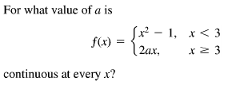
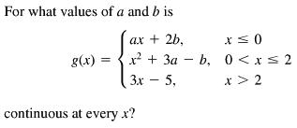
EXAMPLE
EXAMPLE

Slide 8
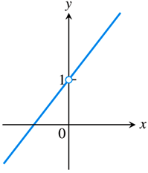
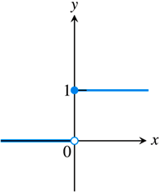
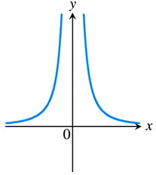
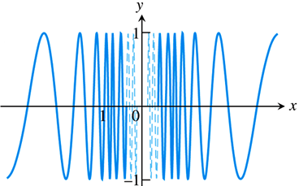
Types of Discontinuity
There are four general types of discontinuities, illustrated by the following graphs:
The graph on the left shows a removable discontinuity, i.e., one that may be removed by an appropriate definition of the function at $x=0$.
If we define a new function, $g\left(x\right)=\left\{\begin{matrix}f\left(x\right) & \text{if} x≠0 \\ 1 & \text{if} x=0\end{matrix}\right.$, then $g\left(x\right)$ is called a continuous extension of $f\left(x\right)$.
The other graphs (from left to right) show jump, infinite, and oscillating discontinuities, respectively. (Note that none of these are removable.)

Slide 9
Algebra of Continuous Functions
Since continuous functions are such an important part of the work we do in Calculus, we need to be able to recognize a continuous function when we see it.
For example, we know that $y=x+1$ and $y=\sqrt{4−x^{2}}$ are continuous functions, but what about $f\left(x\right)=x+1−\sqrt{4−x^{2}}$?
The function $f\left(x\right)$ is simply the difference of two continuous functions, and as the next table points out, any algebraic combination of continuous functions is also continuous.

Slide 10
EXAMPLE
At what points are the given functions Continuous?

Slide 11
Compositions of Continuous Functions
More interesting, and as it turns out, very useful, is the fact that a composition of continuous functions is continuous, as the below figure illustrates.
This theorem is actually a consequence of a more general theorem about limits.

Slide 12
EXAMPLE Evaluate the following limits, showing ALL applications of Limit Laws (including Theorem 10 from the preceding slide).
$\lim_{x→π/2}{\cos\left(2x+\sin\left(\frac{3π}{2}+x\right)\right)}$
$\lim_{x→1}{\sin^{−1}\left(\frac{1−x}{1−x^{2}}\right)}$
$\lim_{x→0}{\sqrt{x+1}e^{\tan{x}}}$
$\lim_{x→π/2}{\cos\left(2x+\sin\left(\frac{3π}{2}+x\right)\right)}$
$=\cos\left(\lim_{x→π/2}\left(2x+\sin\left(\frac{3π}{2}+x\right)\right)\right)$ Theorem 10
$=\cos\left(\lim_{x→π/2}{2x}+\lim_{x→π/2}{\sin\left(\frac{3π}{2}+x\right)}\right)$ Sum Rule
$=\cos\left(2\lim_{x→π/2}{x}+\sin\left(\lim_{x→π/2}\left(\frac{3π}{2}+x\right)\right)\right)$ Constant Mult. / Thm. 10
$=\cos\left(2\lim_{x→π/2}{x}+\sin\left(\lim_{x→π/2}{\frac{3π}{2}}+\lim_{x→π/2}{x}\right)\right)$ Sum Rule
$=\cos\left(2\left(\frac{π}{2}\right)+\sin\left(\frac{3π}{2}+\frac{π}{2}\right)\right)=\cos\left(π+\sin\left(2π\right)\right)=\cos\left(π+0\right)=\boxed{−1}$

Slide 13
EXAMPLE Evaluate the following limits, showing ALL applications of Limit Laws (including Theorem 10 from the preceding slide).
$\lim_{x→π/2}{\cos\left(2x+\sin\left(\frac{3π}{2}+x\right)\right)}$
$\lim_{x→1}{\sin^{−1}\left(\frac{1−x}{1−x^{2}}\right)}$
$\lim_{x→0}{\sqrt{x+1}e^{\tan{x}}}$
$\lim_{x→1}{\sin^{−1}\left(\frac{1−x}{1−x^{2}}\right)}$
$=\sin^{−1}\left(\lim_{x→1}\left(\frac{1−x}{1−x^{2}}\right)\right)$ Theorem 10
$=\sin^{−1}\left(\lim_{x→1}\left(\frac{1−x}{\left(1−x\right)\left(1+x\right)}\right)\right)$
$=\sin^{−1}\left(\lim_{x→1}\left(\frac{1}{1+x}\right)\right)$
$=\sin^{−1}\left(\frac{\lim_{x→1}{1}}{\lim_{x→1}{1}+\lim_{x→1}{x}}\right)$ Quotient/Sum Rules
$=\sin^{−1}\left(\frac{1}{1+1}\right)=\sin^{−1}\left(\frac{1}{2}\right)=\boxed{\frac{π}{6}}$

Slide 14
EXAMPLE Evaluate the following limits, showing ALL applications of Limit Laws (including Theorem 10 from the preceding slide).
$\lim_{x→π/2}{\cos\left(2x+\sin\left(\frac{3π}{2}+x\right)\right)}$
$\lim_{x→1}{\sin^{−1}\left(\frac{1−x}{1−x^{2}}\right)}$
$\lim_{x→0}{\sqrt{x+1}e^{\tan{x}}}$
$\lim_{x→0}{\sqrt{x+1}e^{\tan{x}}}$
$=\lim_{x→0}{\sqrt{x+1}}⋅\lim_{x→0}{e^{\tan{x}}}$ Product Rule
$=\sqrt{\lim_{x→0}\left(x+1\right)}⋅e^{\lim_{x→0}{\tan{x}}}$ Root Rule / Theorem 10
$=\sqrt{\lim_{x→0}{x}+\lim_{x→0}{1}}⋅e^{\tan\left(\lim_{x→0}{x}\right)}$ Sum Rule / Theorem 10
$=\sqrt{0+1}⋅e^{\tan\left(0\right)}=\sqrt{1}⋅e^{0}=\left(1\right)\left(1\right)=\boxed{1}$

Slide 15
Intermediate Value Theorem

Slide 16
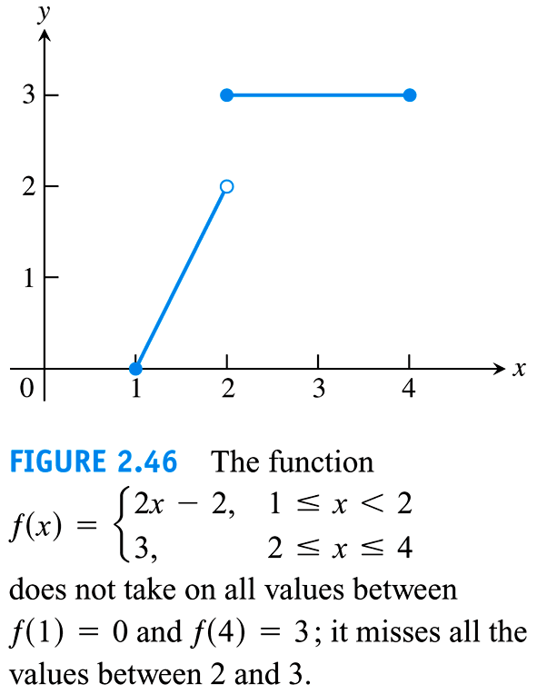
Example

Slide 17
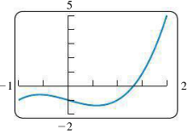
A Consequence for root finding:
We call a solution of the equation f(x)=0 a root of the equation or zero of the function.
Example
$f\left(x\right)=x^{3}−x−1$ is a continuous function.
$$f\left(1\right)=1−1−1=−1<0$$
$$f\left(2\right)=8−2−1=5>0$$

