Slide 1
3.4
The Derivative as Rates of Change

Slide 2
Interpreting Derivatives as Rates of Change
Suppose a body is in one-dimensional motion, and the function $s\left(t\right)$ gives the position (or displacement) of the body at a given time.
Then the first derivative $\frac{ds}{dt}$ gives the rate of change of the body’s position, or how fast the body is moving, i.e., the body’s velocity.
Actually, $\frac{ds}{dt}$ also gives the direction in which the body is moving:
when $\frac{ds}{dt}$ is positive, the body is moving forward;
and when $\frac{ds}{dt}$ is negative, the body is moving backward.
We differentiate between the terms velocity and speed in that speed does not take into account direction, i.e., speed is always positive.

Slide 3
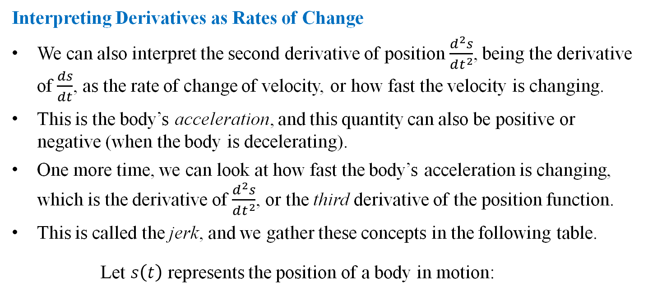
Interpreting Derivatives as Rates of Change
We can also interpret the second derivative of position $\frac{d^{2}s}{dt^{2}}$, being the derivative of $\frac{ds}{dt}$, as the rate of change of velocity, or how fast the velocity is changing.
This is the body’s acceleration, and this quantity can also be positive or negative (when the body is decelerating).
One more time, we can look at how fast the body’s acceleration is changing, which is the derivative of $\frac{d^{2}s}{dt^{2}}$, or the third derivative of the position function.
This is called the jerk, and we gather these concepts in the following table.
Let $s\left(t\right)$ represents the position of a body in motion:
Velocity | $v\left(t\right)=\frac{ds}{dt}=s^{′}\left(t\right)$
Speed | $\left|v\left(t\right)\right|$
Acceleration | $a\left(t\right)=\frac{d^{2}s}{dt^{2}}=s^{′′}\left(t\right)=v^{′}\left(t\right)$
Jerk | $j\left(t\right)=\frac{d^{3}s}{dt^{3}}=s^{′′′}\left(t\right)=a^{′}\left(t\right)$

Slide 4
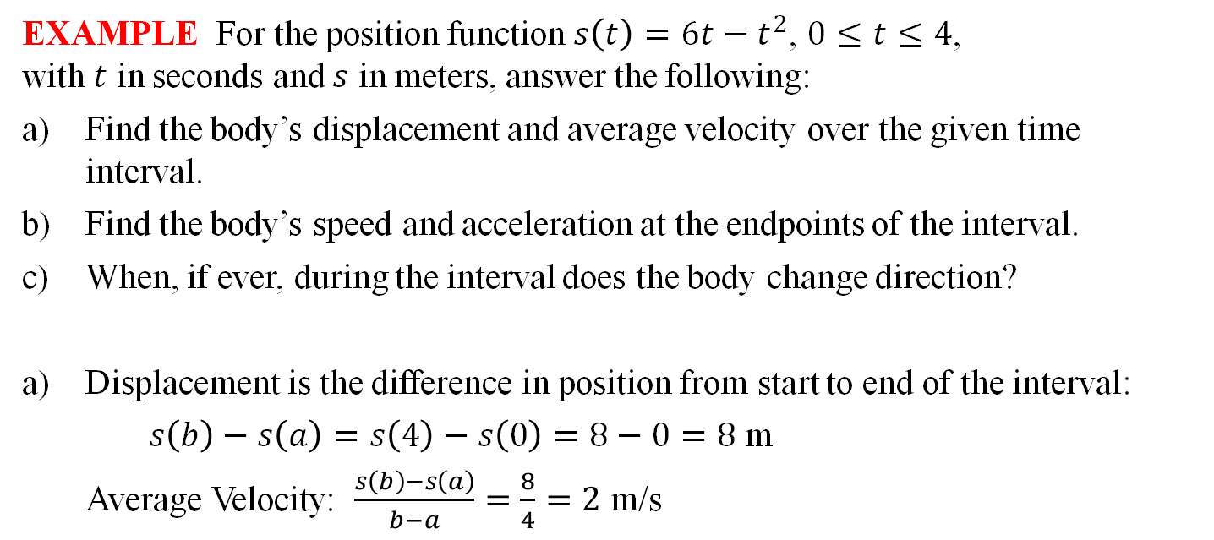
EXAMPLE For the position function $s\left(t\right)=6t−t^{2}$, $0≤t≤4$, with $t$ in seconds and $s$ in meters, answer the following:
Find the body’s displacement and average velocity over the given time interval.
Find the body’s speed and acceleration at the endpoints of the interval.
When, if ever, during the interval does the body change direction?
Displacement is the difference in position from start to end of the interval:
$s\left(b\right)−s\left(a\right)=s\left(4\right)−s\left(0\right)=8−0=8$ m
Average Velocity: $\frac{s\left(b\right)−s\left(a\right)}{b−a}=\frac{8}{4}=2$ m/s

Slide 5
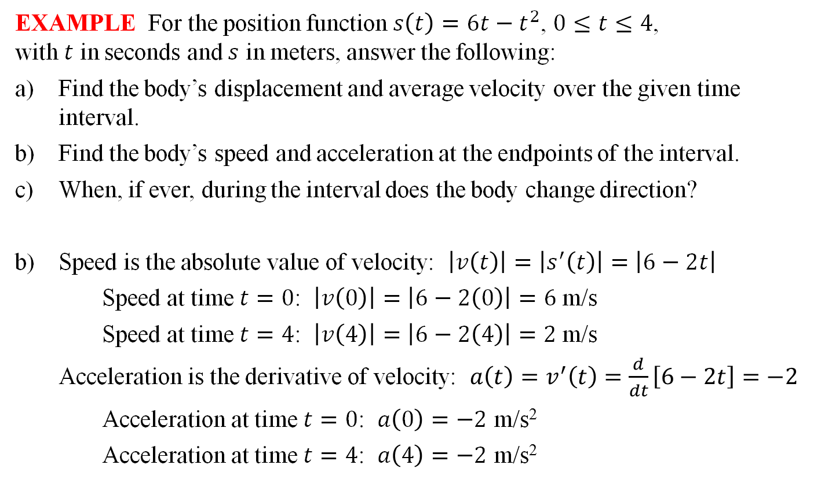
EXAMPLE For the position function $s\left(t\right)=6t−t^{2}$, $0≤t≤4$, with $t$ in seconds and $s$ in meters, answer the following:
Find the body’s displacement and average velocity over the given time interval.
Find the body’s speed and acceleration at the endpoints of the interval.
When, if ever, during the interval does the body change direction?
Speed is the absolute value of velocity: $\left|v\left(t\right)\right|=\left|s^{′}\left(t\right)\right|=\left|6−2t\right|$
Speed at time $t=0$: $\left|v\left(0\right)\right|=\left|6−2\left(0\right)\right|=6$ m/s
Speed at time $t=4$: $\left|v\left(4\right)\right|=\left|6−2\left(4\right)\right|=2$ m/s
Acceleration is the derivative of velocity: $a\left(t\right)=v^{′}\left(t\right)=\frac{d}{dt}\left[6−2t\right]=−2$
Acceleration at time $t=0$: $a\left(0\right)=−2$ m/s²
Acceleration at time $t=4$: $a\left(4\right)=−2$ m/s²

Slide 6
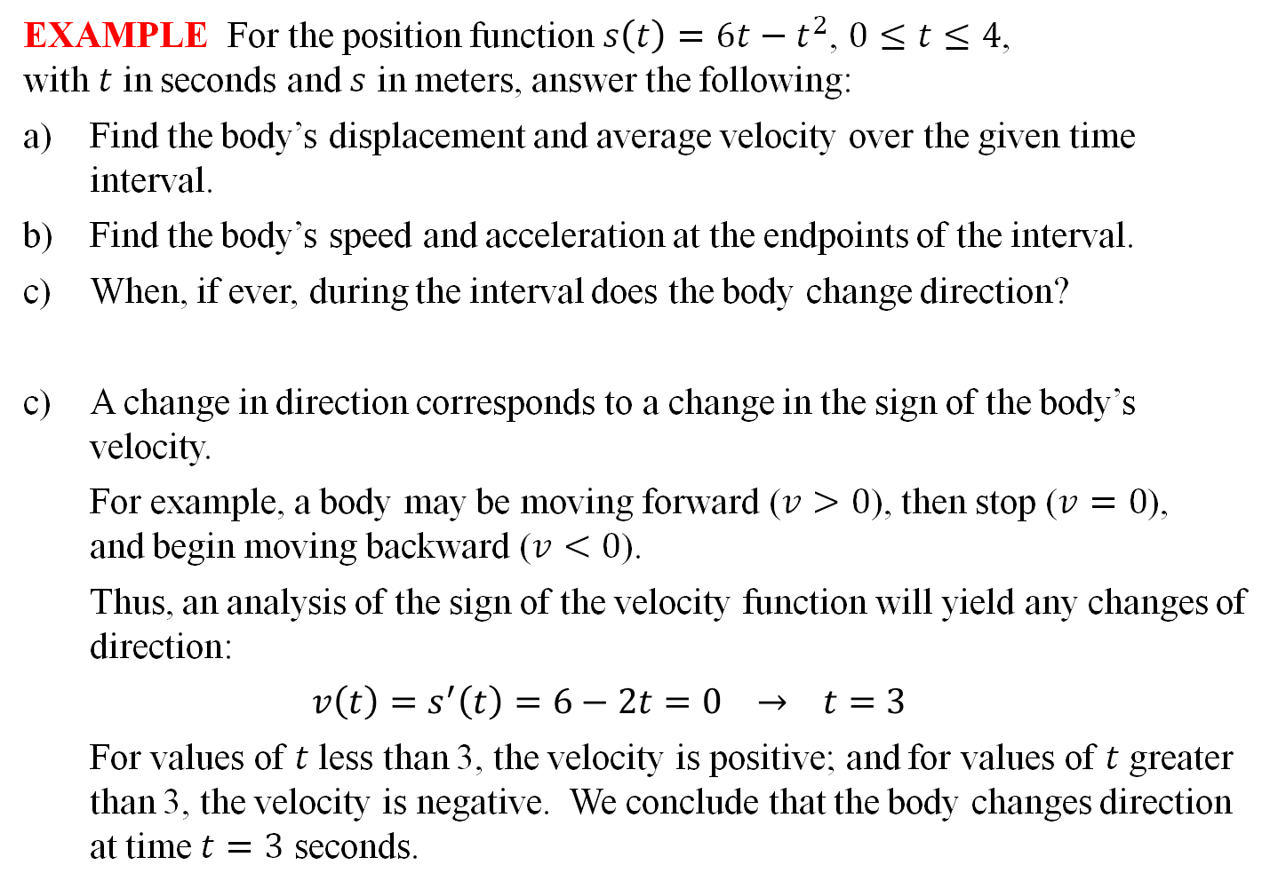
EXAMPLE For the position function $s\left(t\right)=6t−t^{2}$, $0≤t≤4$, with $t$ in seconds and $s$ in meters, answer the following:
Find the body’s displacement and average velocity over the given time interval.
Find the body’s speed and acceleration at the endpoints of the interval.
When, if ever, during the interval does the body change direction?
A change in direction corresponds to a change in the sign of the body’s velocity.
For example, a body may be moving forward ($v>0$), then stop ($v=0$), and begin moving backward ($v<0$).
Thus, an analysis of the sign of the velocity function will yield any changes of direction:
$$v\left(t\right)=s^{′}\left(t\right)=6−2t=0 → t=3$$
For values of $t$ less than 3, the velocity is positive; and for values of $t$ greater than 3, the velocity is negative. We conclude that the body changes direction at time $t=3$ seconds.

Slide 7
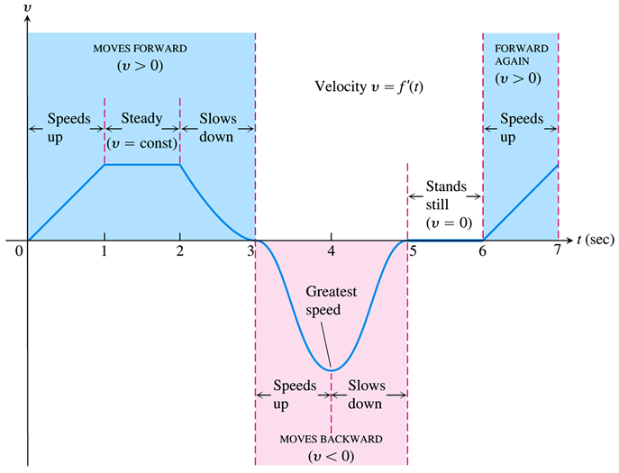
EXAMPLE The following figure shows the graph of the velocity of a body in motion. Consider the information we can obtain from such a graph.

Slide 8
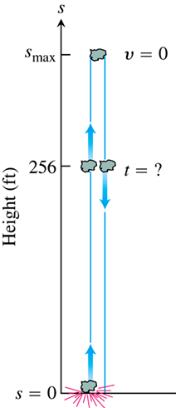
EXAMPLE A dynamite blast blows a heavy rock straight up with a launch velocity of 106 ft/sec. It reaches a height of $s=160t−16t^{2}$ ft after $t$ sec.
How high does the rock go?
What are the velocity and speed of the rock when it is 256 ft above the ground on the way up? On the way down?
What is the acceleration of the rock at any time $t$ during its flight?
When does the rock hit the ground again?
At the apex of its flight, the rock will be changing direction, and hence will have 0 velocity. Solving $v\left(t\right)=0$ gives
$v\left(t\right)=0$
$\frac{d}{dt}\left[160t−16t^{2}\right]=0$
$160−32t=0$
$t=5$ sec.
So the rock reaches a maximum height of $s\left(5\right)=400$ ft.

Slide 9
EXAMPLE A dynamite blast blows a heavy rock straight up with a launch velocity of 106 ft/sec. It reaches a height of $s=160t−16t^{2}$ ft after $t$ sec.
How high does the rock go?
What are the velocity and speed of the rock when it is 256 ft above the ground on the way up? On the way down?
What is the acceleration of the rock at any time $t$ during its flight?
When does the rock hit the ground again?
Solving $s\left(t\right)=256$ gives
$160t−16t^{2}=256$
$16t^{2}−160t+256=0$
$16\left(t−2\right)\left(t−8\right)=0$
$t=2, 8$ sec.
The rock reaches a height of 256 ft on the way up at 2 sec, and on the way down at 8 sec.

Slide 10
EXAMPLE A dynamite blast blows a heavy rock straight up with a launch velocity of 106 ft/sec. It reaches a height of $s=160t−16t^{2}$ ft after $t$ sec.
How high does the rock go?
What are the velocity and speed of the rock when it is 256 ft above the ground on the way up? On the way down?
What is the acceleration of the rock at any time $t$ during its flight?
When does the rock hit the ground again?
With $v\left(t\right)=\frac{d}{dt}\left[160t−16t^{2}\right]=160−32t$, we have:
On the way up:
Velocity: $v\left(2\right)=160−32\left(2\right)=96$ ft/sec
Speed: $\left|v\left(2\right)\right|=96$ ft/sec
On the way down:
Velocity: $v\left(8\right)=160−32\left(8\right)=−96$ ft/sec
Speed: $\left|v\left(8\right)\right|=96$ ft/sec.

Slide 11
EXAMPLE A dynamite blast blows a heavy rock straight up with a launch velocity of 106 ft/sec. It reaches a height of $s=160t−16t^{2}$ ft after $t$ sec.
How high does the rock go?
What are the velocity and speed of the rock when it is 256 ft above the ground on the way up? On the way down?
What is the acceleration of the rock at any time $t$ during its flight?
When does the rock hit the ground again?
The acceleration of the rock is given by the second derivative of the position function (or the derivative of velocity):
$a\left(t\right)=v^{′}\left(t\right)=\frac{d}{dt}\left[160−32t\right]=−32$
Thus, at any time during the interval, the rock’s acceleration is $−32$ ft/s².

Slide 12
EXAMPLE A dynamite blast blows a heavy rock straight up with a launch velocity of 106 ft/sec. It reaches a height of $s=160t−16t^{2}$ ft after $t$ sec.
How high does the rock go?
What are the velocity and speed of the rock when it is 256 ft above the ground on the way up? On the way down?
What is the acceleration of the rock at any time $t$ during its flight?
When does the rock hit the ground again?
The rock will hit the ground when its height above ground (or position) is 0. Solving $s\left(t\right)=0$ gives
$160t−16t^{2}=0$
$16t\left(10−t\right)=0$
$t=0, 10$ sec
Thus, the rock will hit the ground again after 10 seconds.

Slide 13
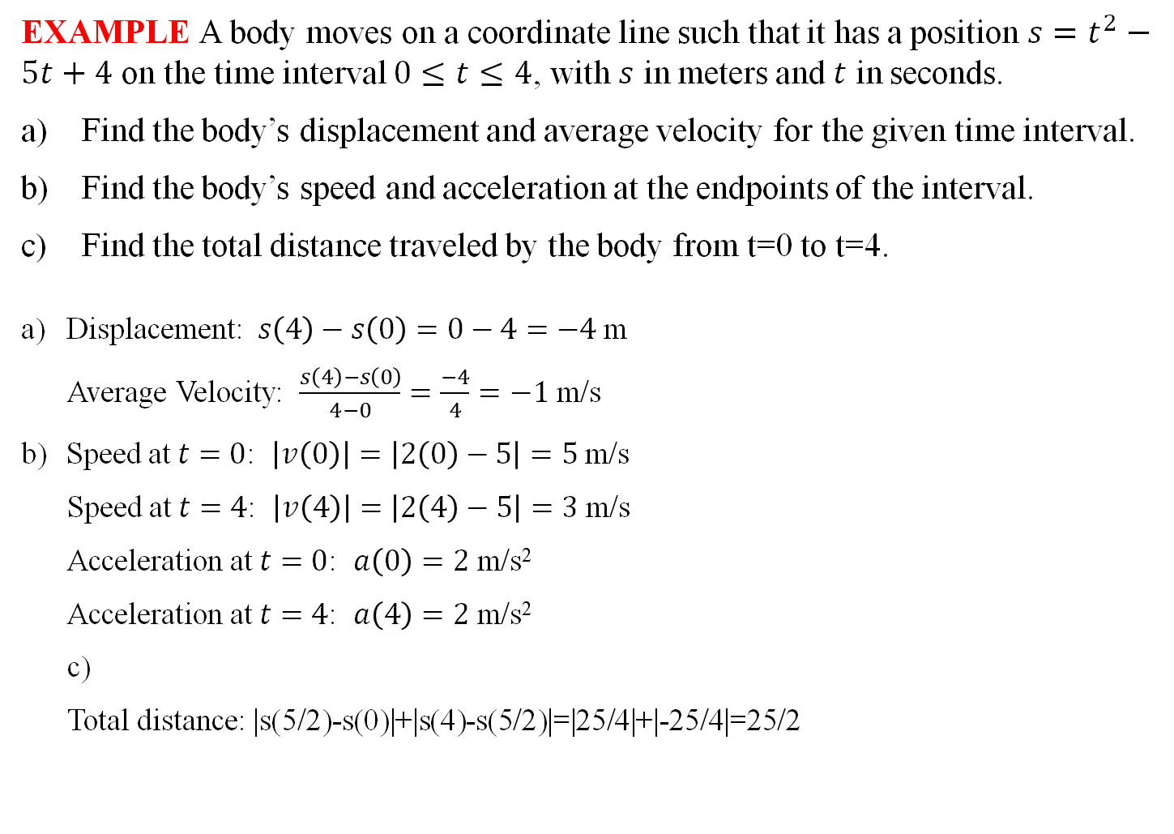
EXAMPLE A body moves on a coordinate line such that it has a position $s=t^{2}−5t+4$ on the time interval $0≤t≤4$, with $s$ in meters and $t$ in seconds.
Find the body’s displacement and average velocity for the given time interval.
Find the body’s speed and acceleration at the endpoints of the interval.
Find the total distance traveled by the body from t=0 to t=4.
Displacement: $s\left(4\right)−s\left(0\right)=0−4=−4$ m
Average Velocity: $\frac{s\left(4\right)−s\left(0\right)}{4−0}=\frac{−4}{4}=−1$ m/s
Speed at $t=0$: $\left|v\left(0\right)\right|=\left|2\left(0\right)−5\right|=5$ m/s
Speed at $t=4$: $\left|v\left(4\right)\right|=\left|2\left(4\right)−5\right|=3$ m/s
Acceleration at $t=0$: $a\left(0\right)=2$ m/s²
Acceleration at $t=4$: $a\left(4\right)=2$ m/s²
c)
Total distance: |s(5/2)-s(0)|+|s(4)-s(5/2)|=|25/4|+|-25/4|=25/2
$$v\left(t\right)=s^{′}\left(t\right)=2t−5$$
$$a\left(t\right)=v^{′}\left(t\right)=2$$
$v\left(t\right)=s^{′}\left(t\right)=2t−5$=0, t=5/2

