Slide 1
3.7
Derivatives of Inverse Functions

Slide 2
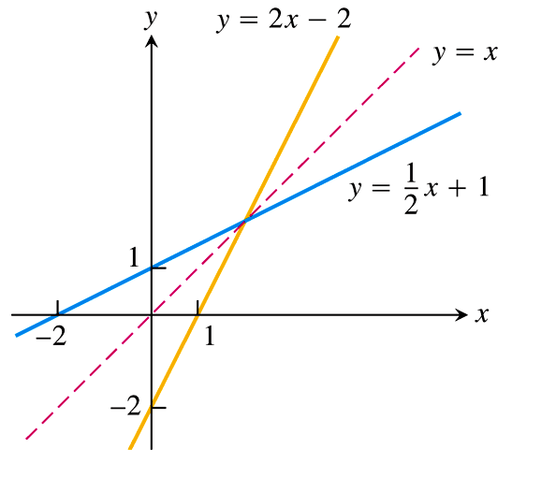
Derivatives of Inverse Functions

Slide 3
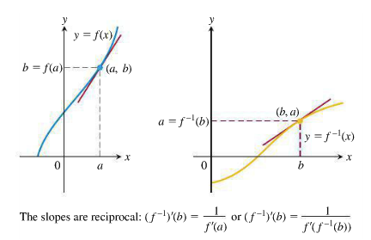
In general, if $f^{−1}$ is the inverse of a function $f$, and we want to find the derivative of the function $y=f^{−1}\left(x\right)$, we have
$\frac{d}{dx}\left[f^{−1}\left(b\right)\right]=\frac{1}{f^{′}\left(f^{−1}\left(b\right)\right)}=\frac{1}{f^{′}\left(a\right)}$

Slide 4
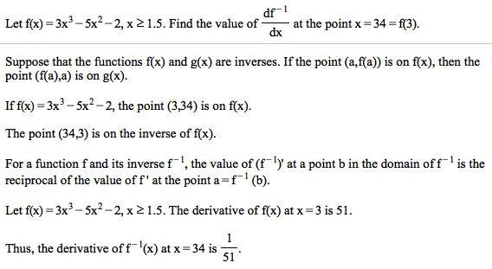
EXAMPLE

Slide 5
Quick Review of Inverse Trigonometric Functions
Recall that with trigonometric functions like $\sin{x}$ and $\cos{x}$ the argument, or input, $x$ is an angle, and the output is the value of the function.
Recall also that with inverse trigonometric functions like $\sin^{−1}{x}$ and $\cos^{−1}{x}$ the input $x$ is the value of the trigonometric function, and the output is an angle.
For example,
$\sin\left(\frac{π}{4}\right)=\frac{\sqrt{2}}{2}$
$\tan\left(\frac{π}{3}\right)=\sqrt{3}$
$\sec\left(\frac{π}{6}\right)=\frac{2}{\sqrt{3}}$
$\cos{x}=y$
Finally, recall that many angles give the same value for a trigonometric function. For example, $\sin{0}=\sin{π}=\sin{2π}=0$, but in order for the inverse to be a function, we must have one value corresponding to only one angle.
To this end, we restrict the ranges of the inverse trigonometric functions, as displayed in the graphs on the following slide.
$→$ $\sin^{−1}\left(\frac{\sqrt{2}}{2}\right)=\frac{π}{4}$
$→$ $\tan^{−1}\left(\sqrt{3}\right)=\frac{π}{3}$
$→$ $\sec^{−1}\left(\frac{2\sqrt{3}}{3}\right)=\frac{π}{6}$
$→$ $\cos^{−1}{y}=x$

Slide 6
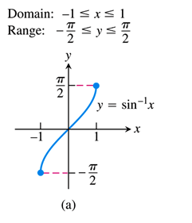
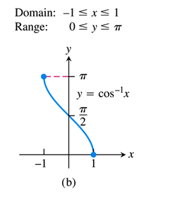
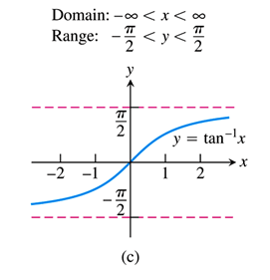
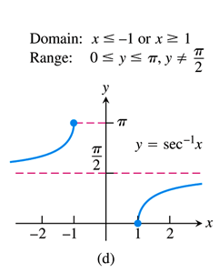
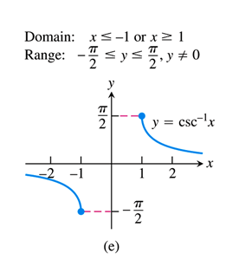
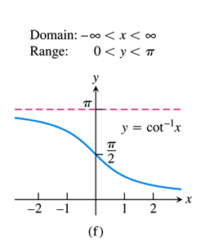
Graphs of Inverse Trigonometric Functions

Slide 7
Derivatives of Inverse Trigonometric Functions
In Section 3.8, we developed the following formula for derivatives of inverse functions:
$$\frac{d}{dx}\left[f^{−1}\left(x\right)\right]=\frac{1}{f^{′}\left(f^{−1}\left(x\right)\right)}$$
We can, and your book does, use this formula to find, say, the derivative of $y=\sin^{−1}{x}$, but I think it is more intuitive to perform the implicit differentiation directly, as follows:
$y=\sin^{−1}{x}$
$\sin{y}=x$
$\frac{d}{dx}\left[\sin{y}\right]=\frac{d}{dx}\left[x\right]$
$\cos{y}⋅\frac{dy}{dx}=1$
$\frac{dy}{dx}=\frac{1}{\cos{y}}$
$\frac{d}{dx}\left[\sin^{−1}{x}\right]=\frac{1}{\sqrt{1−x^{2}}}$
$$\sin{y}=\frac{x}{1}$$
$$1$$
$$x$$
$$y$$
$$\sqrt{1−x^{2}}$$
$$\cos{y}=\frac{\sqrt{1−x^{2}}}{1}=\sqrt{1−x^{2}}$$

Slide 8
Derivatives of Inverse Trigonometric Functions
A similar treatment gives the derivative of the inverse tangent function:
$y=\tan^{−1}{x}$
$\tan{y}=x$
$\frac{d}{dx}\left[\tan{y}\right]=\frac{d}{dx}\left[x\right]$
$\sec^{2}{y}⋅\frac{dy}{dx}=1$
$\frac{dy}{dx}=\frac{1}{\sec^{2}{y}}$
$\frac{d}{dx}\left[\tan^{−1}{x}\right]=\frac{1}{x^{2}+1}$
We can find the derivatives of the other inverse trigonometric functions in similar fashion, and the results are summarized on the following slide.
$$\tan{y}=\frac{x}{1}$$
$$\sqrt{x^{2}+1}$$
$$x$$
$$y$$
$$1$$
$$\sec^{2}{y}={\left(\sqrt{x^{2}+1}\right)}^{2}=x^{2}+1$$

Slide 10
EXAMPLE Find the derivative of the following functions.
$f\left(x\right)=\sin^{−1}\left(x^{2}\right)$
$f\left(x\right)=\sec^{−1}\left(5x^{4}\right)$
c)
d)
$f^{′}\left(x\right)=\frac{1}{\sqrt{1−{\left(x^{2}\right)}^{2}}}⋅\frac{d}{dx}\left[x^{2}\right]$
$=\frac{1}{\sqrt{1−x^{4}}}\left(2x\right)$
$\boxed{f^{′}\left(x\right)=\frac{2x}{\sqrt{1−x^{4}}}}$
$f^{′}\left(x\right)=\frac{1}{\left|5x^{4}\right|\sqrt{{\left(5x^{4}\right)}^{2}−1}}⋅\frac{d}{dx}\left[5x^{4}\right]$
$=\frac{1}{5x^{4}\sqrt{25x^{8}−1}}\left(20x^{3}\right)$
$\boxed{f^{′}\left(x\right)=\frac{4}{x\sqrt{25x^{8}−1}}}$

Slide 11
Classwork
Find the derivative of the following function.
$$f\left(x\right)=\ln\left(\tan^{−1}\left(2x^{4}\right)\right)$$
$f^{′}\left(x\right)=\frac{1}{\tan^{−1}\left(2x^{4}\right)}⋅{\left[\tan^{−1}\left(2x^{4}\right)\right]}^{′}$
$=\frac{1}{\tan^{−1}\left(2x^{4}\right)}⋅\frac{{\left[2x^{4}\right]}^{′}}{1+{\left(2x^{4}\right)}^{2}}$
$\boxed{f^{′}\left(x\right)=\frac{8x^{3}}{\left(1+4x^{8}\right)\tan^{−1}\left(2x^{4}\right)}}$
$\frac{d}{dx}\left[\ln{u}\right]=\frac{u^{′}}{u}$
$$\frac{d}{dx}[\tan^{−1}\left(u\right)]=\frac{u^{′}}{1+u^{2}}$$

