Slide 1
3.3
Differentiation Rules

Slide 2
Derivatives of Polynomial Functions
In previous sections we have placed much emphasis on various interpretations of the derivative of a function.
In this section we set aside (for the moment) these interpretations and ask instead: “Is there an easier way than limits of difference quotients to find derivatives of functions?”
The answer is “YES!” and we will spend this section proving several Differentiation Rules that will allow us to skip the limit definition of a derivative.
Our first task is to find the derivative of a polynomial function, like $x^{3}+\frac{4}{3}x^{2}−5x+1$, which is a sum/difference of a constant and constant multiples of powers of $x$.

Slide 3
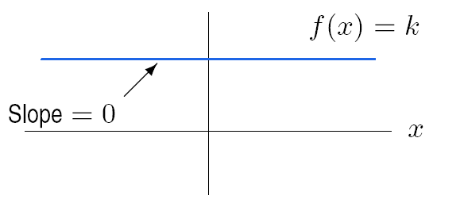
Derivative of a Constant Function
First, let’s find the derivative of a constant function $f\left(x\right)=k$. In this case, we have
$f^{′}\left(x\right)=\lim_{h→0}{\frac{f\left(x+h\right)−f\left(x\right)}{h}}$
$=\lim_{h→0}{\frac{k−k}{h}}$
$=\lim_{h→0}{0}$
$=0.$
Our first differentiation rule, the Constant Rule, is
$$\frac{d}{dx}\left[k\right]=0.$$

Slide 4
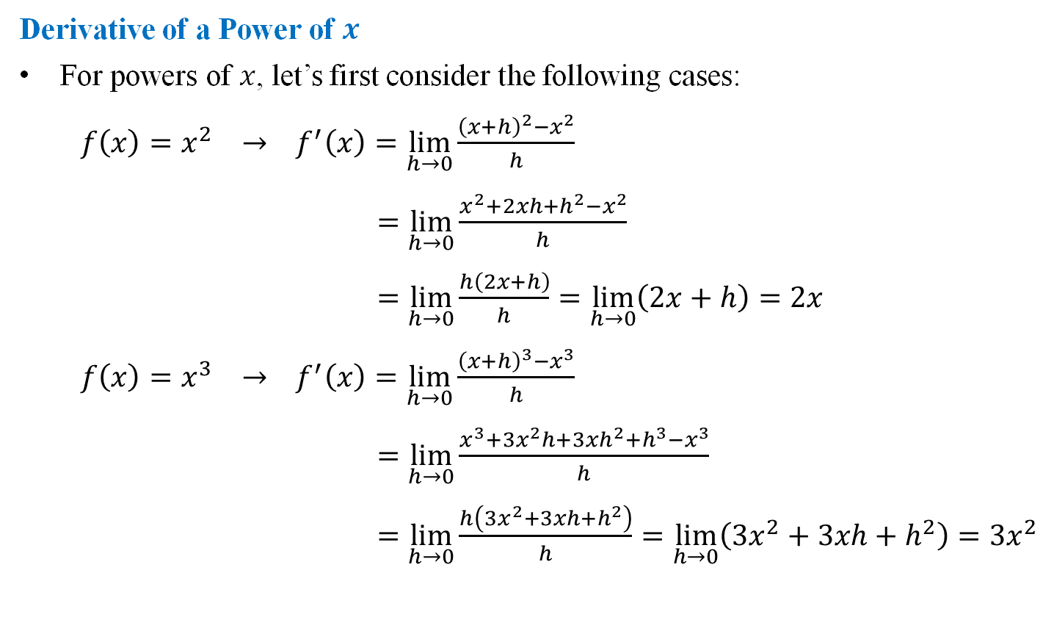
Derivative of a Power of $x$
For powers of $x$, let’s first consider the following cases:
$f\left(x\right)=x^{2} → f^{′}\left(x\right)=\lim_{h→0}{\frac{{\left(x+h\right)}^{2}−x^{2}}{h}}$
$=\lim_{h→0}{\frac{x^{2}+2xh+h^{2}−x^{2}}{h}}$
$=\lim_{h→0}{\frac{h\left(2x+h\right)}{h}}=\lim_{h→0}\left(2x+h\right)=2x$
$f\left(x\right)=x^{3} → f^{′}\left(x\right)=\lim_{h→0}{\frac{{\left(x+h\right)}^{3}−x^{3}}{h}}$
$=\lim_{h→0}{\frac{x^{3}+3x^{2}h+3xh^{2}+h^{3}−x^{3}}{h}}$
$=\lim_{h→0}{\frac{h\left(3x^{2}+3xh+h^{2}\right)}{h}}=\lim_{h→0}\left(3x^{2}+3xh+h^{2}\right)=3x^{2}$
Our second differentiation rule, the Power Rule, is then
$$\frac{d}{dx}\left[x^{n}\right]=nx^{n−1}$$

Slide 5
Derivative of a Constant Multiple of a Function
So we now know, say, that $\frac{d}{dx}\left[x^{2}\right]=2x$, but what about $\frac{d}{dx}\left[3x^{2}\right]$?
$f\left(x\right)=3x^{2} → f^{′}\left(x\right)=\lim_{h→0}{\frac{3{\left(x+h\right)}^{2}−3x^{2}}{h}}$
$=\lim_{h→0}{\frac{3x^{2}+6xh+3h^{2}−3x^{2}}{h}}$
$=\lim_{h→0}{\frac{h\left(6x+3h\right)}{h}}$
$=\lim_{h→0}\left(6x+3h\right)=6x+3\left(0\right)=6x$
Notice that $3x^{2}=3⋅x^{2}$ and $6x=3⋅2x$, or
$$\frac{d}{dx}\left[3x^{2}\right]=6x=3⋅2x=3⋅\frac{d}{dx}\left[x^{2}\right].$$
The Constant Multiple Rule:
$$\frac{d}{dx}\left[k⋅f\left(x\right)\right]=k⋅f^{′}\left(x\right)$$

Slide 6
Derivative of a Sum or Difference of Two Functions
It is also fairly straightforward to find the derivative of the sum (or difference) of two functions.
If we know $\frac{d}{dx}\left[f\left(x\right)\right]=f^{′}\left(x\right)$ and $\frac{d}{dx}\left[g\left(x\right)\right]=g^{′}\left(x\right)$, then
$\frac{d}{dx}\left[f\left(x\right)+g\left(x\right)\right]=\lim_{h→0}{\frac{\left[f\left(x+h\right)+g\left(x+h\right)\right]−\left[f\left(x\right)+g\left(x\right)\right]}{h}}$
$=\lim_{h→0}{\frac{\left[f\left(x+h\right)−f\left(x\right)\right]+\left[g\left(x+h\right)−g\left(x\right)\right]}{h}}$
$=\lim_{h→0}{\frac{f\left(x+h\right)−f\left(x\right)}{h}}+\lim_{h→0}{\frac{g\left(x+h\right)−g\left(x\right)}{h}}$
$=f^{′}\left(x\right)+g^{′}\left(x\right)$.
Derivatives of differences behave similarly, and we have the Sum/Difference Rules:
$$\frac{d}{dx}\left[f\left(x\right)±g\left(x\right)\right]=f^{′}\left(x\right)±g^{′}\left(x\right)$$

Slide 7
EXAMPLE Use the differentiation rules to find the derivatives of the following functions.
$f\left(x\right)=x^{2}+x+8$
$f\left(x\right)=$ $x^{3}+\frac{4}{3}x^{2}−5x+1$
$f\left(x\right)=\frac{5x+1}{2\sqrt{x}}$
$f^{′}\left(x\right)=\frac{d}{dx}\left[x^{2}\right]+\frac{d}{dx}\left[x\right]+\frac{d}{dx}\left[8\right]$
$=2x+1+0$
$\boxed{f^{′}\left(x\right)=2x+1}$
$f^{′}\left(x\right)=\frac{d}{dx}\left[x^{3}\right]+\frac{4}{3}⋅\frac{d}{dx}\left[x^{2}\right]−5⋅\frac{d}{dx}\left[x\right]+\frac{d}{dx}\left[1\right]$
$=3x^{2}+\frac{4}{3}\left(2x\right)−5\left(1\right)+0$
$\boxed{f^{′}\left(x\right)=3x^{2}+\frac{8}{3}x−5}$

Slide 8
EXAMPLE Use the differentiation rules to find the derivatives of the following functions.
$f\left(x\right)=x^{2}+x+8$
$f\left(x\right)=$ $x^{3}+\frac{4}{3}x^{2}−5x+1$
$f\left(x\right)=\frac{5x+1}{2\sqrt{x}}$
$f^{′}\left(x\right)=\frac{d}{dx}\left[\frac{5x}{2\sqrt{x}}+\frac{1}{2\sqrt{x}}\right]$
$=\frac{d}{dx}\left[\frac{5}{2}x^{1/2}+\frac{1}{2}x^{{−1}/2}\right]$
$=\frac{5}{2}⋅\frac{d}{dx}\left[x^{1/2}\right]+\frac{1}{2}⋅\frac{d}{dx}\left[x^{{−1}/2}\right]$
$=\frac{5}{2}⋅\frac{1}{2}x^{{−1}/2}+\frac{1}{2}⋅\left(−\frac{1}{2}\right)x^{{−3}/2}$
$\boxed{f^{′}\left(x\right)=\frac{5}{4}x^{{−1}/2}−\frac{1}{4}x^{{−3}/2}}$

Slide 9
Derivative of the Product of Two Functions
So we know the derivative of a sum is the sum of the derivatives, but is the derivative of a product the product of the derivatives?
The answer is NO, and this is one of the biggest mistakes that students make when finding derivatives.
The proof of the Product Rule follows; it’s awesome, but you don’t have to know it for this course. (Of course, you will need to know the Product Rule.)
$\frac{d}{dx}\left[f\left(x\right)⋅g\left(x\right)\right]=\lim_{h→0}{\frac{f\left(x+h\right)⋅g\left(x+h\right)−f\left(x\right)⋅g\left(x\right)}{h}}$
$=\lim_{h→0}{\frac{f\left(x+h\right)⋅g\left(x+h\right)−f\left(x\right)⋅g\left(x+h\right)+f\left(x\right)⋅g\left(x+h\right)−f\left(x\right)⋅g\left(x\right)}{h}}$
$=\lim_{h→0}{\frac{\left[f\left(x+h\right)−f\left(x\right)\right]⋅g\left(x+h\right)+f\left(x\right)⋅\left[g\left(x+h\right)−g\left(x\right)\right]}{h}}$
$=\lim_{h→0}\left[\left(\frac{f\left(x+h\right)−f\left(x\right)}{h}\right)⋅g\left(x+h\right)\right]+\lim_{h→0}\left[f\left(x\right)⋅\left(\frac{g\left(x+h\right)−g\left(x\right)}{h}\right)\right]$
$=f^{′}\left(x\right)⋅g\left(x+0\right)+f\left(x\right)⋅g^{′}\left(x\right)$
$=f^{′}\left(x\right)⋅g\left(x\right)+f\left(x\right)⋅g^{′}\left(x\right)$

Slide 10
Derivatives of Products and Quotients of Functions
The Product Rule is usually stated as
$$\frac{d}{dx}\left[f\left(x\right)⋅g\left(x\right)\right]=f\left(x\right)⋅g^{′}\left(x\right)+f^{′}\left(x\right)⋅g\left(x\right)$$
Of course, the order in which we multiply or add numbers doesn’t matter, so you may see the product rule written in a variety of equivalent ways.
There is a corresponding Quotient Rule for derivatives, the proof of which is even more fun and can be found in the text:
$$\frac{d}{dx}\left[\frac{f\left(x\right)}{g\left(x\right)}\right]=\frac{g\left(x\right)⋅f^{′}\left(x\right)−f\left(x\right)⋅g^{′}\left(x\right)}{{\left[g\left(x\right)\right]}^{2}}$$
Since the Quotient Rule involves subtraction, it is important not to mix up the terms in the numerator.

Slide 11
EXAMPLE Differentiate the function $f\left(x\right)=\left(x^{2}+1\right)\left(x^{3}+3\right)$ in two ways:
First by using the Product Rule,
Then by foiling and using the Power and Sum/Difference Rules.
$f^{′}\left(x\right)=\left(x^{2}+1\right){\left[x^{3}+3\right]}^{′}+{\left[x^{2}+1\right]}^{′}\left(x^{3}+3\right)$
$=\left(x^{2}+1\right)\left(3x^{2}\right)+\left(2x\right)\left(x^{3}+3\right)$
$=3x^{4}+3x^{2}+2x^{4}+6x$
$\boxed{f^{′}\left(x\right)=5x^{4}+3x^{2}+6x}$
$f^{′}\left(x\right)=\frac{d}{dx}\left[x^{5}+x^{3}+3x^{2}+3\right]$
$=5x^{4}+3x^{2}+6x+0$
$\boxed{f^{′}\left(x\right)=5x^{4}+3x^{2}+6x}$

Slide 12
EXAMPLE Use the Quotient Rule to differentiate the function
$$f\left(x\right)=\frac{x^{2}−1}{x^{3}+1}$$
$f^{′}\left(x\right)=\frac{\left(x^{3}+1\right){\left[x^{2}−1\right]}^{′}−\left(x^{2}−1\right){\left[x^{3}+1\right]}^{′}}{{\left(x^{3}+1\right)}^{2}}$
$=\frac{\left(x^{3}+1\right)\left(2x\right)−\left(x^{2}−1\right)\left(3x^{2}\right)}{{\left(x^{3}+1\right)}^{2}}$
$=\frac{2x^{4}+2x−3x^{4}+3x^{2}}{{\left(x^{3}+1\right)}^{2}}$
$\boxed{f^{′}\left(x\right)=\frac{−x^{4}+3x^{2}+2x}{{\left(x^{3}+1\right)}^{2}}}$

Slide 13
Derivative of the Natural Exponential Function
One function that occurs frequently in calculus applications is the natural exponential function $f\left(x\right)=e^{x}$, so we definitely need to know its derivative.
The trouble is that this is a transcendental function, and these functions are not treated rigorously until Chapter 7 of the text (Calculus II).
The subtitle of this book is Early Transcendentals because such functions and their properties are introduced early, before a rigorous treatment is given.
Thus, we will state the derivative of the natural exponential function without proof at this point:
$$\frac{d}{dx}\left[e^{x}\right]=e^{x}$$
It is actually quite interesting that this is the only function whose derivative is itself, but for now we’ll take it for granted and simply use this rule to solve applications and find derivatives of more complicated functions.

Slide 14
EXAMPLE Differentiate the following functions
$f\left(x\right)=\frac{1}{x}\left(x^{2}+e^{x}\right)$
$f\left(x\right)=e^{2x}$
$f\left(x\right)=e^{−x}$
$f^{′}\left(x\right)=\frac{d}{dx}\left[x^{−1}\left(x^{2}+e^{x}\right)\right]$
$=x^{−1}{\left[x^{2}+e^{x}\right]}^{′}+{\left[x^{−1}\right]}^{′}\left(x^{2}+e^{x}\right)$
$=x^{−1}\left(2x+e^{x}\right)+\left(−x^{−2}\right)\left(x^{2}+e^{x}\right)$
$=\frac{1}{x}\left(2x+e^{x}\right)−\frac{1}{x^{2}}\left(x^{2}+e^{x}\right)$
$=2+\frac{e^{x}}{x}−1−\frac{e^{x}}{x^{2}}$
$\boxed{f^{′}\left(x\right)=1+\frac{e^{x}}{x}−\frac{e^{x}}{x^{2}}}$

Slide 15
EXAMPLE Differentiate the following functions
$f\left(x\right)=\frac{1}{x}\left(x^{2}+e^{x}\right)$
$f\left(x\right)=e^{2x}$
$f\left(x\right)=e^{−x}$
$f^{′}\left(x\right)=\frac{d}{dx}\left[e^{x}⋅e^{x}\right]$
$=e^{x}⋅{\left[e^{x}\right]}^{′}+{\left[e^{x}\right]}^{′}⋅e^{x}$
$=e^{x}⋅e^{x}+e^{x}⋅e^{x}$
$=e^{2x}+e^{2x}$
$\boxed{f^{′}\left(x\right)=2e^{2x}}$

Slide 16
EXAMPLE Differentiate the following functions
$f\left(x\right)=\frac{1}{x}\left(x^{2}+e^{x}\right)$
$f\left(x\right)=e^{2x}$
$f\left(x\right)=e^{−x}$
$f^{′}\left(x\right)=\frac{d}{dx}\left[\frac{1}{e^{x}}\right]$
$=\frac{e^{x}⋅{\left[1\right]}^{′}−1⋅{\left[e^{x}\right]}^{′}}{{\left(e^{x}\right)}^{2}}$
$=\frac{e^{x}⋅0−1⋅e^{x}}{e^{2x}}$
$=−\frac{e^{x}}{e^{2x}}$
$\boxed{f^{′}\left(x\right)=−e^{−x}}$
Parts b) and c) suggest the following rule for exponential functions:
$$\frac{d}{dx}\left[e^{kx}\right]=ke^{kx}$$
We will prove this fact in Section 3.6, but you can use it now on the homework.

Slide 17
Higher Order Derivatives
We know the derivative of $x^{3}$ to be $3x^{2}$, and we further know the derivative of $3x^{2}$ to be $6x$. We call $6x$ the second derivative of $x^{3}$.
Just as the first derivative of a function gives us information about that function (e.g., slope of the tangent line, instantaneous rate of change), the second derivative gives (different) information about the function as well.
We will explore interpretations of higher order derivatives in Chapter 4, but for now let’s look at the notation involved, and work some examples.
For the above example, we write
$f^{′}\left(x\right)=3x^{2}$ and $f^{′′}\left(x\right)=6x$ (read “$f$ double-prime of $x$”), or
$\frac{d}{dx}\left[x^{3}\right]=3x^{2}$ and $\frac{d^{2}}{dx^{2}}\left[x^{3}\right]=6x$.
Similarly we can find third derivatives: $f^{′′′}\left(x\right)$ or $\frac{d^{3}y}{dx^{3}}$,
fourth derivatives: $f^{\left(4\right)}\left(x\right)$ or $\frac{d^{4}y}{dx^{4}}$,
$n$th derivatives: $f^{\left(n\right)}\left(x\right)$ or $\frac{d^{n}y}{dx^{n}}$

Slide 18
EXAMPLE Find derivatives of all orders for the following functions.
$f\left(x\right)=x^{3}−3x^{2}+2$
$f\left(x\right)=e^{x}$
$f^{′}\left(x\right)=3x^{2}−6x$
$f^{′′}\left(x\right)=6x−6$
$f^{′′′}\left(x\right)=6$
$f^{\left(4\right)}\left(x\right)=0$
$f^{\left(n\right)}\left(x\right)=0$ for $n≥4$.

Slide 19
EXAMPLE Find derivatives of all orders for the following functions.
$f\left(x\right)=x^{3}−3x^{2}+2$
$f\left(x\right)=e^{x}$
$f^{′}\left(x\right)=e^{x}$
$f^{′′}\left(x\right)=e^{x}$
$f^{′′′}\left(x\right)=e^{x}$
$f^{\left(n\right)}\left(x\right)=e^{x}$ for all $n$.

Slide 20
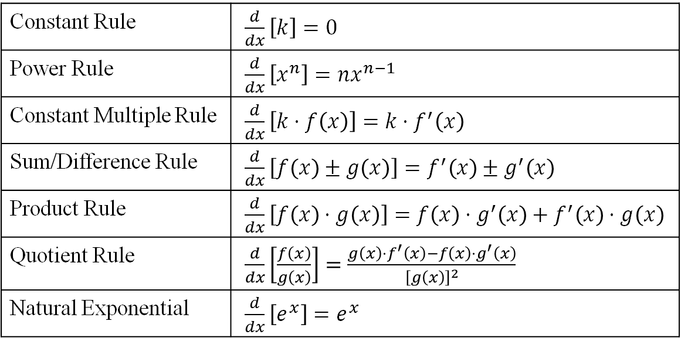
Summary of Differentiation Rules (So Far)
Constant Rule | $\frac{d}{dx}\left[k\right]=0$
Power Rule | $\frac{d}{dx}\left[x^{n}\right]=nx^{n−1}$
Constant Multiple Rule | $\frac{d}{dx}\left[k⋅f\left(x\right)\right]=k⋅f^{′}\left(x\right)$
Sum/Difference Rule | $\frac{d}{dx}\left[f\left(x\right)±g\left(x\right)\right]=f^{′}\left(x\right)±g^{′}\left(x\right)$
Product Rule | $\frac{d}{dx}\left[f\left(x\right)⋅g\left(x\right)\right]=f\left(x\right)⋅g^{′}\left(x\right)+f^{′}\left(x\right)⋅g\left(x\right)$
Quotient Rule | $\frac{d}{dx}\left[\frac{f\left(x\right)}{g\left(x\right)}\right]=\frac{g\left(x\right)⋅f^{′}\left(x\right)−f\left(x\right)⋅g^{′}\left(x\right)}{{\left[g\left(x\right)\right]}^{2}}$
Natural Exponential | $\frac{d}{dx}\left[e^{x}\right]=e^{x}$

Slide 21
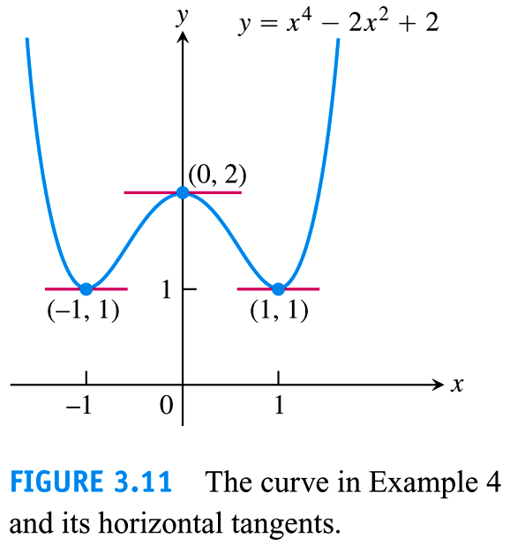
Example

Slide 22
Examples

Slide 23
EXAMPLE Find the first derivative of the function.
$$y=\frac{4−3x}{3x^{2}+x}$$
$y^{′}=\frac{\left(3x^{2}+x\right){\left[4−3x\right]}^{′}−\left(4−3x\right){\left[3x^{2}+x\right]}^{′}}{{\left(3x^{2}+x\right)}^{2}}$
$=\frac{\left(3x^{2}+x\right)\left(−3\right)−\left(4−3x\right)\left(6x+1\right)}{{\left(3x^{2}+x\right)}^{2}}$
$=\frac{−9x^{2}−3x−24x−4+18x^{2}+3x}{{\left(3x^{2}+x\right)}^{2}}$
$\boxed{y^{′}=\frac{9x^{2}−24x−4}{{\left(3x^{2}+x\right)}^{2}}}$

