Slide 1
3.8
Implicit Differentiation

Slide 2
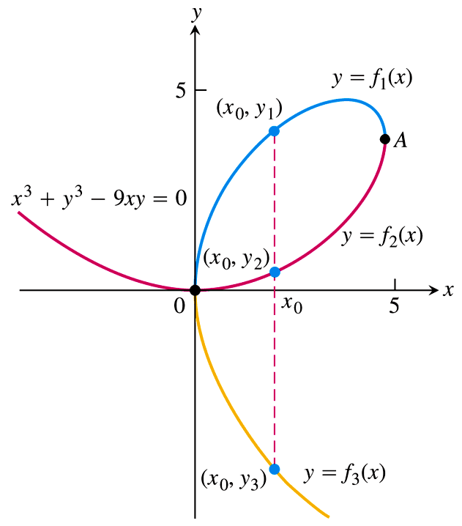
Derivatives of Implicitly Defined Relations
The main question we ask in this section is: “Can we take the derivative of a relation that is not a function?”
The answer is yes, as long as we can parse the relation into several pieces that, individually, are differentiable functions.
Consider the graph on the right, from which we can tell that the equation $x^{3}+y^{3}−9xy=0$ does not define $y$ as a function of $x$. (It fails the vertical line test.)
However, the different colored portions of the graph are themselves functions, so it makes sense that we should be able to find the derivative (i.e., slope of the tangent line) at the points, say, $\left(x_{0},y_{1}\right)$, $\left(x_{0}, y_{2}\right)$, $\left(x_{0}, y_{3}\right)$.
Notice that, for this to be the case, the derivative must not depend on the $x$-value alone, but on the $y$-value as well.

Slide 3
Derivatives of Implicitly Defined Relations
Usually we are given functions in the form $y=f\left(x\right)$, i.e., solved for $y$.
When this is the case, we say that the function is defined explicitly.
If a function (or relation) is not solved for $y$, we say that it is defined implicitly.
To find the derivative of an implicitly defined function (or relation), we use what is called implicit differentiation.
To start with a simple example, let’s consider the relation $y^{2}=x$.
To find the derivative $\frac{dy}{dx}$, we differentiate both sides of the equation with respect to $x$, remembering that $y$ must be viewed as a function of $x$:
$\frac{d}{dx}\left[y^{2}\right]=\frac{d}{dx}\left[x\right]$
$2y⋅\frac{d}{dx}\left[y\right]=1$ $←$ Chain Rule
$2y⋅\frac{dy}{dx}=1$
$\frac{dy}{dx}=\frac{1}{2y}$

Slide 4
Implicit Differentiation
The most important thing to remember as you differentiate is that $y$ must be treated as a function of $x$, so that every time you take a derivative of a term involving $y$, you’re actually applying the Chain Rule.
Put simply, $y$ will always be an “inside” function, and the derivative of a $y$ term will always include a factor of $\frac{dy}{dx}$.
For example,
$\frac{d}{dx}\left[y^{3}\right]=3y^{2}⋅\frac{dy}{dx}$
$\frac{d}{dx}\left[y\right]=1⋅\frac{dy}{dx}=\frac{dy}{dx}$
$\frac{d}{dx}\left[\sin{y}\right]=\cos{y}⋅\frac{dy}{dx}$

Slide 5
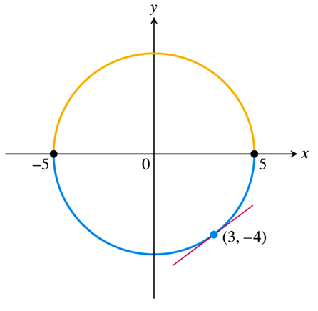
EXAMPLE Find the slope of the circle $x^{2}+y^{2}=25$ at the point $\left(3, −4\right)$.
To find the slope of the curve, we need to determine $\frac{dy}{dx}$ using implicit differentiation:
$\frac{d}{dx}\left[x^{2}+y^{2}\right]=\frac{d}{dx}\left[25\right]$
$\frac{d}{dx}\left[x^{2}\right]+\frac{d}{dx}\left[y^{2}\right]=0$
$2x+2y⋅\frac{dy}{dx}=0$
$\frac{dy}{dx}=\frac{−2x}{2y}=−\frac{x}{y}$
Thus, the slope of the circle at the point $\left(3, −4\right)$ is
${\left.\frac{dy}{dx}\right|}_{\left(3, −4\right)}=−\frac{3}{−4}=\boxed{\frac{3}{4}}.$

Slide 6
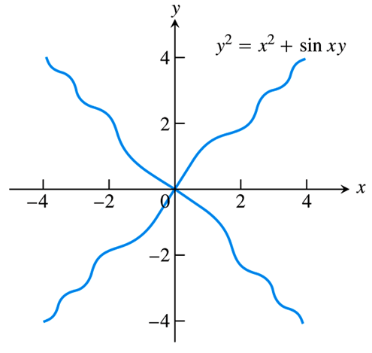
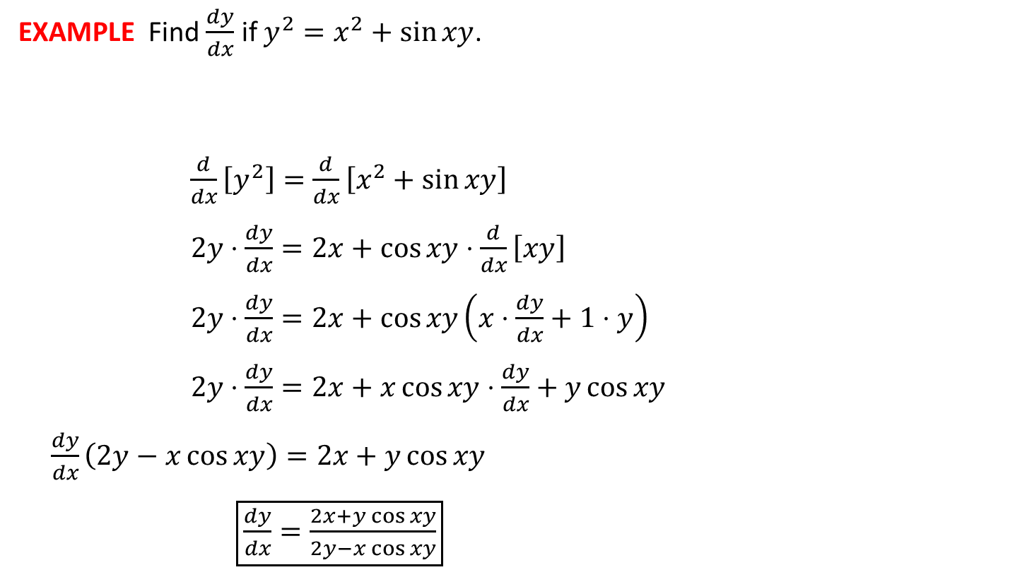
EXAMPLE Find $\frac{dy}{dx}$ if $y^{2}=x^{2}+\sin{xy}$.
$\frac{d}{dx}\left[y^{2}\right]=\frac{d}{dx}\left[x^{2}+\sin{xy}\right]$
$2y⋅\frac{dy}{dx}=2x+\cos{xy}⋅\frac{d}{dx}\left[xy\right]$
$2y⋅\frac{dy}{dx}=2x+\cos{xy}\left(x⋅\frac{dy}{dx}+1⋅y\right)$
$2y⋅\frac{dy}{dx}=2x+x\cos{xy}⋅\frac{dy}{dx}+y\cos{xy}$
$\frac{dy}{dx}\left(2y−x\cos{xy}\right)=2x+y\cos{xy}$
$\boxed{\frac{dy}{dx}=\frac{2x+y\cos{xy}}{2y−x\cos{xy}}}$

Slide 7
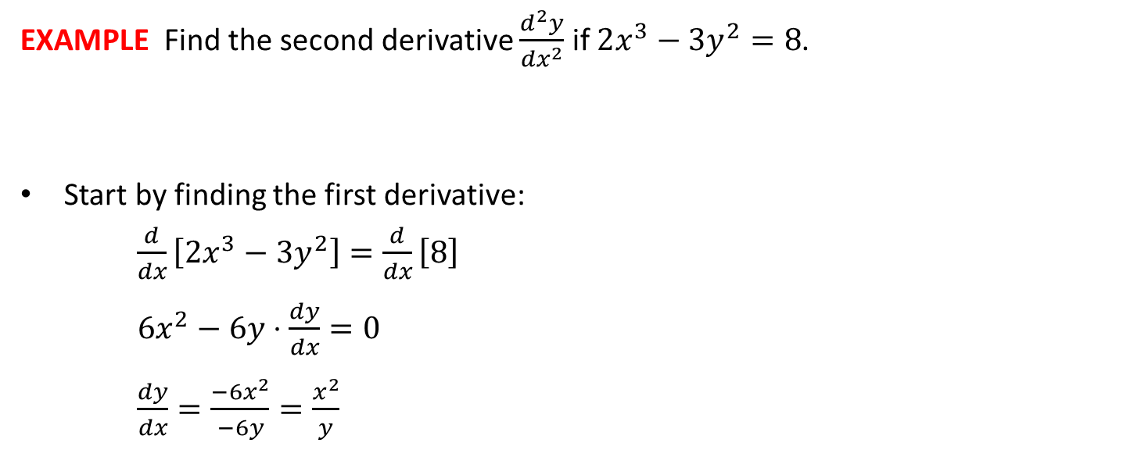

EXAMPLE Find the second derivative $\frac{d^{2}y}{{dx}^{2}}$ if $2x^{3}−3y^{2}=8$.
Start by finding the first derivative:
$\frac{d}{dx}\left[2x^{3}−3y^{2}\right]=\frac{d}{dx}\left[8\right]$
$6x^{2}−6y⋅\frac{dy}{dx}=0$
$\frac{dy}{dx}=\frac{−6x^{2}}{−6y}=\frac{x^{2}}{y}$
Then find the derivative of the first derivative:
$\frac{d^{2}y}{{dx}^{2}}=\frac{d}{dx}\left[\frac{dy}{dx}\right]=\frac{d}{dx}\left[\frac{x^{2}}{y}\right]$
$=\frac{y⋅\frac{d}{dx}\left[x^{2}\right]−x^{2}⋅\frac{d}{dx}\left[y\right]}{y^{2}}$
$=\frac{y\left(2x\right)−x^{2}\left(\frac{dy}{dx}\right)}{y^{2}}$
$=\frac{2xy−x^{2}\left(\frac{x^{2}}{y}\right)}{y^{2}}$
$\boxed{\frac{d^{2}y}{{dx}^{2}}=\frac{2xy^{2}−x^{4}}{y^{3}}}$

Slide 8
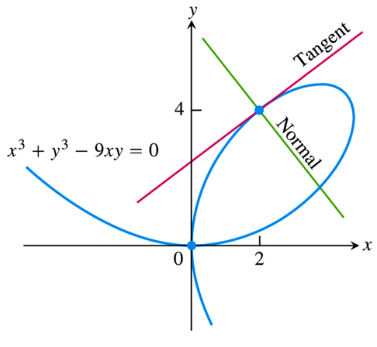

EXAMPLE Find the lines that are a) tangent and b) normal to the given curve at the given point.
$$x^{3}+y^{3}−9xy=0, \left(2, 4\right)$$
To find the slope of the tangent line, we need to determine $\frac{dy}{dx}$ using implicit differentiation:
$\frac{d}{dx}\left[x^{3}+y^{3}−9xy\right]=\frac{d}{dx}\left[0\right]$
$\frac{d}{dx}\left[x^{3}\right]+\frac{d}{dx}\left[y^{3}\right]−9\frac{d}{dx}\left[xy\right]=0$
$3x^{2}+3y^{2}⋅\frac{dy}{dx}−9\left(x⋅\frac{dy}{dx}+1⋅y\right)=0$
$3x^{2}+3y^{2}⋅\frac{dy}{dx}−9x⋅\frac{dy}{dx}−9y=0$
$\frac{dy}{dx}\left(3y^{2}−9x\right)=9y−3x^{2}$
$\frac{dy}{dx}=\frac{9y−3x^{2}}{3y^{2}−9x}$
$m={\left.\frac{dy}{dx}\right|}_{\left(2, 4\right)}=\frac{9\left(4\right)−3{\left(2\right)}^{2}}{3{\left(4\right)}^{2}−9\left(2\right)}=\frac{5}{6}$
Tangent Line:
$y−y_{1}=m\left(x−x_{1}\right)$
$y−4=\frac{5}{6}\left(x−2\right)$
$\boxed{y=\frac{5}{6}x+\frac{7}{3}}$

Slide 9
EXAMPLE Find the lines that are a) tangent and b) normal to the given curve at the given point.
$$x^{3}+y^{3}−9xy=0, \left(2, 4\right)$$
The normal line is perpendicular to the tangent line, and hence has slope:
$m=−\frac{1}{5/6}=−\frac{6}{5}$
Thus, the equation of the normal line is
$y−y_{1}=m\left(x−x_{1}\right)$
$y−4=−\frac{6}{5}\left(x−2\right)$
$\boxed{y=−\frac{6}{5}x+\frac{32}{5}}$

Slide 10
Examples:
1)
a)
b)
c)
2)

Slide 11

EXAMPLE
Find the equation of the line tangent to the following curve at the given point.
$$x^{2}y^{2}=81, \left(−1, 9\right)$$
$\frac{d}{dx}\left[x^{2}y^{2}\right]=\frac{d}{dx}\left[81\right]$
$x^{2}⋅\frac{d}{dx}\left[y^{2}\right]+y^{2}⋅\frac{d}{dx}\left[x^{2}\right]=0$
$x^{2}\left(2y⋅\frac{dy}{dx}\right)+y^{2}\left(2x\right)=0$
$2x^{2}y⋅\frac{dy}{dx}+2xy^{2}=0$
$\frac{dy}{dx}=\frac{−2xy^{2}}{2x^{2}y}=−\frac{y}{x}$
Tangent Slope:
$m={\left.\frac{dy}{dx}\right|}_{\left(−1, 9\right)}=−\frac{9}{−1}=9$
Tangent Line:
$y−y_{1}=m\left(x−x_{1}\right)$
$y−9=9\left(x−\left(−1\right)\right)$
$\boxed{y=9x+18}$

