Slide 1
4.6
Limits at Infinity and Asymptotes

Slide 2
Goals:
limits of functions as $x→±∞$
Horizontal asymptotes
Infinite limits
Vertical asymptotes

Slide 3
Limits As $x$ Increases (or Decreases) Without Bound
We sometimes want to know how a function behaves “in the long run,” or as we plug in values of $x$ that get bigger and bigger.
We can view this as a limiting process, and say that we are finding the limit of a function $f\left(x\right)$ as $x$ increases without bound.
When we do so, we write
$$\lim_{x→∞}{f\left(x\right)},$$
and I will read this as “the limit of $f\left(x\right)$ as $x$ approaches infinity”.
Similarly, we can discuss the limit of $f\left(x\right)$ as $x$ decreases without bound, write
$$\lim_{x→−∞}{f\left(x\right)},$$
and read “the limit of $f\left(x\right)$ as $x$ approaches negative infinity.”

Slide 4
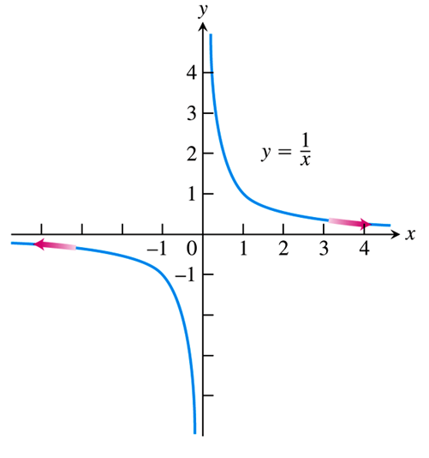
Limits Involving Infinity: An Important Example
The first, simplest, and yet most important function we consider in this section is $f\left(x\right)=\frac{1}{x}$.
It is clear from the graph that
$\lim_{x→±∞}{\frac{1}{x}}=0$.
And in fact we can generalize this result, using the following theorem.
More generally, we may state that, for any constant $k$, and any power $c>0$,
$$\lim_{x→±∞}{\frac{k}{x^{c}}}=0,$$
and we will use this fact in practically every example we work.

Slide 5
EXAMPLE Use the Limit Laws, along with the fact that $\lim_{x→±∞}{\frac{1}{x}}=0$, to evaluate the following limits.
$\lim_{x→∞}\left(5+\frac{1}{x}\right)$
$\lim_{x→−∞}{\frac{π\sqrt{3}}{x^{2}}}$
$\lim_{x→∞}\left(5+\frac{1}{x}\right)=\lim_{x→∞}{5}+\lim_{x→∞}{\frac{1}{x}}=5+0=\boxed{5}$
$\lim_{x→−∞}{\frac{π\sqrt{3}}{x^{2}}}=π\sqrt{3}\lim_{x→−∞}{\frac{1}{x^{2}}}=π\sqrt{3}{\left(\lim_{x→−∞}{\frac{1}{x}}\right)}^{2}=π\sqrt{3}{\left(0\right)}^{2}=\boxed{0}$
Part b) is an example of the rule stated on the preceding slide $\left(\lim_{x→±∞}{\frac{k}{x^{c}}}=0\right)$, with $k$ being the constant $π\sqrt{3}$ and $c=2$.

Slide 6
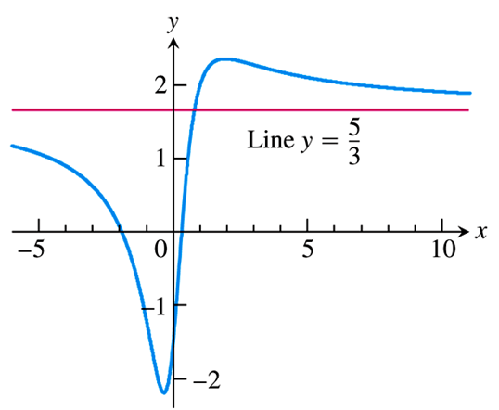
EXAMPLE Use the fact that $\lim_{x→±∞}{\frac{k}{x^{c}}}=0$, to evaluate the following limits.
$\lim_{x→∞}{\frac{5x^{2}+8x−3}{3x^{2}+2}}$
$\lim_{x→−∞}{\frac{11x+2}{2x^{3}−1}}$
$\lim_{x→∞}{\frac{5x^{2}+8x−3}{3x^{2}+2}}=\lim_{x→∞}{\frac{5x^{2}+8x−3}{3x^{2}+2}÷\frac{x^{2}}{x^{2}}}$
$=\lim_{x→∞}{\frac{\left({5x^{2}}/{x^{2}}\right)+\left({8x}/{x^{2}}\right)−\left(3/{x^{2}}\right)}{\left({3x^{2}}/{x^{2}}\right)+\left(2/{x^{2}}\right)}}$
$=\lim_{x→∞}{\frac{5+\left(8/x\right)−\left(3/{x^{2}}\right)}{3+\left(2/{x^{2}}\right)}}$
$=\frac{5+0−0}{3+0}=\boxed{\frac{5}{3}}$
To evaluate limits of rational functions as $x→±∞$, divide by the highest power of $x$ in the denominator.

Slide 7
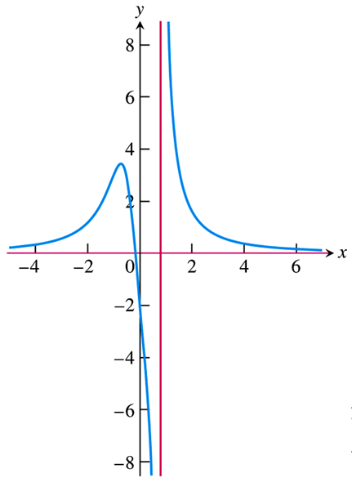
EXAMPLE Use the fact that $\lim_{x→±∞}{\frac{k}{x^{c}}}=0$, to evaluate the following limits.
$\lim_{x→∞}{\frac{5x^{2}+8x−3}{3x^{2}+2}}$
$\lim_{x→−∞}{\frac{11x+2}{2x^{3}−1}}$
$\lim_{x→−∞}{\frac{11x+2}{2x^{3}−1}}=\lim_{x→−∞}{\frac{11x+2}{2x^{3}−1}÷\frac{x^{3}}{x^{3}}}$
$=\lim_{x→−∞}{\frac{\left({11x}/{x^{3}}\right)+\left(2/{x^{3}}\right)}{\left({2x^{3}}/{x^{3}}\right)−\left(1/{x^{3}}\right)}}$
$=\lim_{x→−∞}{\frac{\left({11}/{x^{2}}\right)+\left(2/{x^{3}}\right)}{2−\left(1/{x^{3}}\right)}}$
$=\frac{0+0}{2−0}=\boxed{0}$
To evaluate limits of rational functions as $x→±∞$, divide by the highest power of $x$ in the denominator.

Slide 8
limits of rational functions as $x→±∞$
More generally, given a rational function $y=\frac{P(x)}{Q(x)}=\frac{a_{n}x^{n}+a_{n−1}x^{n−1}+⋯+a_{0}}{b_{m}x^{m}+b_{m−1}x^{m−1}+⋯+b_{0}}$, we have:
$\lim_{x→±∞}{y}=$ $±∞$, n>m
$\lim_{x→±∞}{y}=0$, n<m
$\lim_{x→±∞}{y}=\frac{a_{n}}{b_{m}}$, n=m
$$\lim_{x→∞}{\frac{5x^{2}+8x−3}{3x^{2}+2}}=\frac{5}{3}$$
$$\lim_{x→−∞}{\frac{11x+2}{2x^{3}−1}}=0$$

Slide 9
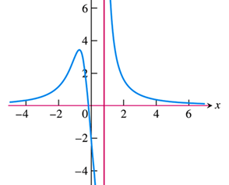
Limits & Horizontal Asymptotes
As illustrated in the previous examples, limits of a function $f\left(x\right)$ as $x→±∞$ correspond to horizontal asymptotes on the graph of $f\left(x\right)$.
The next example shows that a graph may have more than one horizontal asymptote.
$$\lim_{x→∞}{\frac{5x^{2}+8x−3}{3x^{2}+2}}=\frac{5}{3}$$
$$\lim_{x→−∞}{\frac{11x+2}{2x^{3}−1}}=0$$

Slide 10
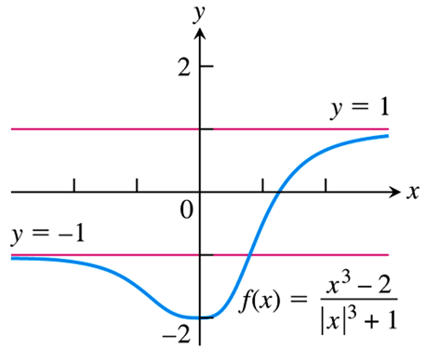
EXAMPLE Find the horizontal asymptotes of the graph of
$$f\left(x\right)=\frac{x^{3}−2}{{\left|x\right|}^{3}+1}.$$
As $x→∞$, we know $x>0$, so that $\left|x\right|=x$, and we have
$\lim_{x→∞}{\frac{x^{3}−2}{{\left|x\right|}^{3}+1}}=\lim_{x→∞}{\frac{x^{3}−2}{x^{3}+1}}=\lim_{x→∞}{\frac{\left({x^{3}}/{x^{3}}\right)−\left(2/{x^{3}}\right)}{\left({x^{3}}/{x^{3}}\right)+\left(1/{x^{3}}\right)}}=\frac{1−0}{1+0}=1.$
As $x→−∞$, we know $x<0$, so that $\left|x\right|=−x$, and we have
$\lim_{x→−∞}{\frac{x^{3}−2}{{\left|x\right|}^{3}+1}}=\lim_{x→−∞}{\frac{x^{3}−2}{−x^{3}+1}}=\lim_{x→−∞}{\frac{\left({x^{3}}/{x^{3}}\right)−\left(2/{x^{3}}\right)}{\left(−{x^{3}}/{x^{3}}\right)+\left(1/{x^{3}}\right)}}=\frac{1−0}{−1+0}=−1.$
Thus, the function $f\left(x\right)$ has two horizontal asymptotes: $y=1$ and $y=−1$.

Slide 11
Transforming the Independent Variable
It is sometimes useful to make a change in the independent variable of a function, in order to transform an unknown limit into a known one.
As a first example, we know that $\frac{1}{x}→0$ as $x→∞$. By letting $t=\frac{1}{x}$, we can transform the corresponding limit as follows:
$$\lim_{x→∞}{\frac{1}{x}}=0 ⇒ \lim_{t→0^{+}}{t}=0.$$
This is a notion that may takes some getting used to. Let’s try a couple of examples.

Slide 12
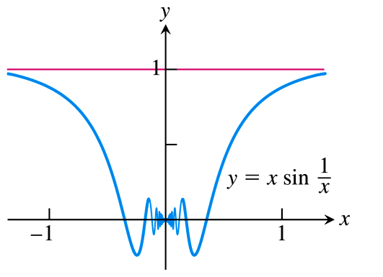
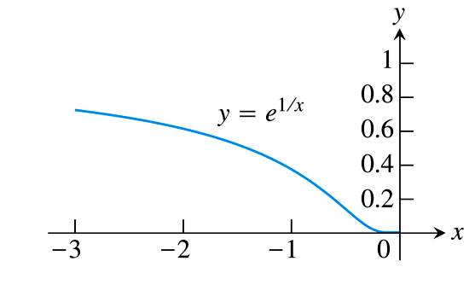
EXAMPLE Evaluate the following limits by transforming the variable.
$\lim_{x→∞}{x\sin\left(\frac{1}{x}\right)}$
$\lim_{x→0^{−}}{e^{1/x}}$
Letting $t=\frac{1}{x}$, we have $t→0^{+}$ as $x→∞$, so
$\lim_{x→∞}{x\sin\left(\frac{1}{x}\right)}=\lim_{x→∞}{\frac{\sin\left(1/x\right)}{1/x}}=\lim_{t→0^{+}}{\frac{\sin{t}}{t}}=\boxed{1}$.
Again letting $t=\frac{1}{x}$, we have $t→−∞$ as $x→0^{−}$, so
$\lim_{x→0^{−}}{e^{1/x}}=\lim_{t→−∞}{e^{t}}=\boxed{0}$.

Slide 13
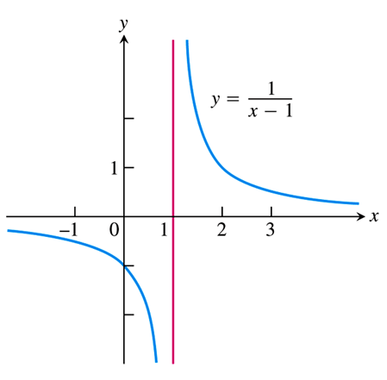
Infinite Limits
Another type of limit involving infinity is one where the $y$-values of the function are either increasing or decreasing without bound.
While these limits formally do not exist (since $y$ is not actually approaching a number), we agree to call them infinite limits.
For example, consider the function $f\left(x\right)=\frac{1}{x−1}$ as $x$ approaches 1.
Since the functional values are increasing without
bound as $x$ approaches 1 from the right, we write $\lim_{x→1^{+}}{\frac{1}{x−1}}=∞$.
And since the functional values decrease without bound as $x$ approaches 1 from the left, we write $\lim_{x→1^{−}}{\frac{1}{x−1}}=−∞$.
We still conclude that the corresponding two-sided limit does not exist.

Slide 14
Infinite Limits & Vertical Asymptotes
As the preceding example illustrates, an infinite limit corresponds to a vertical asymptote on the graph of a function.
The most prevalent examples involve rational functions, which we consider more of on the next slide.
For now we point out the following:
A vertical asymptote of a rational function always occurs at an $x$-value that makes the denominator 0.
However, a 0 of the denominator does not always correspond to a vertical asymptote.

Slide 15
EXAMPLE Evaluate the following limits of rational functions without graphing. Describe the behavior of the graph of each at $x=2$.
$\lim_{x→2}{\frac{x−2}{x^{2}−4}}$
$\lim_{x→2}{\frac{x−3}{x^{2}−4}}$
$\lim_{x→2}{\frac{1}{{\left(x−2\right)}^{2}}}$
$\lim_{x→2}{\frac{x−2}{x^{2}−4}}=\lim_{x→2}{\frac{x−2}{\left(x−2\right)\left(x+2\right)}}=\lim_{x→2}{\frac{1}{x+2}}=\frac{1}{\left(2\right)+2}=\boxed{\frac{1}{4}}$
The graph of $\frac{x−2}{x^{2}−4}$ does not have a vertical asymptote at $x=2$, but a hole at the point $\left(2,\frac{1}{4}\right)$.

Slide 16
EXAMPLE Evaluate the following limits of rational functions without graphing. Describe the behavior of the graph of each at $x=2$.
$\lim_{x→2}{\frac{x−2}{x^{2}−4}}$
$\lim_{x→2}{\frac{x−3}{x^{2}−4}}$
$\lim_{x→2}{\frac{1}{{\left(x−2\right)}^{2}}}$
Now, as $x$ approaches 2 from the left, we have
Thus, $\lim_{x→2^{−}}{\frac{x−3}{x^{2}−4}}=∞$.
And similarly, as $x$ approaches 2 from the right we have
Thus, $\lim_{x→2^{+}}{\frac{x−3}{x^{2}−4}}=−∞$.
We conclude that $\lim_{x→2}{\frac{x−3}{x^{2}−4}}$ does not exist, but the graph of $\frac{x−3}{x^{2}−4}$ does have a vertical asymptote at $x=2$.
$$x$$ | $$1.9$$ | $$1.99$$ | $$1.999$$ | $$1.9999$$
$$y$$ | $$2.821$$ | $$25.313$$ | $$250.313$$ | $$2500.313$$
$$x$$ | $$2.1$$ | $$2.01$$ | $$2.001$$ | $$2.0001$$
$$y$$ | $$−2.195$$ | $$−24.688$$ | $$−249.688$$ | $$−2499.688$$

Slide 17
EXAMPLE Evaluate the following limits of rational functions without graphing. Describe the behavior of the graph of each at $x=2$.
$\lim_{x→2}{\frac{x−2}{x^{2}−4}}$
$\lim_{x→2}{\frac{x−3}{x^{2}−4}}$
$\lim_{x→2}{\frac{1}{{\left(x−2\right)}^{2}}}$
Now, as $x$ approaches 2 from the left, we have
Thus, $\lim_{x→2^{−}}{\frac{1}{{\left(x−2\right)}^{2}}}=∞$.
And similarly, as $x$ approaches 2 from the right we have
Thus, $\lim_{x→2^{+}}{\frac{1}{{\left(x−2\right)}^{2}}}=∞$.
We conclude that $\lim_{x→2}{\frac{1}{{\left(x−2\right)}^{2}}}=∞$, and the graph of $\frac{1}{{\left(x−2\right)}^{2}}$ has a vertical asymptote at $x=2$.
$$x$$ | $$1.9$$ | $$1.99$$ | $$1.999$$ | $$1.9999$$
$$y$$ | $$100$$ | $$10,000$$ | $$1,000,000$$ | $$100,000,000$$
$$x$$ | $$2.1$$ | $$2.01$$ | $$2.001$$ | $$2.0001$$
$$y$$ | $$100$$ | $$10,000$$ | $$1,000,000$$ | $$100,000,000$$

Slide 18
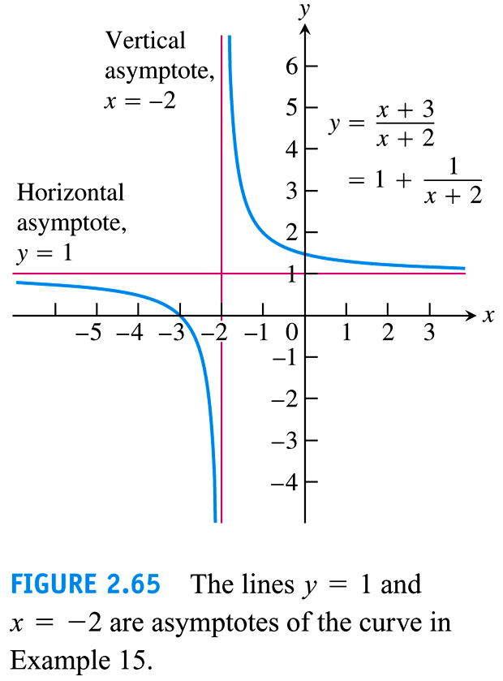
Example :

Slide 19
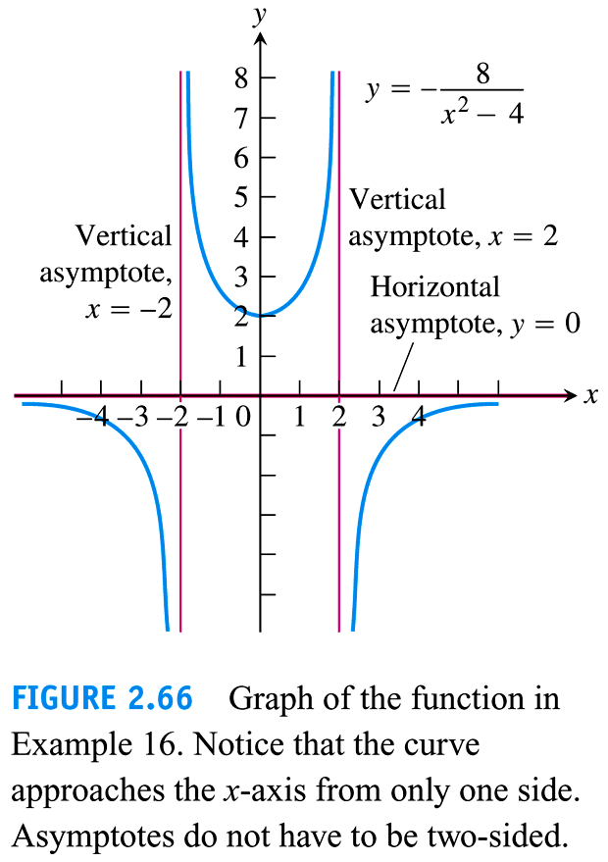
Example :

Slide 20
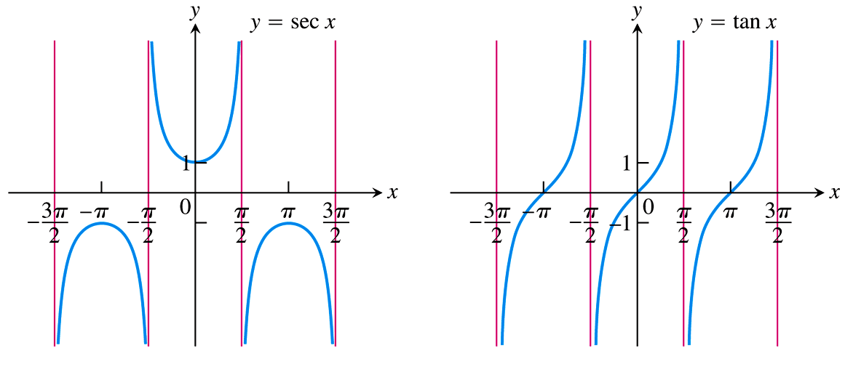
Example :

Slide 21
Example :
Evaluate the following limit.
$$\lim_{x→∞}{\sqrt[3]{\frac{3+64x^{3}}{x^{3}+3}}}$$
$\lim_{x→∞}{\sqrt[3]{\frac{3+64x^{3}}{x^{3}+3}}}=\sqrt{\lim_{x→∞}{\frac{3+64x^{3}}{x^{3}+3}}}$
$=\sqrt{\lim_{x→∞}{\frac{\left(3/{x^{3}}\right)+\left({64x^{3}}/{x^{3}}\right)}{\left({x^{3}}/{x^{3}}\right)+\left(3/{x^{3}}\right)}}}$
$=\sqrt{\lim_{x→∞}{\frac{\left(3/{x^{3}}\right)+64}{1+\left(3/{x^{3}}\right)}}}$
$=\sqrt{\frac{0+64}{1+0}}=\sqrt{64}=\boxed{8}$

