Slide 1
Chapter 2
Limits

Slide 2
2.2
The Limit of a Function
http://webspace.ship.edu/msrenault/GeoGebraCalculus/GeoGebraCalculusApplets.html

Slide 3
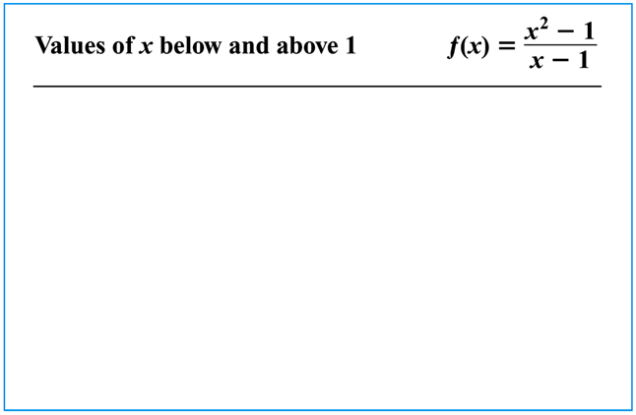
Limits: A First Example
We have actually been discussing limits already, but in this section we put a definition to them, discuss the notation involved in using limits, and determine how to find limits of various functions.
As a first example, let’s consider $\lim_{x→1}{\frac{x^{2}−1}{x−1}}$
EXAMPLE Find $\lim_{x→1}{\frac{x^{2}−1}{x−1}}$.
Since both sets of numbers in the table appear to be
approaching $2$, we find that
$\lim_{x→1}{\frac{x^{2}−1}{x−1}}=2$.

Slide 4
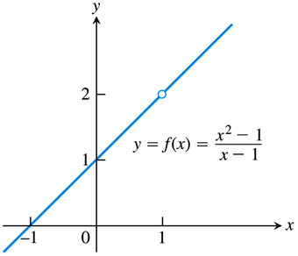
Limits: A Graphical Approach
We can visualize the answer to the example on the preceding slide by graphing the function $f\left(x\right)=\frac{x^{2}−1}{x−1}$.
It is helpful to note that this function may be reduced, giving
$f\left(x\right)=\frac{\left(x−1\right)\left(x+1\right)}{x−1}=x+1, x≠1$.
We then see that the graph of the function is another “line with a hole in it.”
From the picture it should be clear that the $y$-values of the function approach 2 as the $x$-values approach 1 (from either side).

Slide 5
Limits: An Informal Definition
More generally, given a function $y=f\left(x\right)$, we write:
$\lim_{x→a}{f\left(x\right)}=L$,
and say “the limit of $f\left(x\right)$ as $x$ approaches $a$ is $L$,” if the $y$-values of the function are getting closer and closer to the number $L$ as we input $x$-values that get closer and closer to $a$.
It is also important to note that, in general, the limit must be approached from “both sides,” i.e., we must input value of $x$ that are both less than and greater than $a$.
Let’s work a few more examples of limits using this graphical approach.

Slide 6
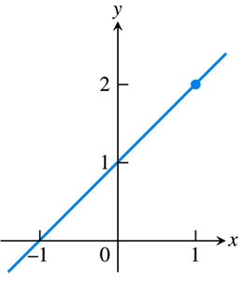
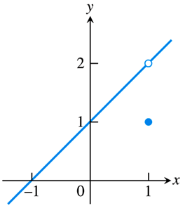
EXAMPLE Find the limit of each function as $x$ approaches 1.
$g\left(x\right)=x+1$
$h\left(x\right)=\left\{\begin{matrix}x+1 & x≠1 \\ 1 & x=1\end{matrix}\right.$
a) From the graph of $g\left(x\right)$ (top) we see that the $y$-values of the function are approaching 2 as the $x$-values approach 1, hence
$\lim_{x→1}{g\left(x\right)}=2$.
b) Again, from the graph of $h\left(x\right)$ (bottom) we see that the $y$-values of the function are approaching 2 as the $x$-values approach 1, hence
$\lim_{x→1}{h\left(x\right)}=2$.
Note that it does not matter how the function behaves at $x=1$, only how it behaves close to $x=1$.

Slide 7
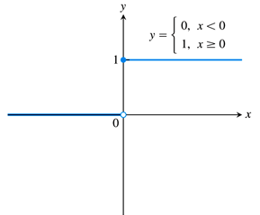
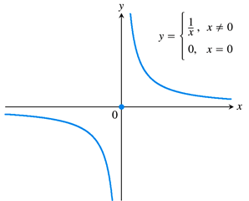
EXAMPLE Discuss the limit of each function as $x$ approaches 0.
$y=\left\{\begin{matrix}0 & x<0 \\ 1 & x≥0\end{matrix}\right.$
$y=\left\{\begin{matrix}\frac{1}{x} & x≠0 \\ 0 & x=0\end{matrix}\right.$
a) From the graph (top) we see that the $y$-values of the function are approaching 0 for $x$-values to the left of $x=0$, but the $y$-values are approaching 1 for $x$-values to the right of $x=0$. In this case, the function has no limit, and we say the limit “does not exist.”
Again, from the graph (bottom) we see that the $y$-values of the function are approaching positive infinity ( negative infinity) as $x$ approaches 0 from right (left). In this case, the function has no limit, and we say the limit “does not exist.”

Slide 8
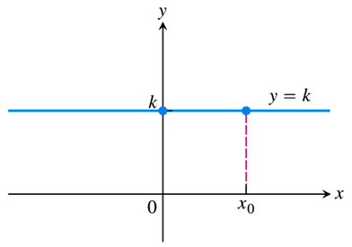
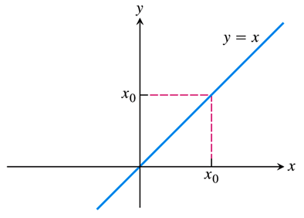
EXAMPLE Discuss the limit of each function as $x$ approaches any value $x_{0}$.
$f\left(x\right)=k \left(k \text{a} \text{constant}\right)$
$g\left(x\right)=x \left(\text{the} \text{identity} \text{function}\right)$
a) From the graph (top) we see that for any $x$-value $x_{0}$ we have $\lim_{x→x_{0}}{f\left(x\right)}=k$.
b) From the graph (bottom) we see that for any $x$-value $x_{0}$ we have $\lim_{x→x_{0}}{g\left(x\right)}=x_{0}$.
This example gives us our first two rules for limits, or “Limit Laws,” namely:
The limit of a constant is that constant: $\lim_{x→x_{0}}{k}=k$
The limit of $x$ is itself: $\lim_{x→x_{0}}{x}=x_{0}$

Slide 9
Two-Sided vs. One-Sided Limits
Recall the step function example we considered in Section 2.2:
In that example, we determined that this function does not have a limit as $x→0$.
However, we obviously have information about the $y$-values of the function as $x→0$.
We don’t want to throw that information away just because the two sides don’t meet.
So we introduce one-sided limits, as follows:
A left-hand limit as $x$ approaches a number $c$ is denoted by $\lim_{x→c^{−}}{f\left(x\right)}=L.$
A right-hand limit as $x$ approaches a number $c$ is denoted by $\lim_{x→c^{+}}{f\left(x\right)}=L.$
In the above example:
$\lim_{x→0^{−}}{f\left(x\right)}=0$,
$\lim_{x→0^{+}}{f\left(x\right)}=1$.

Slide 10
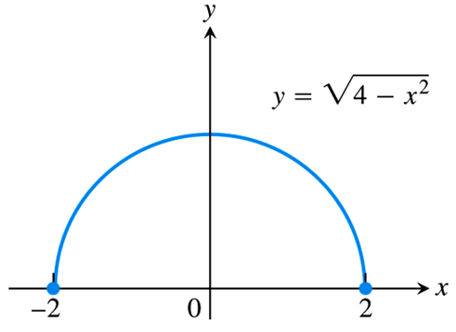
Two-Sided vs. One-Sided Limits
Another situation when a two-sided limit does not exist, but we still have useful information about a function, is that of domain endpoints.
For example, consider the semicircle $f\left(x\right)=\sqrt{4−x^{2}}$.
This function has no limit at either endpoint $x=−2$ or $x=2$.
However, the following one-sided limits do exist:
$\lim_{x→−2^{+}}{\sqrt{4−x^{2}}}=0$,
$\lim_{x→2^{−}}{\sqrt{4−x^{2}}}=0$.

Slide 11
Two-Sided vs. One-Sided Limits
We can state the relationship between one-sided and two-sided limits as follows:
Let’s get some additional practice finding one-sided limits graphically.

Slide 12
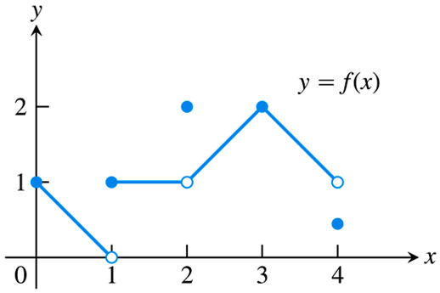
EXAMPLE For the function graphed, discuss the following limits.
$\lim_{x→0}{f\left(x\right)}$
$\lim_{x→1}{f\left(x\right)}$
$\lim_{x→2}{f\left(x\right)}$
$\lim_{x→3}{f\left(x\right)}$
$\lim_{x→4}{f\left(x\right)}$
Now $\lim_{x→0^{+}}{f\left(x\right)}=1$, but $\lim_{x→0^{−}}{f\left(x\right)}$ does not exist, so $\lim_{x→0}{f\left(x\right)}$ does not exist.
Now $\lim_{x→1^{−}}{f\left(x\right)}=0$, but $\lim_{x→1^{+}}{f\left(x\right)}=1$, so $\lim_{x→1}{f\left(x\right)}$ does not exist.
Now $\lim_{x→2^{−}}{f\left(x\right)}=1$, and $\lim_{x→2^{+}}{f\left(x\right)}=1$, so $\lim_{x→2}{f\left(x\right)}=1$.
Now $\lim_{x→3^{−}}{f\left(x\right)}=2$, and $\lim_{x→3^{+}}{f\left(x\right)}=2$, so $\lim_{x→3}{f\left(x\right)}=2$.
Now $\lim_{x→4^{−}}{f\left(x\right)}=1$, but $\lim_{x→4^{+}}{f\left(x\right)}$ does not exist, so $\lim_{x→4}{f\left(x\right)}$ does not exist.

Slide 13
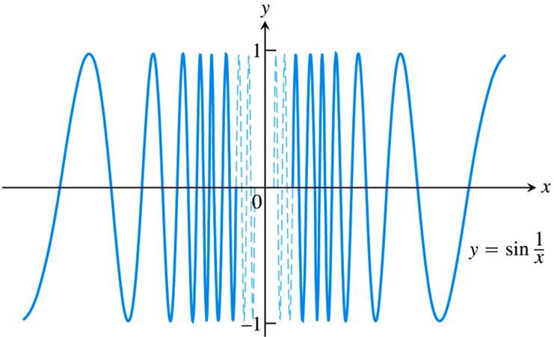
EXAMPLE Discuss the following limit.
$$\lim_{x→0}{\sin\left(\frac{1}{x}\right)}$$
Since the graph of $\sin\left(\frac{1}{x}\right)$ oscillates between $−1$ and $1$ infinitely frequently as $x→0^{−}$ and $x→0^{+}$, we see that this function has neither a left-hand nor a right-hand limit at $x=0$.
Thus, $\lim_{x→0}{\sin\left(\frac{1}{x}\right)}$ does not exist.

