Slide 1
4.2
Linear Approximations and Differentials

Slide 2
Goals:
Approximate a function near the point of tangency using the linear approximation.
2. Differentials.

Slide 3
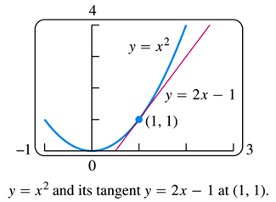
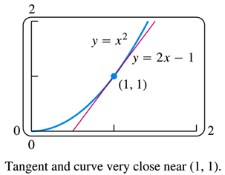
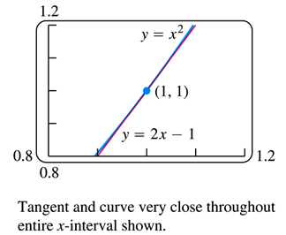
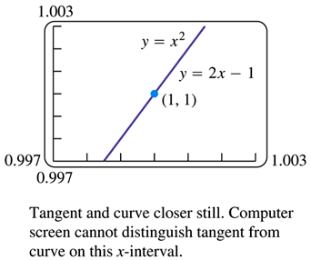
Tangent Lines and Linear Approximation
Tangent lines have always been a focus of our discussions on the interpretations of derivatives, and a linear approximation is just a different perspective on a tangent line.
The fact is that the line tangent to a function at a given point is very close to that function near the point in question, as the following figures demonstrate.
We investigate the behavior of the function $y=x^{2}$ as compared to its tangent line at the point $\left(1, 1\right)$.

Slide 4
Tangent Lines and Linear Approximation
We can make use of this relationship between a curve and its tangent line by using the tangent line to approximate the value of the function near the point of tangency.
Have you ever wondered how a calculator evaluates the square root of a number, or the sine of a given angle?
The fact is, it doesn’t; instead, it approximates the desired values using simpler functions, such as lines.

Slide 5
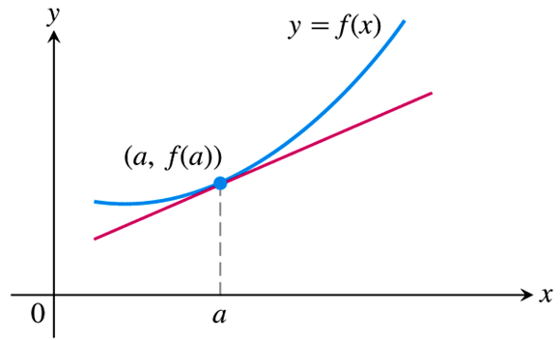
So what does the equation of this linearization look like?
Given a function $f\left(x\right)$ and an $x$-value $x=a$, we will now call the line tangent to $f\left(x\right)$ at the point $\left(a, f\left(a\right)\right)$ the linearization of the function.
The tangent line is given by the equation $y−y_{1}=m\left(x−x_{1}\right)$ where
$x_{1}=a, y_{1}=f\left(a\right), \text{and} m=f^{′}\left(a\right).$
Thus, the tangent line is $y=f\left(a\right)+f^{′}\left(a\right)\left(x−a\right)$, and we write
$$L\left(x\right)=f\left(a\right)+f^{′}\left(a\right)\left(x−a\right)$$
for the linearization of $f\left(x\right)$ at $x=a$.

Slide 6
It is important to recognize that the approximation becomes worse as we get farther from the center of approximation.
But as long as we stay close enough to $x=a$, we should obtain a good approximation of the true value of the function using the linearization.
How close is close enough? And how good is good? These are questions that we answer with the second concept in this section: the differential.
But before we do, let’s work a couple of examples with linearizations.

Slide 7
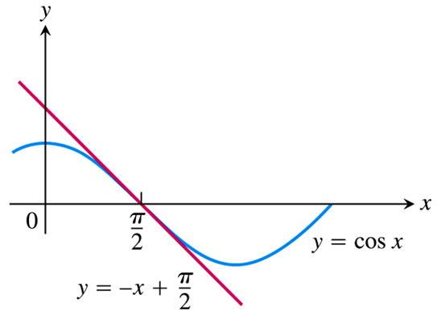
EXAMPLE Find the linear approximation for $f\left(x\right)=\cos{x}$ at $x=\frac{π}{2}$.
We’ll need the derivative of $f\left(x\right)=\cos{x}$
$f^{′}\left(x\right)=−\sin{x}$
With $a=\frac{π}{2}$ we have
$f\left(a\right)=f\left(\frac{π}{2}\right)=\cos\left(\frac{π}{2}\right)=0$, and
$f^{′}\left(a\right)=f^{′}\left(\frac{π}{2}\right)=−\sin\left(\frac{π}{2}\right)=−1$.
Thus, the linearization is
$L\left(x\right)=f\left(a\right)+f^{′}\left(a\right)\left(x−a\right)$
$=0+\left(−1\right)\left(x−\frac{π}{2}\right)$
$\boxed{L\left(x\right)=−x+\frac{π}{2}}$

Slide 8
EXAMPLE Find the linear approximation for $f\left(x\right)=\sqrt{1+x}$ at $x=0$ and at $x=3$.
We’ll need the derivative of $\sqrt{1+x}={\left(1+x\right)}^{1/2}$
$f^{′}\left(x\right)=\frac{1}{2}{\left(1+x\right)}^{{−1}/2}=\frac{1}{2\sqrt{1+x}}$
With $a=0$ we have $f\left(a\right)=f\left(0\right)=1$ and $f^{′}\left(a\right)=f^{′}\left(0\right)=\frac{1}{2}$, so
$L\left(x\right)=f\left(a\right)+f^{′}\left(a\right)\left(x−a\right)$
$=1+\frac{1}{2}\left(x−0\right)$
$\boxed{L\left(x\right)=\frac{1}{2}x+1}$
With $a=3$ we have $f\left(a\right)=f\left(3\right)=2$ and $f^{′}\left(a\right)=f^{′}\left(3\right)=\frac{1}{4}$, so
$L\left(x\right)=f\left(a\right)+f^{′}\left(a\right)\left(x−a\right)$
$=2+\frac{1}{4}\left(x−3\right)$
$\boxed{L\left(x\right)=\frac{1}{4}x+\frac{5}{4}}$

Slide 9
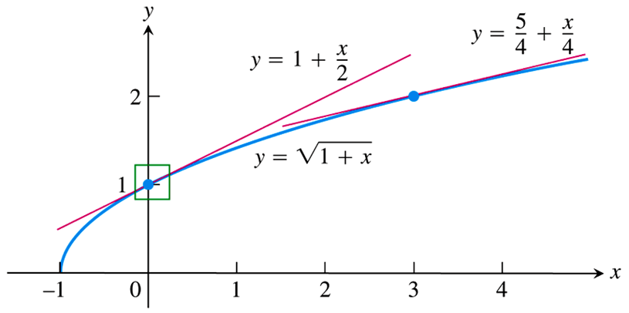
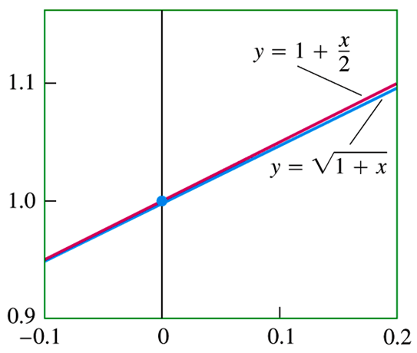
EXAMPLE Find the linear approximation for $f\left(x\right)=\sqrt{1+x}$ at $x=0$ and at $x=3$.

Slide 10
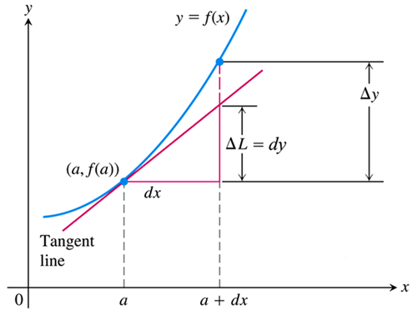
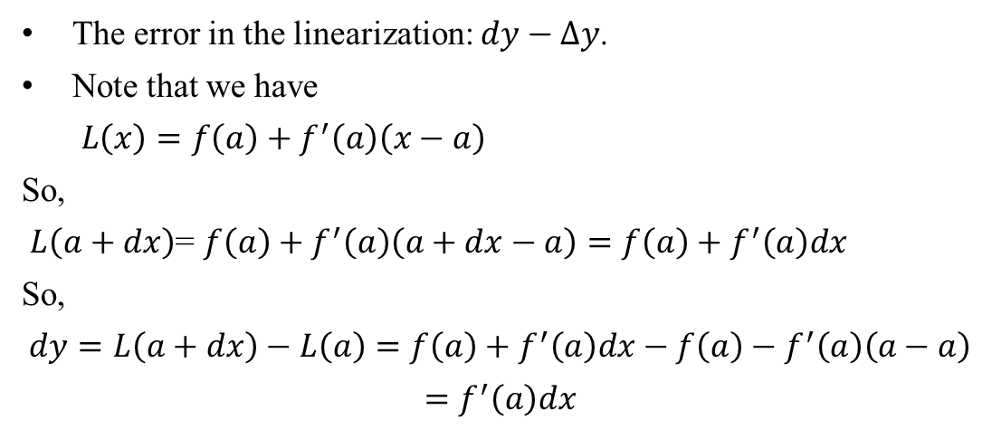
The linear approximation for and Differentials
So, for an $x$-value that is a given distance, say $dx$, from the center of approximation $x=a$, the $y$-value of the linearization, $L\left(a+dx\right)$, is not exactly equal to the $y$-value of the function $f\left(a+dx\right)$.
The true change in $y:$ $∆y=∆f=f\left(a+dx\right)−f(a)$
The approximate change in $y:$ $dy=∆L=L\left(a+dx\right)−L(a)$
The error in the linearization: $dy−∆y$.
Note that we have
$L\left(x\right)=f\left(a\right)+f^{′}\left(a\right)\left(x−a\right)$
So,
$L\left(a+dx\right)$= $f\left(a\right)+f^{′}\left(a\right)\left(a+dx−a\right)=f\left(a\right)+f^{′}\left(a\right)dx$
So,
$$dy=L\left(a+dx\right)−L\left(a\right)=f\left(a\right)+f^{′}\left(a\right)dx−f\left(a\right)−f^{′}\left(a\right)\left(a−a\right)$$
$$=f^{′}\left(a\right)dx$$
Or equivalently, $\frac{dy}{dx}=f^{′}\left(a\right)$, which simply states that the ratio of $dy$ to $dx$ is the slope of the tangent line, as is suggested by the figure.

Slide 11
Definition of the Differential
We call the quantities $dx$ and $dy$ differentials:
We sometimes write $df$ in place of $dy$, as in the following example illustrating estimation with differentials.

Slide 12
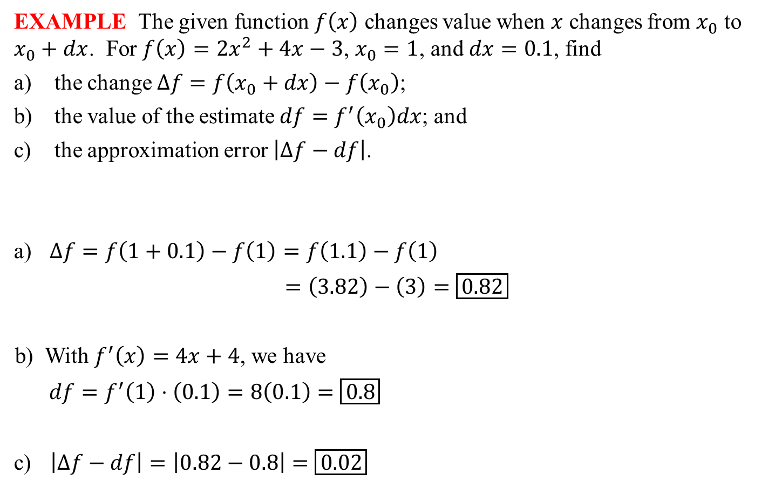
EXAMPLE The given function $f\left(x\right)$ changes value when $x$ changes from $x_{0}$ to $x_{0}+dx$. For $f\left(x\right)=2x^{2}+4x−3$, $x_{0}=1$, and $dx=0.1$, find
the change $∆f=f\left(x_{0}+dx\right)−f\left(x_{0}\right)$;
the value of the estimate $df=f^{′}\left(x_{0}\right)dx$; and
the approximation error $\left|∆f−df\right|$.
$∆f=f\left(1+0.1\right)−f\left(1\right)=f\left(1.1\right)−f\left(1\right)$
$=\left(3.82\right)−\left(3\right)=\boxed{0.82}$
With $f^{′}\left(x\right)=4x+4$, we have
$df=f^{′}\left(1\right)⋅\left(0.1\right)=8\left(0.1\right)=\boxed{0.8}$
$\left|∆f−df\right|=\left|0.82−0.8\right|=\boxed{0.02}$

Slide 13
Differentials and Leibniz Notation
Finally, and most importantly for our later work with antiderivatives, we consider the relationship between the differentials and Leibniz notation, $\frac{dy}{dx}$, for the derivative of a function.
Note that we have
$dy÷dx=\left(f^{′}\left(x\right)dx\right)÷dx=\frac{f^{′}\left(x\right)dx}{dx}=f^{′}\left(x\right)=\frac{dy}{dx}$,
where the last is not a fraction, but the familiar derivative notation.
Thus, the ratio of the differentials is equal to the derivative of $y$ with respect to $x$, giving the rather uninteresting-looking equality
$$\frac{dy}{dx}=\frac{dy}{dx}$$
We use this relationship to write derivatives in differential form, as in
$d\left(x^{2}e^{x}\right)=\left(x^{2}e^{x}+2xe^{x}\right)dx$

Slide 14
Differentiation Rules in Differential Form
All of our differentiation rules have a corresponding differential form, some of which the student may find easier to remember than the original form.
$\frac{d}{dx}\left[f\left(x\right)+g\left(x\right)\right]=f^{′}\left(x\right)+g^{′}\left(x\right)$ | $d\left(u+v\right)=du+dv$
$\frac{d}{dx}\left[f\left(x\right)⋅g\left(x\right)\right]=f\left(x\right)g^{′}\left(x\right)+f^{′}\left(x\right)g\left(x\right)$ | $d\left(uv\right)=udv+vdu$
$\frac{d}{dx}\left[\frac{f\left(x\right)}{g\left(x\right)}\right]=\frac{g\left(x\right)f^{′}\left(x\right)−f\left(x\right)g^{′}\left(x\right)}{{\left[g\left(x\right)\right]}^{2}}$ | $d\left(\frac{u}{v}\right)=\frac{vdu−udv}{v^{2}}$
$\frac{d}{dx}\left[f\left(g\left(x\right)\right)\right]=f^{′}\left(g\left(x\right)\right)⋅g^{′}\left(x\right)$ | $$d\left(f\left(u\right)\right)=f^{′}\left(u\right)du$$

