Slide 1
4.3
Maxima and Minima

Slide 2
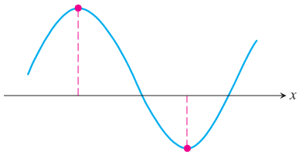
Extreme Values of Functions
We found that a body whose position $s$ at time $t$ is described by a differentiable function $s\left(t\right)$ may change direction only when the body’s velocity $v\left(t\right)=s^{′}\left(t\right)$ is equal to zero.
The graph of a differentiable function may have a turning point only when the function’s derivative is equal to zero.
Typically, a turning point of a function is a point at which the function has a maximum or minimum value, as in the figure.
Notice that we can tell the derivative of this function is zero at these points, since a tangent line at each of these points is horizontal.

Slide 3
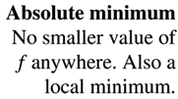
Extreme Values of Functions
In general, we call these points local extremes, local because there may be other points on the function that are higher or lower, but the local extreme is the highest or lowest in the area around that point.
If an extreme is the highest or lowest point on the entire function, we call it an absolute extreme.
As an example, consider the following figure of a function defined on the closed interval $\left[a, b\right]$:

Slide 4
Extreme Values of Functions
A couple of items of interest to note about this figure:
An extreme may occur at a domain endpoint, and
An extreme may occur at a point at which the function is not differentiable.
We next consider some formal definitions and theorems regarding extremes, and then turn to the practical aspects of locating these points.

Slide 5
Local and Absolute Extremes
A point is a local extreme if that point is higher (or lower) than any other point nearby. Here’s how we define this idea mathematically:
A point is an absolute extreme if that point is higher (or lower) than any other point on the entire function. Mathematically, this is stated as:

Slide 6
The Extreme Value Theorem
We’ve already begun to consider when a function has a local extreme (e.g., when the derivative is zero or undefined).
For the moment let’s turn to the question of when a function has absolute extrema.
There’s a theorem for that:
Basically, this theorem states that a function is guaranteed to have absolute extrema (both an absolute maximum and an absolute minimum) when the function is continuous and its domain is restricted to a finite closed interval.
The next couple of slides show examples of functions that do (and do not) satisfy the conditions of the Extreme Value Theorem.

Slide 7
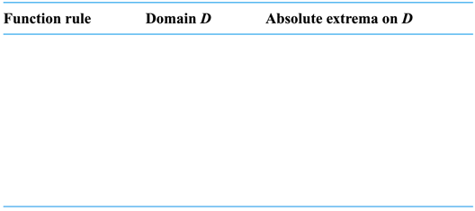
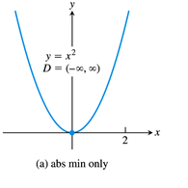
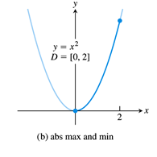
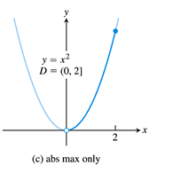
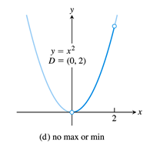
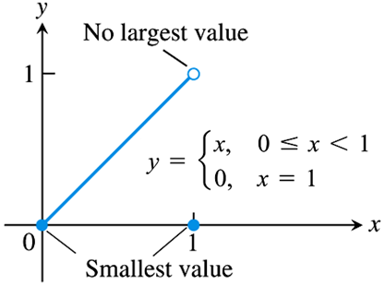
The Extreme Value Theorem
We start with the continuous function $y=x^{2}$, defined on various intervals:
Below is a piecewise (discontinuous) function with no absolute maximum.
Conclusion: A function that is discontinuous, or not defined on a closed interval, may not have absolute extrema.

Slide 8
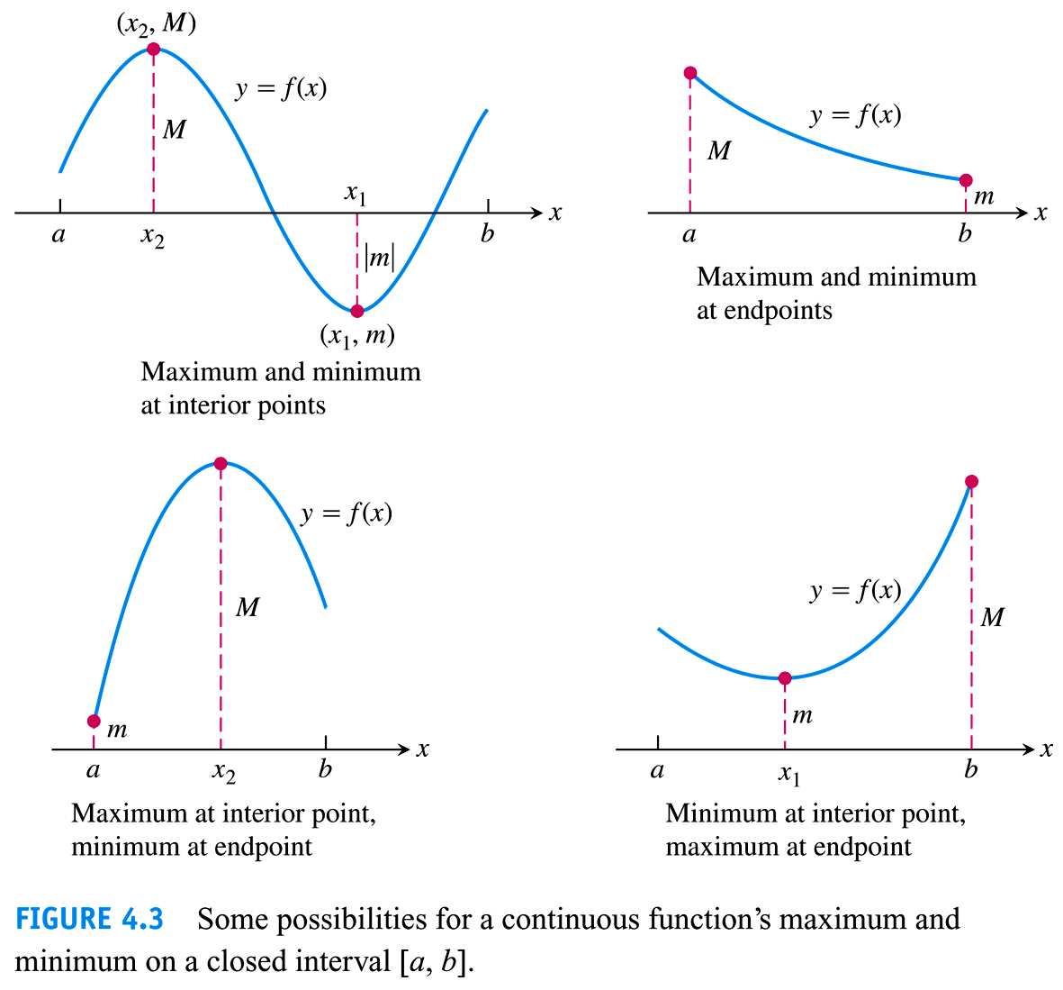
The Extreme Value Theorem
On the other hand, the following are graphs of functions that satisfy the conditions of the Extreme Values Theorem, i.e., functions that are both continuous and defined on a finite closed interval.
Note that an absolute extreme may occur either at a turning point of the function (an interior point), or at a domain endpoint.
Thus, to determine the absolute extrema of a function, we must first be able to find its local maxima and minima.
We now turn our attention back to this question.

Slide 9
Finding Extrema: Critical Points
Recall from a previous example that the extrema of a function tend to occur at one of three places:
Interior points where the function’s derivative is equal to zero,
Interior points where the function’s derivative is undefined, and
Endpoints of the domain.
There is no mystery in finding the domain endpoints of a function, but based on the above observations we can state the following concerning interior points:
And focus our investigation into potential extrema on what we call critical points:

Slide 10
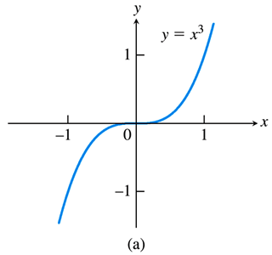
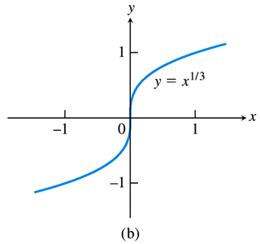
Finding Extrema: Critical Points
It is important to note that the First Derivative Theorem does not state that every critical point is a local extreme.
Consider the following graphs:
The function $y=x^{3}$ (left) has a critical point at $x=0$, since $f^{′}\left(x\right)=3x^{2}=0$ when $x=0$. But this function does not have a local extreme at that point.
The function $y=x^{1/3}$ (right) also has a critical point at $x=0$, since $f^{′}\left(x\right)=\frac{1}{3}x^{{−2}/3}=\frac{1}{3x^{2/3}}$ is undefined at $x=0$. Again, this function does not have a local extreme at that point.

Slide 11
Finding Absolute Extrema
We can now answer the practical question (and work related examples) of finding the absolute extrema of a function.
Here’s what we know:
Absolute extrema occur at points that have the highest or lowest $y$-values across the entire function, and
Absolute extrema may occur at either critical points or domain endpoints.
Putting this information together gives:
As it turns out, the practical aspects of finding local extrema, i.e., determining which critical points yield extrema, requires a little more thought, and we will return to this question in Section 4.3.
For now, use a graphing utility to determine if a critical point is a local extreme.

Slide 12
EXAMPLE Find the absolute maximum and minimum values of $f\left(x\right)=x^{2}$ on the interval $\left[−2, 1\right]$.
The domain endpoints $x=−2, 1$ are potential absolute extrema.
The function’s derivative is $f^{′}\left(x\right)=2x$, which is never undefined, but is equal to zero at $x=0$. Thus, the only critical point is $x=0$.
To find the absolute extrema, we simply pick the highest and lowest $y$-value given by these points:
$x=−2$ $→ f\left(−2\right)={\left(−2\right)}^{2}=4$
$x=0$ $→ f\left(0\right)={\left(0\right)}^{2}=0$
$x=1$ $→ f\left(1\right)={\left(1\right)}^{2}=1$
Thus, the function has an absolute maximum value of 4 at $x=−2$, and an absolute minimum value of 0 at $x=0$.
Note that an extreme has two components: the value ($y$-value), and the location (x-value).

Slide 13
EXAMPLE Find the absolute maximum and minimum values of $f\left(x\right)=10x\left(2−\ln{x}\right)$ on the interval $\left[1, e^{2}\right]$.
$f^{′}\left(x\right)=10x\left(−\frac{1}{x}\right)+10\left(2−\ln{x}\right)=10−10\ln{x}$
Critical Points:
The derivative is defined on the interval $\left[1, e^{2}\right]$.
The derivative is zero at $10−10\ln{x}=0 → 10\ln{x}=10 → \ln{x}=1 → x=e$.
Potential Absolute Extrema (including critical points and domain endpoints):
$x=1$ $→ f\left(1\right)=10\left(1\right)\left(2−\ln{1}\right)=10\left(2−0\right)=20$
$x=e$ $→ f\left(e\right)=10\left(e\right)\left(2−\ln{e}\right)=10e\left(2−1\right)=10e≈27.2$
$x=e^{2}$ $→ f\left(e^{2}\right)=10\left(e^{2}\right)\left(2−\ln{e^{2}}\right)=10e^{2}\left(2−2\right)=0$
Thus, the function has an absolute maximum value of $10e≈27.2$ at $x=e$, and an absolute minimum value of 0 at $x=e^{2}$.

Slide 14
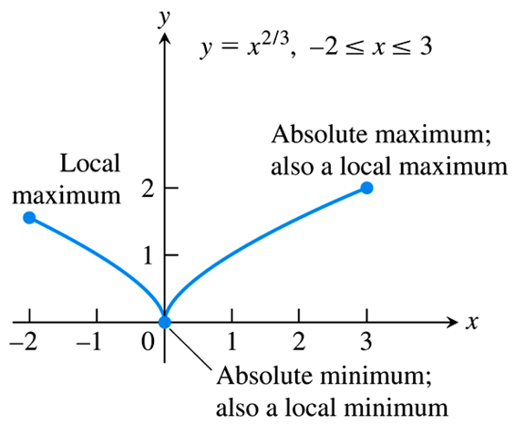
EXAMPLE Find the absolute maximum and minimum values of $f\left(x\right)=x^{2/3}$ on the interval $\left[−2, 3\right]$.
$f^{′}\left(x\right)=\frac{2}{3}x^{{−1}/3}=\frac{2}{3x^{1/3}}$
Critical Points:
The derivative is undefined at $x=0$.
The derivative is never equal to zero.
Potential Absolute Extrema:
$x=−2$ $→ f\left(−2\right)={\left(−2\right)}^{2/3}=\sqrt[3]{4}≈1.59$
$x=0$ $→ f\left(0\right)=0^{2/3}=0$
$x=3$ $→ f\left(3\right)=3^{2/3}=\sqrt[3]{9}≈2.08$
Thus, the function has an absolute maximum value of $\sqrt[3]{9}≈2.08$ at $x=3$, and an absolute minimum value of 0 at $x=0$.

Slide 15
Example:
Find all critical points of the following function.
$$f\left(x\right)=\frac{x^{2}}{x−2}$$
$f^{′}\left(x\right)=\frac{\left(x−2\right)\left(2x\right)−x^{2}\left(1\right)}{{\left(x−2\right)}^{2}}=\frac{2x^{2}−4x−x^{2}}{{\left(x−2\right)}^{2}}=\frac{x^{2}−4x}{{\left(x−2\right)}^{2}}$
The derivative is equal to zero at
$x^{2}−4x=0 → x\left(x−4\right)=0 → x=0, 4$
The derivative is undefined at $x−2=0 → x=2$, but this is not in the domain of the original function, so it is not a critical point.
Thus, the critical points of the function are $x=0, 4$.

