Slide 1
4.1
Related Rates

Slide 2
Goals:
Determine the rate at which a certain quantity is changing. These problems are called related rates problems.
2. General strategy for solving related rates problems.

Slide 3
EXAMPLE Air is being pumped into a spherical balloon so that its volume increases at a rate of 100 $\frac{{cm}^{3}}{s}.$How fast is the radius of the balloon increasing when the diameter is 50cm?
The variables in the problem are
$V=$ the volume of the balloon.
$r=$ the radius of the balloon.
$\frac{dv}{dt}=$rate of increase of volume of air
$\frac{dr}{dt}=$ rate of increase of the radius of the balloon
The one known constant is diameter of the sphere (50cm).
We are asked to find $\frac{dr}{dt}$ when
$r=25cm$ and $\frac{dv}{dt}=100\frac{{cm}^{3}}{s}$.

Slide 4
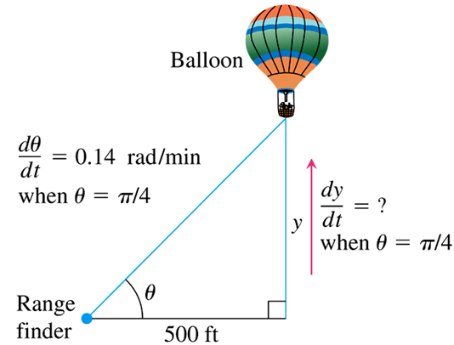
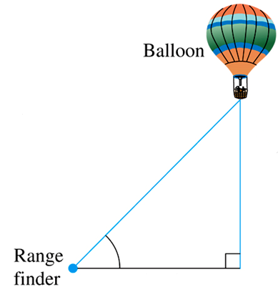
EXAMPLE A hot air balloon rising straight up from a level field is tracked by a range finder 500 ft from the liftoff point. At the moment the range finder’s elevation angle is $π/4$, the angle is increasing at the rate of 0.14 rad/min. How fast is the balloon rising at that moment?
The variables in the problem are
$θ=$ the angle in radians the range finder makes with the ground.
$y=$ the height in feet of the balloon.
The one known constant is the horizontal distance from the range finder.
We are asked to find $\frac{dy}{dt}$ when
$θ=\frac{π}{4}$ and $\frac{dθ}{dt}=0.14 \text{rad}\text{/}\text{min}$.

Slide 5
EXAMPLE A hot air balloon rising straight up from a level field is tracked by a range finder 500 ft from the liftoff point. At the moment the range finder’s elevation angle is $π/4$, the angle is increasing at the rate of 0.14 rad/min. How fast is the balloon rising at that moment?
An equation that relates the variables $y$ and $θ$ is
$$\tan{θ}=\frac{y}{500} \text{or} y=500\tan{θ}.$$
Differentiating with respect to time yields
$\frac{d}{dt}\left[y\right]=\frac{d}{dt}\left[500\tan{θ}\right]$
$\frac{dy}{dt}=500\sec^{2}{θ}⋅\frac{dθ}{dt}$
Evaluating at the known quantities gives
$\frac{dy}{dt}=500\sec^{2}\left(\frac{π}{4}\right)⋅0.14$
$=500{\left(\sqrt{2}\right)}^{2}\left(0.14\right)=140$
The balloon is rising at a rate of 140 ft/min.

Slide 6
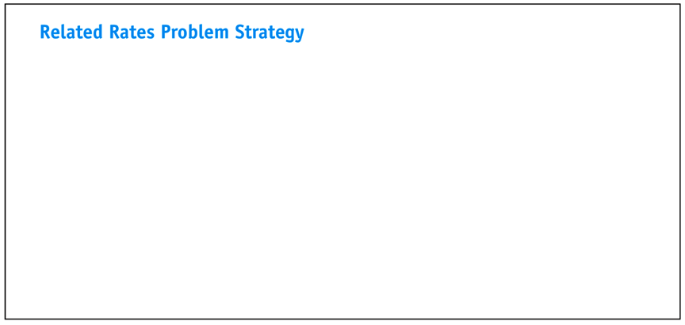

Slide 7
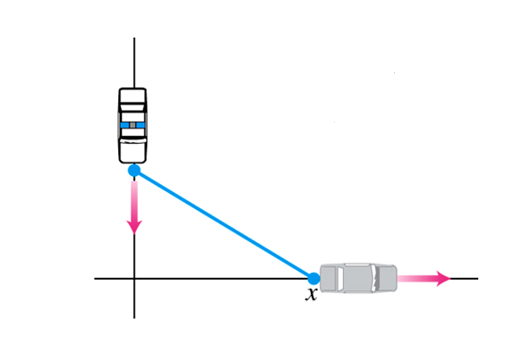
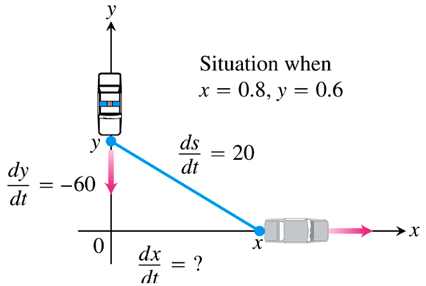
EXAMPLE A police cruiser, approaching a right-angled intersection from the north, is chasing a speeding car that has turned the corner and is now moving straight east. When the cruiser is 0.6 mi north of the intersection and the car is 0.8 mi to the east, the police determine with radar that the distance between them and the car is increasing at 20 mph. If the cruiser is moving at 60 mph at the instant of measurement, what is the speed of the car?
We picture the car and cruiser in the coordinate plane, using the positive $x$-axis as the eastbound highway and the positive $y$-axis as the southbound highway.
The variables in the problem are
$x=$ position of car at time $t$
$y=$ position of cruiser at time $t$
$s=$ distance between car and cruiser.
We are asked to find $\frac{dx}{dt}$ when
$x=0.8 \text{mi}, y=0.6 \text{mi},$
$\frac{dy}{dt}=−60 \text{mph}, \frac{ds}{dt}=20 \text{mph}.$

Slide 8
EXAMPLE A police cruiser, approaching a right-angled intersection from the north, is chasing a speeding car that has turned the corner and is now moving straight east. When the cruiser is 0.6 mi north of the intersection and the car is 0.8 mi to the east, the police determine with radar that the distance between them and the car is increasing at 20 mph. If the cruiser is moving at 60 mph at the instant of measurement, what is the speed of the car?
The Pythagorean theorem gives the equation
$x^{2}+y^{2}=s^{2}.$
Differentiating with respect to time yields
$\frac{d}{dt}\left[x^{2}+y^{2}\right]=\frac{d}{dt}\left[s^{2}\right]$
$2x⋅\frac{dx}{dt}+2y⋅\frac{dy}{dt}=2s⋅\frac{ds}{dt}$
Evaluating at the known quantities gives
$2\left(0.8\right)\frac{dx}{dt}+2\left(0.6\right)\left(−60\right)=2\left(1\right)\left(20\right)$
Solving, we find the car’s speed ($\frac{dx}{dt}$) to be 70 mph.
When $x=0.8$ and $y=0.6$ we have
$$s=\sqrt{{\left(0.8\right)}^{2}+{\left(0.6\right)}^{2}}=1$$

Slide 9
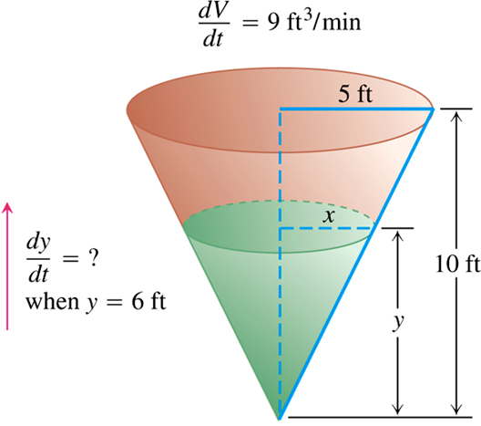
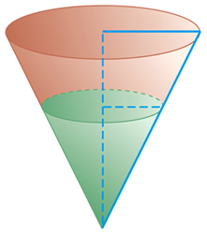
EXAMPLE Water runs into a conical tank at the rate of $9$ ft³/min. The tank stands point down and has a height of 10 ft and a base radius of 5 ft. How fast is the water level rising when the water is 6 ft deep?
The figure to the right shows a partially filled tank.
The variables in the problem are
$V=$ volume (ft³) of the water in the tank at time $t$ (min)
$x=$ radius (ft) of the surface of the water at time $t$
$y=$ depth (ft) of the water in the tank at time $t$
The constants are the dimensions of the tank.
We are asked to find $\frac{dy}{dt}$ when
$y=6 \text{ft}$ and $\frac{dV}{dt}=9 \text{ft}\text{3}\text{/}\text{min}$.

Slide 10
EXAMPLE Water runs into a conical tank at the rate of $9$ ft³/min. The tank stands point down and has a height of 10 ft and a base radius of 5 ft. How fast is the water level rising when the water is 6 ft deep?
The water forms a cone with volume
$$V=\frac{1}{3}πx^{2}y.$$
This equation involves $x$ as well as $V$ and $y$; but since no information is given about $x$ at the time in question, we need to eliminate this variable.
The similar triangles in the figure suggest that
$\frac{x}{y}=\frac{5}{10} → x=\frac{y}{2}.$
Therefore, we have
$V=\frac{1}{3}πx^{2}y=\frac{1}{3}π{\left(\frac{y}{2}\right)}^{2}y=\frac{π}{12}y^{3}.$

Slide 11
EXAMPLE Water runs into a conical tank at the rate of $9$ ft³/min. The tank stands point down and has a height of 10 ft and a base radius of 5 ft. How fast is the water level rising when the water is 6 ft deep?
To determine the rate at which the water level is rising ($\frac{dy}{dt}$), we differentiate the equation $V=\frac{π}{12}y^{3}$ with respect to time $t$.
$\frac{d}{dt}\left[V\right]=\frac{d}{dt}\left[\frac{π}{12}y^{3}\right]$
$\frac{dV}{dt}=\frac{π}{4}y^{2}⋅\frac{dy}{dt}$
Finally, we use $y=6$ and $\frac{dV}{dt}=9$ to obtain $\frac{dy}{dt}$.
$9=\frac{π}{4}{\left(6\right)}^{2}\frac{dy}{dt}$
$\frac{dy}{dt}=\frac{1}{π}≈0.32$
At the moment in question, the water level is rising at about $0.32$ ft/min.

Slide 12
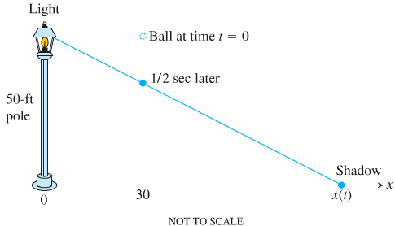
EXAMPLE A light shines from the top of a pole 50 ft high. A ball is dropped from the same height from a point 30 ft away from the light. (See figure below.) How fast is the shadow of the ball moving along the ground 0.5 sec later? (Assume the ball falls a distance $s=16t^{2}$ ft in $t$ sec.)
The variables in the problem are
$x=$ distance of shadow to pole at time $t$; so that the shadow’s length is $x−30$.
$y=$ height of the ball at time $t$; so that $y=50−16t^{2}$.
We are asked to find $\frac{dx}{dt}$ when $t=0.5$ sec.
The similar triangles in the figure suggest that the variables are related by the equation
$\frac{50}{x}=\frac{y}{x−30}$
or $xy=50x−1500$.

Slide 13
EXAMPLE A light shines from the top of a pole 50 ft high. A ball is dropped from the same height from a point 30 ft away from the light. (See figure below.) How fast is the shadow of the ball moving along the ground 0.5 sec later? (Assume the ball falls a distance $s=16t^{2}$ ft in $t$ sec.)
$$xy=50x−1500$$
Differentiating with respect to time gives
$\frac{d}{dt}\left[xy\right]=\frac{d}{dt}\left[50x−1500\right]$
$x\frac{dy}{dt}+y\frac{dx}{dt}=50\frac{dx}{dt}$
To solve for $\frac{dx}{dt}$ we need $x$, $y$, and $\frac{dy}{dt}$ when $t=0.5$ sec.
We have $y=50−16t^{2}$
$y=50−16{\left(0.5\right)}^{2}=46 ft$
${\left.\frac{dy}{dt}\right|}_{t=0.5}={\left.−32t\right|}_{t=0.5}=−16$ ft/sec
$xy=50x−1500$ $→$ $x\left(46\right)=50x−1500$
$→$ $4x=1500$ $→$ $x=375$ ft

Slide 14
EXAMPLE A light shines from the top of a pole 50 ft high. A ball is dropped from the same height from a point 30 ft away from the light. (See figure below.) How fast is the shadow of the ball moving along the ground 0.5 sec later? (Assume the ball falls a distance $s=16t^{2}$ ft in $t$ sec.)
Thus, we have
$x\frac{dy}{dt}+y\frac{dx}{dt}=50\frac{dx}{dt}$
$\left(375\right)\left(−16\right)+\left(46\right)\frac{dx}{dt}=50\frac{dx}{dt}$
$−6000=4\frac{dx}{dt}$
$\boxed{\frac{dx}{dt}=−1500 \text{ft}\text{/}\text{sec}}$

