Slide 1
3.6
The Chain Rule

Slide 2
Derivatives of Compositions of Functions
We now know how to find derivatives of polynomial, exponential, and trigonometric functions, as well as algebraic combinations of these functions (i.e., sums, differences, products, and quotients).
But what about the function $h\left(x\right)=\cos\left(x^{2}+1\right)$?
This function is different from ones we’ve considered previously, in that it is a composition of two functions:
If $f\left(x\right)=\cos{x}$ and $g\left(x\right)=x^{2}+1$, then $h\left(x\right)=f\left(g\left(x\right)\right)$.
In this section we learn how to find derivatives of such compositions.
We’ll return to the above function later, but as a first example, consider the function $h\left(x\right)={\left(3x^{2}+1\right)}^{2}$.

Slide 3
Derivatives of Compositions of Functions: A First Example
The function $h\left(x\right)={\left(3x^{2}+1\right)}^{2}$ is another composite function, for which it will be most helpful to use the following notation:
Let $h=f\left(u\right)$, where $u=3x^{2}+1$ and $f\left(u\right)=u^{2}$.
The fact is we already know how to find the derivative of $h\left(x\right)$, simply by first performing some algebra manipulations:
$h\left(x\right)=\left(3x^{2}+1\right)\left(3x^{2}+1\right)=9x^{4}+6x^{2}+1$
We now find $h^{′}\left(x\right)$ and attempt to relate it to $u$ and $f\left(u\right)$ in order to motivate a more general rule for derivatives of composite functions.
$h^{′}\left(x\right)={\left[9x^{4}+6x^{2}+1\right]}^{′}=36x^{3}+12x$
$=12x\left(3x^{2}+1\right)$
$=2\left(3x^{2}+1\right)\left(6x\right)$
$=2u⋅u^{′}$
$=f^{′}\left(u\right)⋅u^{′}$
We see then, that $h^{′}=f^{′}\left(u\right)⋅u^{′}$, and this is what is known as the Chain Rule.

Slide 4
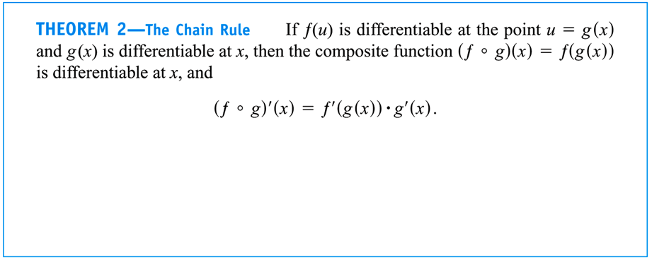
The Chain Rule
The Chain Rule is one that sometimes gives students trouble, but it simply states that the derivative of a composition is the product of the derivatives.
I like to remember the rule as: The derivative of a composite $f\left(g\left(x\right)\right)$ is the derivative of the “outside” function, $f^{′}$, times the derivative of the “inside” function, $g^{′}$. This works great, as long as you remember to leave the “inside” function $g$ unchanged when you take $f^{′}$.

Slide 5
EXAMPLE Use the Chain Rule to find the derivatives of the following function.
$$h\left(x\right)=\cos\left(x^{2}+1\right)$$
The “inside” function is $u=x^{2}+1$,
and the “outside” function is $f\left(u\right)=\cos{u}$.
We have $f^{′}\left(u\right)=−\sin{u}$ and $u^{′}=2x$, so
$h^{′}\left(x\right)=f^{′}\left(u\right)⋅u^{′}$
$=−\sin{u}⋅2x$
$=−\sin\left(x^{2}+1\right)⋅2x$
$=\boxed{−2x\sin\left(x^{2}+1\right)}$
In the following examples, we practice applying the Chain Rule without explicitly stating the “inside” and “outside” functions.
Students are encouraged to rewrite those examples as we did this one in order to gain a better understanding of the rule.

Slide 6
EXAMPLE Use the Chain Rule to find the derivatives of the following functions.
$f\left(x\right)=\sin\left(x^{2}+e^{x}\right)$
$f\left(x\right)=e^{\cos{x}}$
$f\left(x\right)={\left(5x^{3}−x^{4}\right)}^{7}$
$f\left(x\right)=\sin^{5}{x}$
$f^{′}\left(x\right)=\cos\left(x^{2}+e^{x}\right){\left[x^{2}+e^{x}\right]}^{′}$
$=\cos\left(x^{2}+e^{x}\right)\left(2x+e^{x}\right)$
$\boxed{f^{′}\left(x\right)=\left(2x+e^{x}\right)\cos\left(x^{2}+e^{x}\right)}$
$f^{′}\left(x\right)=e^{\cos{x}}{\left[\cos{x}\right]}^{′}$
$=e^{\cos{x}}\left(−\sin{x}\right)$
$\boxed{f^{′}\left(x\right)=−\sin{x}e^{\cos{x}}}$

Slide 7
EXAMPLE Use the Chain Rule to find the derivatives of the following functions.
$f\left(x\right)=\sin\left(x^{2}+e^{x}\right)$
$f\left(x\right)=e^{\cos{x}}$
$f\left(x\right)={\left(5x^{3}−x^{4}\right)}^{7}$
$f\left(x\right)=\sin^{5}{x}$
$f^{′}\left(x\right)=7{\left(5x^{3}−x^{4}\right)}^{6}{\left[5x^{3}−x^{4}\right]}^{′}$
$\boxed{f^{′}\left(x\right)=7{\left(5x^{3}−x^{4}\right)}^{6}\left(15x^{2}−4x^{3}\right)}$
$f^{′}\left(x\right)=5\sin^{4}{x}{\left[\sin{x}\right]}^{′}$
$\boxed{f^{′}\left(x\right)=5\sin^{4}{x}\cos{x}}$
These are examples of what we call the General Power Rule, which is the Power Rule $\frac{d}{dx}\left[x^{n}\right]=nx^{n−1}$ combined with the Chain Rule:
$\frac{d}{dx}\left[u^{n}\right]=nu^{n−1}⋅\frac{du}{dx}$

Slide 8
Generalized Differentiation Rules
From now on, we will give differentiation rules in a more general form that includes the possibility of an inside function.
For example,
$\frac{d}{dx}\left[x^{n}\right]=nx^{n−1}$ $→$ $\frac{d}{dx}\left[u^{n}\right]=nu^{n−1}⋅\frac{du}{dx}$
$\frac{d}{dx}\left[e^{x}\right]=e^{x}$ $→$ $\frac{d}{dx}\left[e^{u}\right]=e^{u}⋅\frac{du}{dx}$
$\frac{d}{dx}\left[\sin{x}\right]=\cos{x}$ $→$ $\frac{d}{dx}\left[\sin{u}\right]=\cos{u}⋅\frac{du}{dx}$
$\frac{d}{dx}\left[\sec{x}\right]=\sec{x}\tan{x}$ $→$ $\frac{d}{dx}\left[\sec{u}\right]=\sec{u}\tan{u}⋅\frac{du}{dx}$
$\frac{d}{dx}\left[\cot{x}\right]=−\csc^{2}{x}$ $→$ $\frac{d}{dx}\left[\cot{u}\right]=−\csc^{2}{u}⋅\frac{du}{dx}$
Finally, we consider some examples in which we must apply the Chain Rule multiple times.

Slide 9
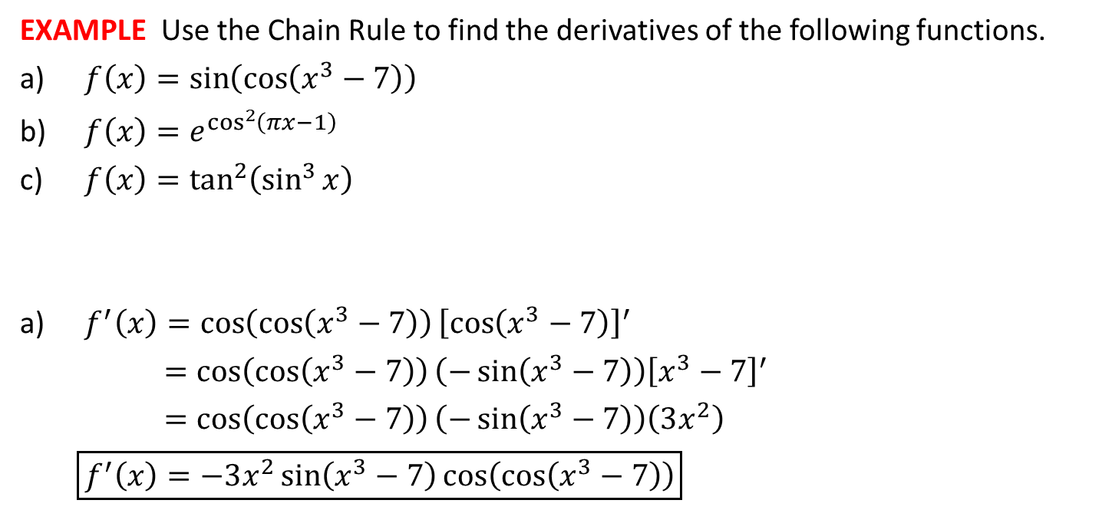
EXAMPLE Use the Chain Rule to find the derivatives of the following functions.
$f\left(x\right)=\sin\left(\cos\left(x^{3}−7\right)\right)$
$f\left(x\right)=e^{\cos^{2}\left(πx−1\right)}$
$f\left(x\right)=\tan^{2}\left(\sin^{3}{x}\right)$
$f^{′}\left(x\right)=\cos\left(\cos\left(x^{3}−7\right)\right){\left[\cos\left(x^{3}−7\right)\right]}^{′}$
$=\cos\left(\cos\left(x^{3}−7\right)\right)\left(−\sin\left(x^{3}−7\right)\right){\left[x^{3}−7\right]}^{′}$
$=\cos\left(\cos\left(x^{3}−7\right)\right)\left(−\sin\left(x^{3}−7\right)\right)\left(3x^{2}\right)$
$\boxed{f^{′}\left(x\right)=−3x^{2}\sin\left(x^{3}−7\right)\cos\left(\cos\left(x^{3}−7\right)\right)}$

Slide 10
EXAMPLE Use the Chain Rule to find the derivatives of the following functions.
$f\left(x\right)=\sin\left(\cos\left(x^{3}−7\right)\right)$
$f\left(x\right)=e^{\cos^{2}\left(πx−1\right)}$
$f\left(x\right)=\tan^{2}\left(\sin^{3}{x}\right)$
$f^{′}\left(x\right)=e^{\cos^{2}\left(πx−1\right)}{\left[\cos^{2}\left(πx−1\right)\right]}^{′}$
$=e^{\cos^{2}\left(πx−1\right)}\left(2\cos\left(πx−1\right)\right){\left[\cos\left(πx−1\right)\right]}^{′}$
$=e^{\cos^{2}\left(πx−1\right)}\left(2\cos\left(πx−1\right)\right)\left(−\sin\left(πx−1\right)\right){\left[πx−1\right]}^{′}$
$=e^{\cos^{2}\left(πx−1\right)}\left(2\cos\left(πx−1\right)\right)\left(−\sin\left(πx−1\right)\right)\left(π\right)$
$\boxed{f^{′}\left(x\right)=−2π\sin\left(πx−1\right)\cos\left(πx−1\right)e^{\cos^{2}\left(πx−1\right)}}$
$\cos^{2}\left(πx−1\right)={\left(\cos\left(πx−1\right)\right)}^{2}$

Slide 11
EXAMPLE Use the Chain Rule to find the derivatives of the following functions.
$f\left(x\right)=\sin\left(\cos\left(x^{3}−7\right)\right)$
$f\left(x\right)=e^{\cos^{2}\left(πx−1\right)}$
$f\left(x\right)=\tan^{2}\left(\sin^{3}{x}\right)$
$f^{′}\left(x\right)=2\tan\left(\sin^{3}{x}\right){\left[\tan\left(\sin^{3}{x}\right)\right]}^{′}$
$=2\tan\left(\sin^{3}{x}\right)\sec^{2}\left(\sin^{3}{x}\right){\left[\sin^{3}{x}\right]}^{′}$
$=2\tan\left(\sin^{3}{x}\right)\sec^{2}\left(\sin^{3}{x}\right)\left(3\sin^{2}{x}\right){\left[\sin{x}\right]}^{′}$
$=2\tan\left(\sin^{3}{x}\right)\sec^{2}\left(\sin^{3}{x}\right)\left(3\sin^{2}{x}\right)\cos{x}$
$\boxed{f^{′}\left(x\right)=6\sin^{2}{x}\cos{x}\tan\left(\sin^{3}{x}\right)\sec^{2}\left(\sin^{3}{x}\right) }$
$\tan^{2}\left(\sin^{3}{x}\right)={\left(\tan\left(\sin^{3}{x}\right)\right)}^{2}$
$\sin^{3}{x}={\left(\sin{x}\right)}^{3}$

Slide 12
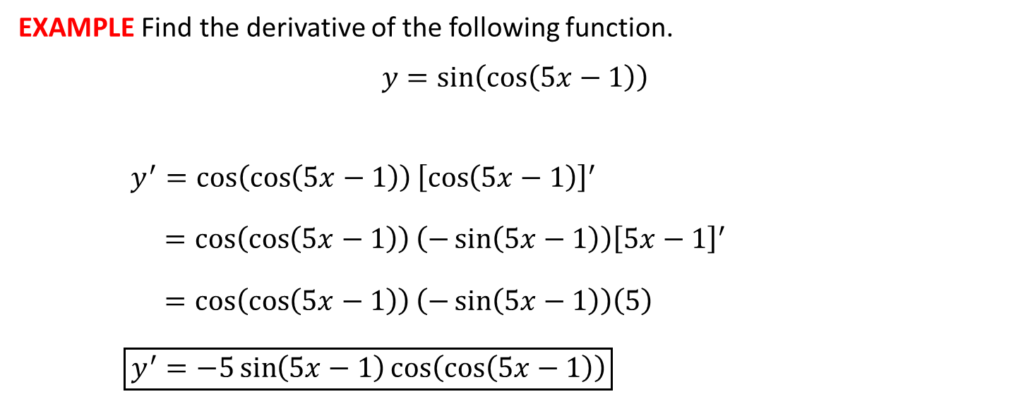
EXAMPLE Find the derivative of the following function.
$$y=\sin\left(\cos\left(5x−1\right)\right)$$
$y^{′}=\cos\left(\cos\left(5x−1\right)\right){\left[\cos\left(5x−1\right)\right]}^{′}$
$=\cos\left(\cos\left(5x−1\right)\right)\left(−\sin\left(5x−1\right)\right){\left[5x−1\right]}^{′}$
$=\cos\left(\cos\left(5x−1\right)\right)\left(−\sin\left(5x−1\right)\right)\left(5\right)$
$\boxed{y^{′}=−5\sin\left(5x−1\right)\cos\left(\cos\left(5x−1\right)\right)}$

