Slide 1
5.2
The Definite Integral

Slide 2
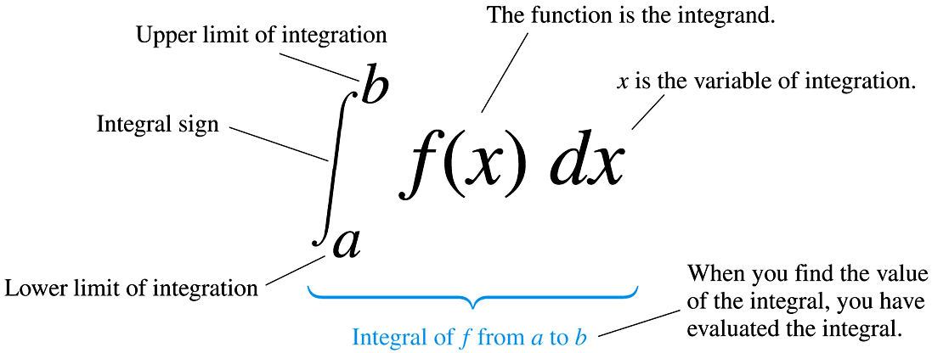
Integral Notation
Recall that we decided that the best approximation we could obtain of the area under a curve $f\left(x\right)$ is given by the limit of the Riemann sums:
$$\lim_{n→∞}{\sum_{k=1}^{n}{f\left(c_{k}\right)∆x}}$$
We now introduce a new notation, called integral notation, for this limit:
$$\lim_{n→∞}{\sum_{k=1}^{n}{f\left(c_{k}\right)∆x}}=\int_{a}^{b}{f\left(x\right)dx}$$
Here’s how to interpret this integral notation:

Slide 3
The Definite Integral
We can use this notation to express the area under a curve:
Notes:
This is called a definite integral, and evaluates as a number [the area under the curve $f\left(x\right)$ from $x=a$ to $x=b$], to differentiate it from the indefinite integrals, or antiderivatives, we discussed in Section 4.8. (I wonder why the overlapping notation…?)
We still lack an efficient method to evaluate a definite integral. We must fall back on taking the limit of the Riemann sums. (If only we could relate this integral back to something we already know how to calculate….)

Slide 4
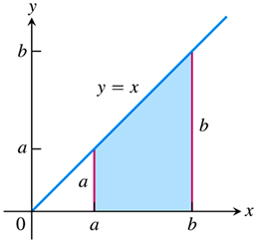
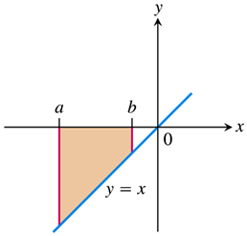
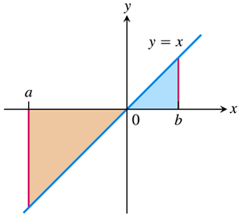
The Definite Integral – A Signed Area
We must also note (as stated in the definition on the preceding slide) that the definite integral only gives the area under a positive curve.
If the curve under consideration is negative, i.e., below the $x$-axis, or worse yet, sometimes positive and some- times negative, then the definite integral gives what we may think of as a signed area.
For example, consider the function $f\left(x\right)=x$, and areas “under” various regions of this function.
The definite integral $\int_{a}^{b}{xdx}$ gives
A positive number as the area under the curve in the top figure.
A negative number as the area “under” the curve, i.e., the area between the curve and the $x$-axis, in the middle figure.
A negative “net” area in the bottom figure.

Slide 5
EXAMPLE Evaluate the definite integral
$$\int_{a}^{b}{xdx}$$
Then use this result to find the net area between the function $f\left(x\right)=x$ and the $x$-axis on the intervals $\left[2,5\right]$, $\left[−3, −1\right]$, and $\left[−4, 2\right]$.
To evaluate this integral we must determine the limit $\lim_{n→∞}{\sum_{k=1}^{n}{f\left(c_{k}\right)∆x}}$.
Let’s continue to use intervals of equal width, so that $∆x=\frac{b−a}{n}$, and right-endpoint values to determine the heights, so that $c_{k}=a+\frac{\left(b−a\right)k}{n}$.
Now let’s use our rules for summations to simplify $\sum_{k=1}^{n}{\left[f\left(a+\frac{\left(b−a\right)k}{n}\right)\left(\frac{b−a}{n}\right)\right]}$

Slide 6
EXAMPLE Evaluate the definite integral
$$\int_{a}^{b}{xdx}$$
Then use this result to find the net area between the function $f\left(x\right)=x$ and the $x$-axis on the intervals $\left[2,5\right]$, $\left[−3, −1\right]$, and $\left[−4, 2\right]$.
$\sum_{k=1}^{n}{\left[f\left(a+\frac{\left(b−a\right)k}{n}\right)\left(\frac{b−a}{n}\right)\right]}=\sum_{k=1}^{n}{\left[\left(a+\frac{\left(b−a\right)k}{n}\right)\left(\frac{b−a}{n}\right)\right]}$
$=\sum_{k=1}^{n}{\left[\frac{ab−a^{2}}{n}+\frac{{\left(b−a\right)}^{2}k}{n^{2}}\right]}$
$=\sum_{k=1}^{n}{\left[\frac{ab−a^{2}}{n}\right]}+\sum_{k=1}^{n}{\left[\frac{{\left(b−a\right)}^{2}k}{n^{2}}\right]}$
$=n\left(\frac{ab−a^{2}}{n}\right)+\frac{{\left(b−a\right)}^{2}}{n^{2}}\sum_{k=1}^{n}{k}$
$=\left(ab−a^{2}\right)+\frac{{\left(b−a\right)}^{2}}{n^{2}}\left[\frac{n\left(n+1\right)}{2}\right]$
$=ab−a^{2}+\frac{{\left(b−a\right)}^{2}}{2}+\frac{{\left(b−a\right)}^{2}}{2n}$
$=\frac{b^{2}}{2}−\frac{a^{2}}{2}+\frac{{\left(b−a\right)}^{2}}{2n}$

Slide 7
EXAMPLE Evaluate the definite integral
$$\int_{a}^{b}{xdx}$$
Then use this result to find the net area between the function $f\left(x\right)=x$ and the $x$-axis on the intervals $\left[2,5\right]$, $\left[−3, −1\right]$, and $\left[−4, 2\right]$.
Finally, the limit of these sums gives the integral:
$\int_{a}^{b}{xdx}=\lim_{n→∞}\left[\frac{b^{2}}{2}−\frac{a^{2}}{2}+\frac{{\left(b−a\right)}^{2}}{2n}\right]=\frac{b^{2}}{2}−\frac{a^{2}}{2}$
Thus, we have
$\int_{2}^{5}{xdx}=\frac{5^{2}}{2}−\frac{2^{2}}{2}=\frac{21}{2}$
$\int_{−3}^{−1}{xdx}=\frac{{\left(−1\right)}^{2}}{2}−\frac{{\left(−3\right)}^{2}}{2}=−4$
$\int_{−4}^{2}{xdx}=\frac{{\left(2\right)}^{2}}{2}−\frac{{\left(−4\right)}^{2}}{2}=−6$

Slide 8
Other Definite Integrals
Using a similar process as in the preceding example, we can find other rules for definite integrals, such as:
$\int_{a}^{b}{c dx}=c\left(b−a\right)$
$\int_{a}^{b}{x^{2}dx}=\frac{b^{3}}{3}−\frac{a^{3}}{3}$
Also, it is important to note that, just as some function were not differentiable, it is the case that some functions are not integrable. However, many functions are integrable, and we can at least say that every continuous functions is.
More on integrability of functions after we find a way to circumvent this horrible “limit of Riemann sums” business in Section 5.4. (It’s even worse than the “limit of difference quotients” definition of a derivative.)

Slide 9
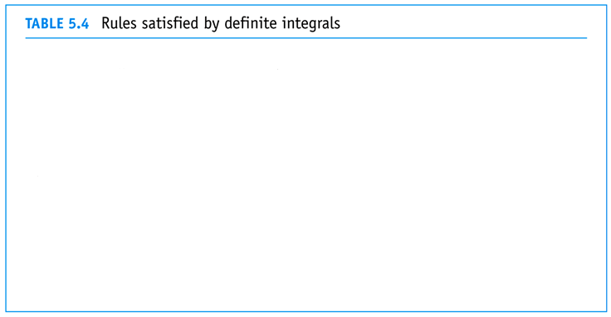
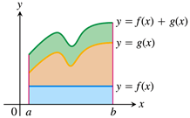
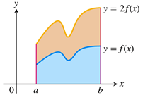
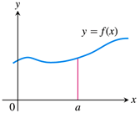
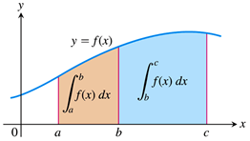
Definite Integrals for Combinations of Functions
We can begin to evaluate definite integrals of more interesting (read: complicated) functions by generalizing the algebra rules for sums into the following rules for integrals:

Slide 10
EXAMPLE Evaluate the following definite integrals.
$\int_{1}^{6}{\left(x^{2}−5x+7\right)dx}$
$\int_{2}^{2}{\sqrt{9−x^{2}}dx}$
$\int_{1}^{6}{\left(x^{2}−5x+7\right)dx}=\int_{1}^{6}{x^{2}dx}−5\int_{1}^{6}{xdx}+\int_{1}^{6}{7dx}$
$=\left[\frac{{\left(6\right)}^{3}}{3}−\frac{{\left(1\right)}^{3}}{3}\right]−5\left[\frac{{\left(6\right)}^{2}}{2}−\frac{{\left(1\right)}^{2}}{2}\right]+7\left(6−1\right)$
$=\frac{215}{3}−5\left(\frac{35}{2}\right)+7\left(5\right)$
$=\frac{215}{3}−\frac{175}{2}+35$
$=\boxed{\frac{115}{6}}$
$\int_{2}^{2}{\sqrt{9−x^{2}}dx}=\boxed{0}$

Slide 11
An(other) Application of Definite Integrals
Finally, a first (well second, after area under a curve) application of the definite integral is that of determining the average value of a function.
We know how to find the average of a finite list of numbers: add them all up and divide by the length of the list.
We extend this to an average of infinitely many numbers using the integral: $\int_{a}^{b}{f\left(x\right)dx}$ is, in a sense, nothing more than the sum of all of the values of the function $f\left(x\right)$ from $x=a$ to $x=b$.
Thus, we can find the average value of a function $f\left(x\right)$ as the integral of $f\left(x\right)$ divided by the length of the interval $\left[a, b\right]$:
(A more complete explanation is given on pages 320-321 of the text.)

Slide 12
EXAMPLE Find the average value of the function $$f\left(x\right)=x^{2}+3$$ on the interval $\left[2,4\right]$.
$av\left(f\right)=\frac{1}{b−a}\int_{a}^{b}{f\left(x\right)dx}$
$=\frac{1}{4−2}\int_{2}^{4}{\left(x^{2}+3\right)dx}$
$=\frac{1}{2}\left[\int_{2}^{4}{x^{2}dx}+\int_{2}^{4}{3dx}\right]$
$=\frac{1}{2}\left[\left(\frac{{\left(4\right)}^{3}}{3}−\frac{{\left(2\right)}^{3}}{3}\right)+3\left(4−2\right)\right]$
$=\frac{1}{2}\left[\frac{56}{3}+6\right]$
$=\boxed{14}$

Slide 13
