Slide 1
3.1
Defining the Derivative

Slide 2
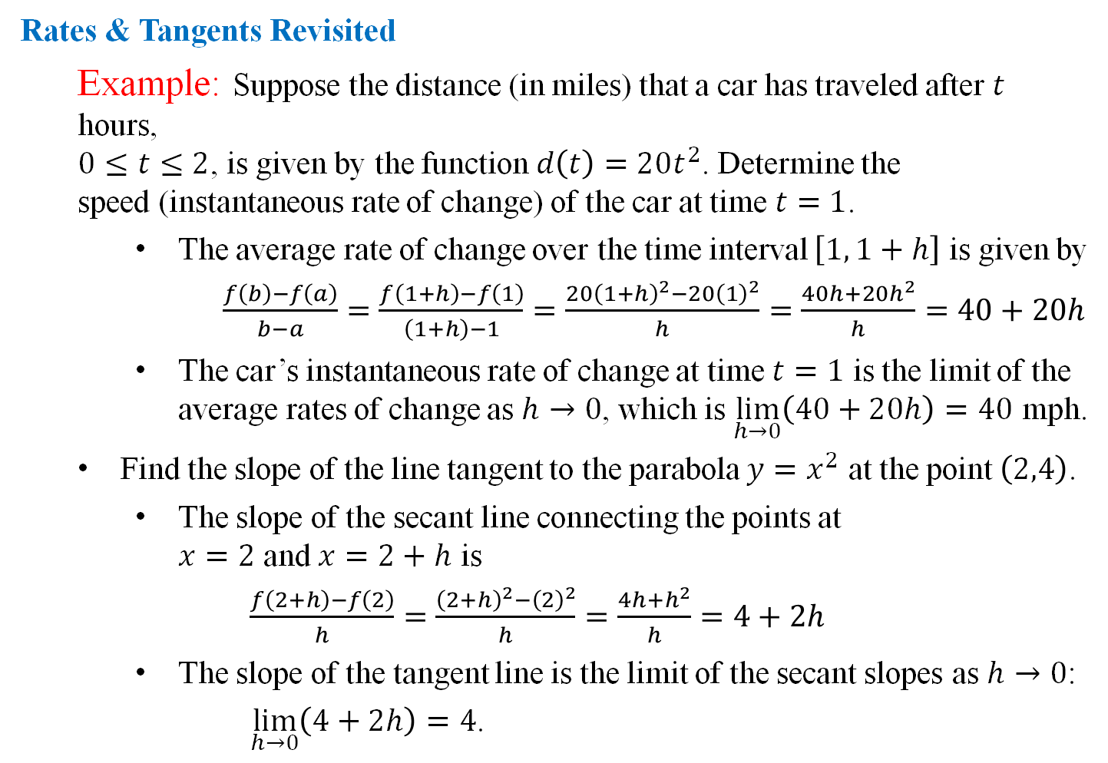
Rates & Tangents Revisited
  Example: Suppose the distance (in miles) that a car has traveled after $t$ hours,
  $0≤t≤2$, is given by the function $d\left(t\right)=20t^{2}$. Determine the
  speed (instantaneous rate of change) of the car at time $t=1$.
    The average rate of change over the time interval $\left[1, 1+h\right]$ is given by
    $\frac{f\left(b\right)−f\left(a\right)}{b−a}=\frac{f\left(1+h\right)−f\left(1\right)}{\left(1+h\right)−1}=\frac{20{\left(1+h\right)}^{2}−20{\left(1\right)}^{2}}{h}=\frac{40h+20h^{2}}{h}=40+20h$
    The car’s instantaneous rate of change at time $t=1$ is the limit of the average rates of change as $h→0$, which is $\lim_{h→0}\left(40+20h\right)=40$ mph.
  Find the slope of the line tangent to the parabola $y=x^{2}$ at the point $\left(2,4\right)$.
    The slope of the secant line connecting the points at
    $x=2$ and $x=2+h$ is
    $\frac{f\left(2+h\right)−f\left(2\right)}{h}=\frac{{\left(2+h\right)}^{2}−{\left(2\right)}^{2}}{h}=\frac{4h+h^{2}}{h}=4+2h$
    The slope of the tangent line is the limit of the secant slopes as $h→0$:
    $\lim_{h→0}\left(4+2h\right)=4$.

Slide 3
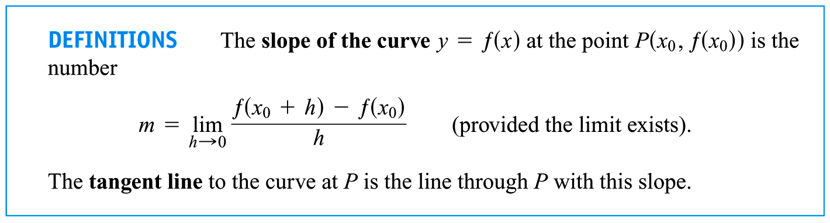
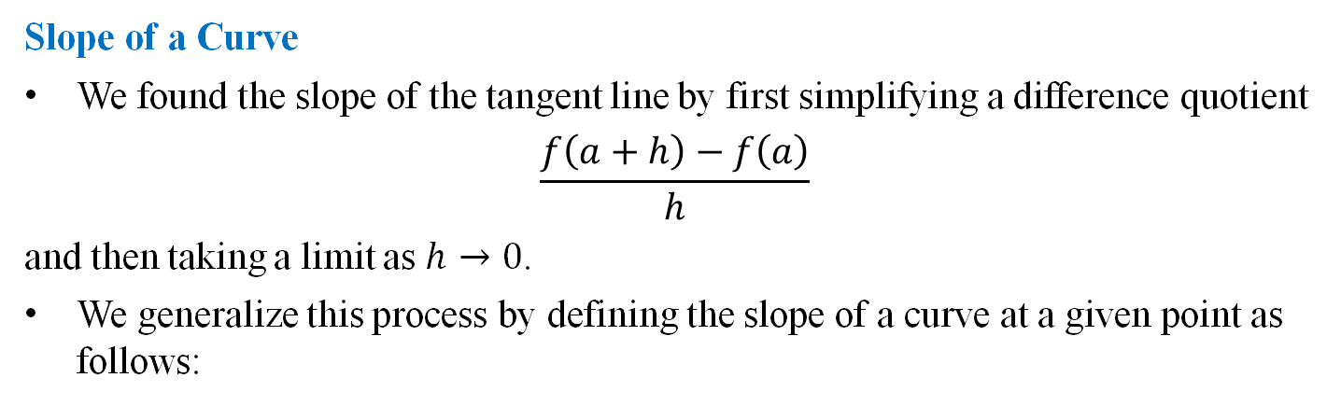
Slope of a Curve
We found the slope of the tangent line by first simplifying a difference quotient
$$\frac{f\left(a+h\right)−f\left(a\right)}{h}$$
and then taking a limit as $h→0$.
We generalize this process by defining the slope of a curve at a given point as follows:

Slide 4
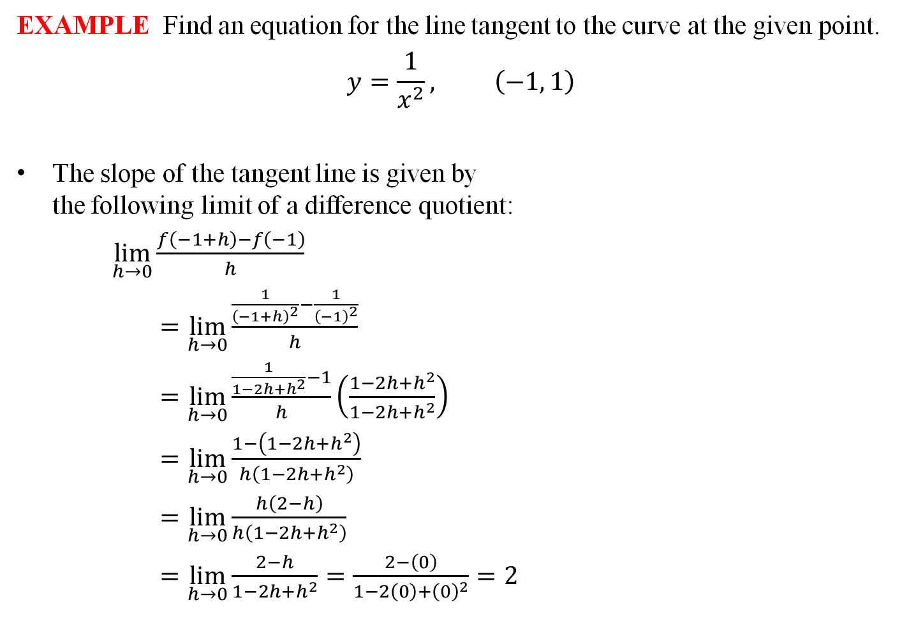

EXAMPLE Find an equation for the line tangent to the curve at the given point.
$$y=\frac{1}{x^{2}}, \left(−1, 1\right)$$
The slope of the tangent line is given by
the following limit of a difference quotient:
$\lim_{h→0}{\frac{f\left(−1+h\right)−f\left(−1\right)}{h}}$
$=\lim_{h→0}{\frac{\frac{1}{{\left(−1+h\right)}^{2}}−\frac{1}{{\left(−1\right)}^{2}}}{h}}$
$=\lim_{h→0}{\frac{\frac{1}{1−2h+h^{2}}−1}{h}\left(\frac{1−2h+h^{2}}{1−2h+h^{2}}\right)}$
$=\lim_{h→0}{\frac{1−\left(1−2h+h^{2}\right)}{h\left(1−2h+h^{2}\right)}}$
$=\lim_{h→0}{\frac{h\left(2−h\right)}{h\left(1−2h+h^{2}\right)}}$
$=\lim_{h→0}{\frac{2−h}{1−2h+h^{2}}}=\frac{2−\left(0\right)}{1−2\left(0\right)+{\left(0\right)}^{2}}=2$
The equation of the tangent line is then
$y−y_{1}=m\left(x−x_{1}\right)$
$y−1=2\left(x−\left(−1\right)\right)$
$\boxed{y=2x+3}$

Slide 5
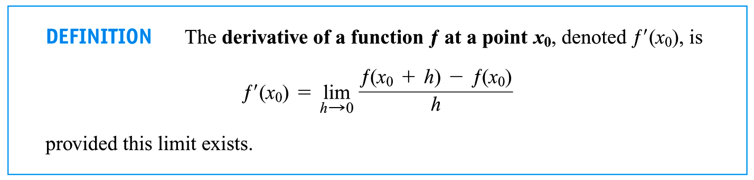
Derivative of a Function at a Given Point
In fact, many applications, including tangent slopes and rates of change for starters, involve basically the same “limit of a difference quotient” process.
So much so that we define a new quantity based on this idea: the derivative.
The derivative has many useful applications, some of which we will consider later, but for it’s enough to look at the above definition as simply a new notation for a quantity we have been discussing since day one of this course.

Slide 6
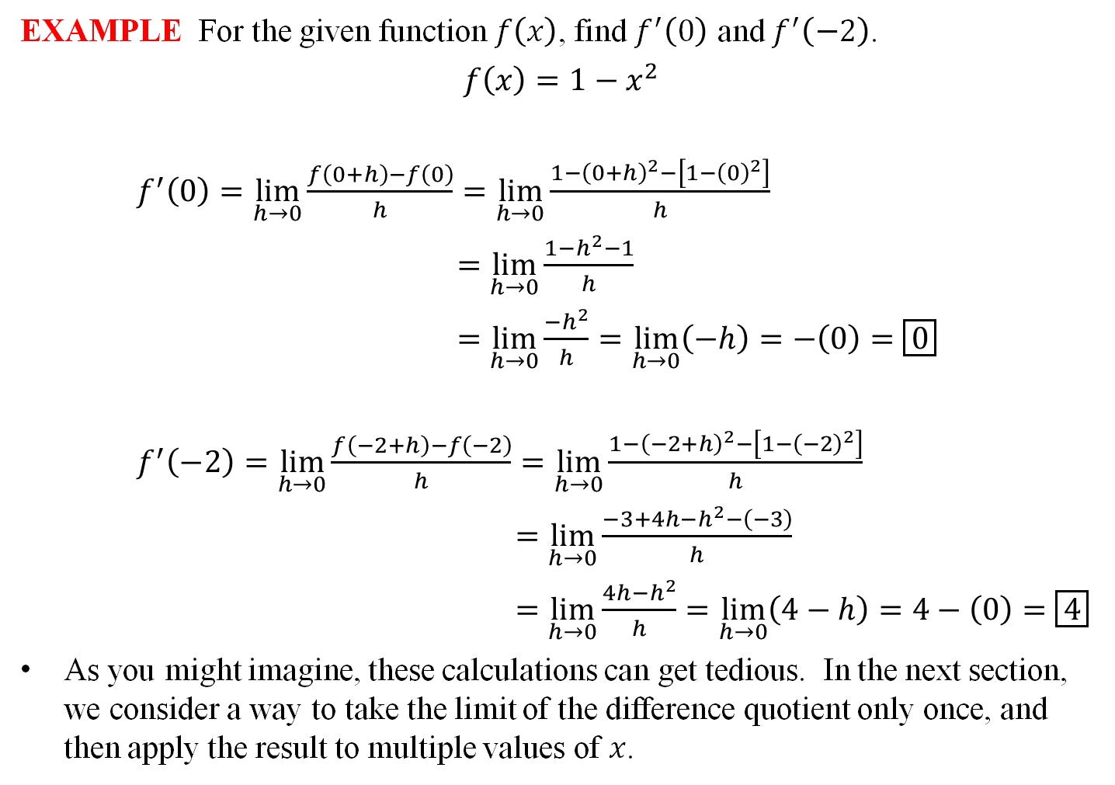
EXAMPLE For the given function $f\left(x\right)$, find $f^{′}\left(0\right)$ and $f^{′}\left(−2\right)$.
$$f\left(x\right)=1−x^{2}$$
$f^{′}\left(0\right)=\lim_{h→0}{\frac{f\left(0+h\right)−f\left(0\right)}{h}}=\lim_{h→0}{\frac{1−{\left(0+h\right)}^{2}−\left[1−{\left(0\right)}^{2}\right]}{h}}$
$=\lim_{h→0}{\frac{1−h^{2}−1}{h}}$
$=\lim_{h→0}{\frac{−h^{2}}{h}}=\lim_{h→0}\left(−h\right)=−\left(0\right)=\boxed{0}$
$f^{′}\left(−2\right)=\lim_{h→0}{\frac{f\left(−2+h\right)−f\left(−2\right)}{h}}=\lim_{h→0}{\frac{1−{\left(−2+h\right)}^{2}−\left[1−{\left(−2\right)}^{2}\right]}{h}}$
$=\lim_{h→0}{\frac{−3+4h−h^{2}−\left(−3\right)}{h}}$
$=\lim_{h→0}{\frac{4h−h^{2}}{h}}=\lim_{h→0}\left(4−h\right)=4−\left(0\right)=\boxed{4}$
As you might imagine, these calculations can get tedious. In the next section, we consider a way to take the limit of the difference quotient only once, and then apply the result to multiple values of $x$.

Slide 7
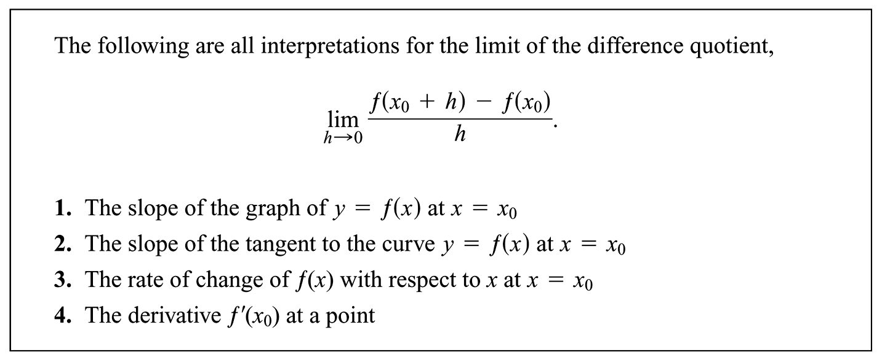
Interpretations of the Derivative
By itself, the derivative of a function doesn’t really mean anything, but the examples we considered at the beginning of this section suggest that there are useful ways of interpreting this number.

Slide 8

EXAMPLE:
Use a limit of difference quotients to find the slope of the curve at the given point.
$$y=4−6x^{2}, \text{at} \left(−3, −50\right)$$
$Slope: \lim_{h→0}{\frac{f\left(−3+h\right)−f\left(−3\right)}{h}}=\lim_{h→0}{\frac{4−6{\left(−3+h\right)}^{2}−\left[4−6{\left(−3\right)}^{2}\right]}{h}}$
$=\lim_{h→0}{\frac{−50+36h−6h^{2}−\left[−50\right]}{h}}$
$=\lim_{h→0}{\frac{36h−6h^{2}}{h}}$
$=\lim_{h→0}{\frac{h\left(36−6h\right)}{h}}$
$=\lim_{h→0}\left(36−6h\right)$
$=36−6\left(0\right)=\boxed{36}$

