Slide 1
3.2
The Derivative as a Function

Slide 2
The Derivative as a Function
In Section 3.1 we discussed the following “limit of a difference quotient definition” of the derivative of a function at a given $x$-value.
We used this definition to calculate the derivative (a.k.a., slope of the tangent line, instantaneous rate of change) of a function at various values of $x$.
When we did so, we realized that we were performing much the same calculations again and again.
In this section we consider a way to perform these calculations once for any $x$-value, resulting in a formula (or function) that allows us to determine the derivative at whatever point we choose.

Slide 3
The Derivative as a Function
The following definition gives the derivative of $f\left(x\right)$ as a new function, called the derivative function, which we will usually denote by $f^{′}\left(x\right)$.
Note that the above limit may or may not exist at a particular $x$-value.
When it does, we say that $f\left(x\right)$ is differentiable at that value of $x$.
Finding the derivative of a function is called differentiating the function.
Let’s get some practice differentiating functions in a few examples.

Slide 4
EXAMPLE Find the derivative of the following functions.
$f\left(x\right)=1−x^{2}$
$f\left(x\right)=\frac{1}{x}$
$f\left(x\right)=\sqrt{x}$
$f^{′}\left(x\right)=\lim_{h→0}{\frac{f\left(x+h\right)−f\left(x\right)}{h}}=\lim_{h→0}{\frac{1−{\left(x+h\right)}^{2}−\left[1−x^{2}\right]}{h}}$
$=\lim_{h→0}{\frac{1−x^{2}−2xh−h^{2}−1+x^{2}}{h}}$
$=\lim_{h→0}{\frac{−2xh−h^{2}}{h}}$
$=\lim_{h→0}{\frac{h\left(−2x−h\right)}{h}}$
$=\lim_{h→0}\left(−2x−h\right)$
$=−2x−\left(0\right)$
$\boxed{f^{′}\left(x\right)=−2x}$

Slide 5
EXAMPLE Find the derivative of the following functions.
$f\left(x\right)=1−x^{2}$
$f\left(x\right)=\frac{1}{x}$
$f\left(x\right)=\sqrt{x}$
$f^{′}\left(x\right)=\lim_{h→0}{\frac{f\left(x+h\right)−f\left(x\right)}{h}}=\lim_{h→0}{\frac{\frac{1}{x+h}−\frac{1}{x}}{h}}$
$=\lim_{h→0}\left(\frac{\frac{1}{x+h}−\frac{1}{x}}{h}\right)\left(\frac{x\left(x+h\right)}{x\left(x+h\right)}\right)$
$=\lim_{h→0}{\frac{x−\left(x+h\right)}{hx\left(x+h\right)}}$
$=\lim_{h→0}{\frac{−h}{hx\left(x+h\right)}}$
$=\lim_{h→0}\left(−\frac{1}{x\left(x+h\right)}\right)$
$=−\frac{1}{x\left(x+0\right)}$
$\boxed{f^{′}\left(x\right)=−\frac{1}{x^{2}}}$

Slide 6
EXAMPLE Find the derivative of the following functions.
$f\left(x\right)=1−x^{2}$
$f\left(x\right)=\frac{1}{x}$
$f\left(x\right)=\sqrt{x}$
$f^{′}\left(x\right)=\lim_{h→0}{\frac{f\left(x+h\right)−f\left(x\right)}{h}}=\lim_{h→0}{\frac{\sqrt{x+h}−\sqrt{x}}{h}}$
$=\lim_{h→0}\left(\frac{\sqrt{x+h}−\sqrt{x}}{h}\right)\left(\frac{\sqrt{x+h}+\sqrt{x}}{\sqrt{x+h}+\sqrt{x}}\right)$
$=\lim_{h→0}{\frac{\left(x+h\right)−x}{h\left(\sqrt{x+h}+\sqrt{x}\right)}}$
$=\lim_{h→0}{\frac{h}{h\left(\sqrt{x+h}+\sqrt{x}\right)}}$
$=\lim_{h→0}{\frac{1}{\sqrt{x+h}+\sqrt{x}}}$
$=\frac{1}{\sqrt{x+0}+\sqrt{x}}$
$\boxed{f^{′}\left(x\right)=\frac{1}{2\sqrt{x}}}$

Slide 7
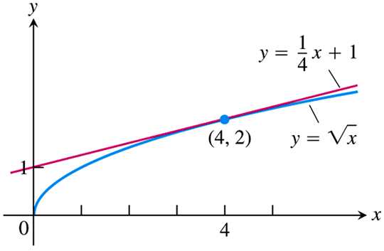
EXAMPLE Find the line tangent to the curve $f\left(x\right)=\sqrt{x}$ at $x=4$.
From the preceding example, we know $f^{′}\left(x\right)=\frac{1}{2\sqrt{x}}$.
We also know that one of the interpretations of the derivative is the slope of a line tangent to the given curve.
Thus, we can interpret the derivative $f^{′}\left(x\right)$ evaluated at $x=4$ as the slope of the line tangent to the curve $f\left(x\right)$ at the point $\left(4, f\left(4\right)\right)=\left(4, 2\right)$:
$\text{Tangent} \text{slope}\text{:} m=f^{′}\left(4\right)=\frac{1}{2\sqrt{4}}=\frac{1}{4}$
The equation of the tangent line is then
$y−y_{1}=m\left(x−x_{1}\right)$
$y−2=\frac{1}{4}\left(x−4\right)$
$\boxed{y=\frac{1}{4}x+1}$

Slide 8
Notations for the Derivative
The concept of the derivative was developed by more than one mathematician at around the same time, most notably Newton and Leibniz; and each one used their own notation.
Newton introduced the “prime” notation that we have used thus far:
The derivative of $f\left(x\right)$ is denoted $f^{′}\left(x\right)$, read “$f$ prime of $x$.”
Similarly the derivative of a function $y$ is denoted $y^{′}$.
Leibniz introduced a more detailed notation that becomes much more useful later on in our studies.
Leibniz’ notation for the “derivative of $y$ with respect to $x$” is $\frac{dy}{dx}$.
Similarly, the derivative of $f\left(x\right)$ is written $\frac{df}{dx}$ or $\frac{d}{dx}\left[f\left(x\right)\right]$.

Slide 9
Notations for the Derivative
Finally in our discussion of notation, we consider evaluating a derivative at a given value of $x$.
We have already seen how we use Newton’s notation to denote the derivative evaluated at an $x$-value, e.g., $f^{′}\left(x\right)$ at $x=4$ is denoted $f^{′}\left(4\right)$.
In Leibniz notation, we express the derivative evaluated at $x=a$ as ${\left.\frac{df}{dx}\right|}_{x=a}$. For example, to denote the derivative of $f\left(x\right)$ at $x=4$ In Leibniz notation, which we did in a previous example using prime notation, we may write
$${\left.\frac{df}{dx}\right|}_{x=4}={\left.\frac{d}{dx}\left[f\right]\right|}_{x=4}$$

Slide 10
Derivatives, Continuity, & Graphs
We end this section by answering the question: “When does a function not have a derivative at a point?”
Short answer: “When the limit $\lim_{h→0}{\frac{f\left(x+h\right)−f\left(x\right)}{h}}$ does not exist.”
One interesting result (proved on page 131 of the text) is that a differentiable function is always continuous. However the reverse is not necessarily true:
A continuous function may not be differentiable.

Slide 11
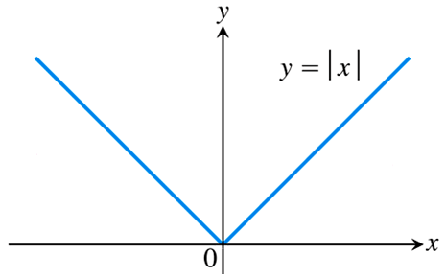
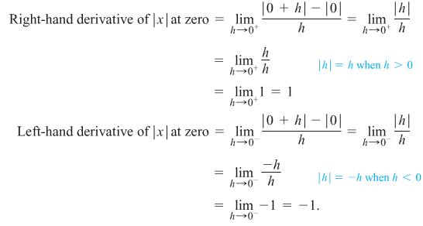
The simplest example of this is the function $y=\left|x\right|$.
What is the derivative of $y=\left|x\right|$ at $x=0$?
This question is equivalent to asking: What is the slope of the line tangent to $y=\left|x\right|$ at $x=0$?
The fact is that we could draw many tangent lines at this “corner” of the graph on the right.
The result is that the limit of the difference quotients does not exist, and the function is not differentiable at $x=0$.

Slide 12
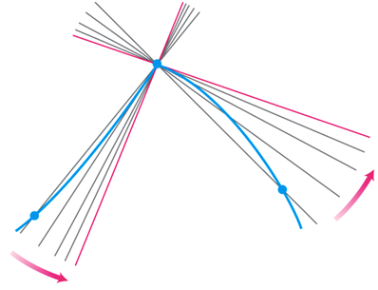
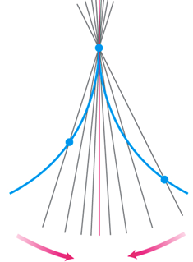
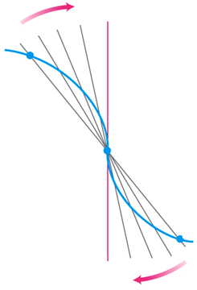
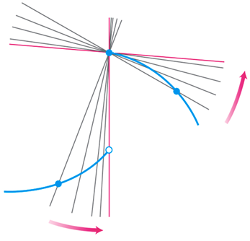
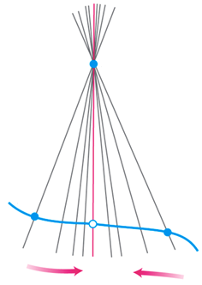
Derivatives, Continuity, & Graphs
Other cases when we can tell that a function has no derivative based on the graph include:
Any point where a function’s graph has a “corner” or a “cusp.”
A point where a function has a vertical tangent. (Vertical lines have undefined slope.)
Any point where a function is discontinuous.

