Slide 1
5.3
The Fundamental Theorem of Calculus

Slide 2
Areas and Antiderivatives
In previous sections in this chapter, we have seen hints that the area problem is related to antiderivatives.
In this section we seek a mathematical basis for that relationship, which will turn out to be the so-called Fundamental Theorem of Calculus (FTC).
In Section 5.3, we showed that the net area between the curve $f\left(x\right)=x$ and the $x$-axis, from $x=a$ to $x=b$, is given by
$\int_{a}^{b}{x dx}=\frac{b^{2}}{2}−\frac{a^{2}}{2}$.
Note that $F\left(x\right)=\frac{x^{2}}{2}$ is an antiderivative of the function $f\left(x\right)=x$.
We might guess from this that, if $f\left(x\right)$ is any given function, and $F\left(x\right)$ is an antiderivative of $f\left(x\right)$, then the following relation holds:
$\int_{a}^{b}{f\left(x\right)dx}=F\left(b\right)−F\left(a\right)$.
It does indeed, and this is part of the FTC, but we need to see why it makes sense.

Slide 3
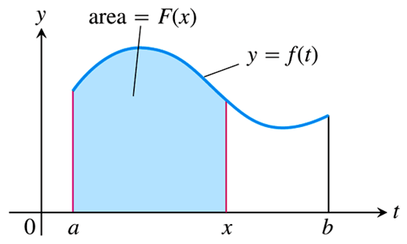
Areas and Antiderivatives
We start by defining a function $F\left(x\right)$ that satisfies the relation
$\int_{a}^{b}{f\left(x\right)dx}=F\left(b\right)−F\left(a\right)$
in terms of the area under the curve $f\left(x\right)$, without any thought of antiderivatives.
If we can then show that $F^{′}=f$, we will have that $F\left(x\right)$ is indeed an antiderivative of $f\left(x\right)$, providing the relationship we were seeking.
We define $F\left(x\right)$ as in the figure on the right:
$F\left(x\right)=\int_{a}^{x}{f\left(t\right)dt}$
Note the use of the letter $t$ as a “dummy variable,” since $x$ cannot have two different mean- ings within the same equation.
Use this definition of $F\left(x\right)$ to find expressions for $F\left(b\right)$ and $F\left(a\right)$.

Slide 4
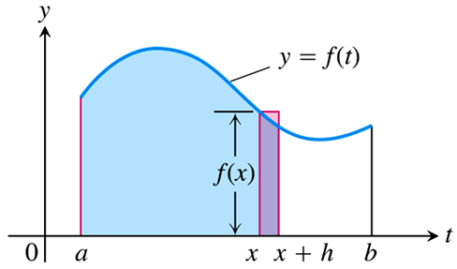
Areas and Antiderivatives
With $F\left(a\right)=\int_{a}^{a}{f\left(t\right)dt}=0$, and $F\left(b\right)=\int_{a}^{b}{f\left(t\right)dt}$, we have
$F\left(b\right)−F\left(a\right)=\left[\int_{a}^{b}{f\left(t\right)dt}\right]−\left[0\right]=\int_{a}^{b}{f\left(t\right)dt}$,
as desired.
Now to show that $F\left(x\right)$ is actually an antiderivative of $f\left(x\right)$, i.e., that $F^{′}=f$, we must show that
$f\left(x\right)=\lim_{h→0}{\frac{F\left(x+h\right)−F\left(x\right)}{h}}$.
In order to do so, consider the figure:
Note that the area of the red rectangle is approximately $h⋅f\left(x\right)$.
And this area is also given approx- imately by $F\left(x+h\right)−F\left(x\right)$.
Furthermore, these approximations get better as the rectangle narrows, i.e., as $h$ gets smaller.

Slide 5
Areas and Antiderivatives
Thus, we have
$Area of rectangle≈h⋅f\left(x\right)$, and
$Area of rectangle≈F\left(x+h\right)−F\left(x\right)$, so that
$h⋅f\left(x\right)≈F\left(x+h\right)−F\left(x\right)$, or
$f\left(x\right)≈\frac{F\left(x+h\right)−F\left(x\right)}{h}$.
And since these approximations get better as $h$ gets smaller, we have
$f\left(x\right)=\lim_{h→0}{\frac{F\left(x+h\right)−F\left(x\right)}{h}}=F^{′}\left(x\right)$,
as desired.
While far from a rigorous proof of the Fundamental Theorem of Calculus, this discussion does give the student a good beginning for understanding the FTC, which is formally stated on the next slide.

Slide 6
The Fundamental Theorem of Calculus (Part 1)
The FTC is given in two parts, and is called such because it puts on a firm mathematical footing the idea that integrals and derivatives are inverses of each other.
Loosely speaking, the first part states that taking the derivative of an integral gives you back the original function:
Consider how this supports the idea that the integral is an antiderivative.

Slide 8
The Fundamental Theorem of Calculus (Part 2)
The second part of the FTC starts with a function $F\left(x\right)$ and states, again loosely speaking, that if we integrate its derivative $F^{′}=f$, we again get back the original function.
The second part is of more practical significance, giving us a simple way to evaluate definite integrals, and thus solve the area problem, without using limits of Riemann sums.
This being said, the idea of determining a quantity by taking limits of simpler approximations is central to integral calculus, and one that will come up again and again in Calculus II.

Slide 9
EXAMPLE Find the area under the curve $f\left(x\right)=\frac{1}{x}$ from $x=1$ to $x=5$.
This area is given by the definite integral $\int_{1}^{5}{\frac{1}{x}dx}$, and we can use the FTC (Part 2) to evaluate it.
To facilitate this usage, we introduce the following notation: We will rewrite $F\left(b\right)−F\left(a\right)$ as ${\left.F\left(x\right)\right|}_{a}^{b}$, so that Part 2 of the FTC becomes
$$\int_{a}^{b}{f\left(x\right)dx}={\left.F\left(x\right)\right|}_{a}^{b}=F\left(b\right)−F\left(a\right).$$
We thus have,
$\int_{1}^{5}{\frac{1}{x}dx}={\left.\ln\left|x\right|\right|}_{1}^{5}=\ln\left|5\right|−\ln\left|1\right|=\ln\left(5\right)≈\boxed{1.609}$.

Slide 10
EXAMPLE Evaluate the following definite integrals.
$\int_{1}^{4}{\left(\frac{3}{2}\sqrt{x}−\frac{4}{x^{2}}\right)dx}$
$\int_{0}^{1}{\frac{dx}{x^{2}+1}}$
$\int_{1}^{4}{\left(\frac{3}{2}\sqrt{x}−\frac{4}{x^{2}}\right)dx}=\int_{1}^{4}{\left(\frac{3}{2}x^{1/2}−4x^{−2}\right)dx}$
$={\left[x^{3/2}+4x^{−1}\right]}_{1}^{4}$
$=\left[{\left(4\right)}^{3/2}+4{\left(4\right)}^{−1}\right]−\left[{\left(1\right)}^{3/2}+4{\left(1\right)}^{−1}\right]=\boxed{4}$
$\int_{0}^{1}{\frac{dx}{x^{2}+1}}={\left.\tan^{−1}{x}\right|}_{0}^{1}=\tan^{−1}\left(1\right)−\tan^{−1}\left(0\right)=\boxed{\frac{π}{4}}$

Slide 11
EXAMPLE Using the formula $av\left(f\right)=\frac{1}{b−a}\int_{a}^{b}{f\left(x\right)dx}$, find the average value of the function $f\left(x\right)=e^{3x}$ on the interval $\left[0, 3\right]$.
$av\left(f\right)=\frac{1}{3−0}\int_{0}^{3}{e^{3x}dx}$
$=\frac{1}{3}{\left[\frac{1}{3}e^{3x}\right]}_{0}^{3}$
$=\frac{1}{3}\left[\frac{1}{3}e^{3\left(3\right)}−\frac{1}{3}e^{3\left(0\right)}\right]$
$=\frac{1}{9}\left(e^{9}−1\right)$
$≈\boxed{900.232}$

Slide 12
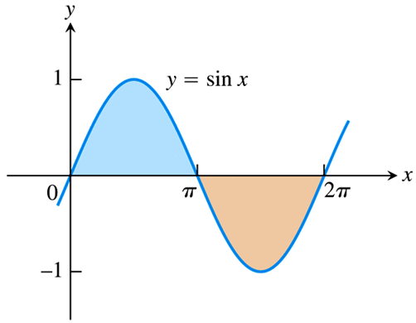
EXAMPLE Find the total area between the function $y=\sin{x}$ and the $x$-axis from $x=0$ to $x=2π$.
Now, $\int_{0}^{2π}{\sin{x}dx}={\left.−\cos{x}\right|}_{0}^{2π}=\left[−\cos\left(2π\right)\right]−\left[−\cos\left(0\right)\right]=0$, but this is the net area between the curve $y=\sin{x}$ and the $x$-axis, not the total area.
To find the total area, consider the graph of $y=\sin{x}$.
The blue area in the figure is the integral
$\int_{0}^{π}{\sin{x}dx}={\left.−\cos{x}\right|}_{0}^{π}$
$=\left[−\cos\left(π\right)\right]−\left[−\cos\left(0\right)\right]=2$.
The integral from $π$ to $2π$ will give a negative result, so if we want the area we must take the absolute value of that integral:
$\left|\int_{π}^{2π}{\sin{x}dx}\right|=\left|{\left.−\cos{x}\right|}_{π}^{2π}\right|=\left|−2\right|=2$
Thus, the total area between the curve and the $x$-axis is $2+2=4$.

Slide 13
Net Area vs. Total Area
In summary, to find the net area under the curve $y=f\left(x\right)$ from $x=a$ to $x=b$, simply evaluate the definite integral $\int_{a}^{b}{f\left(x\right)dx}$.
However, to find the total area between the curve $y=f\left(x\right)$ and the $x$-axis from $x=a$ to $x=b$, follow these steps:

Slide 14
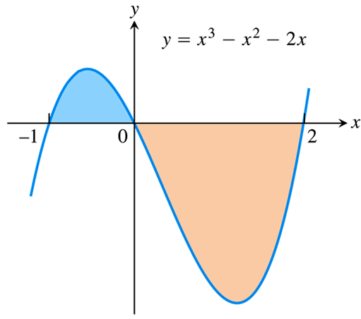
EXAMPLE Find the total area between the function $y=x^{3}−x^{2}−2x$ and the $x$-axis from $x=−1$ to $x=2$.
Since $x^{3}−x^{2}−2x=x\left(x−2\right)\left(x+1\right)=0$ when $x=−1, 0, 2$, we must consider the two integrals $\int_{−1}^{0}{\left(x^{3}−x^{2}−2x\right)dx}$ and $\int_{0}^{2}{\left(x^{3}−x^{2}−2x\right)dx}$, as in the figure.
We find
$\int_{−1}^{0}{\left(x^{3}−x^{2}−2x\right)dx}={\left[\frac{x^{4}}{4}−\frac{x^{3}}{3}−x^{2}\right]}_{−1}^{0}=0−\left(−\frac{5}{12}\right)=\frac{5}{12}$, and
$\int_{0}^{2}{\left(x^{3}−x^{2}−2x\right)dx}={\left[\frac{x^{4}}{4}−\frac{x^{3}}{3}−x^{2}\right]}_{0}^{2}=\left(−\frac{8}{3}\right)−0=−\frac{8}{3}$.
So the total area between the curve and the $x$-axis is
$\left|\int_{−1}^{0}{\left(x^{3}−x^{2}−2x\right)dx}\right|+\left|\int_{0}^{2}{\left(x^{3}−x^{2}−2x\right)dx}\right|=\left|\frac{5}{12}\right|+\left|−\frac{8}{3}\right|=\boxed{\frac{37}{12}}$.

