Slide 1
2.3
The Limit Laws

Slide 2
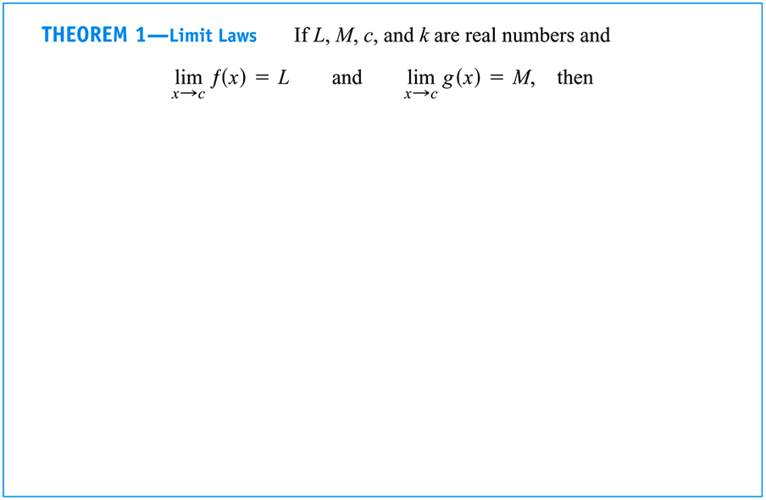
Limit Laws
We expand on the rules for limits begun in the preceding example, using the following laws to find limits of more complicated functions from known limits.
The proofs of these laws depend on the formal definition of a limit (Section 2.3).

Slide 3
EXAMPLE Determine the limits of the following functions, using the Limit Laws.
$\lim_{x→2}\left(x^{3}+4x^{2}−3\right)$
$\lim_{x→1}{\frac{x^{4}+x^{2}−1}{x^{2}+5}}$
$\lim_{x→−3}{\sqrt{4x^{2}−3}}$
$\lim_{x→2}\left(x^{3}+4x^{2}−3\right)=\lim_{x→2}{x^{3}}+\lim_{x→2}{4x^{2}}−\lim_{x→2}{3}$
$=\lim_{x→2}{x^{3}}+4\lim_{x→2}{x^{2}}−\lim_{x→2}{3}$
$={\left(\lim_{x→2}{x}\right)}^{3}+4{\left(\lim_{x→2}{x}\right)}^{2}−\lim_{x→2}{3}$
$={\left(2\right)}^{3}+4{\left(2\right)}^{2}−3$
$=\boxed{21}$

Slide 4
EXAMPLE Determine the limits of the following functions, using the Limit Laws.
$\lim_{x→2}\left(x^{3}+4x^{2}−3\right)$
$\lim_{x→1}{\frac{x^{4}+x^{2}−1}{x^{2}+5}}$
$\lim_{x→−3}{\sqrt{4x^{2}−3}}$
$\lim_{x→1}{\frac{x^{4}+x^{2}−1}{x^{2}+5}}=\frac{\lim_{x→1}\left(x^{4}+x^{2}−1\right)}{\lim_{x→1}\left(x^{2}+5\right)}$
$=\frac{\lim_{x→1}{x^{4}}+\lim_{x→1}{x^{2}}−\lim_{x→1}{1}}{\lim_{x→1}{x^{2}}+\lim_{x→1}{5}}$
$=\frac{{\left(\lim_{x→1}{x}\right)}^{4}+{\left(\lim_{x→1}{x}\right)}^{2}−\lim_{x→1}{1}}{{\left(\lim_{x→1}{x}\right)}^{2}+\lim_{x→1}{5}}$
$=\frac{{\left(1\right)}^{4}+{\left(1\right)}^{2}−1}{{\left(1\right)}^{2}+5}=\boxed{\frac{1}{6}}$

Slide 5
EXAMPLE Determine the limits of the following functions, using the Limit Laws.
$\lim_{x→2}\left(x^{3}+4x^{2}−3\right)$
$\lim_{x→1}{\frac{x^{4}+x^{2}−1}{x^{2}+5}}$
$\lim_{x→−3}{\sqrt{4x^{2}−3}}$
$\lim_{x→−3}{\sqrt{4x^{2}−3}}=\sqrt{\lim_{x→−3}\left(4x^{2}−3\right)}$
$=\sqrt{4{\left(\lim_{x→−3}{x}\right)}^{2}−\lim_{x→−3}{3}}$
$=\sqrt{4{\left(−3\right)}^{2}−3}$
$=\boxed{\sqrt{33}}$

Slide 6
Limits of Polynomial and Rational Functions
Based on the preceding examples, it appears that we can easily determine the limit of any polynomial or rational function, simply by plugging the given value of $x$ into that function (provided the functional value exists).
The Limit Laws do in fact support this “short cut,” as described in the following theorems:

Slide 7
EXAMPLE Determine the limit of the following rational function.
$$\lim_{x→1}{\frac{x^{2}+x−2}{x^{2}−x}}$$
$\lim_{x→1}{\frac{x^{2}+x−2}{x^{2}−x}}=\lim_{x→1}{\frac{\left(x+2\right)\left(x−1\right)}{x\left(x−1\right)}}$
$=\lim_{x→1}{\frac{x+2}{x}}$
$=\frac{\left(1\right)+2}{\left(1\right)}$
$=\boxed{3}$

Slide 8
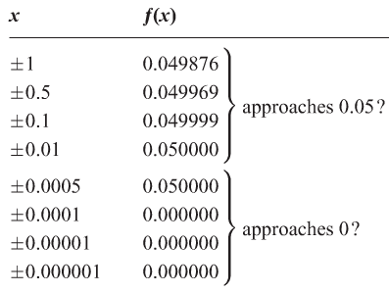
Using calculators and computers to estimate limits
EXAMPLE

Slide 9
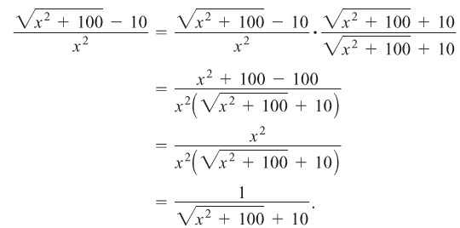
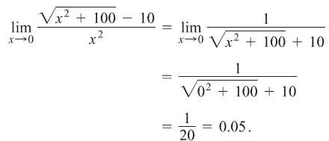
EXAMPLE

Slide 10
EXAMPLE

Slide 11
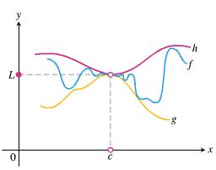
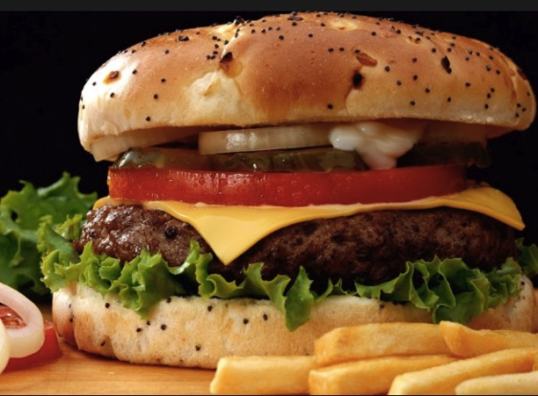
Sandwich Theorem
Theorem 3:

Slide 12
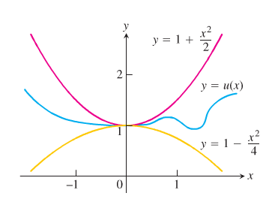
EXAMPLE
EXAMPLE

Slide 13
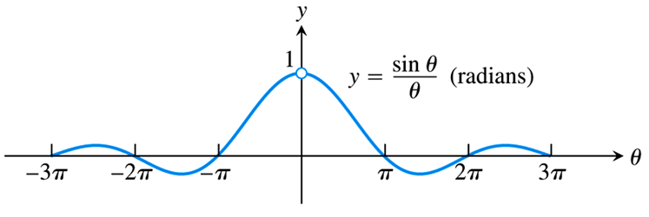
Limits of Fractions Involving Trigonometric Functions
In Chapter 3 we will need to consider several important limits of fractions involving trigonometric functions, most of which can be evaluated with the aid of the following limit theorem:
One-sided limits (and some help from geometry) is required to prove this theorem (see pg. 89 of the text), but the graph of the function $f\left(θ\right)=\frac{\sin{θ}}{θ}$ shows it nicely:

Slide 14
EXAMPLE Evaluate the following limits, using the fact that $\lim_{θ→0}{\frac{\sin{θ}}{θ}}=1$.
$\lim_{x→0}{\frac{\sin{2x}}{5x}}$
$\lim_{t→0}{\frac{\tan{t}\sec{2t}}{3t}}$
$\lim_{h→0}{\frac{\cos\left(h\right)−1}{h}}$
$\lim_{x→0}{\frac{\sin{2x}}{5x}}=\lim_{x→0}\left(\frac{1}{5}\right)\left(\frac{\sin{2x}}{x}\right)$
$=\frac{1}{5}\lim_{x→0}\left(\frac{\sin{2x}}{x}\right)\left(\frac{2}{2}\right)$
$=\frac{2}{5}\lim_{x→0}{\frac{\sin{2x}}{2x}}$
$=\frac{2}{5}\left(1\right)$
$=\boxed{\frac{2}{5}}$

Slide 15
EXAMPLE Evaluate the following limits, using the fact that $\lim_{θ→0}{\frac{\sin{θ}}{θ}}=1$.
$\lim_{x→0}{\frac{\sin{2x}}{5x}}$
$\lim_{t→0}{\frac{\tan{t}\sec{2t}}{3t}}$
$\lim_{h→0}{\frac{\cos\left(h\right)−1}{h}}$
$\lim_{t→0}{\frac{\tan{t}\sec{2t}}{3t}}=\lim_{t→0}\left(\frac{1}{3t}\right)\left(\frac{\sin{t}}{\cos{t}}\right)\left(\frac{1}{\cos{2t}}\right)$
$=\frac{1}{3}\lim_{t→0}\left(\frac{\sin{t}}{t}\right)\left(\frac{1}{\cos{t}}\right)\left(\frac{1}{\cos{2t}}\right)$
$=\frac{1}{3}\left(1\right)\left(\frac{1}{\cos{0}}\right)\left(\frac{1}{\cos{0}}\right)$
$=\frac{1}{3}\left(1\right)\left(1\right)\left(1\right)$
$=\boxed{\frac{1}{3}}$

Slide 16
EXAMPLE Evaluate the following limits, using the fact that $\lim_{θ→0}{\frac{\sin{θ}}{θ}}=1$.
$\lim_{x→0}{\frac{\sin{2x}}{5x}}$
$\lim_{t→0}{\frac{\tan{t}\sec{2t}}{3t}}$
$\lim_{h→0}{\frac{\cos\left(h\right)−1}{h}}$
$\lim_{h→0}{\frac{\cos\left(h\right)−1}{h}}=\lim_{h→0}\left(\frac{\cos\left(h\right)−1}{h}\right)\left(\frac{\cos\left(h\right)+1}{\cos\left(h\right)+1}\right)$
$=\lim_{h→0}{\frac{\cos^{2}\left(h\right)−1}{h\left(\cos\left(h\right)+1\right)}}$
$=\lim_{h→0}{\frac{−\sin^{2}\left(h\right)}{h\left(\cos\left(h\right)+1\right)}}$
$=\lim_{h→0}\left(\frac{\sin{h}}{h}\right)\left(\frac{−\sin{h}}{\cos\left(h\right)+1}\right)$
$=\left(1\right)\left(\frac{−\sin\left(0\right)}{\cos\left(0\right)+1}\right)$
$=\left(1\right)\left(0\right)=\boxed{0}$

Slide 17
EXAMPLE

