Slide 1
4.4
The Mean Value Theorem

Slide 2
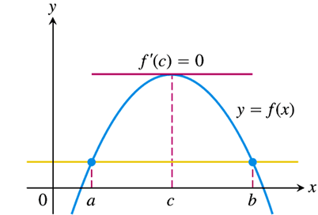
Rolle’s Theorem
I remember Rolle’s Theorem as: “What goes up must come down.”
The mathematical statement, and a corresponding picture description follows.
Okay, so a more accurate description would be
What goes up and then comes down must have turned at some point.

Slide 3
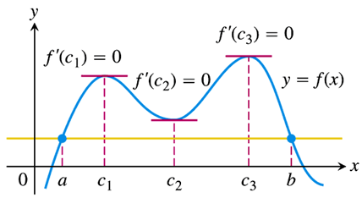
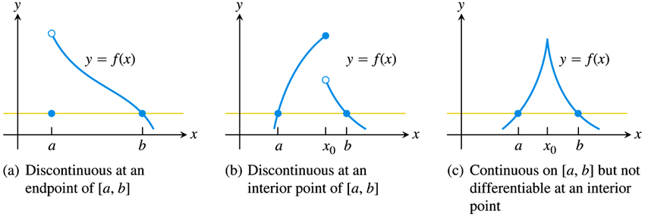
Rolle’s Theorem
Geometrically, Rolle’s Theorem says that a differentiable curve has at least one horizontal tangent between any two points where it crosses a horizontal line.
Note that, as in the figure on the right, there may in fact be more than one such point.
However, if the hypotheses of Rolle’s Theorem are not satisfied (as in the figures below), there need not be such a horizontal tangent.

Slide 4
Rolle’s Theorem
Rolle’s Theorem thus implies that a differentiable curve that does not have a horizontal tangent (turning point) cannot pass twice through a horizontal line. We can use this fact to determine the uniqueness of solutions to certain equations.
Consider the equation $x^{3}+3x+1=0$.
Solving this equation is equivalent to finding values of $x$ for which the function $f\left(x\right)=x^{3}+3x+1$ is equal to 0.
We know that this function has at least one zero, since, say,
$f\left(−1\right)={\left(−1\right)}^{3}+3\left(−1\right)+1=−3<0$, and
$f\left(0\right)={\left(0\right)}^{3}+3\left(0\right)+1=1>0$.
Thus, for some number $x=c$, with $−1≤c≤0$, we have $f\left(c\right)=0$.
We claim that this number is unique, i.e., that $c$ is the only value of $x$ for which $f\left(x\right)=0$.

Slide 5
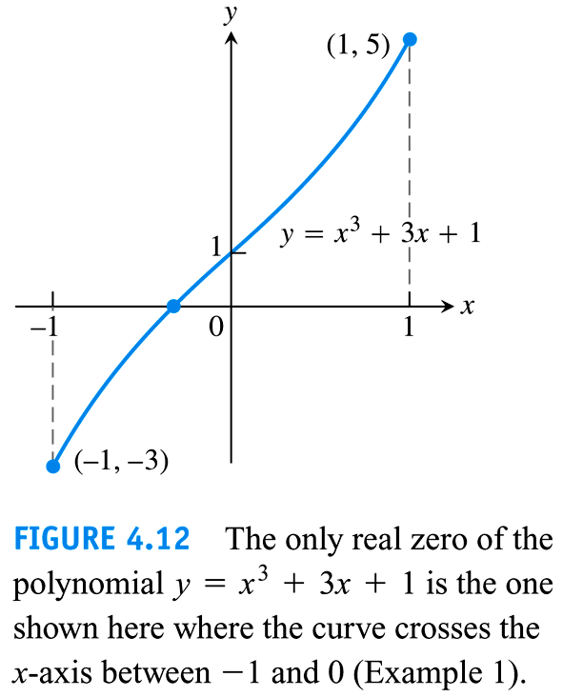
Rolle’s Theorem
Rolle’s Theorem says that the only way for there to possibly be another such number is if the function has a horizontal tangent (i.e., a point at which $f^{′}\left(x\right)=0$).
But notice that, for $f\left(x\right)=x^{3}+3x+1$, we have
$f^{′}\left(x\right)=3x^{2}+3$,
and $f^{′}\left(x\right)=0 → 3x^{2}+3=0 → x^{2}=−1$, which is impossible.
Thus, the function cannot have more zeroes, and the equation $x^{3}+3x+1=0$ has exactly one solution, which lies somewhere between $x=−1$ and $x=0$.

Slide 6
EXAMPLE Show that the following function has exactly one zero in the given interval.
$$f\left(x\right)=\sec{x}−\frac{1}{x^{3}}+5, on the interval \left[\frac{π}{6},\frac{π}{3}\right]$$
The function has at least one zero on the interval, since it changes sign:
$f\left(\frac{π}{6}\right)=\sec\left(\frac{π}{6}\right)−\frac{1}{{\left(π/6\right)}^{3}}+5=\frac{2}{\sqrt{3}}−\frac{216}{π^{3}}+5≈−0.812<0$, and
$f\left(\frac{π}{3}\right)=\sec\left(\frac{π}{3}\right)−\frac{1}{{\left(π/3\right)}^{3}}+5=2−\frac{27}{π^{3}}+5≈6.129>0$.
The function has at most one zero on the interval, since it has no critical points:
$f^{′}\left(x\right)=\sec{x}tan{x}+\frac{3}{x^{4}}≠0$ on the interval, because $\sec{x}$ and $\tan{x}$ are positive in Quadrant I, and $\frac{3}{x^{4}}$ is always positive.
Thus, the function has one, and only one, zero in the given interval.

Slide 7
The Mean Value Theorem
We now turn to the Mean Value Theorem, which is essentially a generalization of Rolle’s Theorem.
It states that the instantaneous rate of change of a continuous, differentiable function must at some point take on the value of its average rate of change.
In a plain English example, this means that a car that averages 50 mph over a trip must actually be travelling exactly 50 mph at some point in time during the trip.
Of course, to average 50 mph, you do not need to be going 50 mph the whole time; sometimes you will be going more than 50 mph, and sometimes less.
But the Mean Value Theorem asserts that there must be some (at least one) moment at which your velocity takes on the value of your average velocity.

Slide 8
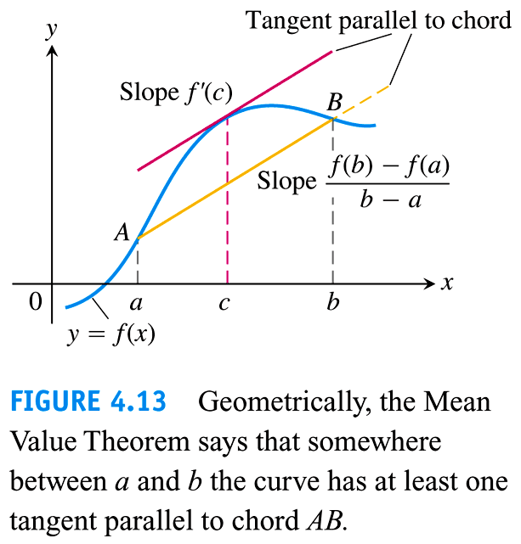
The Mean Value Theorem
The precise statement of the Mean Value Theorem is:
And a geometric interpretation (see the figure on the right) is that the slope of the tangent line (derivative) must equal the slope of the secant line (average rate of change) at some point in the interval.
Note that in order for the Mean Value Theorem to apply, the function must be continuous on the closed interval $\left[a, b\right]$, and differentiable on the open interval $\left(a, b\right)$.

Slide 9
EXAMPLE Find a value of $x$ for which the following function’s derivative is equal to its average rate of change on the given interval.
$$f\left(x\right)=\sqrt{x−1}, on the interval \left[1, 3\right]$$
(First show that the function satisfies the hypotheses of the Mean Value Theorem.)
The function $f\left(x\right)=\sqrt{x−1}$ is continuous on $\left[1, ∞\right)$, and hence on $\left[1, 3\right]$.
The derivative, $f^{′}\left(x\right)=\frac{1}{2\sqrt{x−1}}$ is defined on $\left(1, ∞\right)$, and hence $f\left(x\right)$ is differentiable on $\left(1, 3\right)$.
Applying the Mean Value Theorem, we find $c∈\left(1, 3\right)$ for which
$\frac{f\left(3\right)−f\left(1\right)}{3−1}=f^{′}\left(c\right)$ $→ \frac{\sqrt{2}}{2}=\frac{1}{2\sqrt{c−1}}$
$→ 2\sqrt{2c−2}=2$
$→ 2c−2=1$
$→ \boxed{c=\frac{3}{2}}$

Slide 10
Consequences of the Mean Value Theorem
The real power of the Mean Value Theorem is in its usefulness for proving other, more interesting mathematical facts.
For instance, consider the question: Can two different functions have the same derivative?
The answer is, of course: Yes. For example, the functions $f\left(x\right)=x^{2}+3$ and $g\left(x\right)=x^{2}−5$ have the same derivative: $f^{′}\left(x\right)=2x=g^{′}\left(x\right)$.
One could argue that these two functions are almost the same, in that they differ only by a constant.
A more interesting question, which the Mean Value Theorem helps us answer is: If two functions have the same derivative, how different can they be?

Slide 11
Consequences of the Mean Value Theorem
A first corollary (or consequence) of the Mean Value Theorem is that the only functions that have zero derivatives are constant functions:
The proof of this corollary goes something like this:
We want to show that $f\left(x\right)$ is constant. In other words, we want to show that any two $x$-values, say $x_{1}$ and $x_{2}$, correspond to the same $y$-value, i.e., $f\left(x_{1}\right)=f\left(x_{2}\right)$.
But the Mean Value Theorem gives $\frac{f\left(x_{2}\right)−f\left(x_{1}\right)}{x_{2}−x_{1}}=f^{′}\left(c\right)$ for some $c∈\left(x_{1}, x_{2}\right)$, and we already know that $f^{′}\left(c\right)=0$ (whatever $c$ is).
Thus, we have
$\frac{f\left(x_{2}\right)−f\left(x_{1}\right)}{x_{2}−x_{1}}=0 → f\left(x_{2}\right)−f\left(x_{1}\right)=0 → f\left(x_{1}\right)=f\left(x_{2}\right),$
and we conclude that $f\left(x\right)$ is a constant function.

Slide 12
Consequences of the Mean Value Theorem
We can use Corollary 1 to show the following important fact concerning differentiable functions:
This corollary states that any two functions with the same derivative may differ only by a constant.
The proof follows directly from Corollary 1:
Let $h\left(x\right)=f\left(x\right)−g\left(x\right)$, so that
$h^{′}\left(x\right)=f^{′}\left(x\right)−g^{′}\left(x\right)=0$,
and hence $h\left(x\right)=C$, a constant.
Thus, $f\left(x\right)−g\left(x\right)=C$, or $f\left(x\right)=g\left(x\right)+C$.
In other words, $f\left(x\right)$ and $g\left(x\right)$ differ only by a constant.

Slide 13
EXAMPLE Use Corollary 2 of the Mean Value Theorem to find the velocity and position functions, given the following information.
$$a\left(t\right)=−4\sin\left(2t\right), v\left(0\right)=2, s\left(0\right)=−3$$
The velocity function is a function $v\left(t\right)$ for which $v^{′}\left(t\right)=a\left(t\right)$.
Since $\frac{d}{dt}\left[2\cos\left(2t\right)\right]=2\left(−\sin\left(2t\right)\right)\left(2\right)=−4\sin\left(2t\right)=a\left(t\right)$, we must have
$v\left(t\right)=2\cos\left(2t\right)+C$, for some constant $C$.
Furthermore, since $v\left(0\right)=2$, we know
$2=v\left(0\right)=2\cos\left(0\right)+C=2\left(1\right)+C=2+C → C=0$
so that $v\left(t\right)=2\cos\left(2t\right)$.
Similarly, the position function is a function $s\left(t\right)$ for which $s^{′}\left(t\right)=v\left(t\right)$.
Since $\frac{d}{dt}\left[\sin\left(2t\right)\right]=2\cos\left(2t\right)$, we must have $s\left(t\right)=\sin\left(2t\right)+C$.
And this time, $s\left(0\right)=−3$ gives $\sin\left(0\right)+C=−3 → C=−3$.
Thus, $s\left(t\right)=\sin\left(2t\right)−3$, and we just solved our first (of many) differential equation, and a second-order one at that!

Slide 14
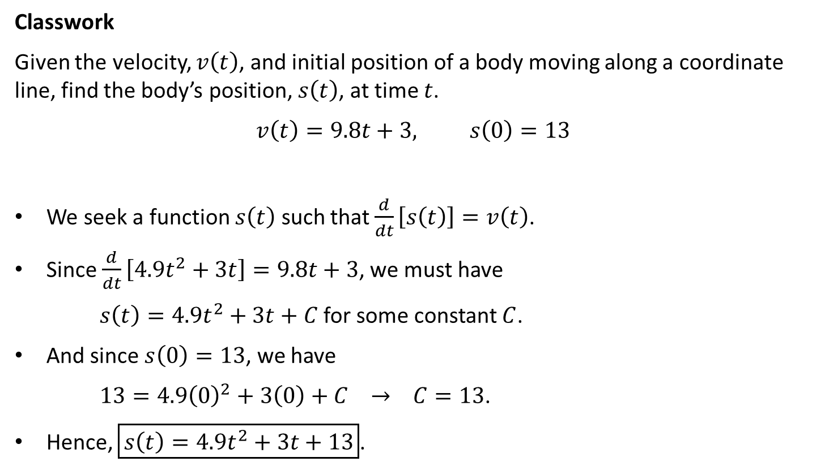
Classwork
Given the velocity, $v\left(t\right)$, and initial position of a body moving along a coordinate line, find the body’s position, $s\left(t\right)$, at time $t$.
$$v\left(t\right)=9.8t+3, s\left(0\right)=13$$
We seek a function $s\left(t\right)$ such that $\frac{d}{dt}\left[s\left(t\right)\right]=v\left(t\right)$.
Since $\frac{d}{dt}\left[4.9t^{2}+3t\right]=9.8t+3$, we must have
$s\left(t\right)=4.9t^{2}+3t+C$ for some constant $C$.
And since $s\left(0\right)=13$, we have
$13=4.9{\left(0\right)}^{2}+3\left(0\right)+C → C=13$.
Hence, $\boxed{s\left(t\right)=4.9t^{2}+3t+13}$.

